Slide 1
Wexford County Business & Employment Demographics
Chambers Ireland

Slide 2
Theme 1: Wexford Rates & LPT Income
Audience: Existing/Prospective Local Authority members
Highlights: Increasing reliance on Commercial Rates to support Local Authority Activities
Key messages:
Local Authority Budget Reform needed
Rates system putting pressure on labour intensive & vulnerable sectors
Hospitality
Retail
Manufacturing
Obligation on Local Authority to use these taxes effectively

Slide 3
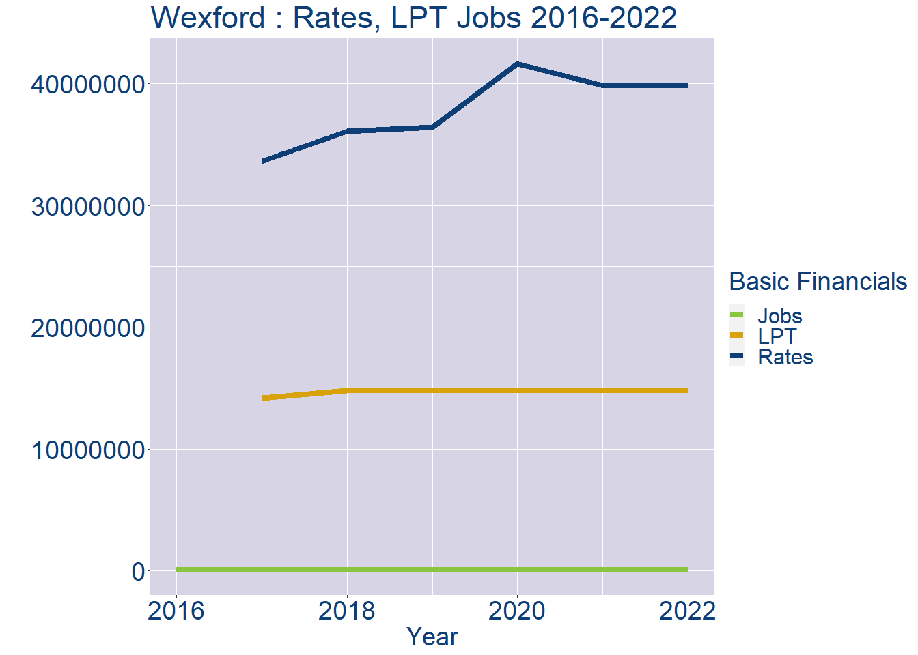
Theme 1: Wexford Rates & LPT Income
Wexford Local Authority Rates and LPT: 2016-2022
Year | Jobs | LPT | Rates
2016 | 57759 | NA | NA
2017 | 59713 | 14155328 | 33611755
2018 | 61667 | 14766033 | 36118431
2019 | 63621 | 14770451 | 36437513
2020 | 65575 | 14773182 | 41632045
2021 | 67529 | 14788968 | 39865776
2022 | 69485 | 14788968 | 39865776

Slide 4
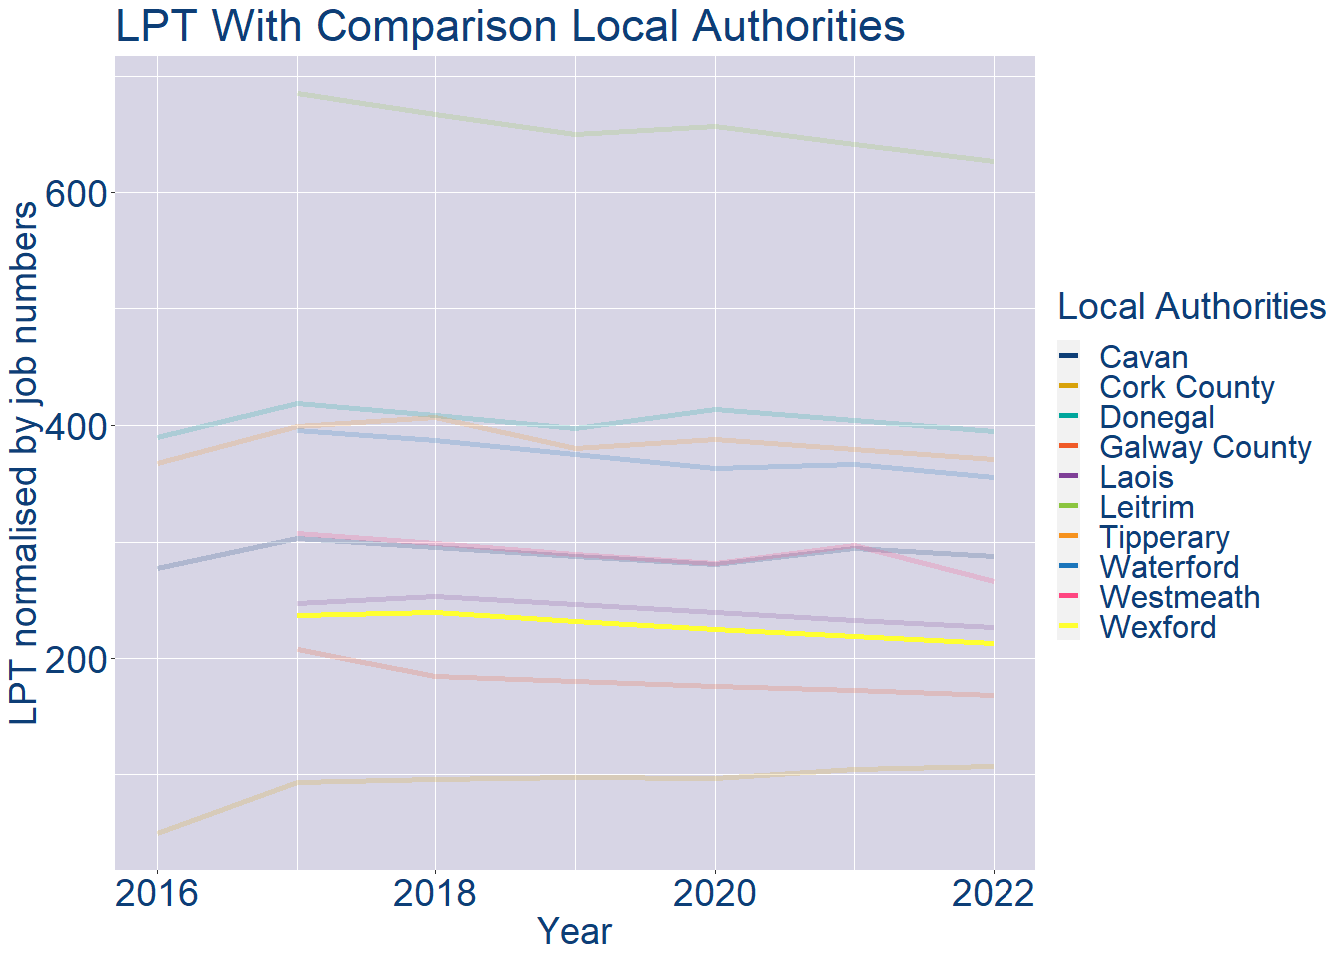
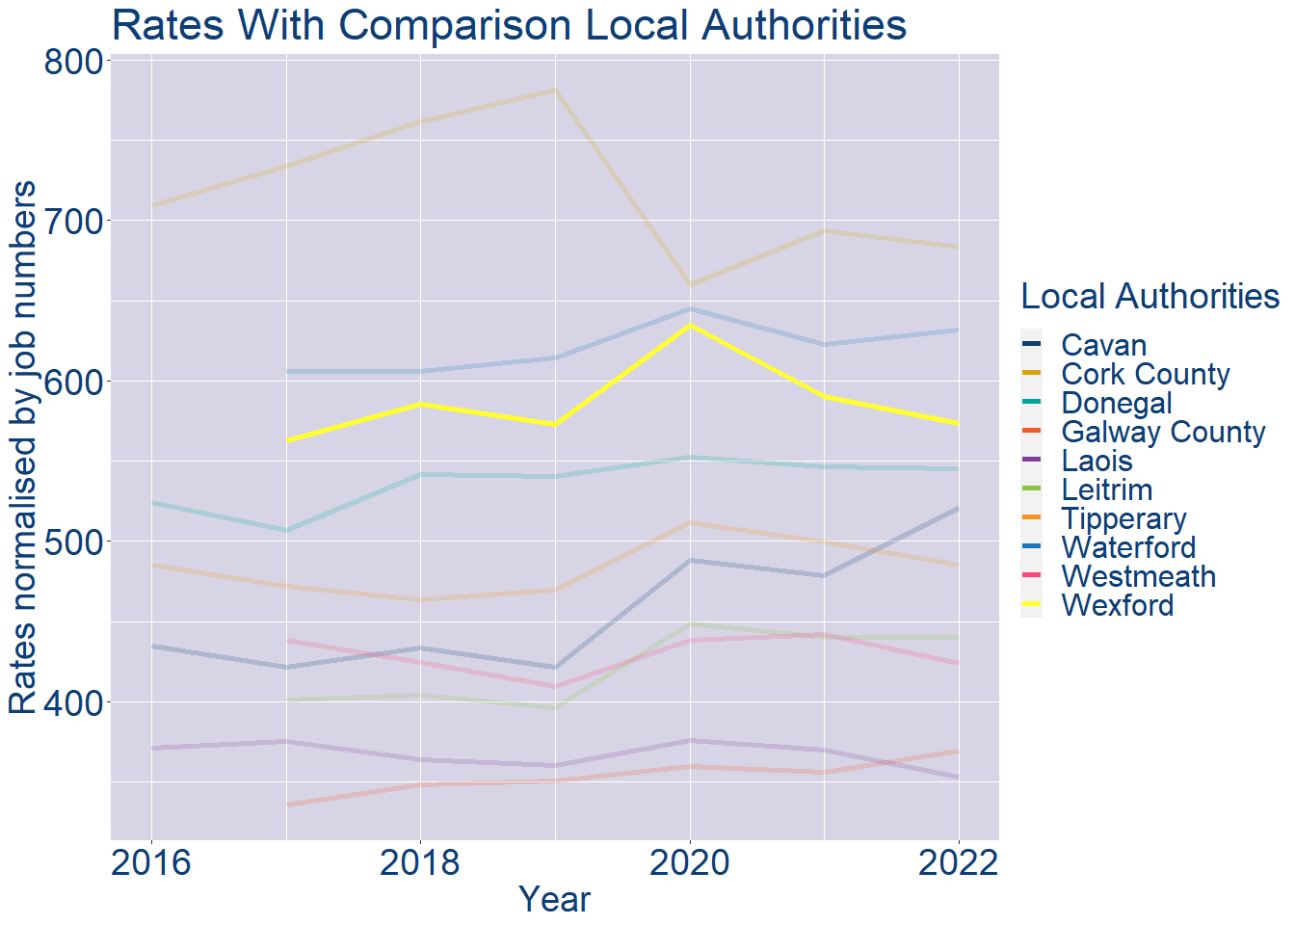
Theme 1: Wexford Rates & LPT Income
Wexford Local Authority 2022 LPT/employee €213
Wexford Local Authority 2022 Rates/employee €574

Slide 5
Theme 2: Wexford Workforce Demographics
Audience: Membership/Businesses that are interested in expanding into the local area
Highlights: Workforce details, who is available, education level, population growth
Key messages:
Varies from Local Authority area to area
Important for you to understand the numbers of people who are available to work in your area, their experience levels and the training they have

Slide 6
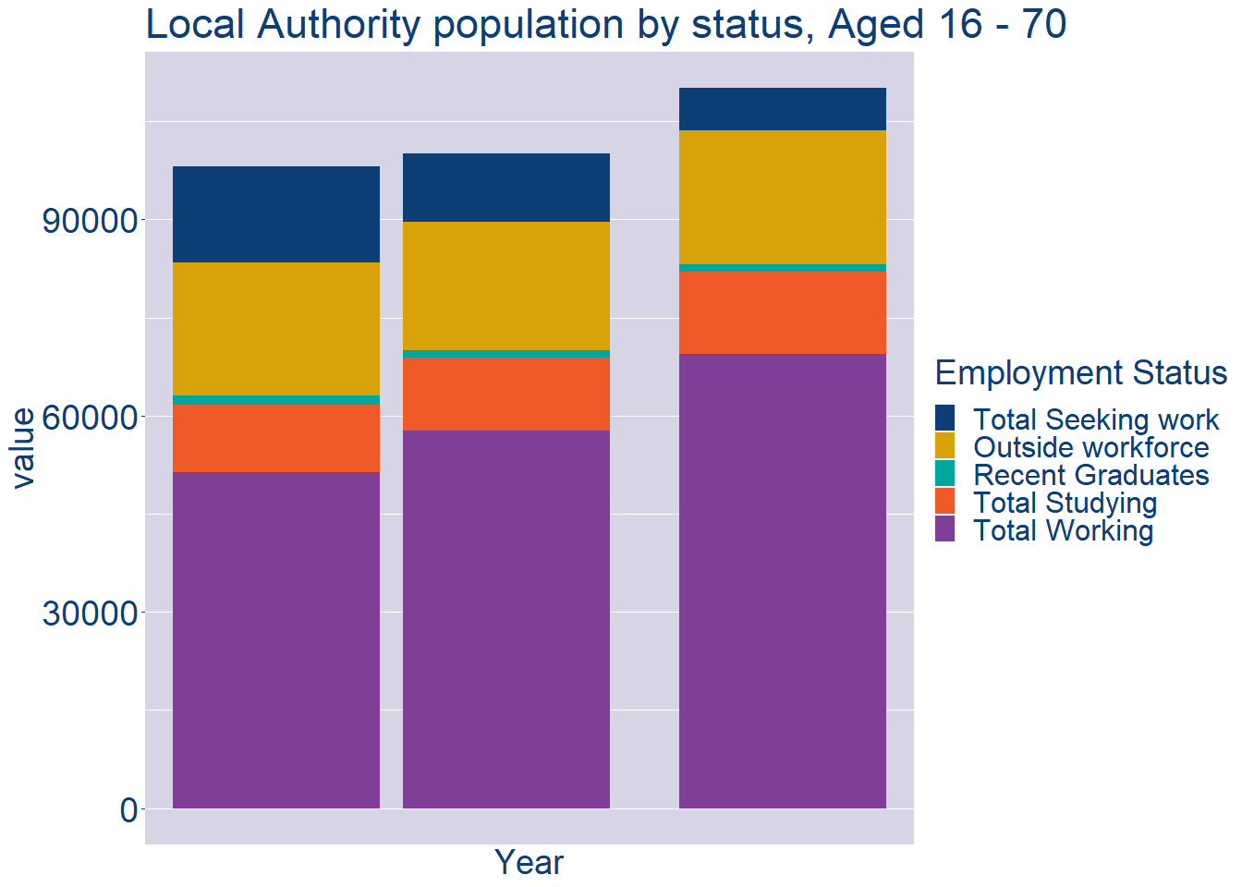
Theme 2: Wexford Workforce Demographics
Wexford Local Authority Workforce Population
Year | 2022
Total_working | 69485
Total_studying | 12444
Total_recent_grads | 1147
Total_job_seeking | 6439
Total_not_seeking | 20575

Slide 7
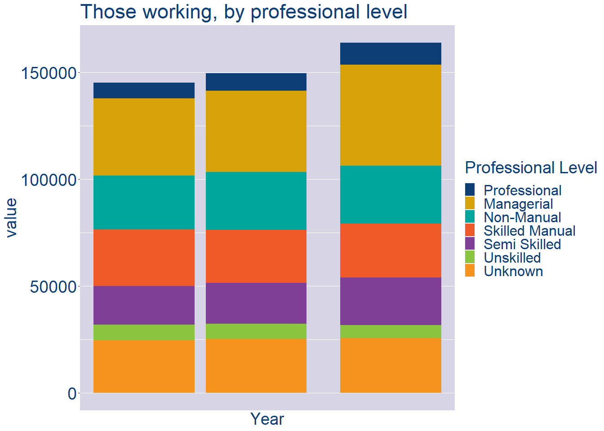
Theme 2: Wexford Workforce Demographics
Wexford Local Authority Workforce Experience Level
Year | 2022
Professional | 10241
Managerial | 47428
Non_Manual | 27115
Skilled_Manual | 25271
Semi_Skilled | 22211
Unskilled | 5995
All_Others | 25658

Slide 8
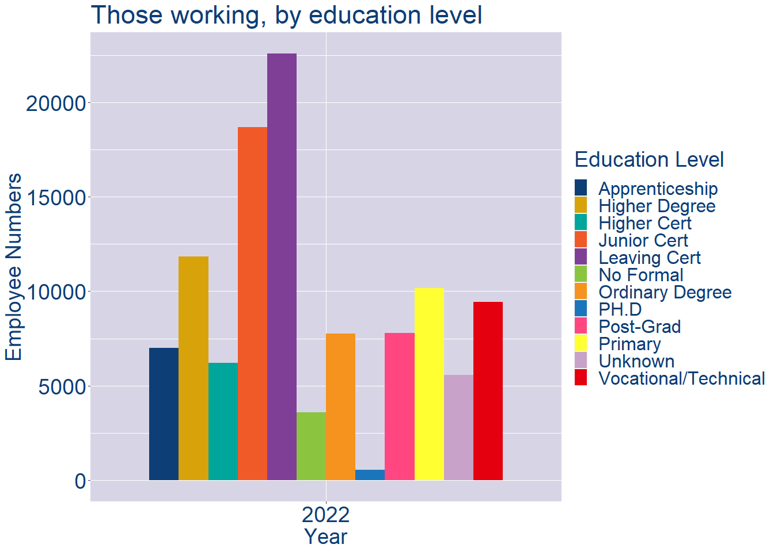
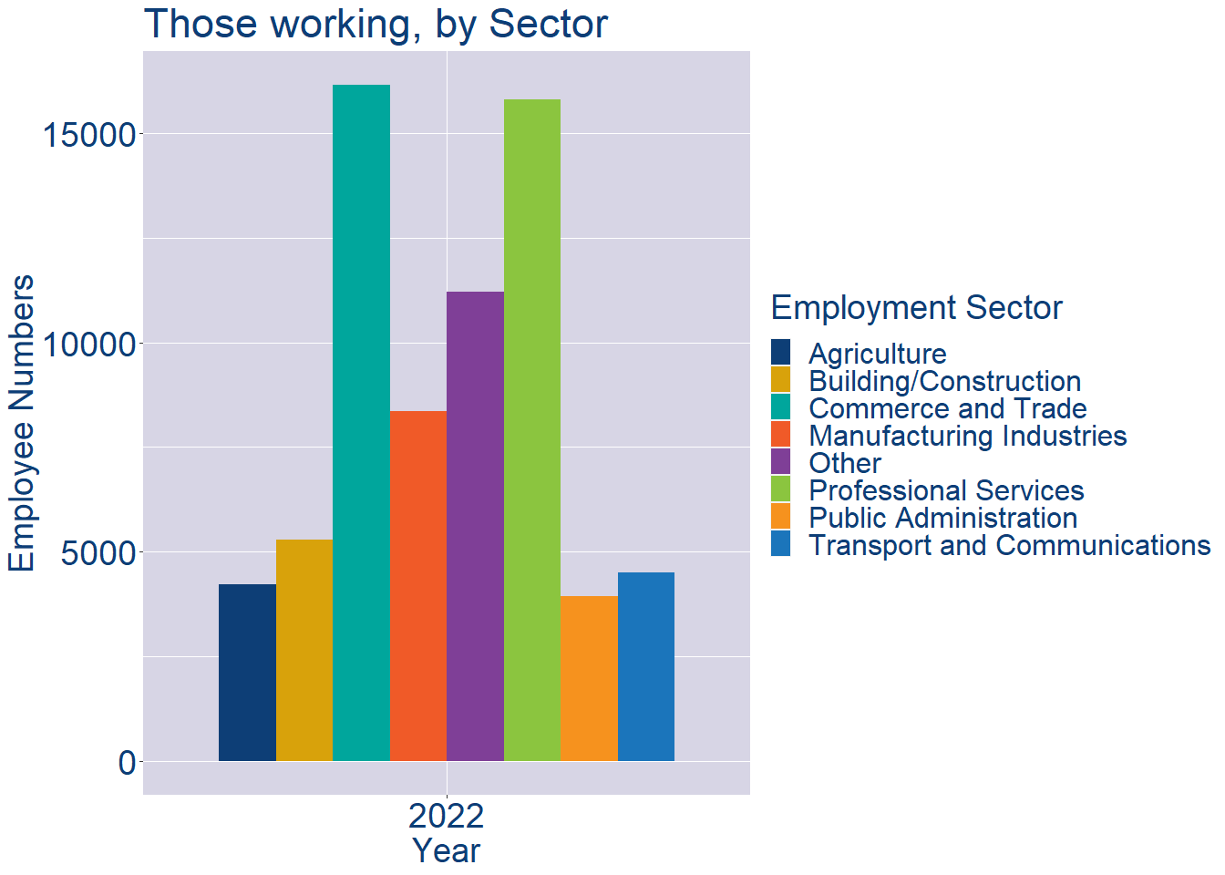
Theme 2: Wexford Workforce Demographics
Wexford Local Authority Workforce Education Level
Wexford Local Authority Workforce Sectors

Slide 9
Theme 3: Co. Wexford Business Demographics
Audience: Internal to Chambers
Highlights: Local Business Community Information
Key messages:
Varies from Local Authority area to area
Local market intelligence to help you identify trends in your local area’s business community i.e.:
Sectoral activity increasing/decreasing
What sectors the self-employed are active in

Slide 10
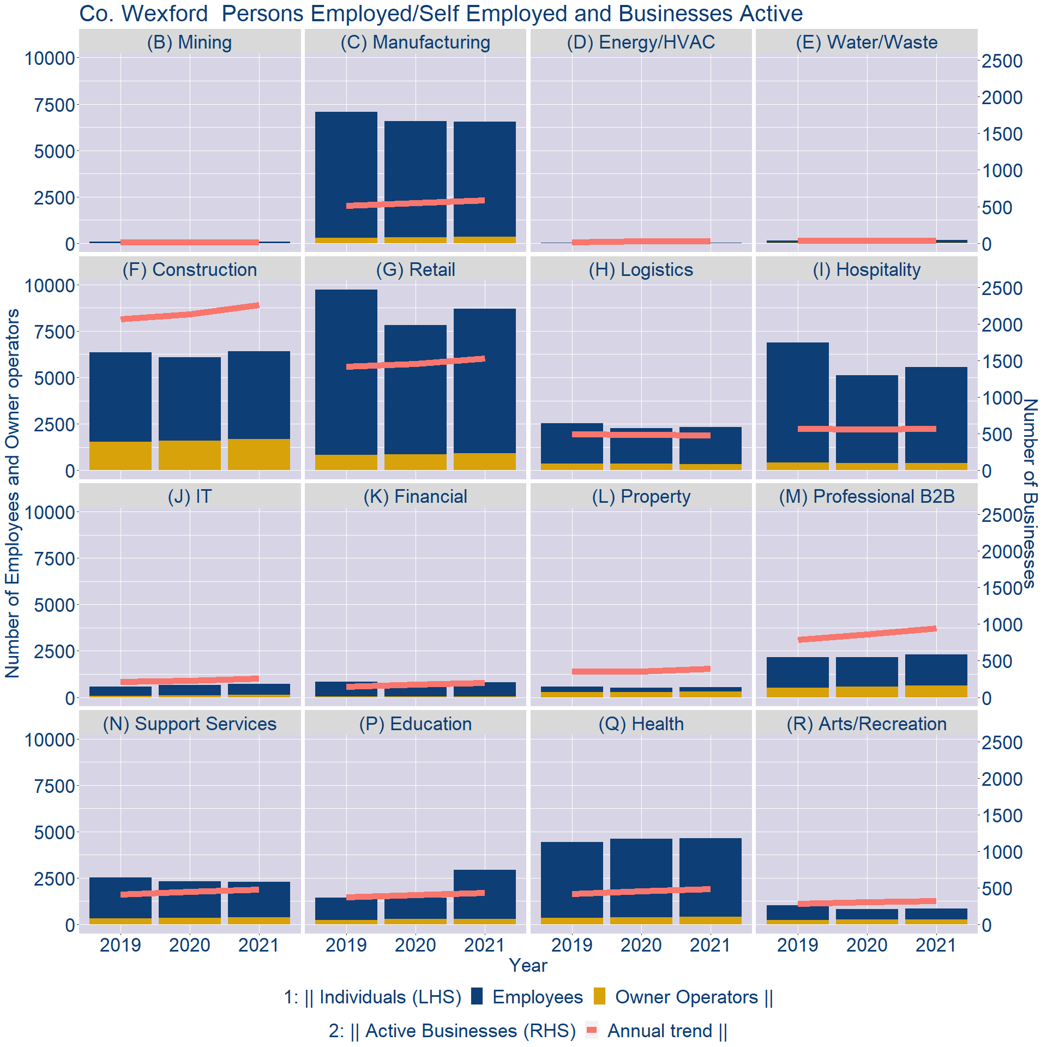
Theme 3: Co. Wexford Business Demographics

Slide 11
Theme 3: Co. Wexford Business Demographics
Sectors | Businesses | Owners | Employees
(B) Mining | 16 | 1 | 77
(C) Manufacturing | 658 | 334 | 6208
(D) Energy/HVAC | 32 | 3 | 15
(E) Water/Waste | 35 | 10 | 154
(F) Construction | 2517 | 1668 | 4735
(G) Retail | 1702 | 908 | 7797
(H) Logistics | 531 | 339 | 2000
(I) Hospitality | 634 | 374 | 5187
(J) IT | 291 | 124 | 595
(K) Financial | 219 | 47 | 755
(L) Property | 438 | 295 | 257
(M) Professional B2B | 1053 | 619 | 1681
(N) Support Services | 532 | 371 | 1915
(P) Education | 481 | 303 | 2648
(Q) Health | 537 | 401 | 4241
(R) Arts/Recreation | 359 | 275 | 575
Employment in locally registered businesses, by Sector

Slide 12
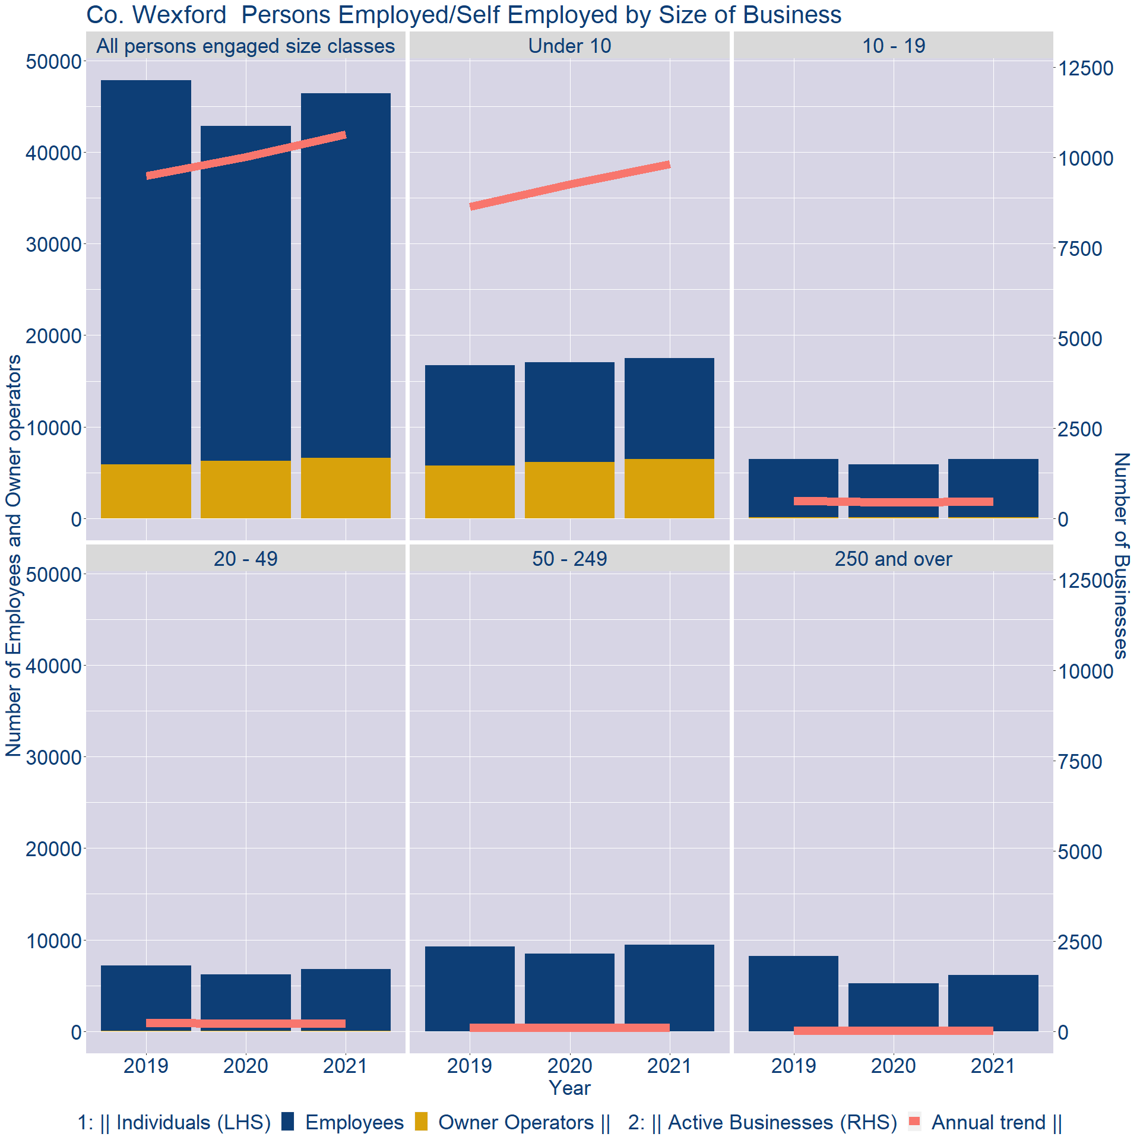
Theme 3: Co. Wexford Business Demographics
Employment in locally registered businesses, by employer size - 2021

Slide 13
Theme 3: Co. Wexford Business Demographics
Employment.Size | Businesses | Owners | Employees
All persons engaged size classes | 10635 | 6608 | 39781
Under 10 | 9807 | 6465 | 11008
10 - 19 | 481 | 99 | 6389
20 - 49 | 235 | 40 | 6777
50 - 249 | 101 | 4 | 9474
250 and over | 11 | 0 | 6133
Employment in locally registered businesses, by employer size - 2021

