Slide 1
Westmeath County Business & Employment Demographics
Chambers Ireland

Slide 2
Theme 1: Westmeath Rates & LPT Income
Audience: Existing/Prospective Local Authority members
Highlights: Increasing reliance on Commercial Rates to support Local Authority Activities
Key messages:
Local Authority Budget Reform needed
Rates system putting pressure on labour intensive & vulnerable sectors
Hospitality
Retail
Manufacturing
Obligation on Local Authority to use these taxes effectively

Slide 3
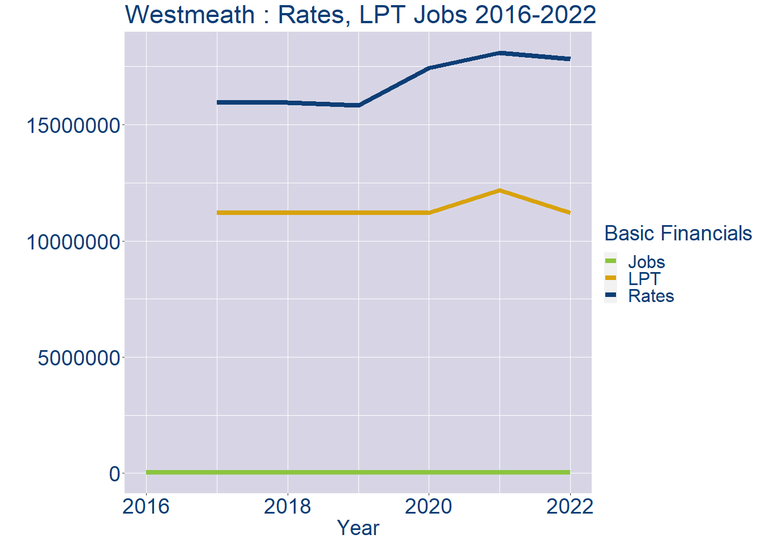
Theme 1: Westmeath Rates & LPT Income
Westmeath Local Authority Rates and LPT: 2016-2022
Year | Jobs | LPT | Rates
2016 | 35289 | NA | NA
2017 | 36420 | 11205507 | 15973743
2018 | 37551 | 11205507 | 15951045
2019 | 38682 | 11205507 | 15836188
2020 | 39813 | 11205510 | 17443799
2021 | 40944 | 12178135 | 18089041
2022 | 42077 | 11205510 | 17836273

Slide 4
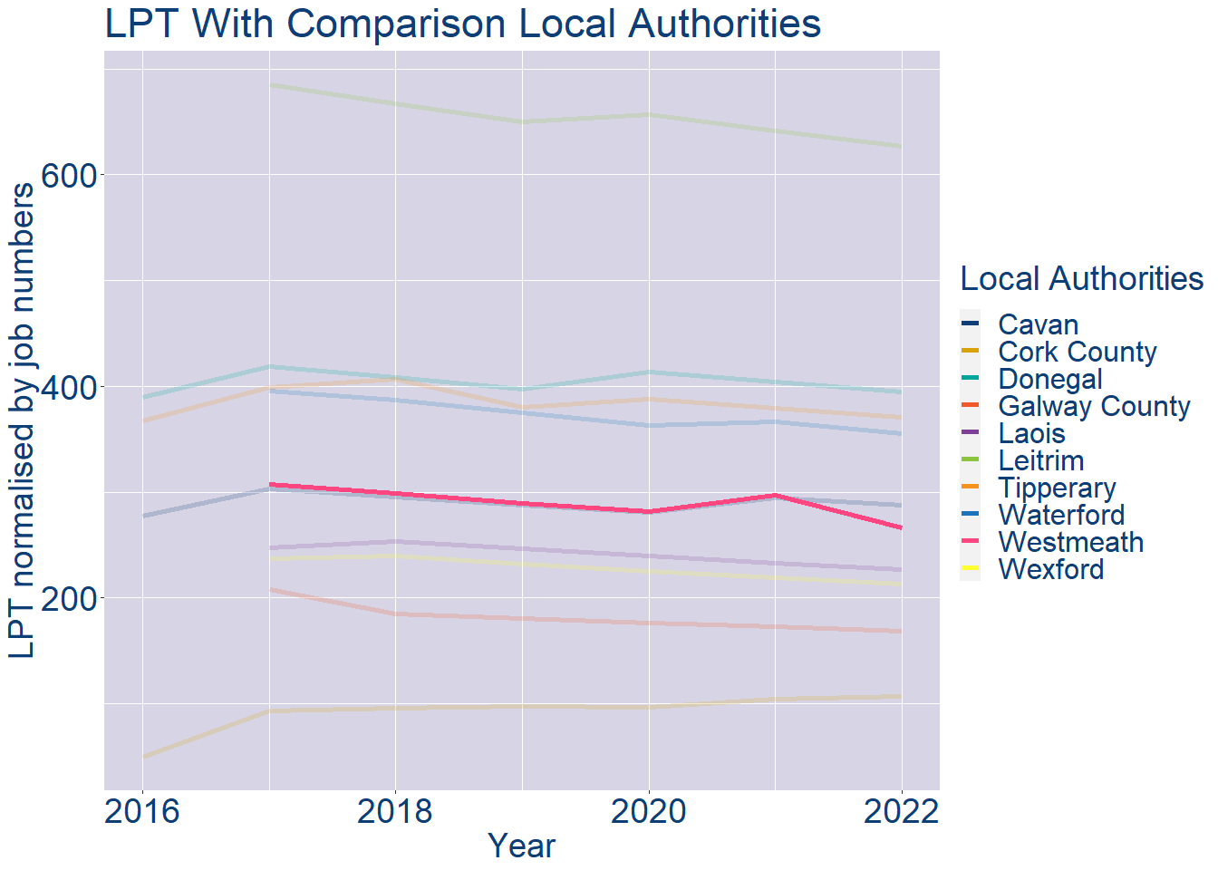
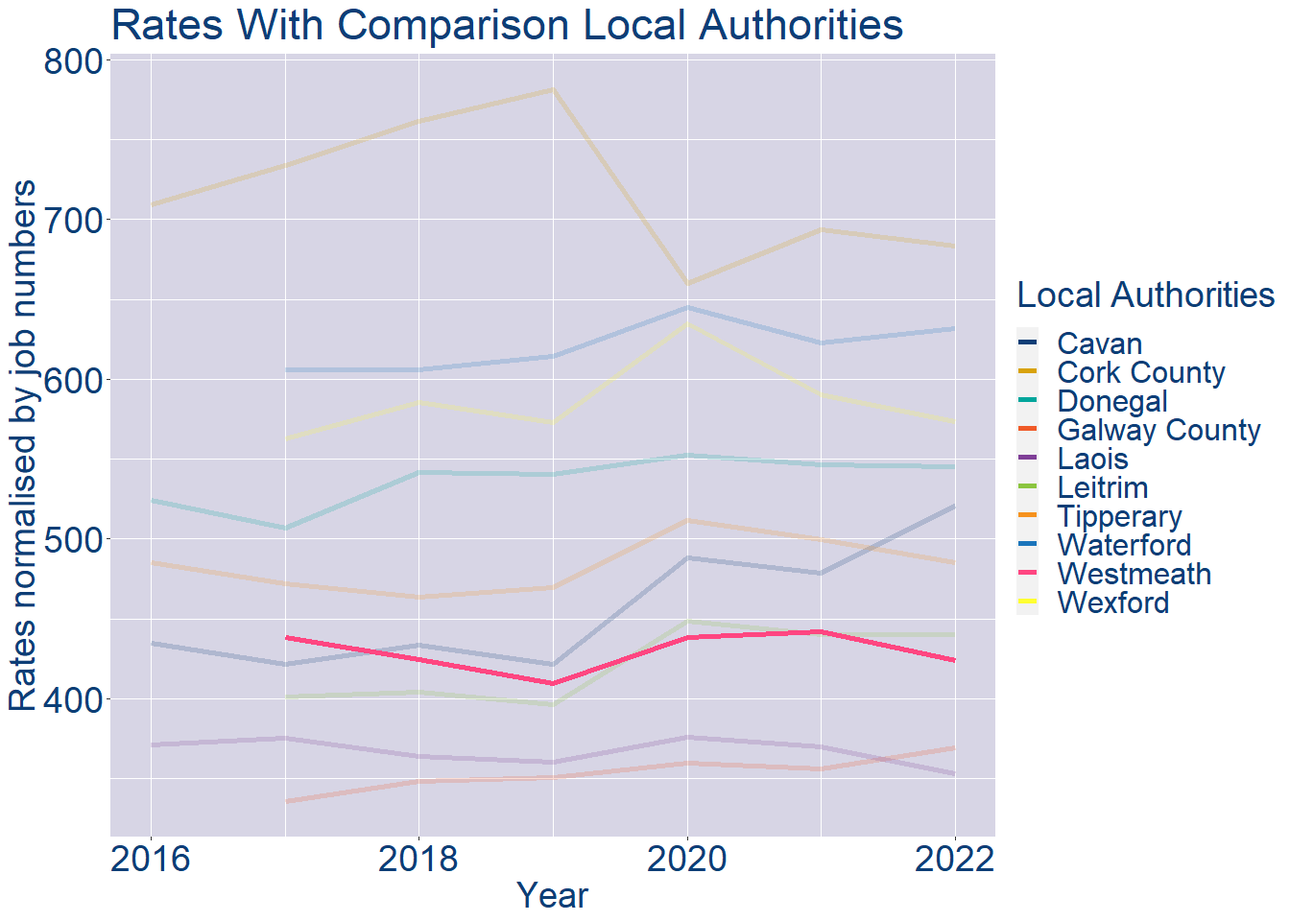
Theme 1: Westmeath Rates & LPT Income
Westmeath Local Authority 2022 LPT/employee €266
Westmeath Local Authority 2022 Rates/employee €424

Slide 5
Theme 2: Westmeath Workforce Demographics
Audience: Membership/Businesses that are interested in expanding into the local area
Highlights: Workforce details, who is available, education level, population growth
Key messages:
Varies from Local Authority area to area
Important for you to understand the numbers of people who are available to work in your area, their experience levels and the training they have

Slide 6
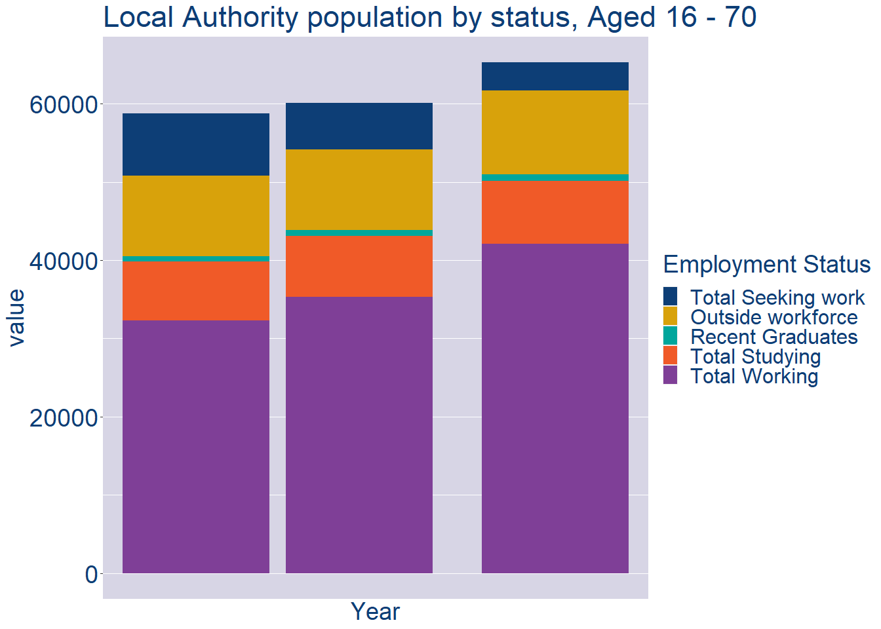
Theme 2: Westmeath Workforce Demographics
Westmeath Local Authority Workforce Population
Year | 2022
Total_working | 42077
Total_studying | 8099
Total_recent_grads | 786
Total_job_seeking | 3622
Total_not_seeking | 10715

Slide 7
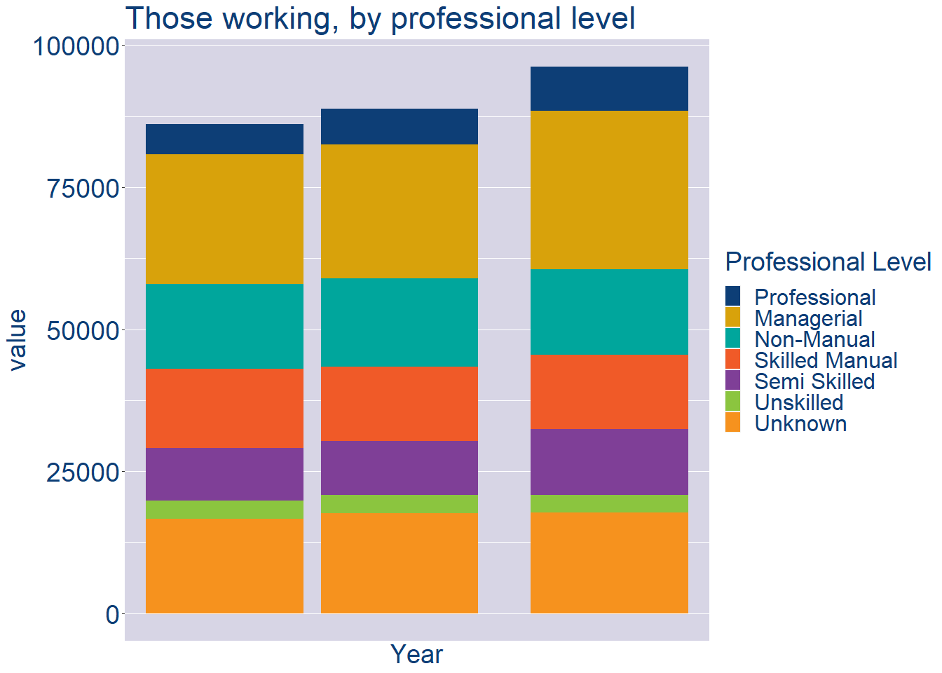
Theme 2: Westmeath Workforce Demographics
Westmeath Local Authority Workforce Experience Level
Year | 2022
Professional | 7769
Managerial | 27911
Non_Manual | 15104
Skilled_Manual | 13029
Semi_Skilled | 11637
Unskilled | 3002
All_Others | 17769

Slide 8
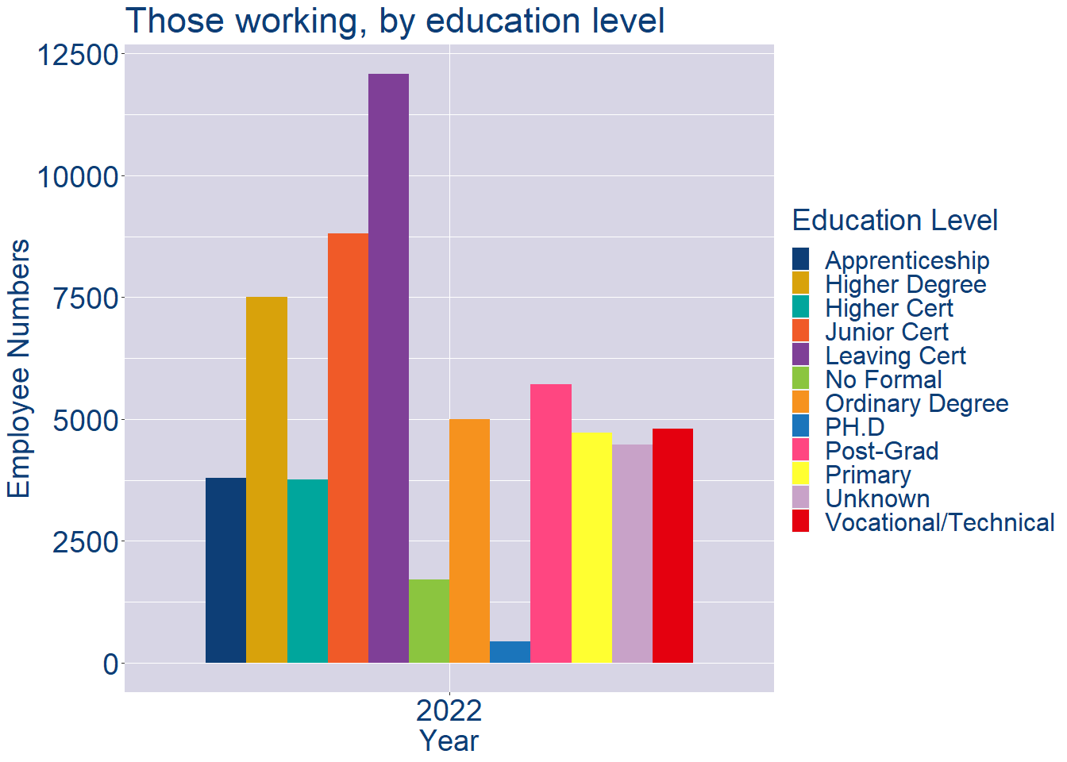
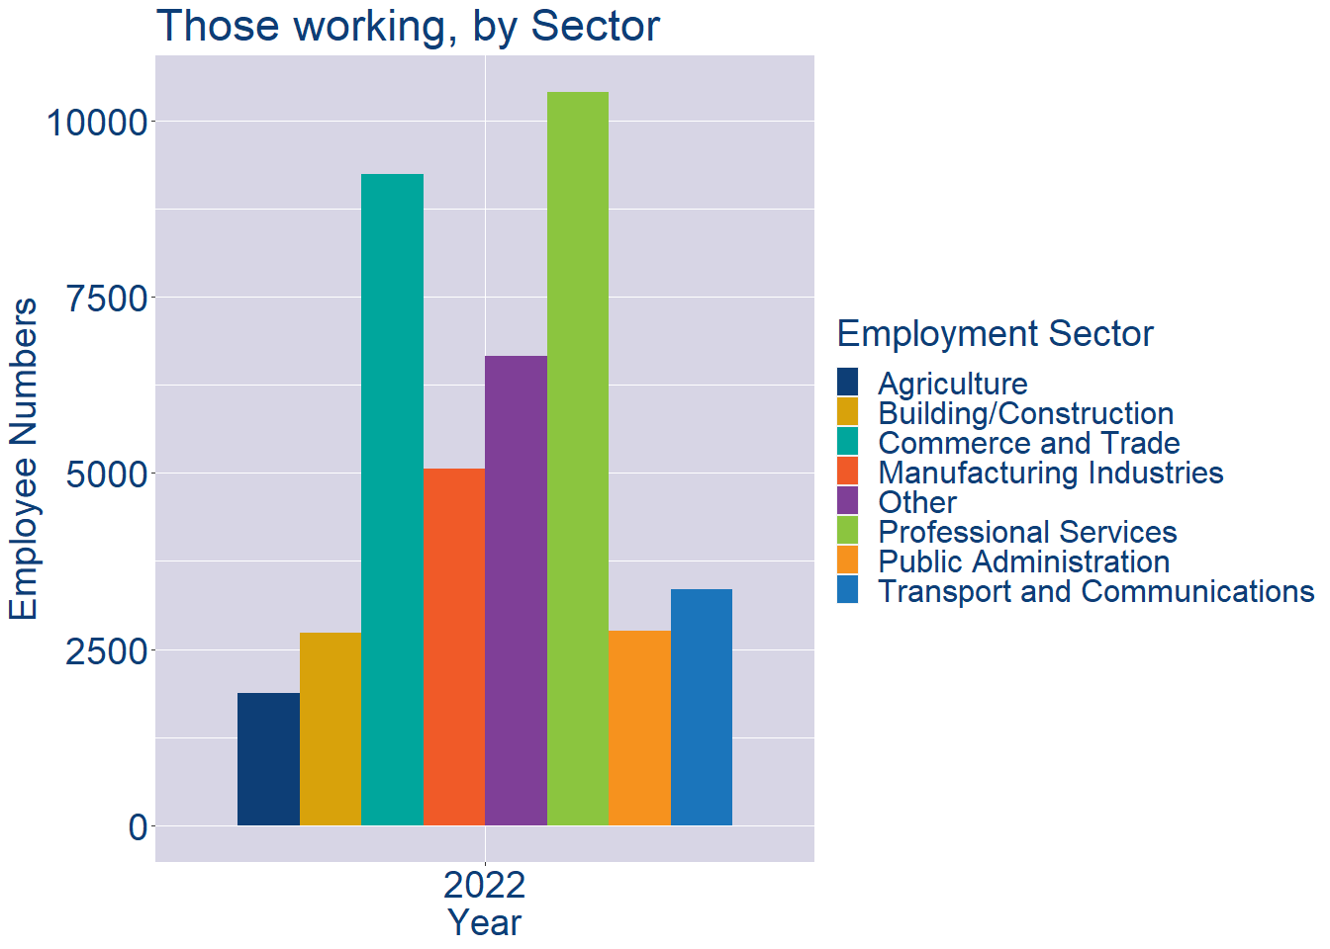
Theme 2: Westmeath Workforce Demographics
Westmeath Local Authority Workforce Education Level
Westmeath Local Authority Workforce Sectors

Slide 9
Theme 3: Co. Westmeath Business Demographics
Audience: Internal to Chambers
Highlights: Local Business Community Information
Key messages:
Varies from Local Authority area to area
Local market intelligence to help you identify trends in your local area’s business community i.e.:
Sectoral activity increasing/decreasing
What sectors the self-employed are active in

Slide 10
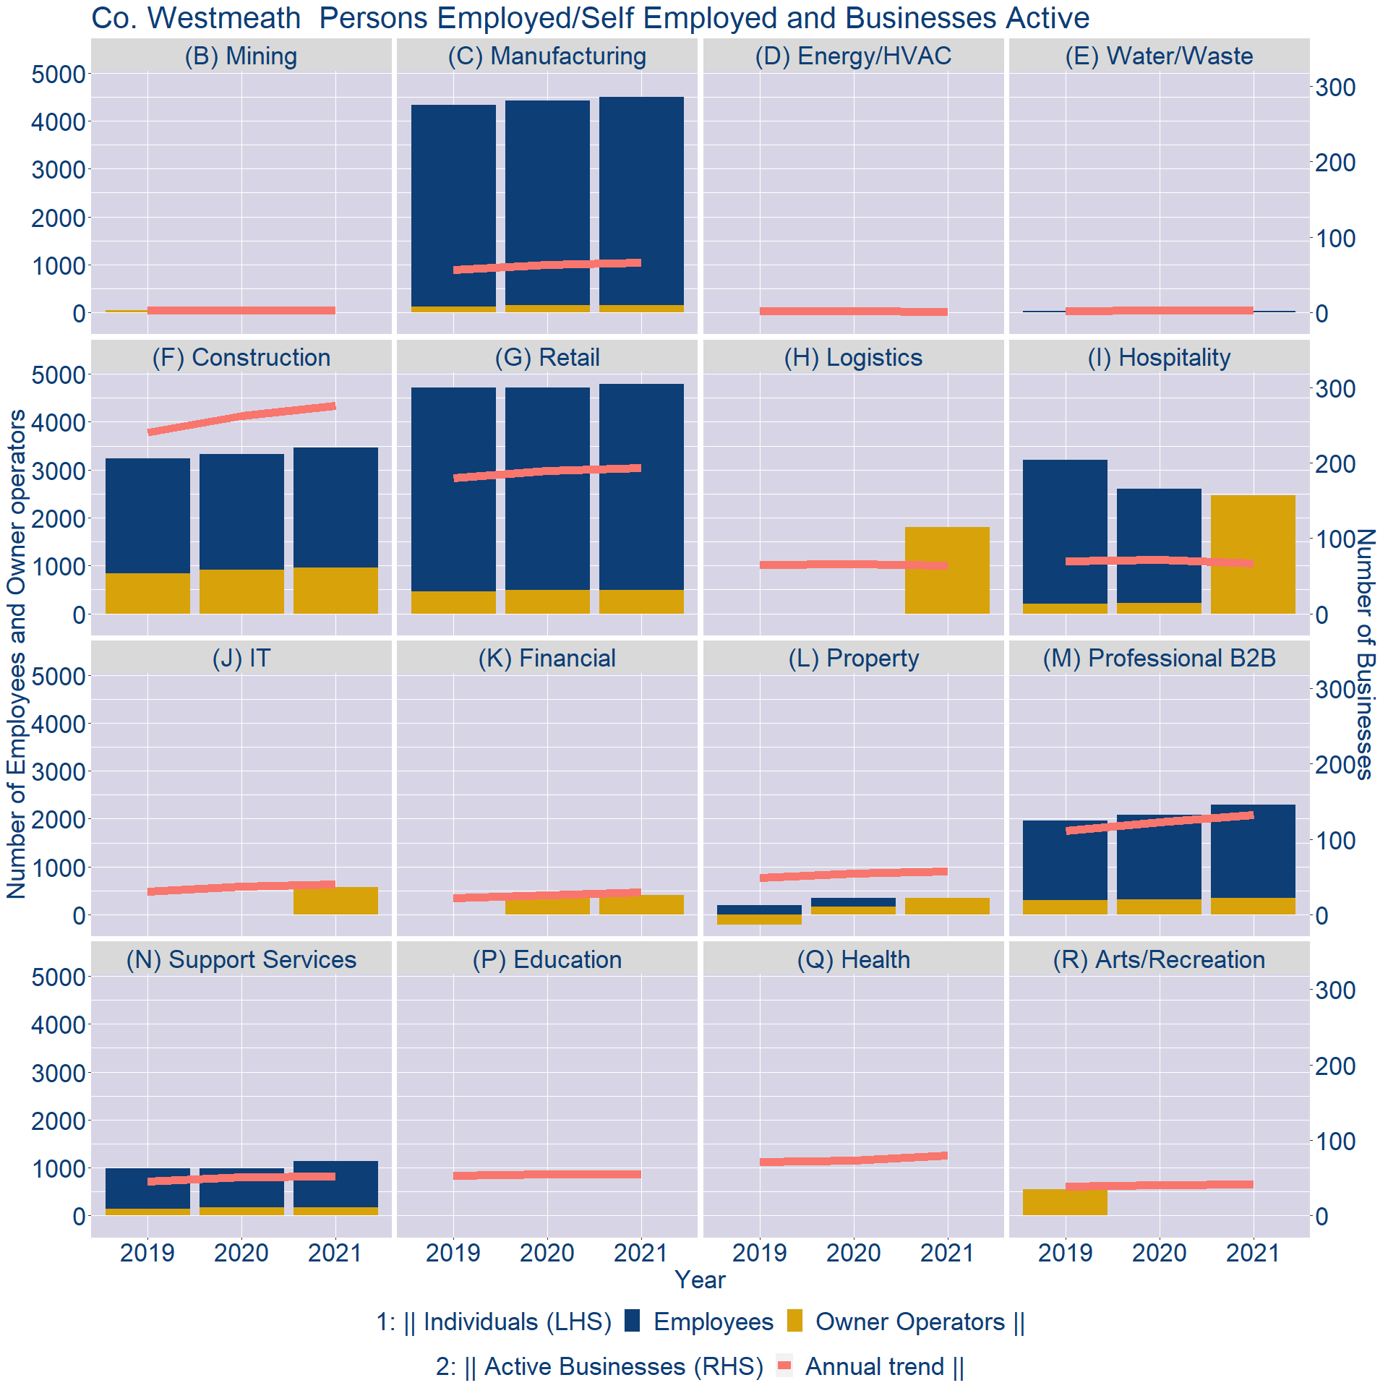
Theme 3: Co. Westmeath Business Demographics

Slide 11
Theme 3: Co. Westmeath Business Demographics
Sectors | Businesses | Owners | Employees
(B) Mining | 16 | 0 | 0
(C) Manufacturing | 345 | 160 | 4335
(D) Energy/HVAC | 6 | 0 | 0
(E) Water/Waste | 15 | 1 | 33
(F) Construction | 1433 | 964 | 2501
(G) Retail | 1007 | 496 | 4298
(H) Logistics | 334 | 1809 | 0
(I) Hospitality | 349 | 2470 | 0
(J) IT | 208 | 581 | 0
(K) Financial | 157 | 407 | 0
(L) Property | 299 | 353 | 0
(M) Professional B2B | 686 | 345 | 1953
(N) Support Services | 271 | 167 | 968
(P) Education | 289 | 0 | 0
(Q) Health | 418 | 0 | 0
(R) Arts/Recreation | 215 | 0 | 0
Employment in locally registered businesses, by Sector

Slide 12
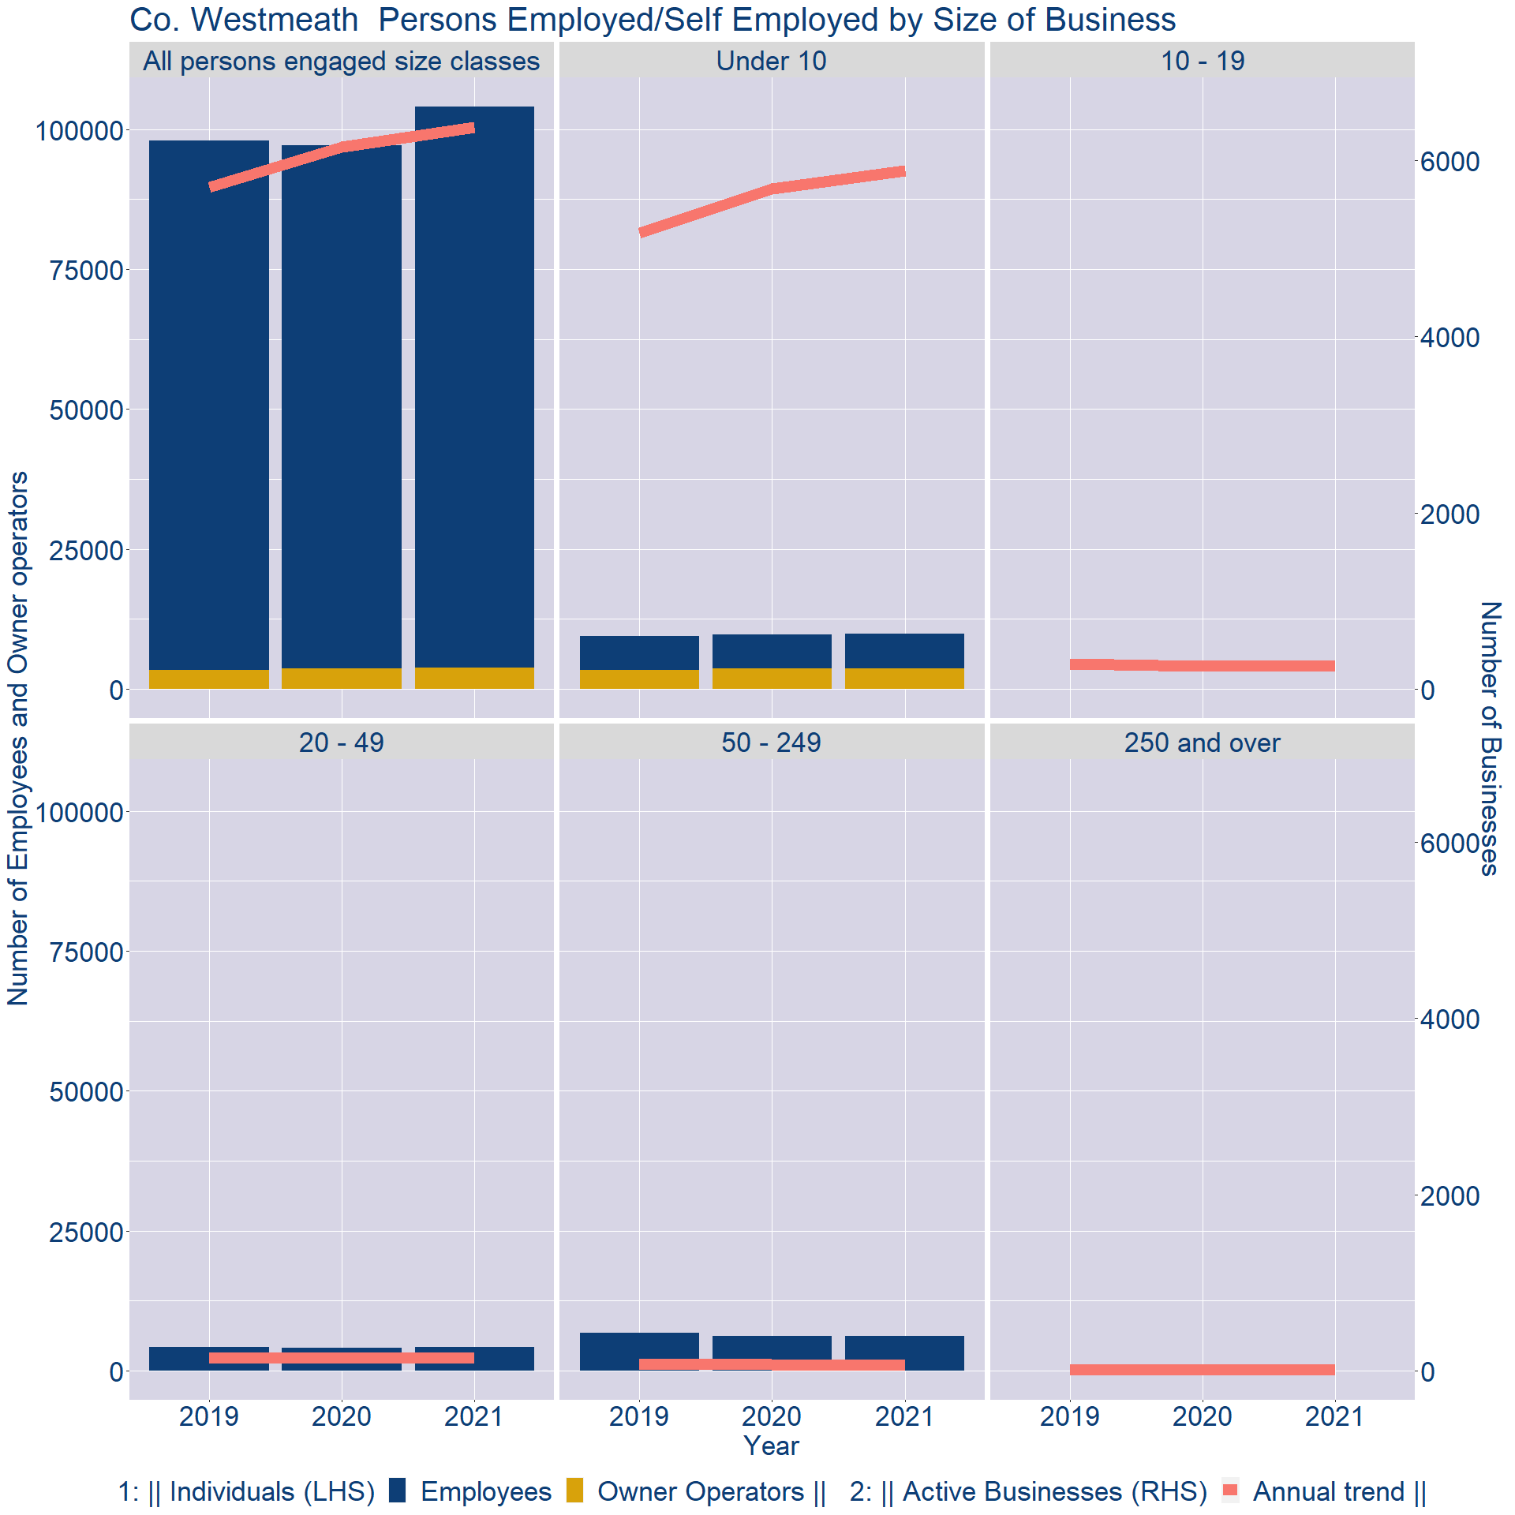
Theme 3: Co. Westmeath Business Demographics
Employment in locally registered businesses, by employer size - 2021

Slide 13
Theme 3: Co. Westmeath Business Demographics
Employment.Size | Businesses | Owners | Employees
All persons engaged size classes | 6375 | 3749 | 100342
Under 10 | 5885 | 3675 | 6214
10 - 19 | 270 | 0 | 0
20 - 49 | 142 | 11 | 4140
50 - 249 | 65 | 2 | 6135
250 and over | 13 | 0 | 0
Employment in locally registered businesses, by employer size - 2021

