Slide 1
Waterford County Business & Employment Demographics
Chambers Ireland

Slide 2
Theme 1: Waterford Rates & LPT Income
Audience: Existing/Prospective Local Authority members
Highlights: Increasing reliance on Commercial Rates to support Local Authority Activities
Key messages:
Local Authority Budget Reform needed
Rates system putting pressure on labour intensive & vulnerable sectors
Hospitality
Retail
Manufacturing
Obligation on Local Authority to use these taxes effectively

Slide 3
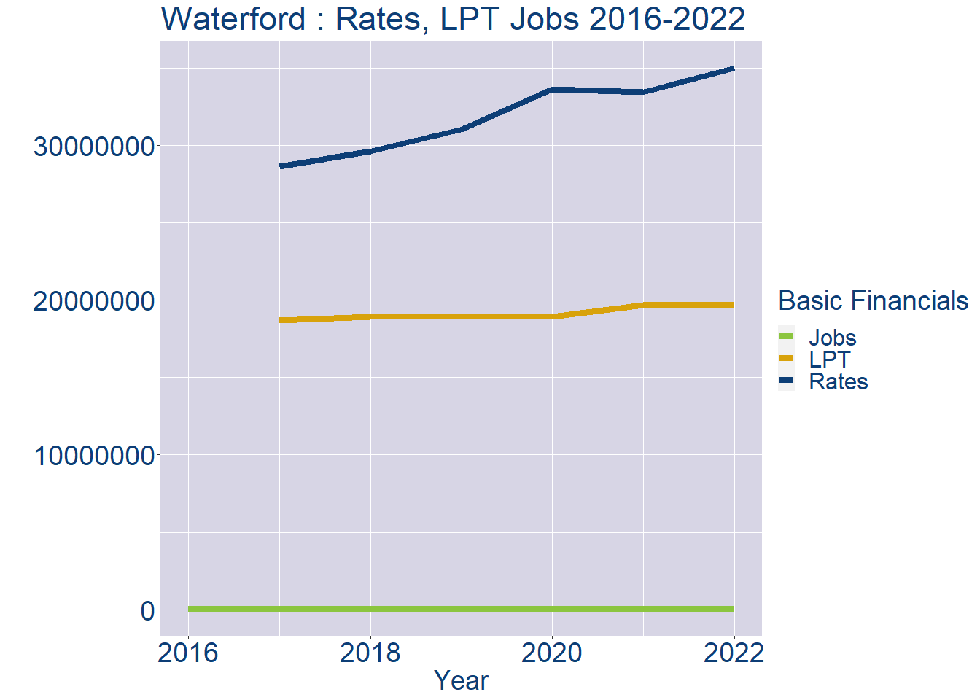
Theme 1: Waterford Rates & LPT Income
Waterford Local Authority Rates and LPT: 2016-2022
Year | Jobs | LPT | Rates
2016 | 45595 | NA | NA
2017 | 47217 | 18678971 | 28602282
2018 | 48839 | 18911516 | 29604412
2019 | 50461 | 18912115 | 31014258
2020 | 52083 | 18912564 | 33602216
2021 | 53705 | 19665016 | 33439115
2022 | 55330 | 19668516 | 34967971

Slide 4
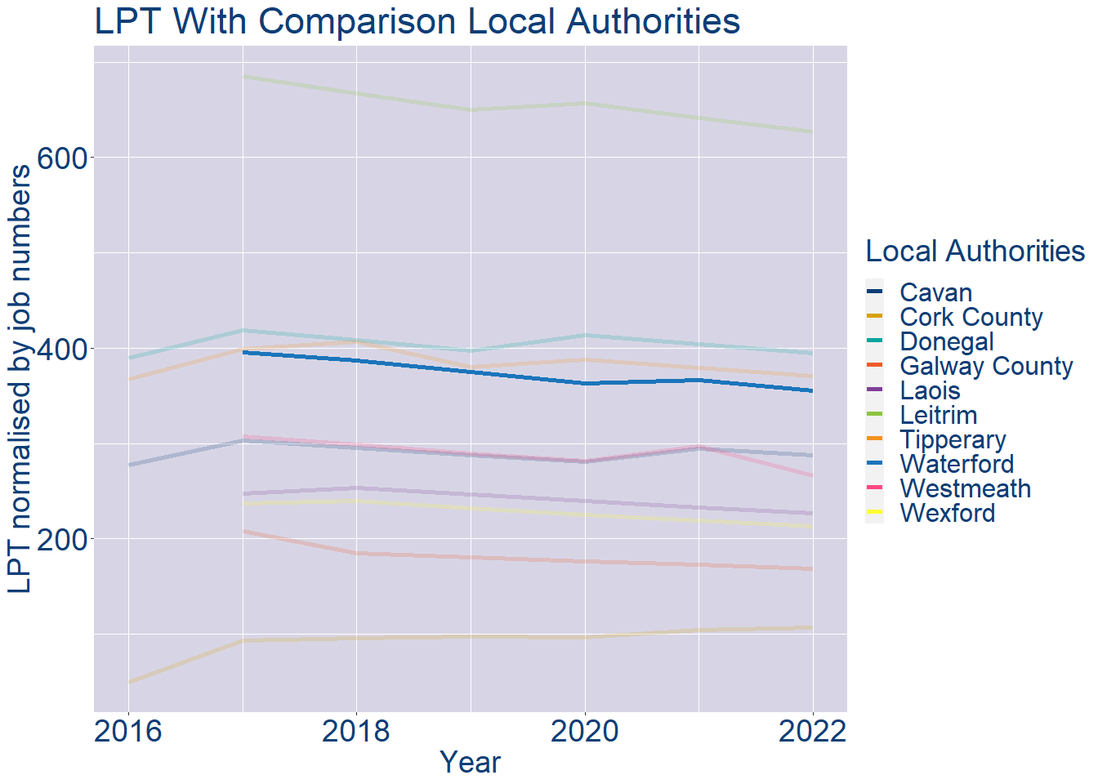
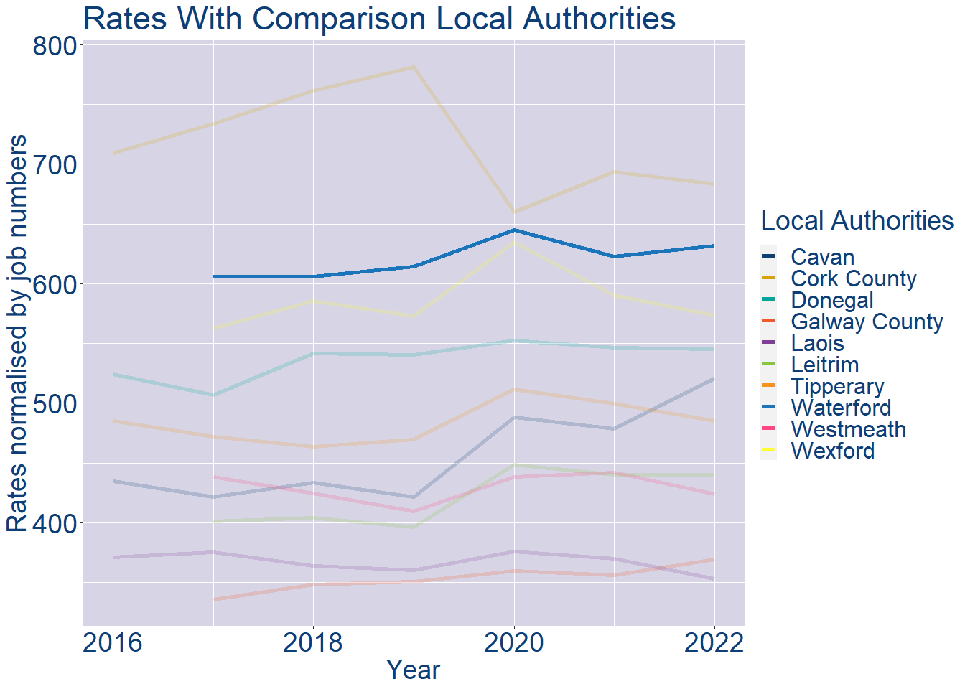
Theme 1: Waterford Rates & LPT Income
Waterford Local Authority 2022 LPT/employee €355
Waterford Local Authority 2022 Rates/employee €632

Slide 5
Theme 2: Waterford Workforce Demographics
Audience: Membership/Businesses that are interested in expanding into the local area
Highlights: Workforce details, who is available, education level, population growth
Key messages:
Varies from Local Authority area to area
Important for you to understand the numbers of people who are available to work in your area, their experience levels and the training they have

Slide 6
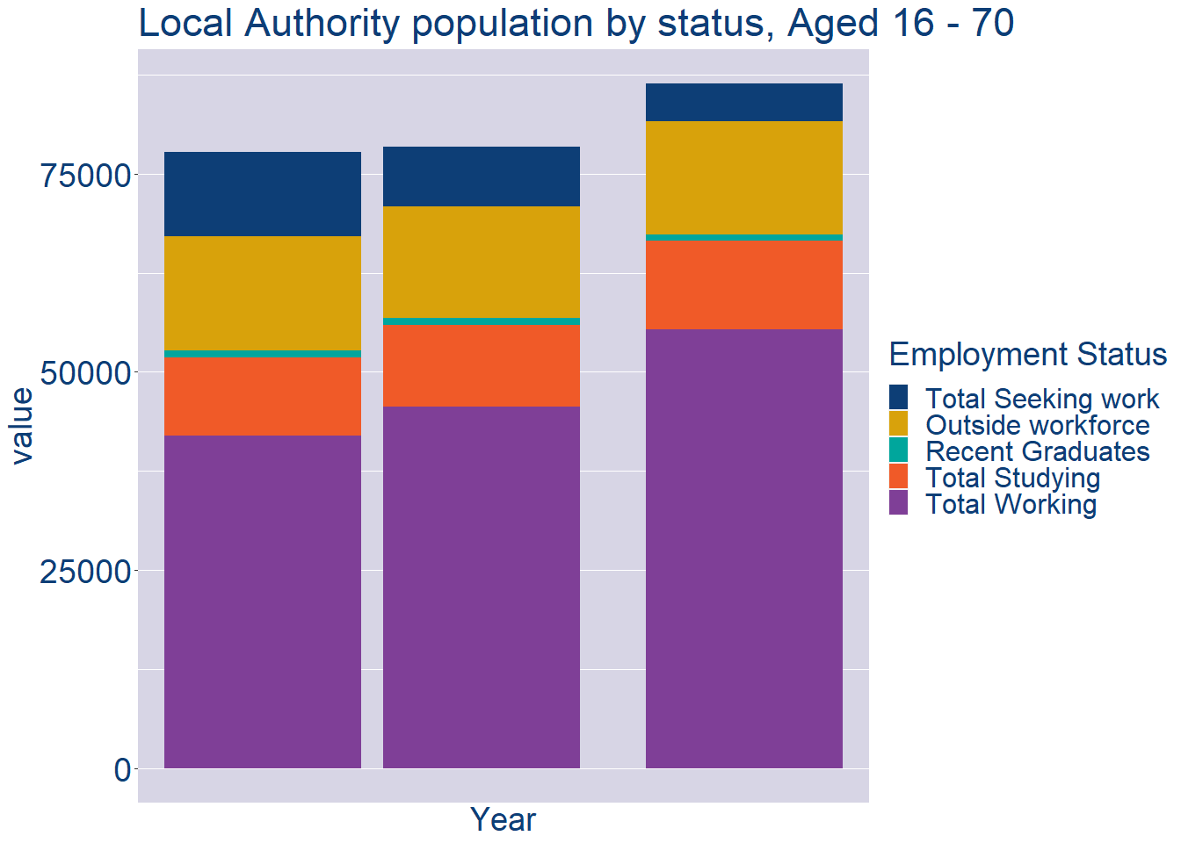
Theme 2: Waterford Workforce Demographics
Waterford Local Authority Workforce Population
Year | 2022
Total_working | 55330
Total_studying | 11207
Total_recent_grads | 838
Total_job_seeking | 4747
Total_not_seeking | 14267

Slide 7
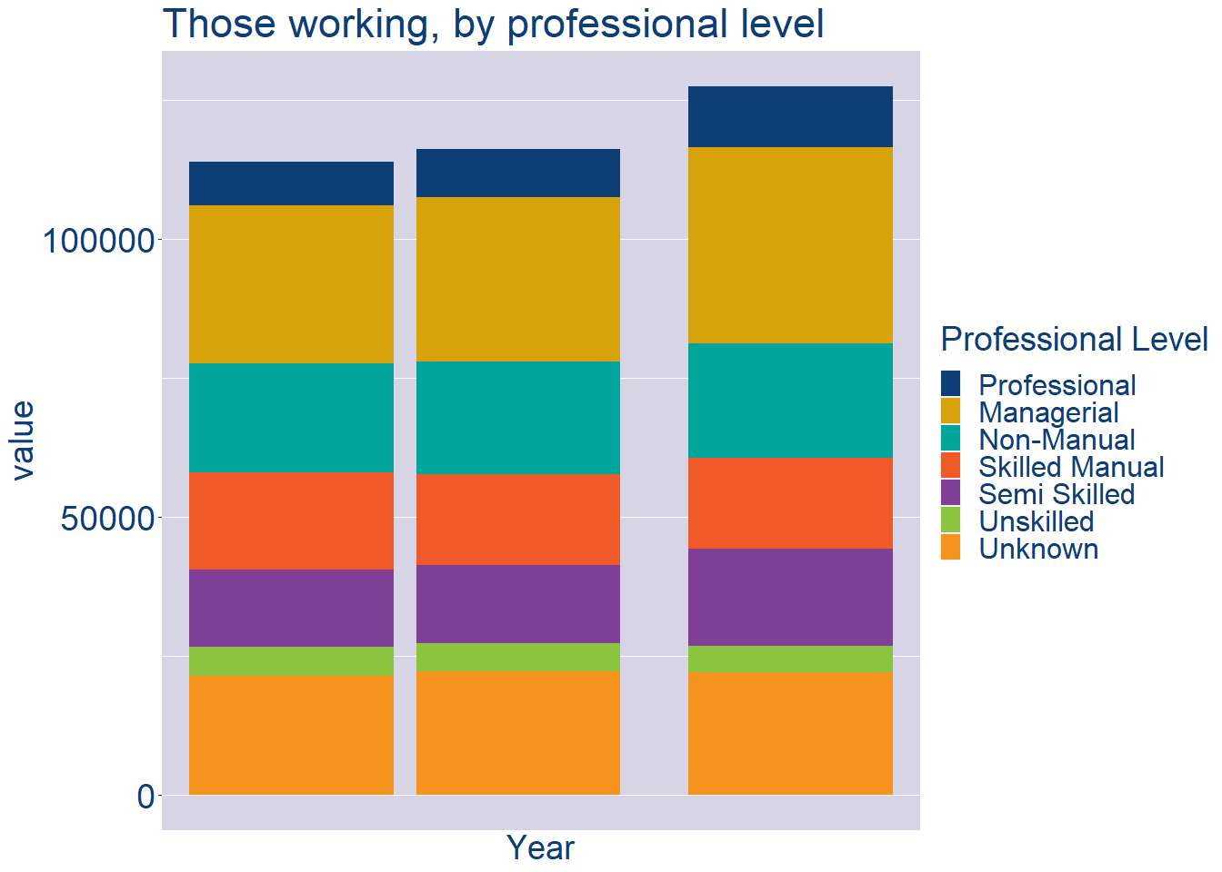
Theme 2: Waterford Workforce Demographics
Waterford Local Authority Workforce Experience Level
Year | 2022
Professional | 10933
Managerial | 35255
Non_Manual | 20667
Skilled_Manual | 16304
Semi_Skilled | 17462
Unskilled | 4810
All_Others | 21932

Slide 8
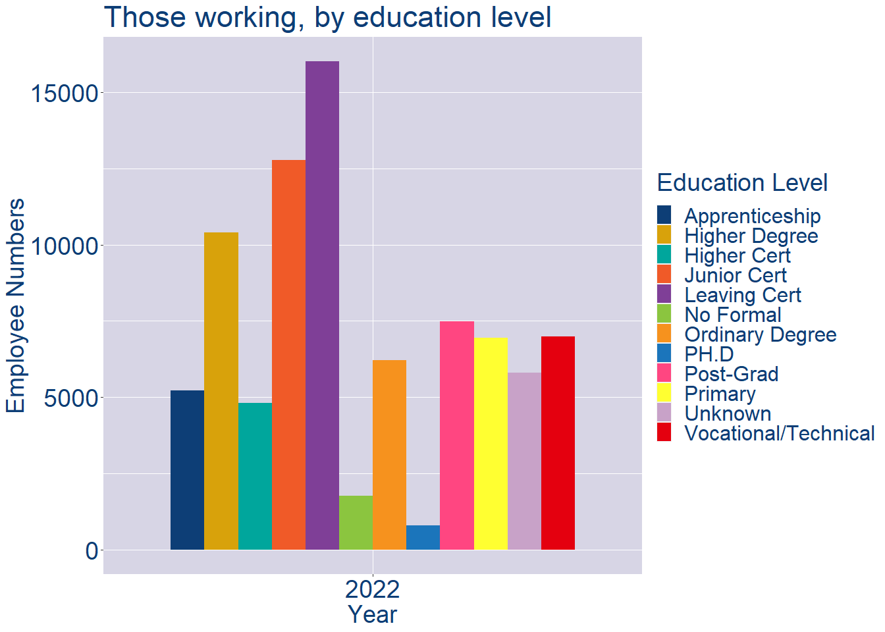
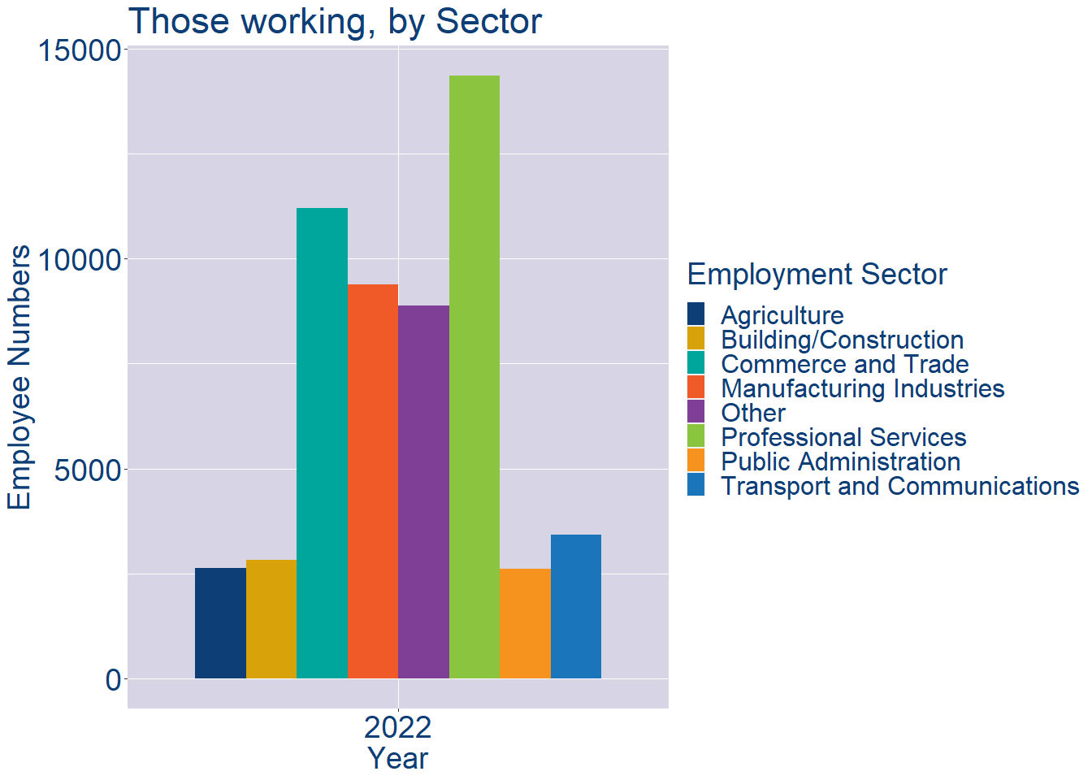
Theme 2: Waterford Workforce Demographics
Waterford Local Authority Workforce Education Level
Waterford Local Authority Workforce Sectors

Slide 9
Theme 3: Co. Waterford Business Demographics
Audience: Internal to Chambers
Highlights: Local Business Community Information
Key messages:
Varies from Local Authority area to area
Local market intelligence to help you identify trends in your local area’s business community i.e.:
Sectoral activity increasing/decreasing
What sectors the self-employed are active in

Slide 10
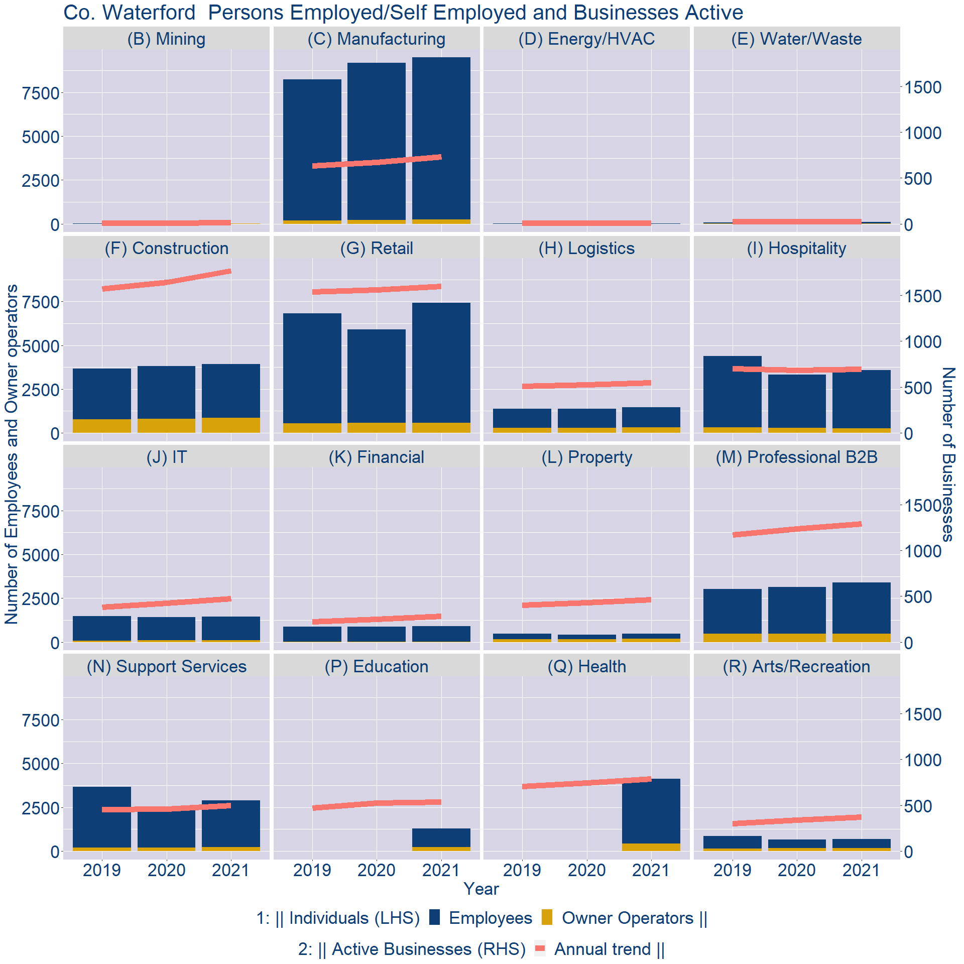
Theme 3: Co. Waterford Business Demographics

Slide 11
Theme 3: Co. Waterford Business Demographics
Sectors | Businesses | Owners | Employees
(B) Mining | 9 | 5 | 21
(C) Manufacturing | 511 | 242 | 9247
(D) Energy/HVAC | 7 | 0 | 7
(E) Water/Waste | 19 | 8 | 83
(F) Construction | 1236 | 865 | 3068
(G) Retail | 1117 | 563 | 6871
(H) Logistics | 384 | 313 | 1149
(I) Hospitality | 486 | 274 | 3307
(J) IT | 330 | 104 | 1331
(K) Financial | 199 | 26 | 873
(L) Property | 323 | 178 | 308
(M) Professional B2B | 903 | 484 | 2897
(N) Support Services | 347 | 220 | 2659
(P) Education | 376 | 240 | 1052
(Q) Health | 553 | 424 | 3713
(R) Arts/Recreation | 262 | 183 | 500
Employment in locally registered businesses, by Sector

Slide 12
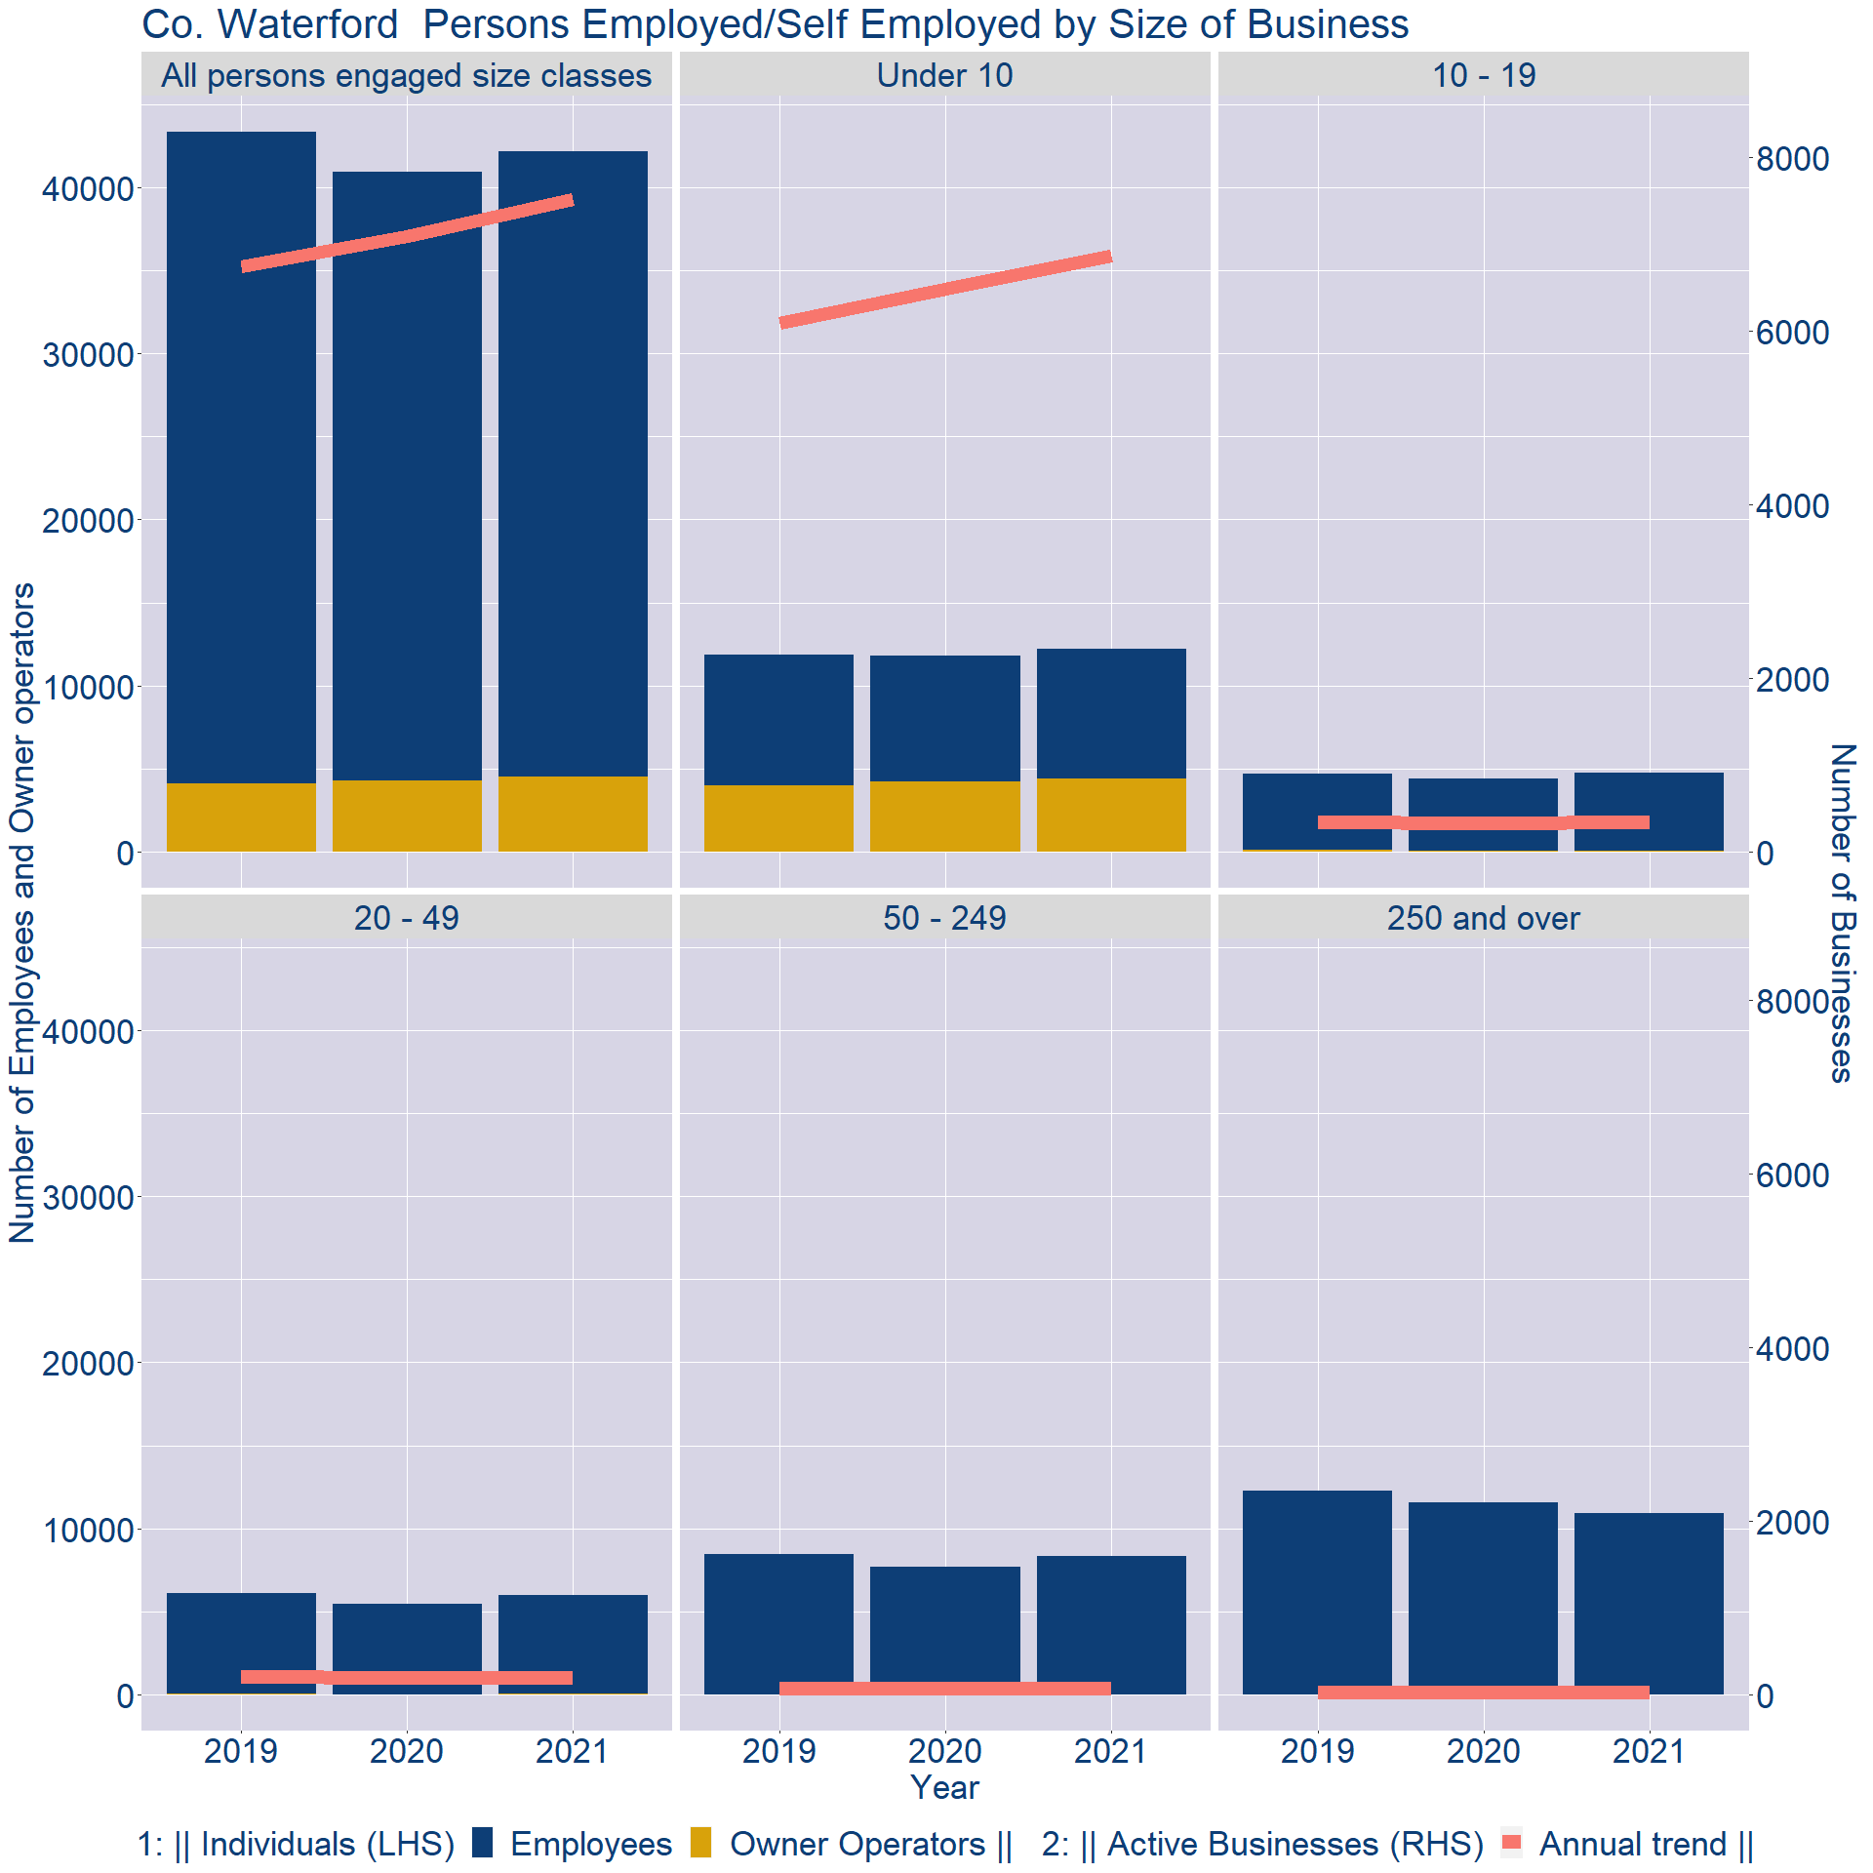
Theme 3: Co. Waterford Business Demographics
Employment in locally registered businesses, by employer size - 2021

Slide 13
Theme 3: Co. Waterford Business Demographics
Employment.Size | Businesses | Owners | Employees
All persons engaged size classes | 7509 | 4534 | 37643
Under 10 | 6858 | 4425 | 7761
10 - 19 | 352 | 75 | 4670
20 - 49 | 202 | 23 | 5983
50 - 249 | 78 | 11 | 8310
250 and over | 19 | 0 | 10919
Employment in locally registered businesses, by employer size - 2021

