Slide 1
Tipperary County Business & Employment Demographics
Chambers Ireland

Slide 2
Theme 1: Tipperary Rates & LPT Income
Audience: Existing/Prospective Local Authority members
Highlights: Increasing reliance on Commercial Rates to support Local Authority Activities
Key messages:
Local Authority Budget Reform needed
Rates system putting pressure on labour intensive & vulnerable sectors
Hospitality
Retail
Manufacturing
Obligation on Local Authority to use these taxes effectively

Slide 3
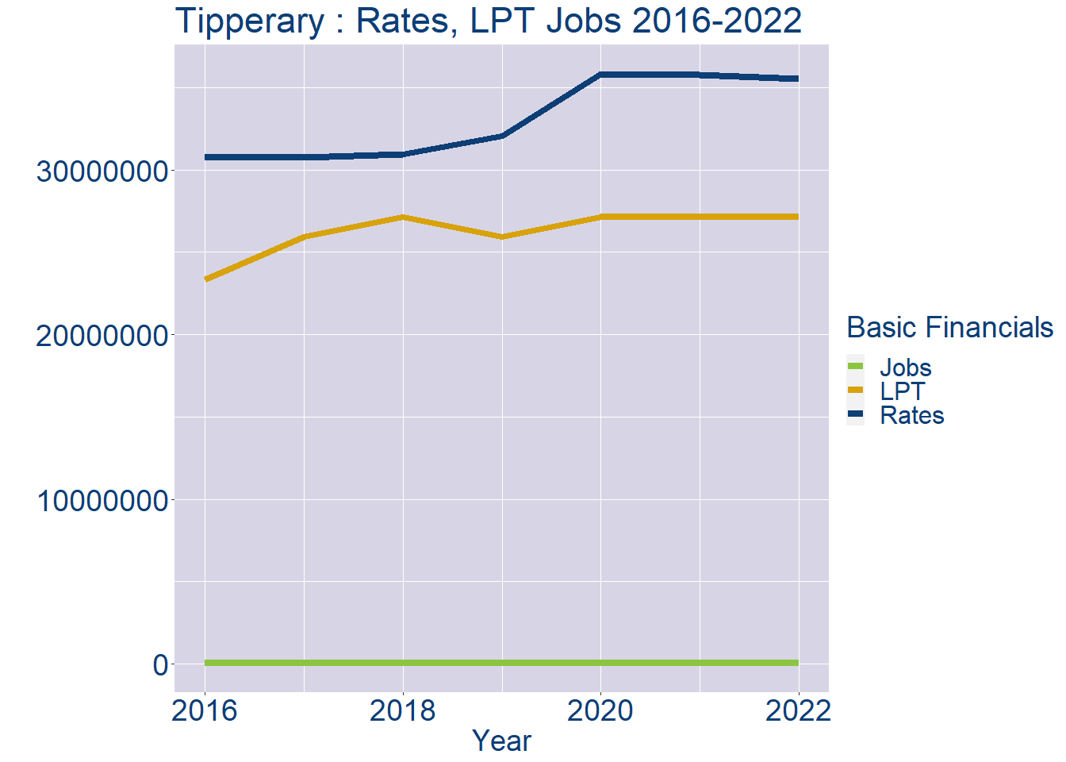
Theme 1: Tipperary Rates & LPT Income
Tipperary Local Authority Rates and LPT: 2016-2022
Year | Jobs | LPT | Rates
2016 | 63472 | 23320110 | 30795846
2017 | 65094 | 25951602 | 30732493
2018 | 66716 | 27134513 | 30931079
2019 | 68338 | 25951602 | 32076385
2020 | 69960 | 27136956 | 35801344
2021 | 71582 | 27156665 | 35761637
2022 | 73207 | 27158966 | 35520000

Slide 4
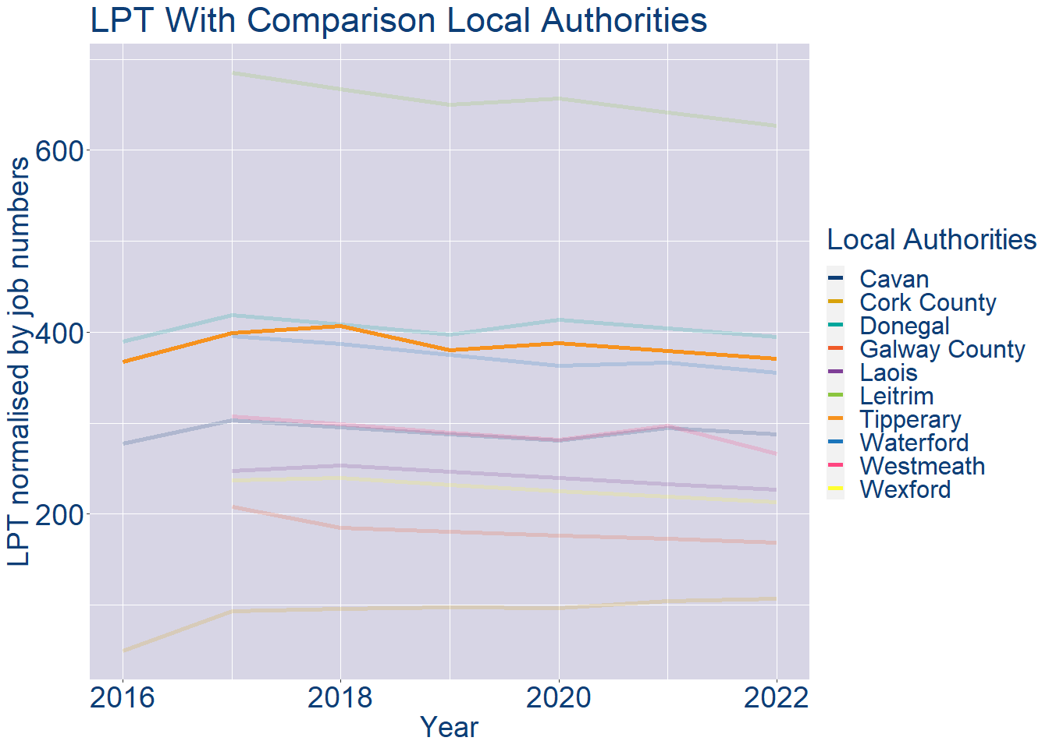
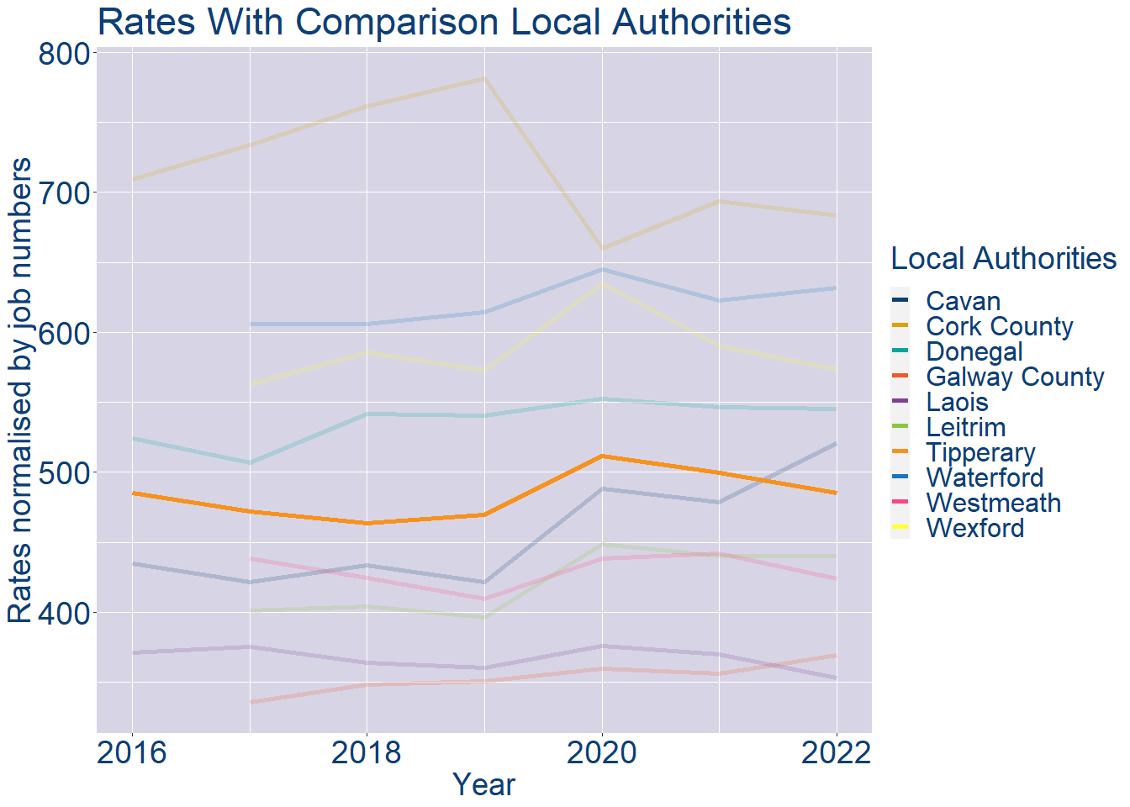
Theme 1: Tipperary Rates & LPT Income
Tipperary Local Authority 2022 LPT/employee €371
Tipperary Local Authority 2022 Rates/employee €485

Slide 5
Theme 2: Tipperary Workforce Demographics
Audience: Membership/Businesses that are interested in expanding into the local area
Highlights: Workforce details, who is available, education level, population growth
Key messages:
Varies from Local Authority area to area
Important for you to understand the numbers of people who are available to work in your area, their experience levels and the training they have

Slide 6
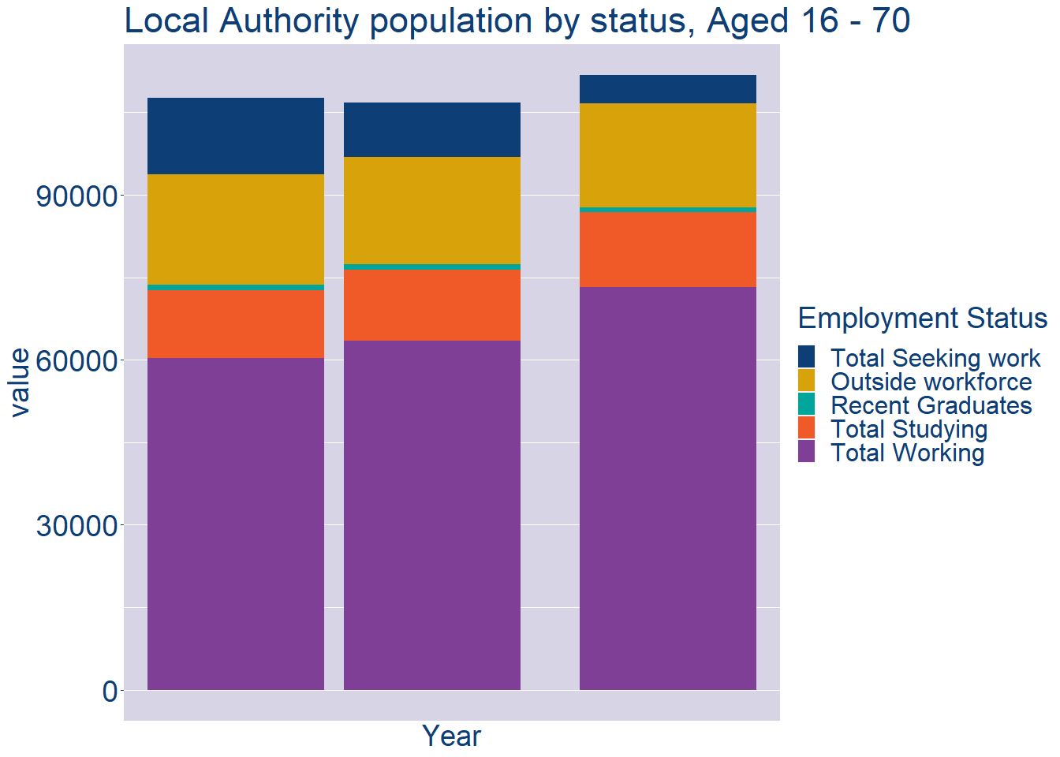
Theme 2: Tipperary Workforce Demographics
Tipperary Local Authority Workforce Population
Year | 2022
Total_working | 73207
Total_studying | 13631
Total_recent_grads | 927
Total_job_seeking | 5191
Total_not_seeking | 18843

Slide 7
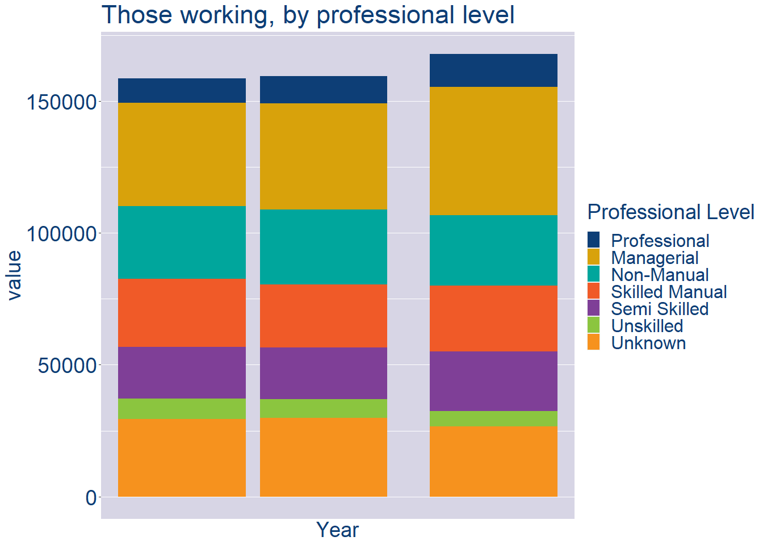
Theme 2: Tipperary Workforce Demographics
Tipperary Local Authority Workforce Experience Level
Year | 2022
Professional | 12395
Managerial | 48651
Non_Manual | 26849
Skilled_Manual | 24982
Semi_Skilled | 22608
Unskilled | 5846
All_Others | 26564

Slide 8
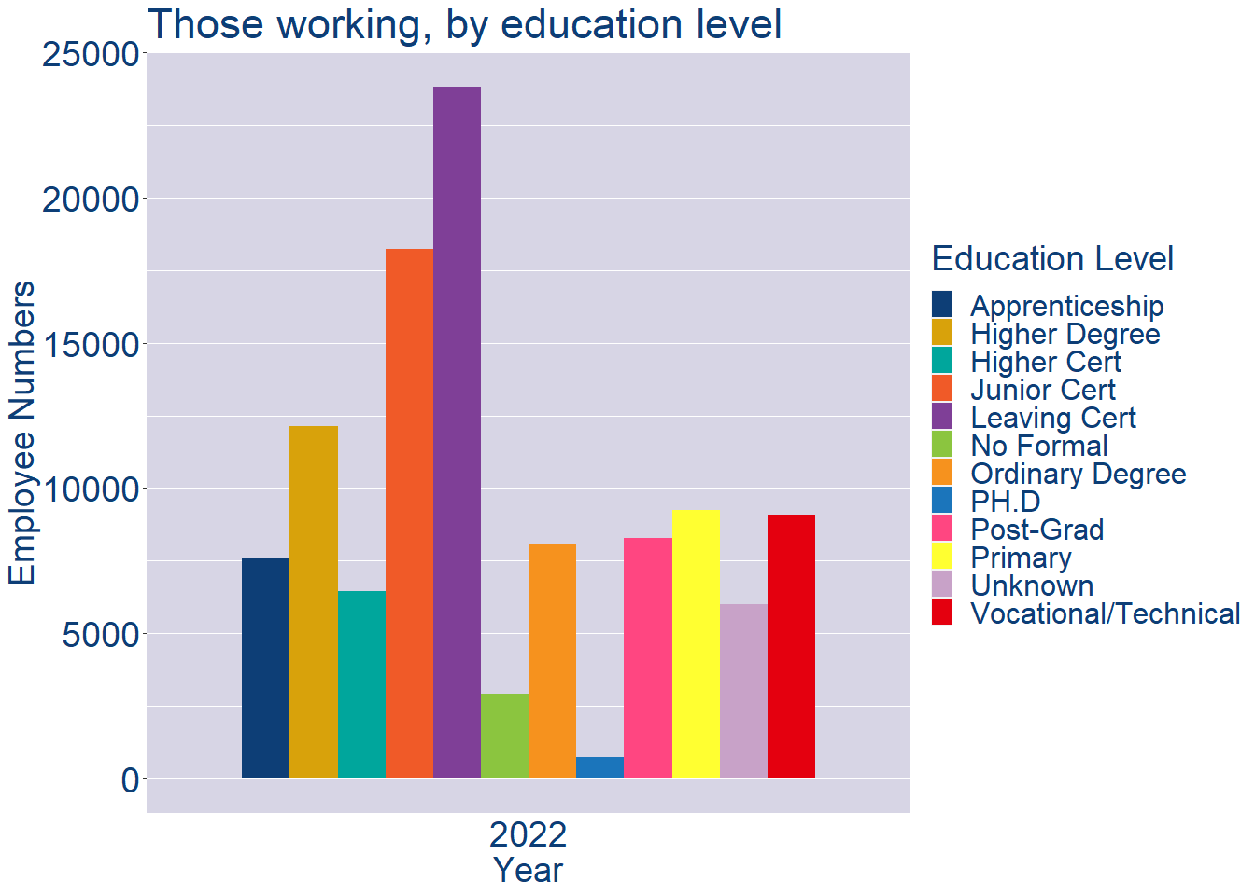
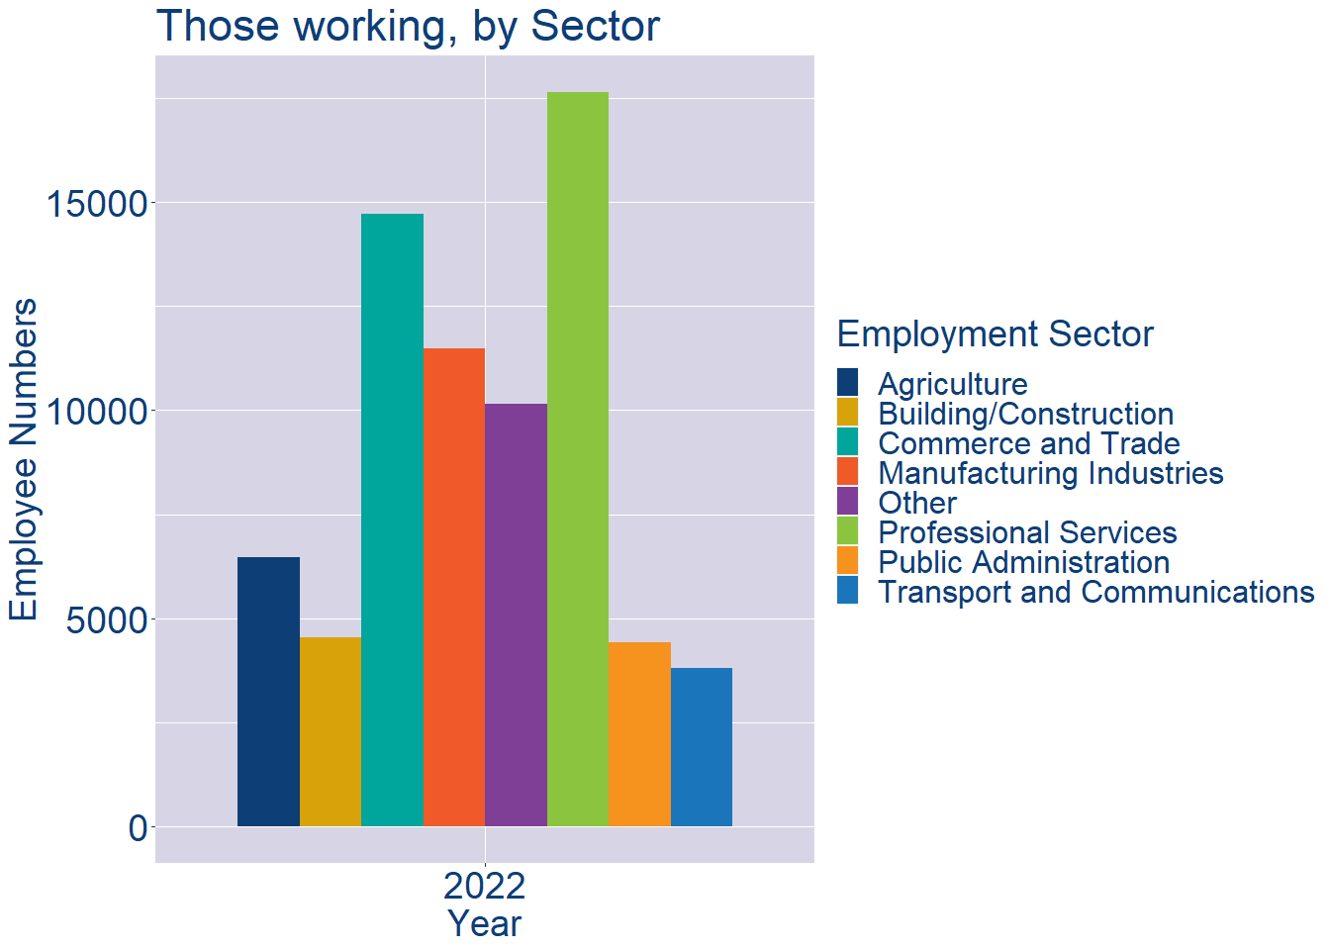
Theme 2: Tipperary Workforce Demographics
Tipperary Local Authority Workforce Education Level
Tipperary Local Authority Workforce Sectors

Slide 9
Theme 3: Co. Tipperary Business Demographics
Audience: Internal to Chambers
Highlights: Local Business Community Information
Key messages:
Varies from Local Authority area to area
Local market intelligence to help you identify trends in your local area’s business community i.e.:
Sectoral activity increasing/decreasing
What sectors the self-employed are active in

Slide 10
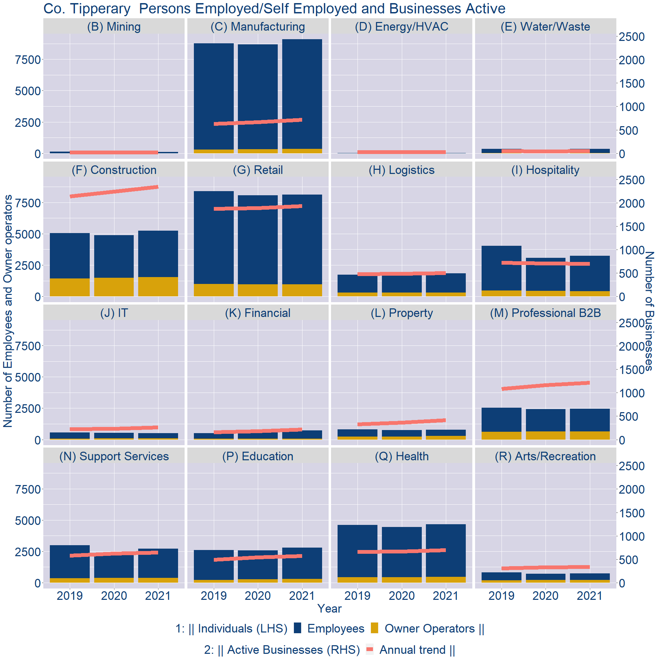
Theme 3: Co. Tipperary Business Demographics

Slide 11
Theme 3: Co. Tipperary Business Demographics
Sectors | Businesses | Owners | Employees
(B) Mining | 17 | 3 | 106
(C) Manufacturing | 662 | 340 | 8752
(D) Energy/HVAC | 24 | 2 | 25
(E) Water/Waste | 45 | 11 | 339
(F) Construction | 2161 | 1551 | 3683
(G) Retail | 1783 | 958 | 7169
(H) Logistics | 460 | 297 | 1538
(I) Hospitality | 646 | 426 | 2820
(J) IT | 241 | 99 | 414
(K) Financial | 203 | 63 | 677
(L) Property | 384 | 281 | 507
(M) Professional B2B | 1122 | 659 | 1793
(N) Support Services | 593 | 391 | 2320
(P) Education | 530 | 302 | 2503
(Q) Health | 643 | 458 | 4195
(R) Arts/Recreation | 314 | 225 | 506
Employment in locally registered businesses, by Sector

Slide 12
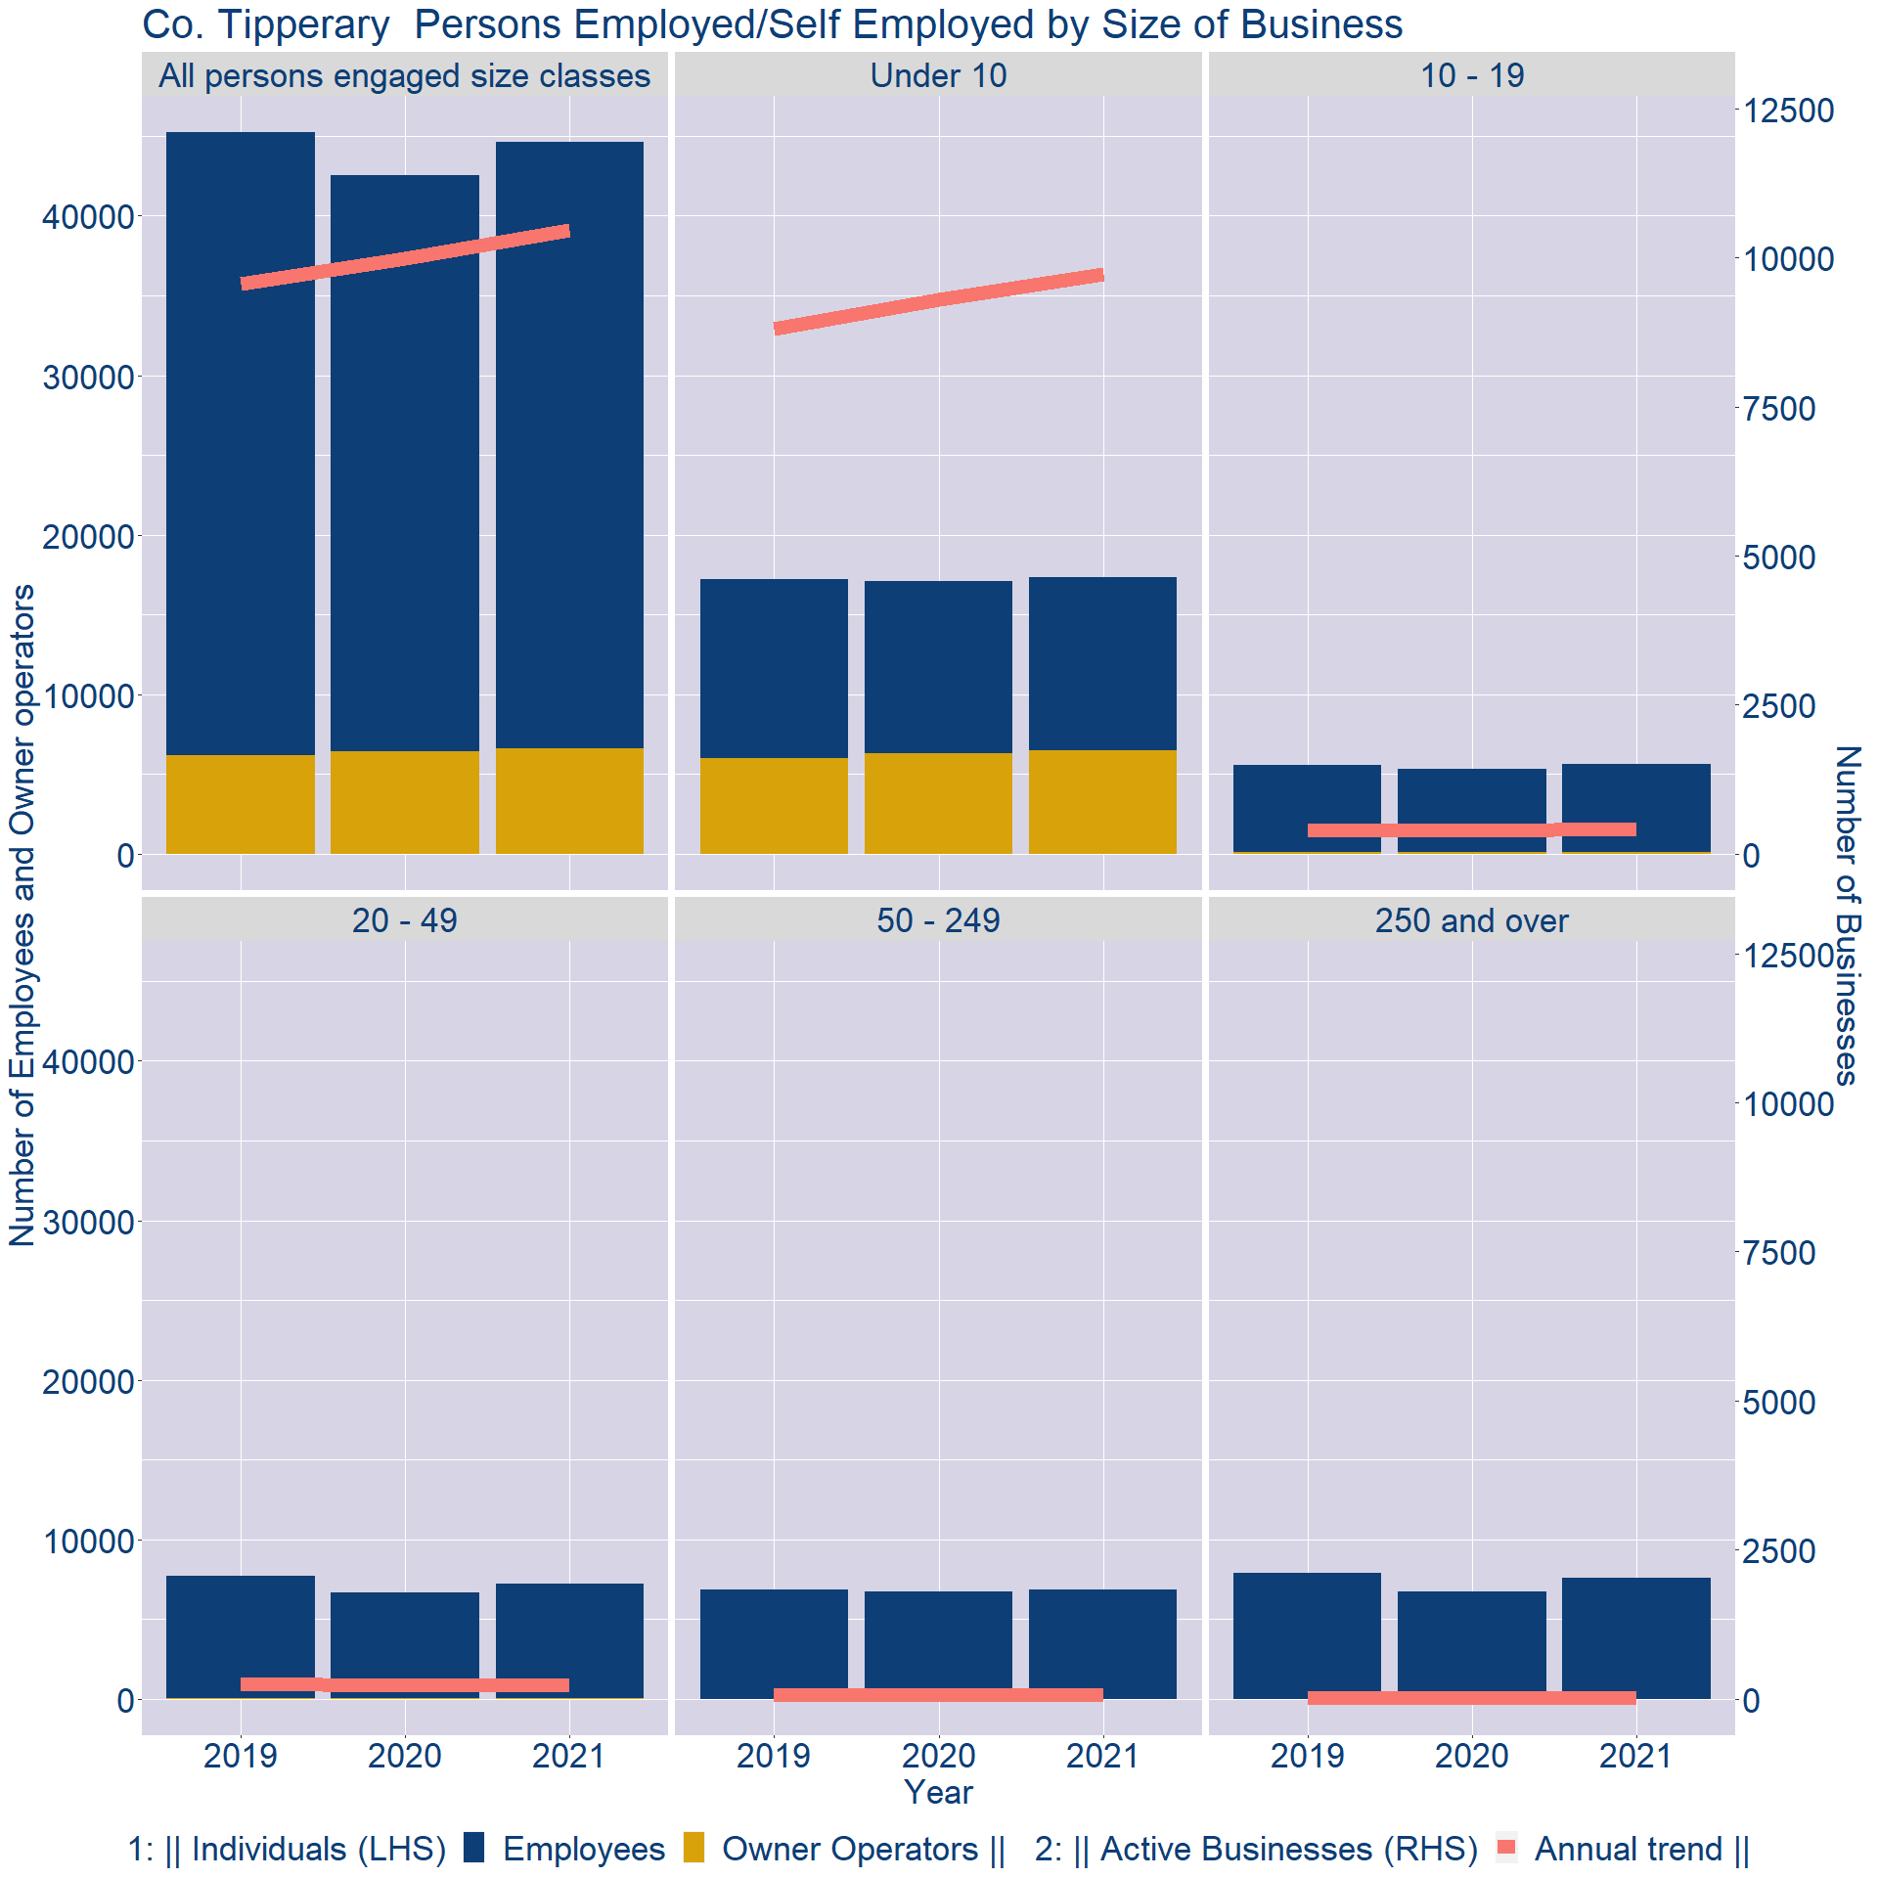
Theme 3: Co. Tipperary Business Demographics
Employment in locally registered businesses, by employer size - 2021

Slide 13
Theme 3: Co. Tipperary Business Demographics
Employment.Size | Businesses | Owners | Employees
All persons engaged size classes | 10459 | 6616 | 38038
Under 10 | 9720 | 6492 | 10822
10 - 19 | 418 | 93 | 5559
20 - 49 | 240 | 30 | 7183
50 - 249 | 70 | 1 | 6875
250 and over | 11 | 0 | 7599
Employment in locally registered businesses, by employer size - 2021

