Slide 1
South Dublin Business & Employment Demographics
Chambers Ireland

Slide 2
Theme 1: South Dublin Rates & LPT Income
Audience: Existing/Prospective Local Authority members
Highlights: Increasing reliance on Commercial Rates to support Local Authority Activities
Key messages:
Local Authority Budget Reform needed
Rates system putting pressure on labour intensive & vulnerable sectors
Hospitality
Retail
Manufacturing
Obligation on Local Authority to use these taxes effectively

Slide 3
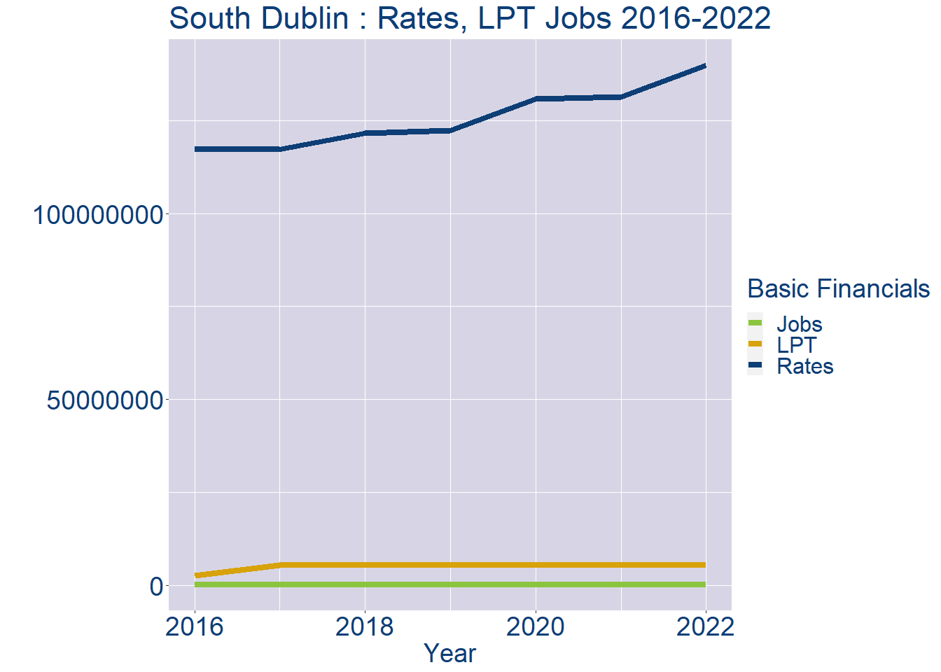
Theme 1: South Dublin Rates & LPT Income
South Dublin Local Authority Rates and LPT: 2016-2022
Year | Jobs | LPT | Rates
2016 | 119210 | 2556577 | 117344152
2017 | 122194 | 5425579 | 117151143
2018 | 125178 | 5431730 | 121485055
2019 | 128162 | 5436834 | 122312727
2020 | 131146 | 5440667 | 130712588
2021 | 134130 | 5449671 | 131418709
2022 | 137111 | 5454600 | 139795600

Slide 4
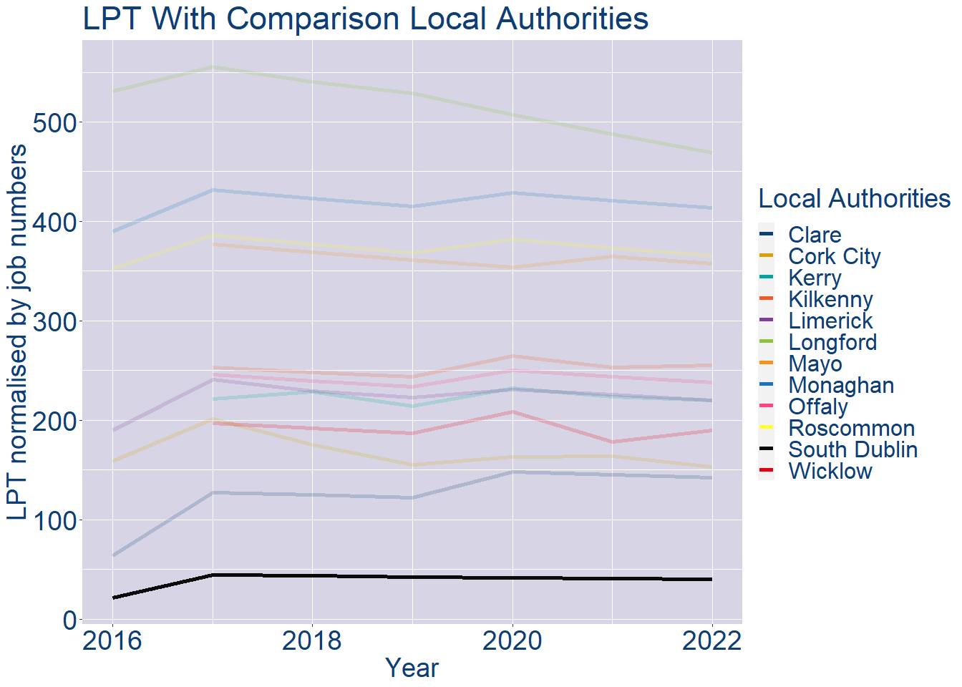
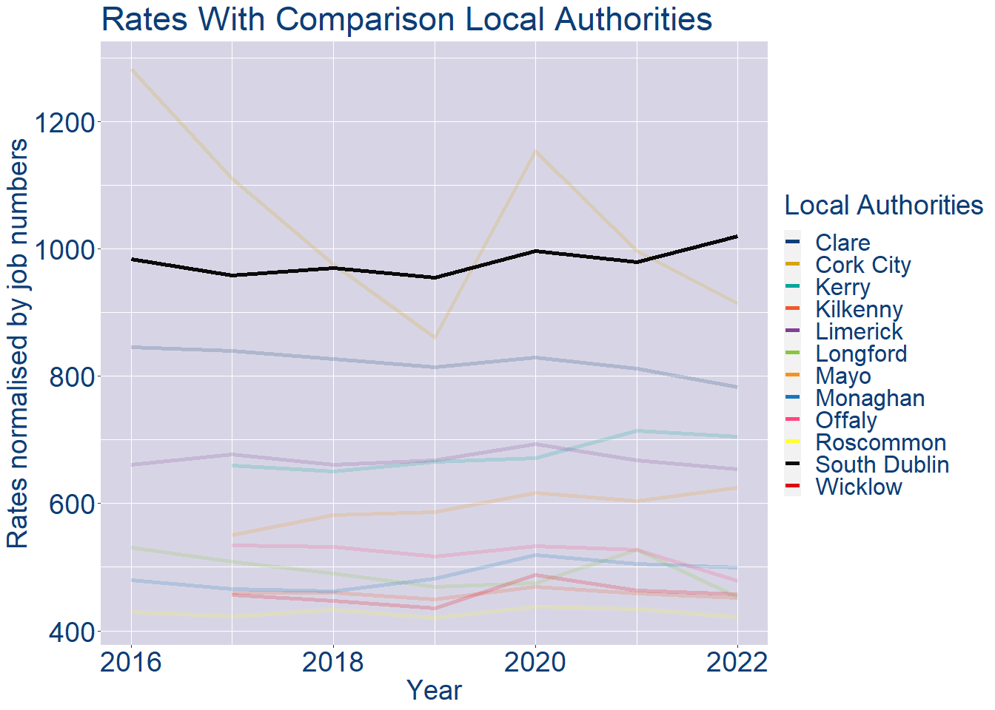
Theme 1: South Dublin Rates & LPT Income
South Dublin Local Authority 2022 LPT/employee €40
South Dublin Local Authority 2022 Rates/employee €1020

Slide 5
Theme 2: South Dublin Workforce Demographics
Audience: Membership/Businesses that are interested in expanding into the local area
Highlights: Workforce details, who is available, education level, population growth
Key messages:
Varies from Local Authority area to area
Important for you to understand the numbers of people who are available to work in your area, their experience levels and the training they have

Slide 6
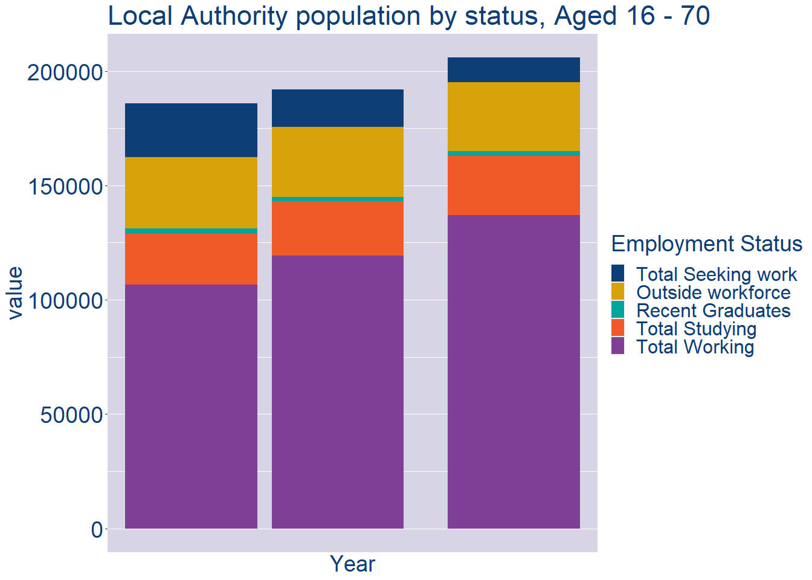
Theme 2: South Dublin Workforce Demographics
South Dublin Local Authority Workforce Population
Year | 2022
Total_working | 137111
Total_studying | 25822
Total_recent_grads | 2208
Total_job_seeking | 10841
Total_not_seeking | 29979

Slide 7
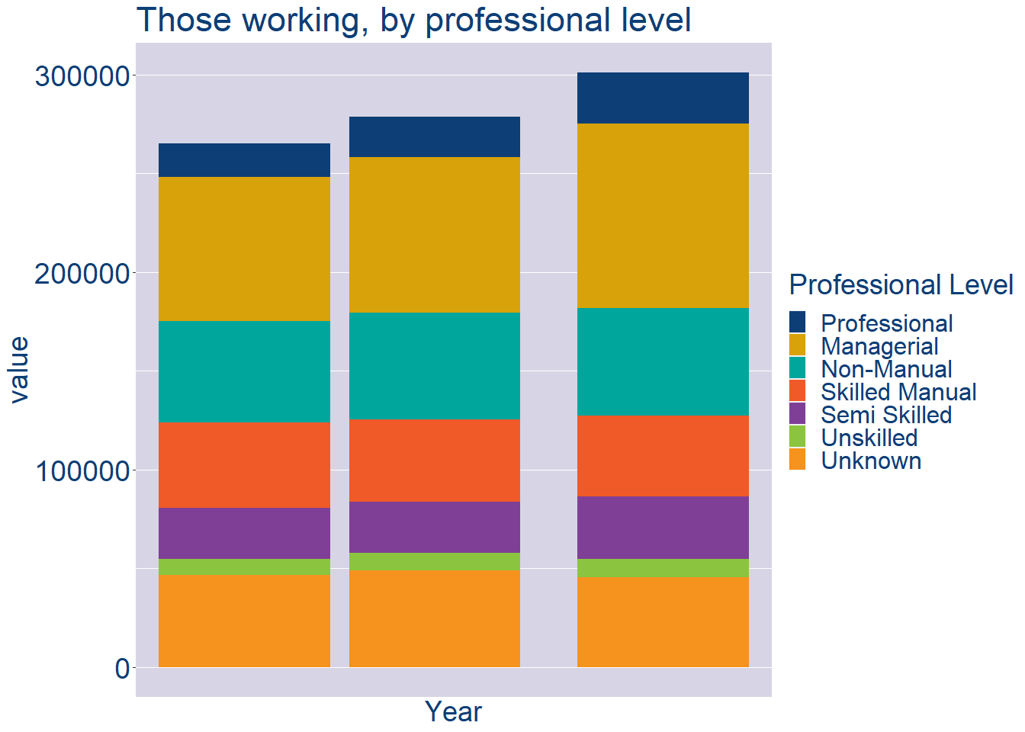
Theme 2: South Dublin Workforce Demographics
South Dublin Local Authority Workforce Experience Level
Year | 2022
Professional | 25844
Managerial | 93597
Non_Manual | 54347
Skilled_Manual | 40747
Semi_Skilled | 31948
Unskilled | 9311
All_Others | 45281

Slide 8
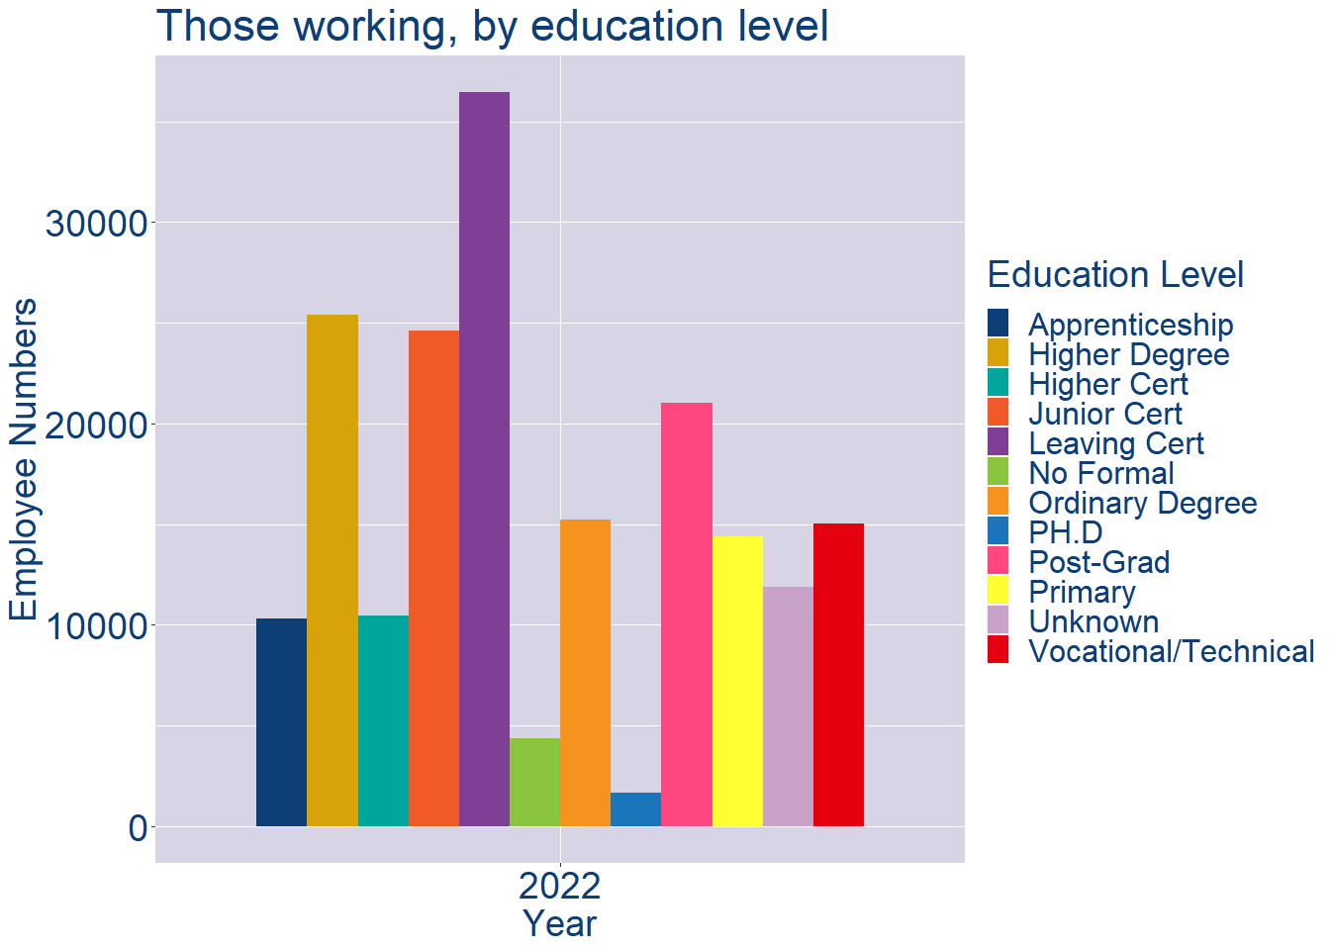
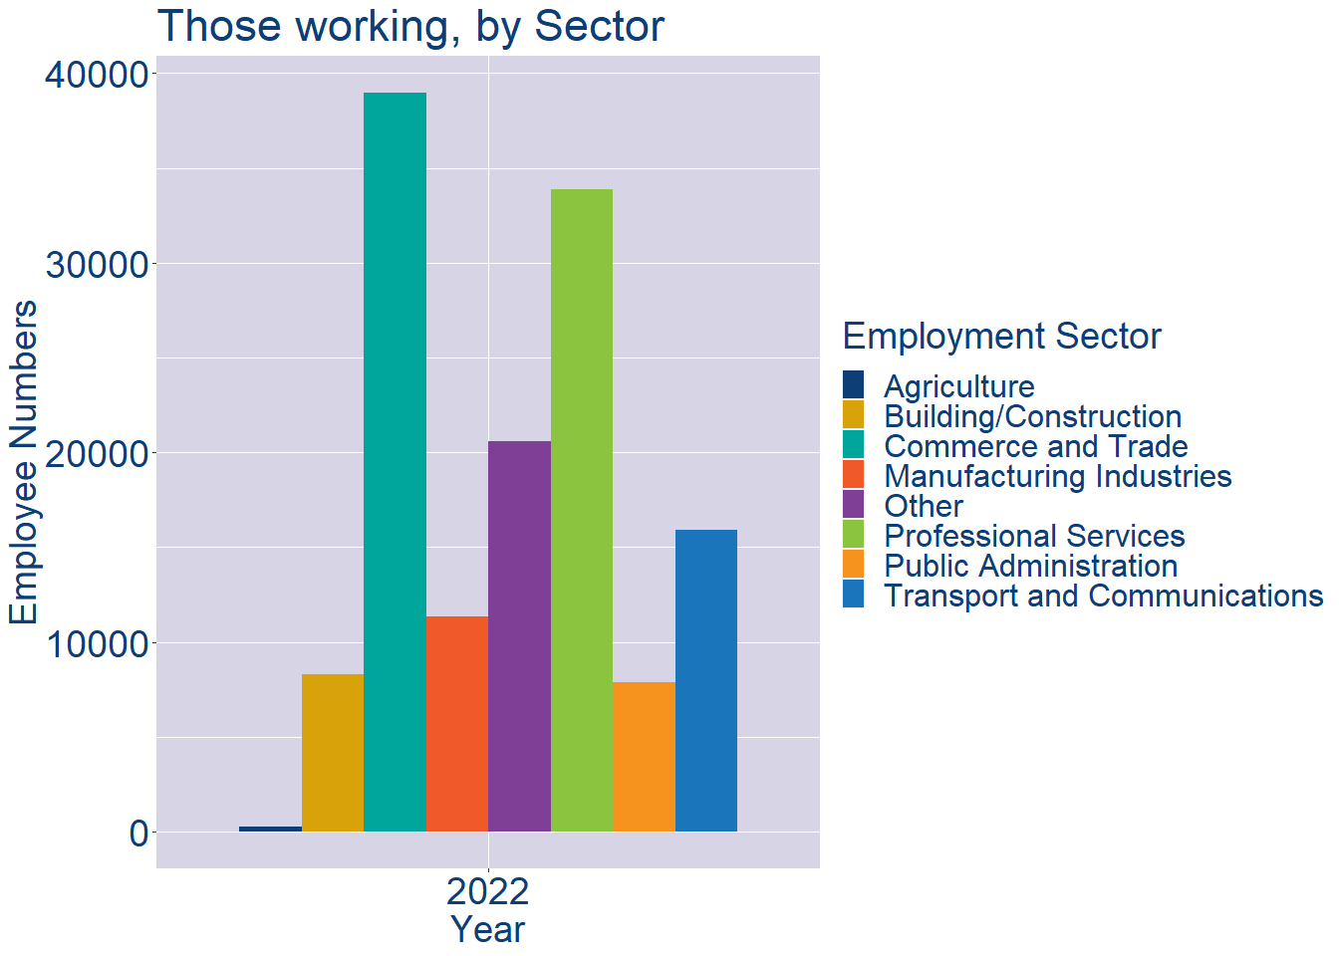
Theme 2: South Dublin Workforce Demographics
South Dublin Local Authority Workforce Education Level
South Dublin Local Authority Workforce Sectors

Slide 9
Theme 3: Co. Dublin Business Demographics
Audience: Internal to Chambers
Highlights: Local Business Community Information
Key messages:
Varies from Local Authority area to area
Local market intelligence to help you identify trends in your local area’s business community i.e.:
Sectoral activity increasing/decreasing
What sectors the self-employed are active in

Slide 10
Theme 3: Co. Dublin Business Demographics

Slide 11
Theme 3: Co. Dublin Business Demographics
Sectors | Businesses | Owners | Employees
(B) Mining | 48 | 6 | 313
(C) Manufacturing | 3725 | 1355 | 56844
(D) Energy/HVAC | 293 | 7 | 8572
(E) Water/Waste | 231 | 49 | 4732
(F) Construction | 19142 | 13042 | 35473
(G) Retail | 12820 | 3883 | 173264
(H) Logistics | 10341 | 8621 | 52661
(I) Hospitality | 4485 | 1247 | 57655
(J) IT | 9529 | 2280 | 99739
(K) Financial | 9641 | 1152 | 91965
(L) Property | 5800 | 2411 | 13275
(M) Professional B2B | 19778 | 9628 | 92635
(N) Support Services | 7194 | 1965 | 79467
(P) Education | 4384 | 2701 | 41294
(Q) Health | 7638 | 5245 | 113727
(R) Arts/Recreation | 4504 | 3249 | 14142
Employment in locally registered businesses, by Sector

Slide 12
Theme 3: Co. Dublin Business Demographics
Employment in locally registered businesses, by employer size - 2021

Slide 13
Theme 3: Co. Dublin Business Demographics
Employment.Size | Businesses | Owners | Employees
All persons engaged size classes | 123874 | 59999 | 947794
Under 10 | 113877 | 58685 | 104583
10 - 19 | 4657 | 718 | 62095
20 - 49 | 3018 | 282 | 90944
50 - 249 | 1811 | 161 | 182776
250 and over | 511 | 153 | 507396
Employment in locally registered businesses, by employer size - 2021

