Slide 1
Sligo County Business & Employment Demographics
Chambers Ireland

Slide 2
Theme 1: Sligo County Rates & LPT Income
Audience: Existing/Prospective Local Authority members
Highlights: Increasing reliance on Commercial Rates to support Local Authority Activities
Key messages:
Local Authority Budget Reform needed
Rates system putting pressure on labour intensive & vulnerable sectors
Hospitality
Retail
Manufacturing
Obligation on Local Authority to use these taxes effectively

Slide 3
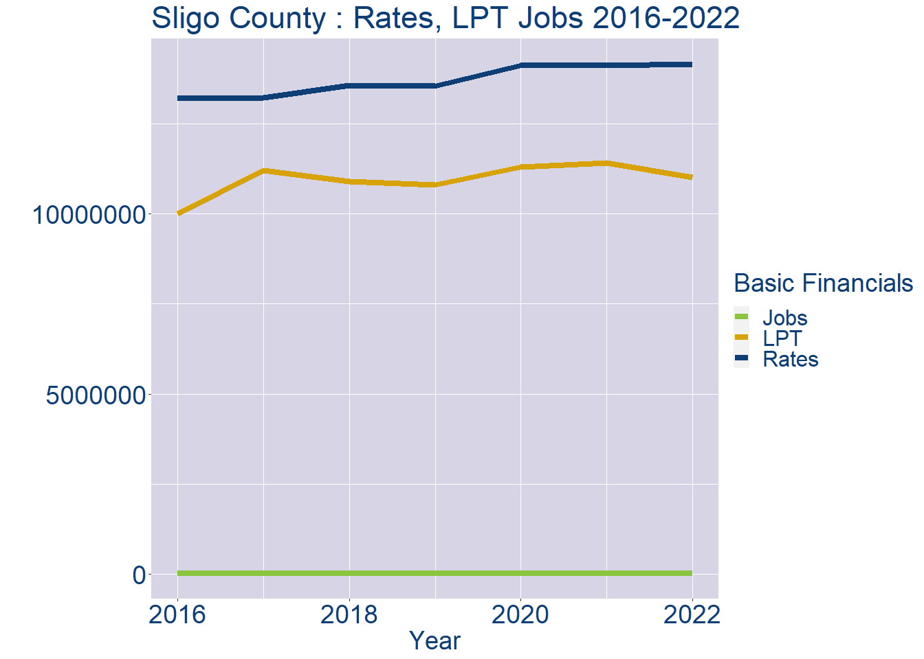
Theme 1: Sligo County Rates & LPT Income
Sligo County Local Authority Rates and LPT: 2016-2022
Year | Jobs | LPT | Rates
2016 | 26002 | 9993352 | 13202579
2017 | 26728 | 11202628 | 13211198
2018 | 27454 | 10902628 | 13570115
2019 | 28180 | 10802627 | 13546966
2020 | 28906 | 11293320 | 14119007
2021 | 29632 | 11404973 | 14113574
2022 | 30360 | 11007018 | 14149998

Slide 4
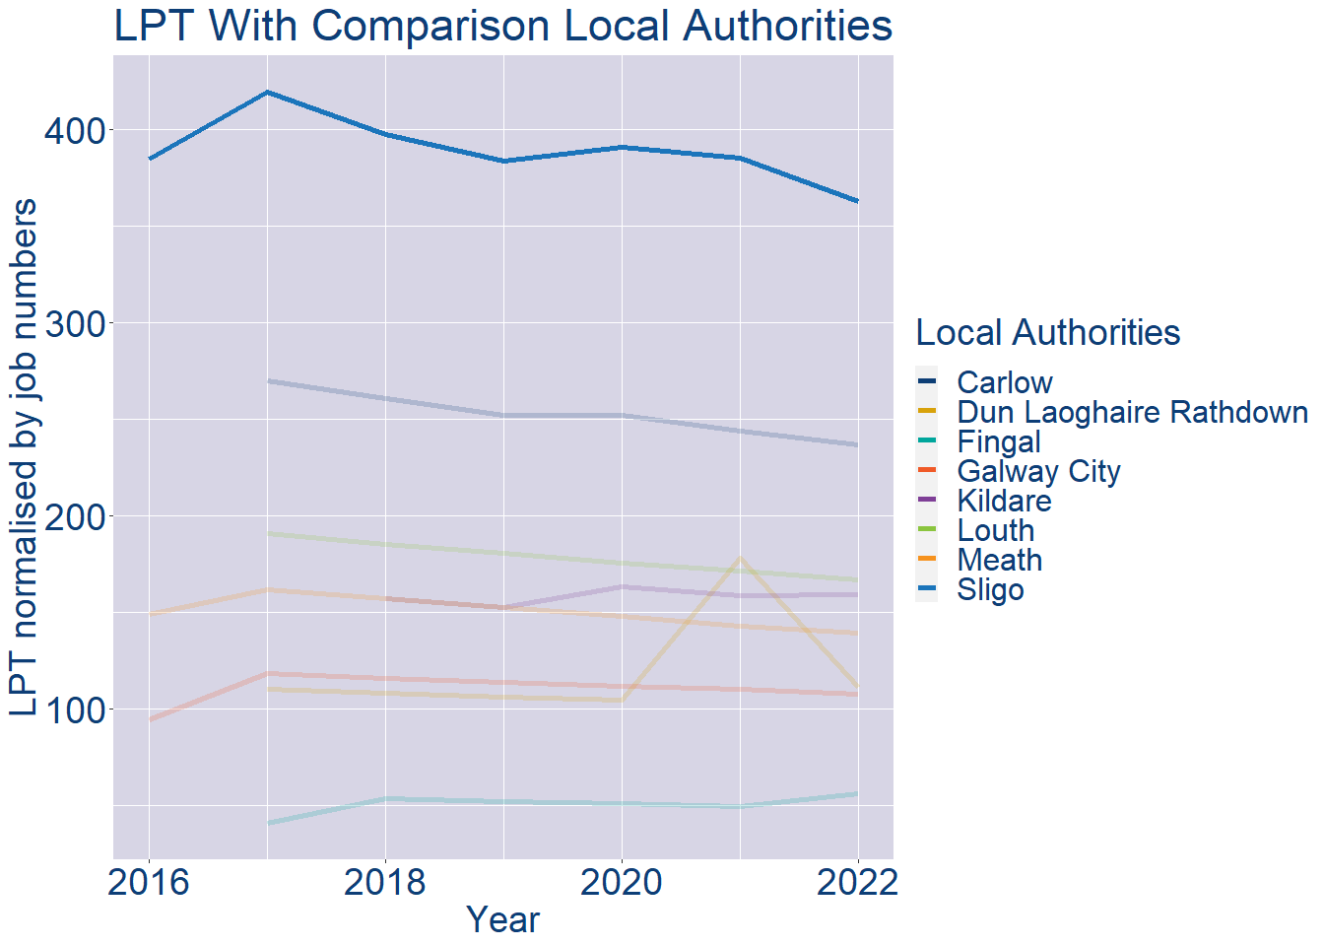
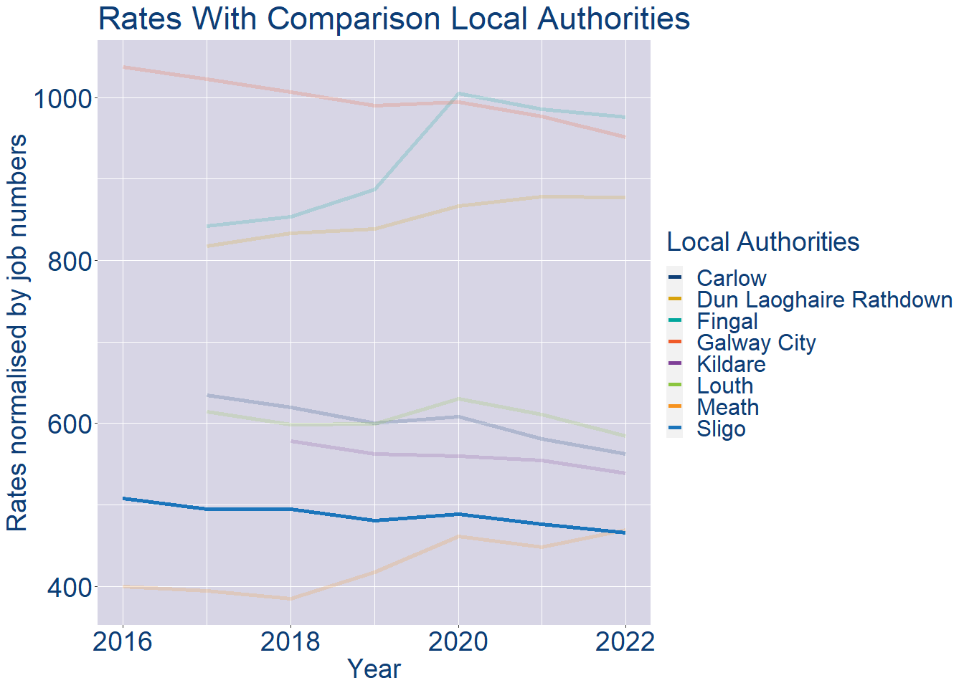
Theme 1: Sligo County Rates & LPT Income
Sligo County Local Authority 2022 LPT/employee €363
Sligo County Local Authority 2022 Rates/employee €466

Slide 5
Theme 2: Sligo County Workforce Demographics
Audience: Membership/Businesses that are interested in expanding into the local area
Highlights: Workforce details, who is available, education level, population growth
Key messages:
Varies from Local Authority area to area
Important for you to understand the numbers of people who are available to work in your area, their experience levels and the training they have

Slide 6
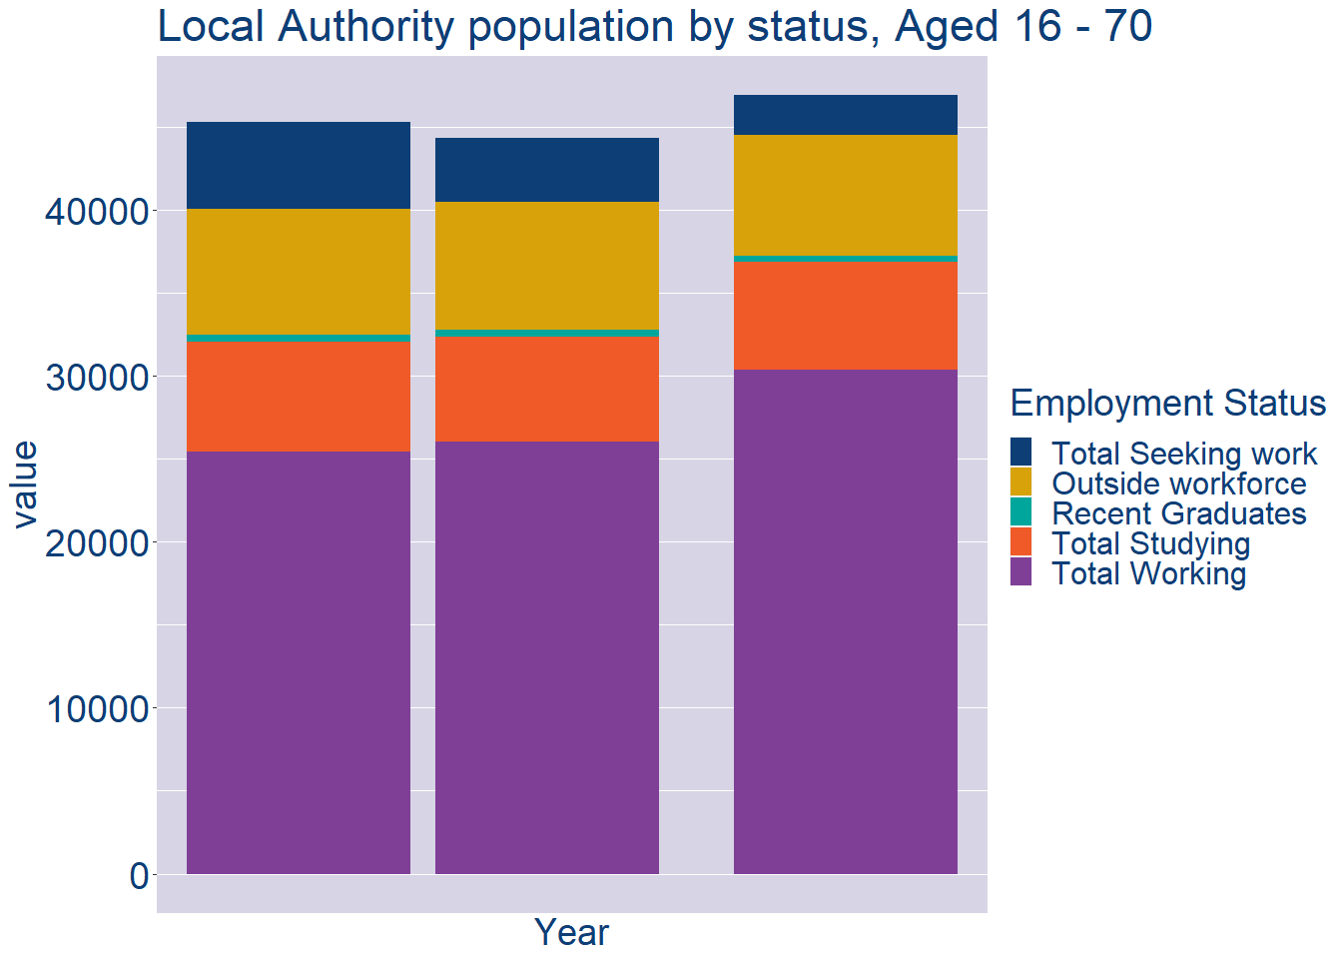
Theme 2: Sligo County Workforce Demographics
Sligo County Local Authority Workforce Population
Year | 2022
Total_working | 30360
Total_studying | 6492
Total_recent_grads | 374
Total_job_seeking | 2421
Total_not_seeking | 7250

Slide 7
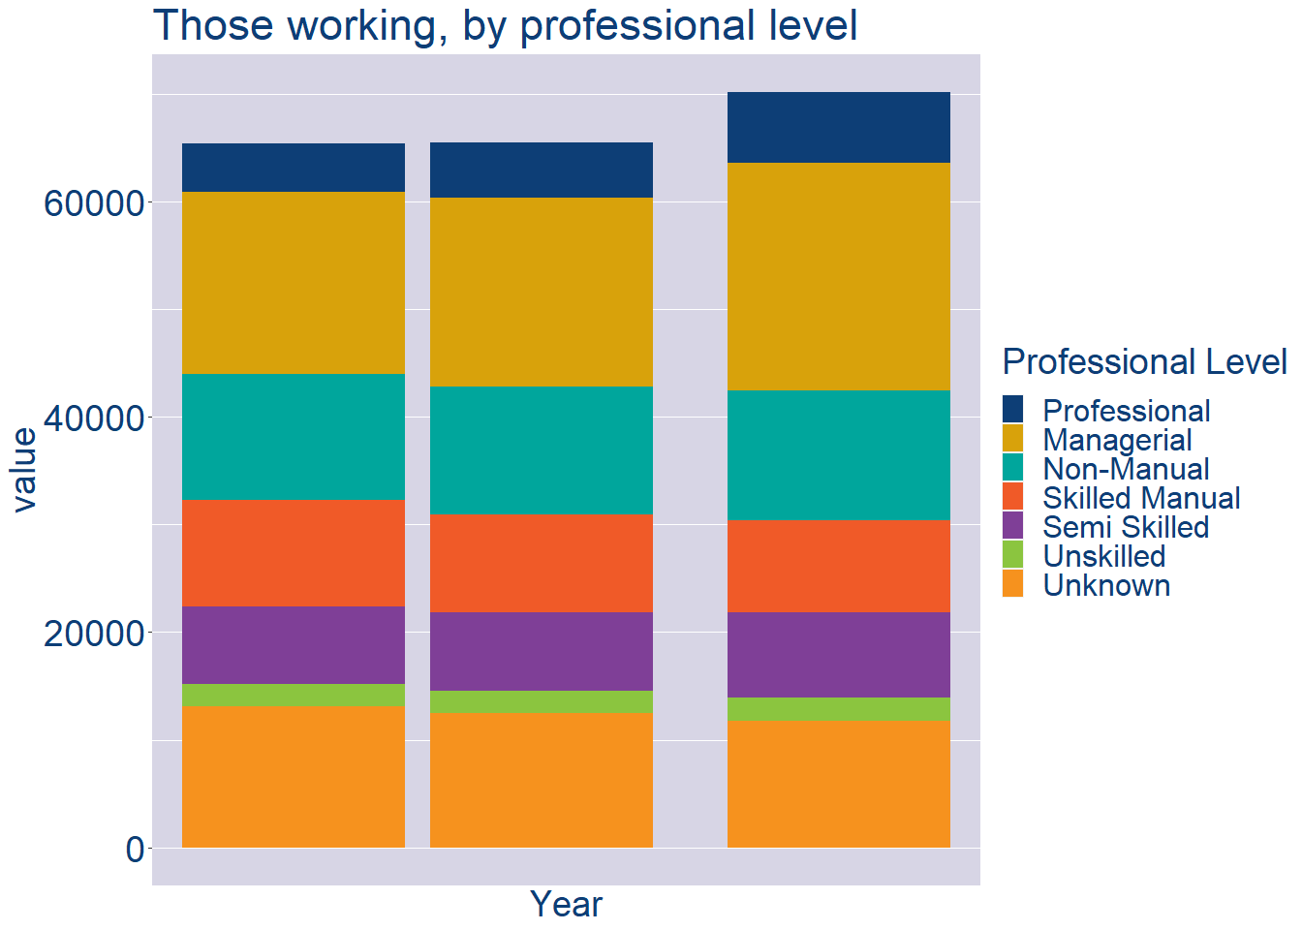
Theme 2: Sligo County Workforce Demographics
Sligo County Local Authority Workforce Experience Level
Year | 2022
Professional | 6530
Managerial | 21174
Non_Manual | 12102
Skilled_Manual | 8525
Semi_Skilled | 7975
Unskilled | 2175
All_Others | 11717

Slide 8
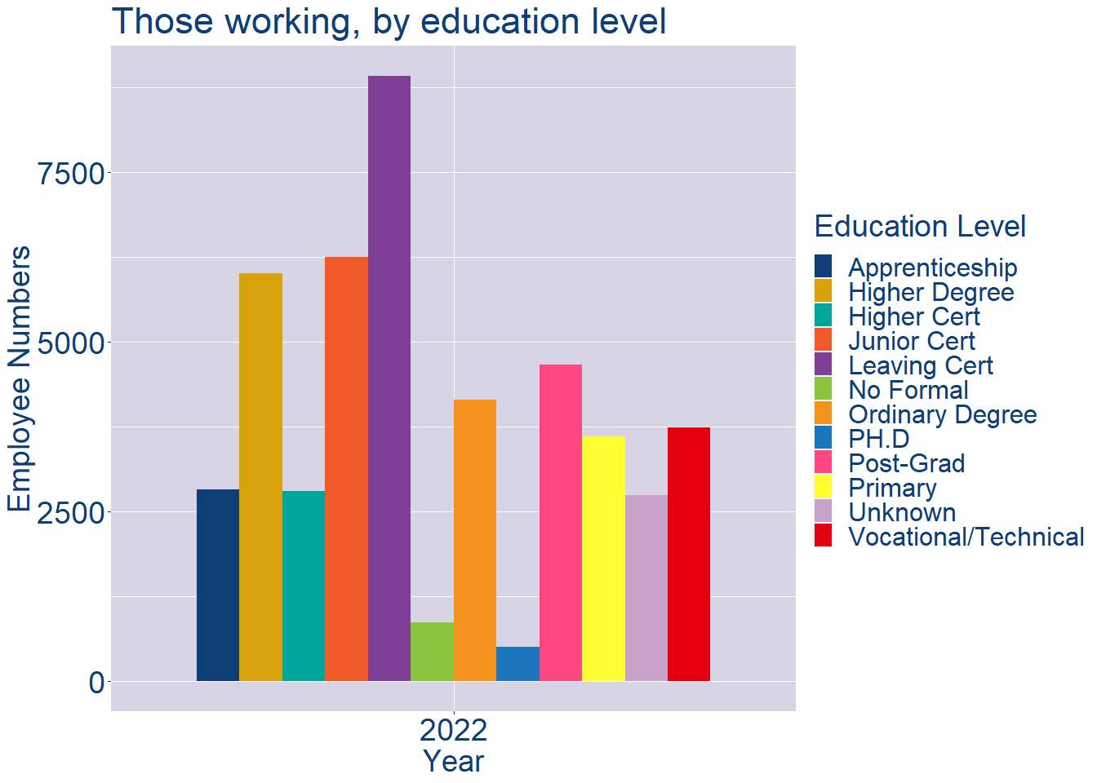
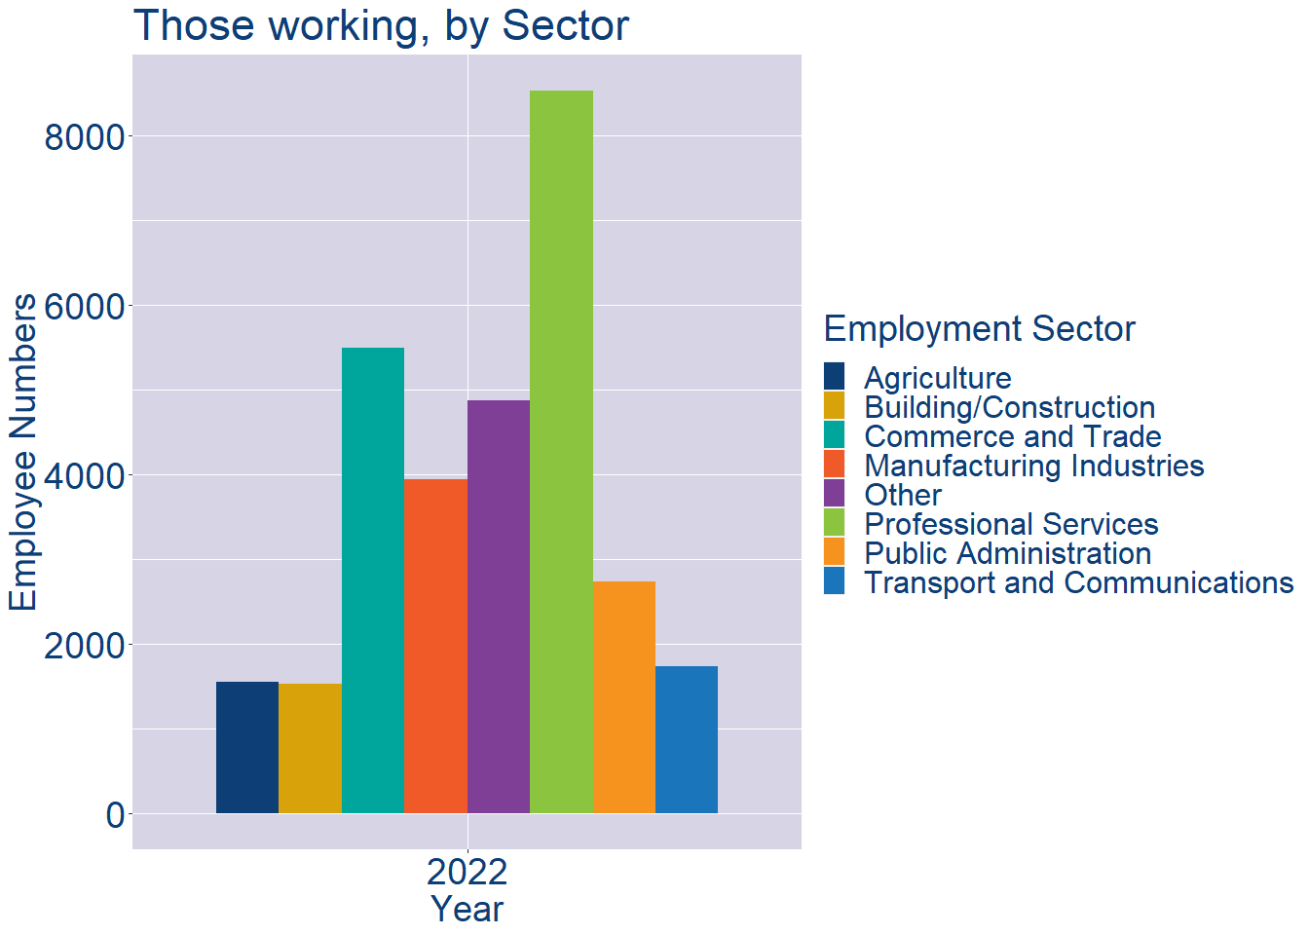
Theme 2: Sligo County Workforce Demographics
Sligo County Local Authority Workforce Education Level
Sligo County Local Authority Workforce Sectors

Slide 9
Theme 3: Co. Sligo Business Demographics
Audience: Internal to Chambers
Highlights: Local Business Community Information
Key messages:
Varies from Local Authority area to area
Local market intelligence to help you identify trends in your local area’s business community i.e.:
Sectoral activity increasing/decreasing
What sectors the self-employed are active in

Slide 10
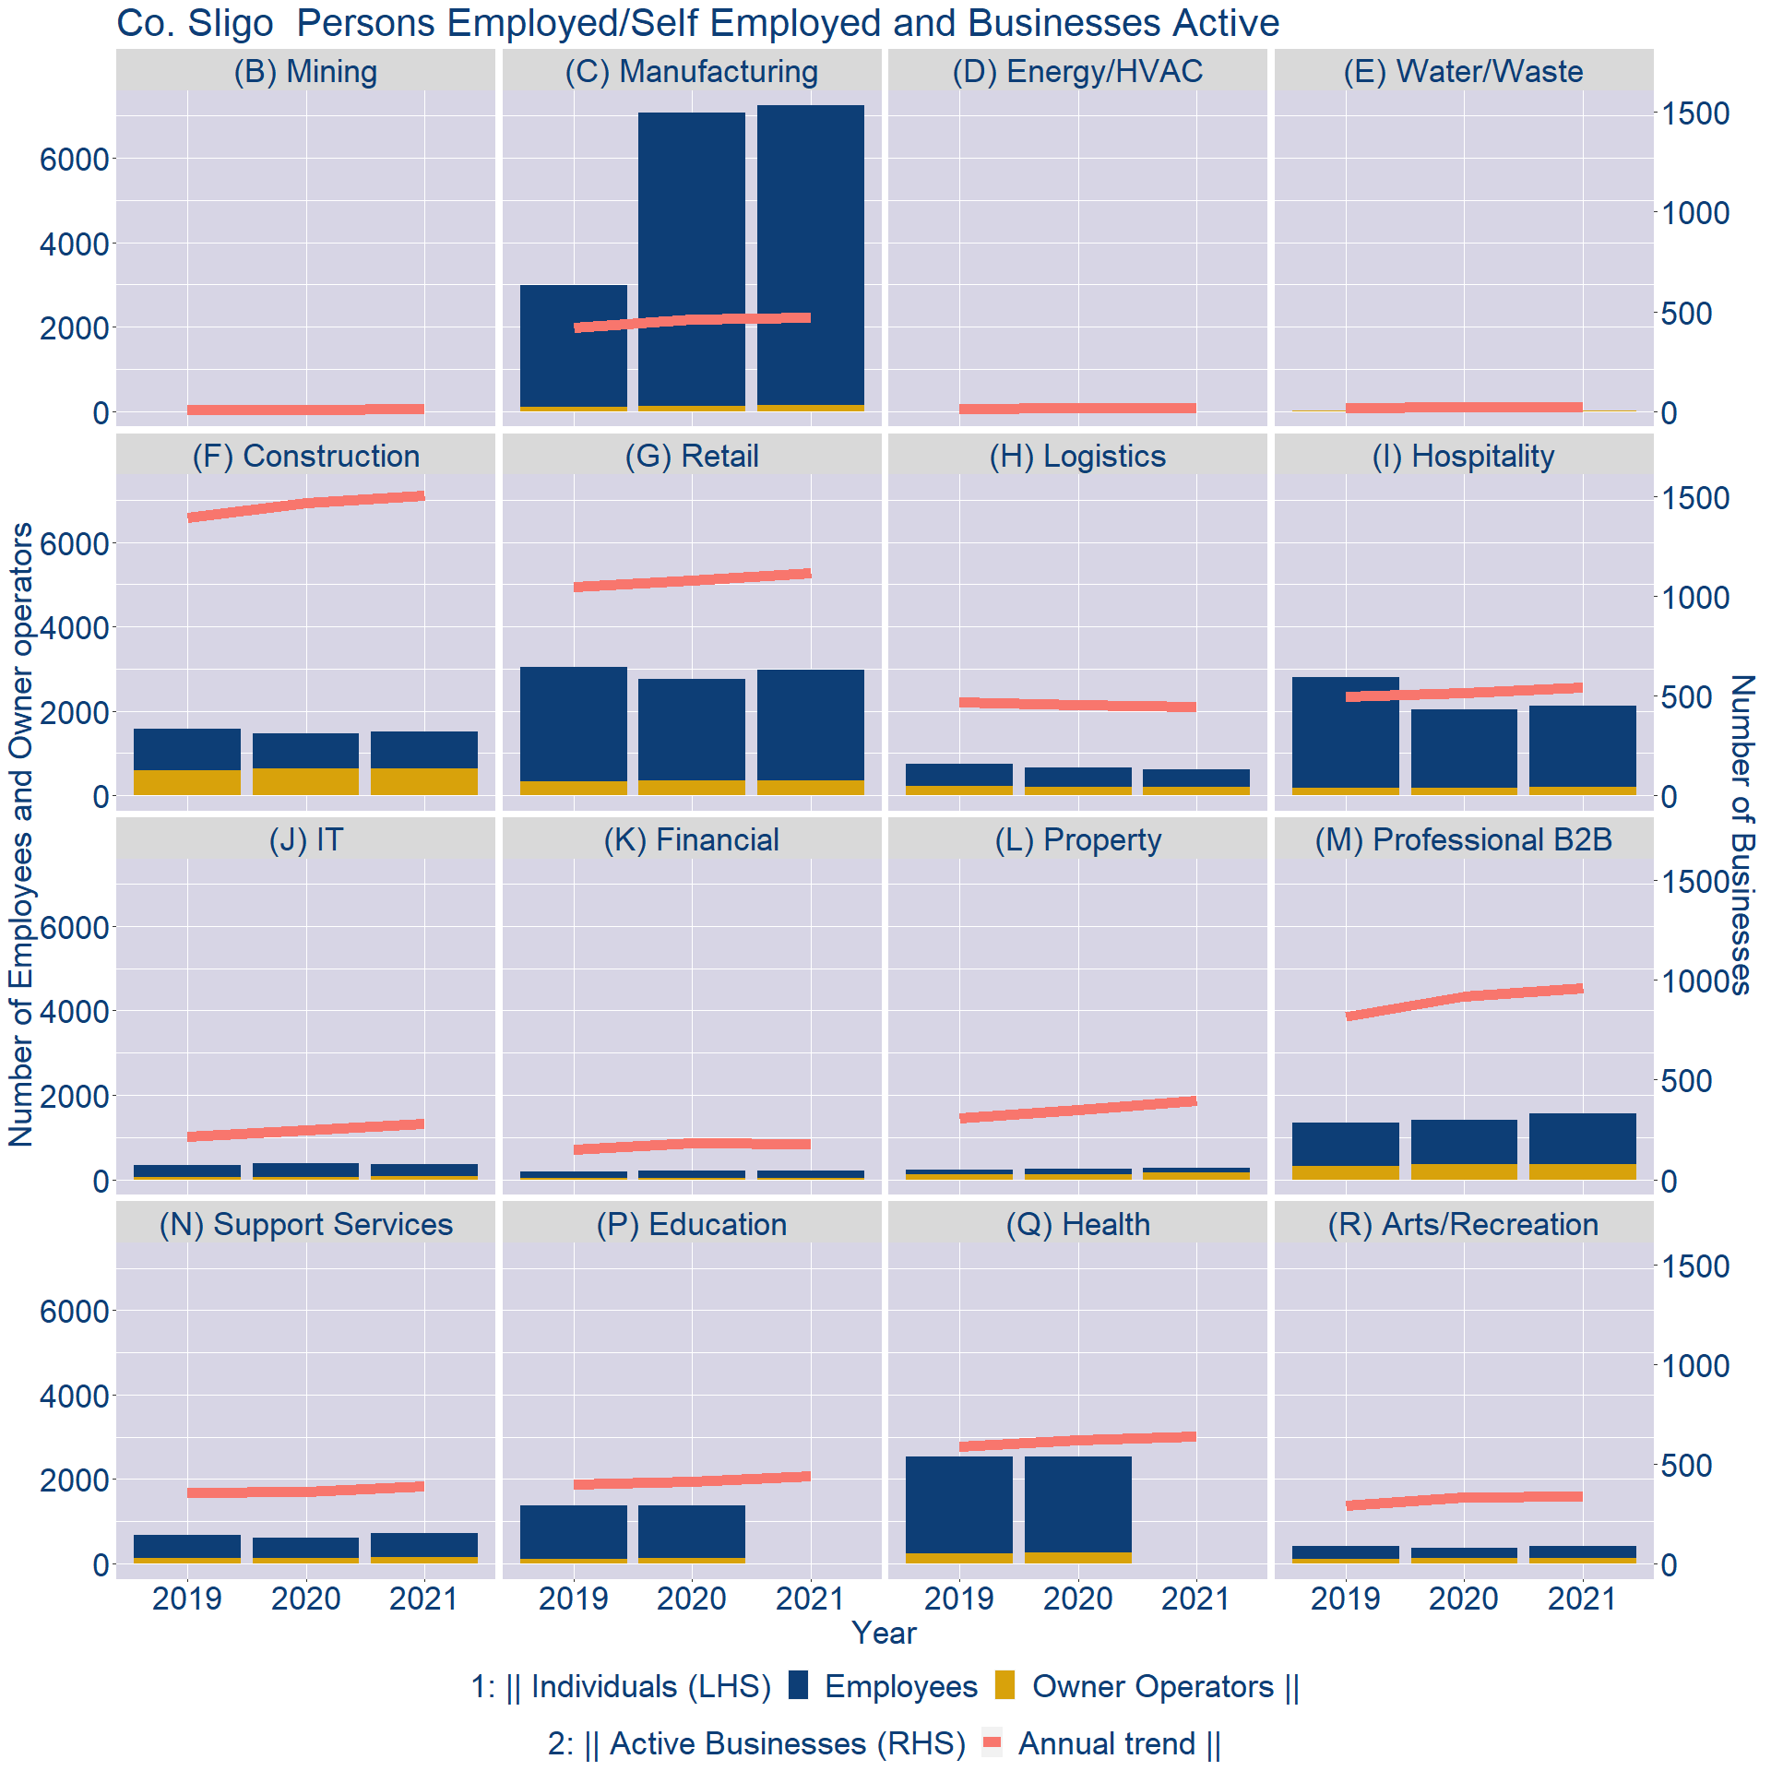
Theme 3: Co. Sligo Business Demographics

Slide 11
Theme 3: Co. Sligo Business Demographics
Sectors | Businesses | Owners | Employees
(B) Mining | 7 | 0 | 0
(C) Manufacturing | 258 | 137 | 7103
(D) Energy/HVAC | 9 | 0 | 0
(E) Water/Waste | 12 | 25 | 0
(F) Construction | 825 | 637 | 879
(G) Retail | 613 | 350 | 2631
(H) Logistics | 243 | 194 | 422
(I) Hospitality | 296 | 191 | 1926
(J) IT | 153 | 72 | 288
(K) Financial | 97 | 29 | 172
(L) Property | 217 | 155 | 119
(M) Professional B2B | 527 | 365 | 1204
(N) Support Services | 213 | 146 | 572
(P) Education | 240 | 0 | 0
(Q) Health | 349 | 0 | 0
(R) Arts/Recreation | 184 | 133 | 278
Employment in locally registered businesses, by Sector

Slide 12
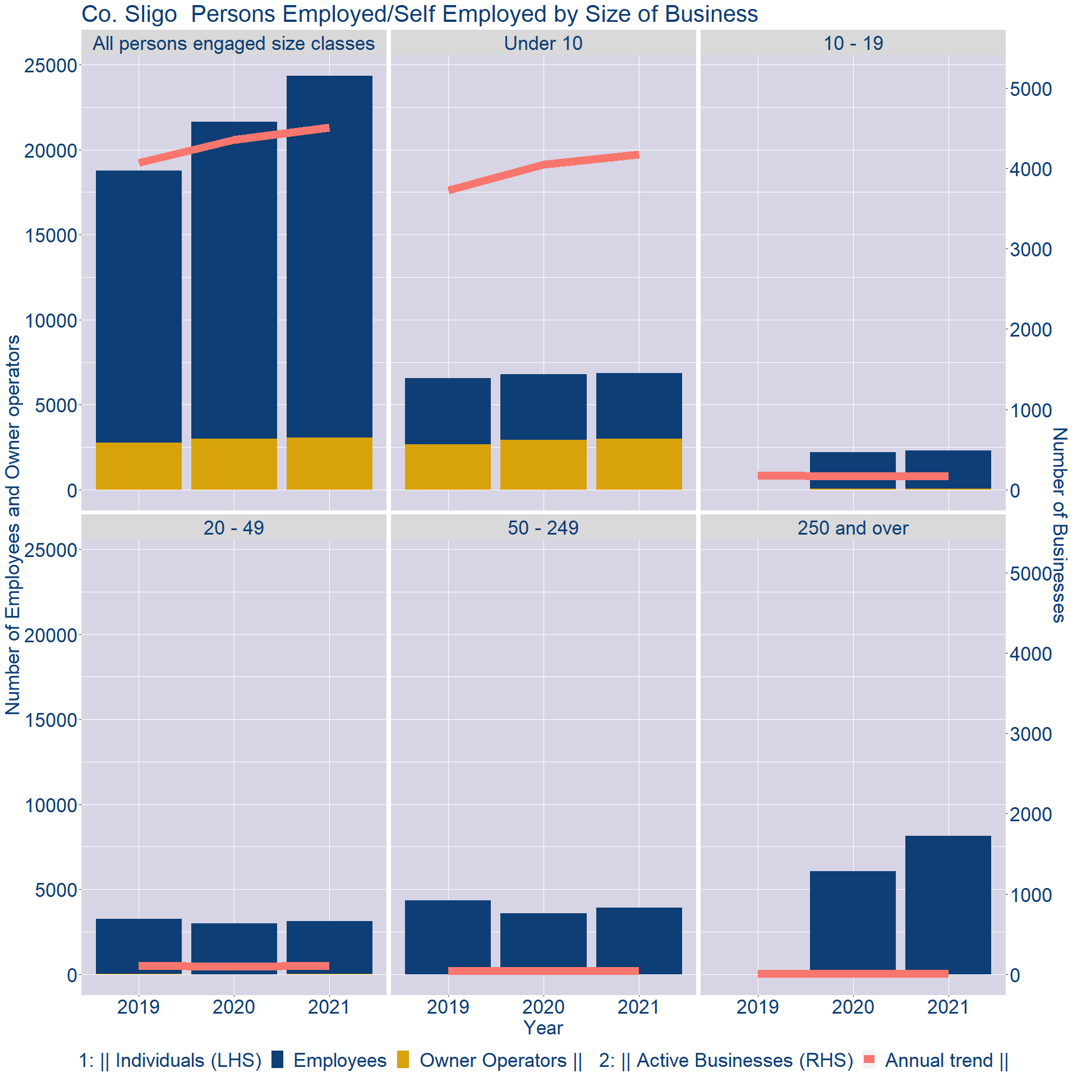
Theme 3: Co. Sligo Business Demographics
Employment in locally registered businesses, by employer size - 2021

Slide 13
Theme 3: Co. Sligo Business Demographics
Employment.Size | Businesses | Owners | Employees
All persons engaged size classes | 4507 | 3059 | 21291
Under 10 | 4177 | 2985 | 3868
10 - 19 | 173 | 61 | 2239
20 - 49 | 108 | 12 | 3110
50 - 249 | 42 | 1 | 3928
250 and over | 7 | 0 | 8146
Employment in locally registered businesses, by employer size - 2021

