Slide 1
Roscommon County Business & Employment Demographics
Chambers Ireland

Slide 2
Theme 1: Roscommon County Rates & LPT Income
Audience: Existing/Prospective Local Authority members
Highlights: Increasing reliance on Commercial Rates to support Local Authority Activities
Key messages:
Local Authority Budget Reform needed
Rates system putting pressure on labour intensive & vulnerable sectors
Hospitality
Retail
Manufacturing
Obligation on Local Authority to use these taxes effectively

Slide 3
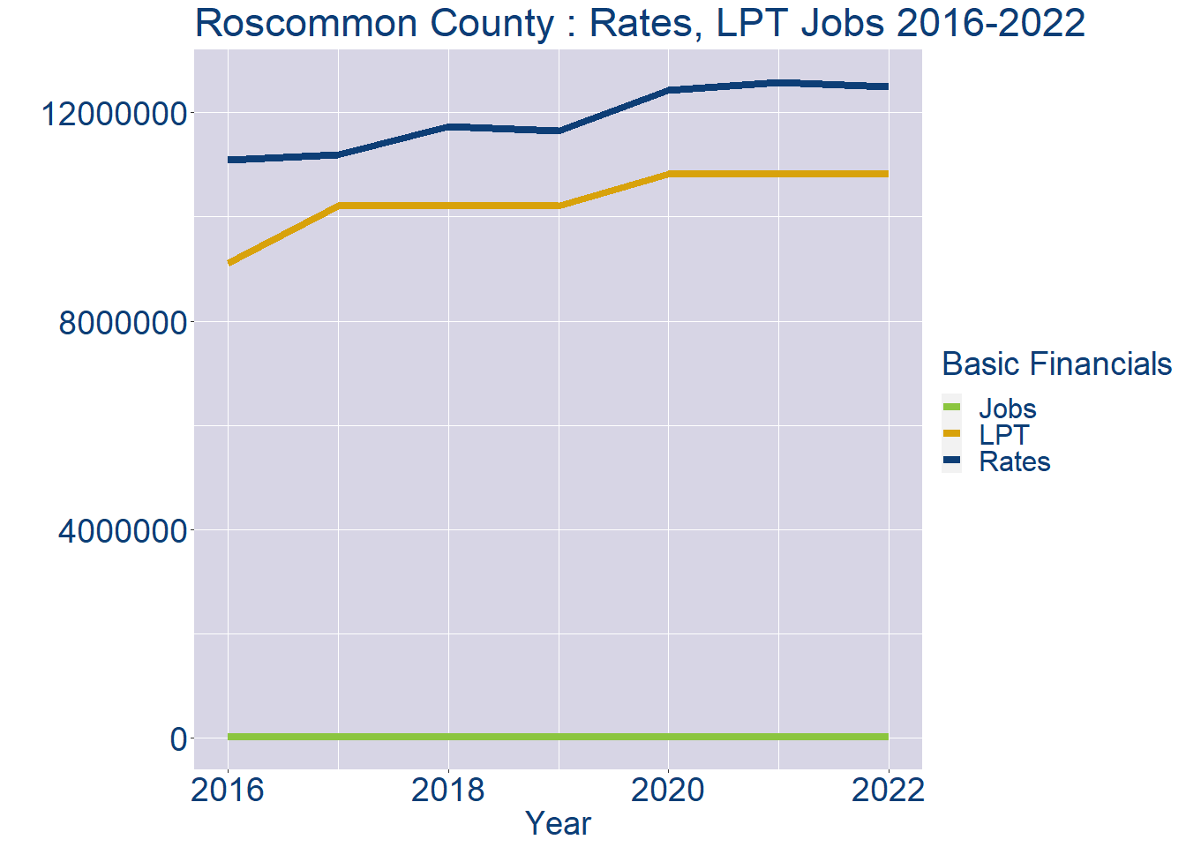
Theme 1: Roscommon County Rates & LPT Income
Roscommon County Local Authority Rates and LPT: 2016-2022
Year | Jobs | LPT | Rates
2016 | 25819 | 9107439 | 11093226
2017 | 26451 | 10216232 | 11185011
2018 | 27083 | 10216232 | 11724326
2019 | 27715 | 10216228 | 11653614
2020 | 28347 | 10817612 | 12425769
2021 | 28979 | 10825692 | 12573441
2022 | 29611 | 10825752 | 12496462

Slide 4
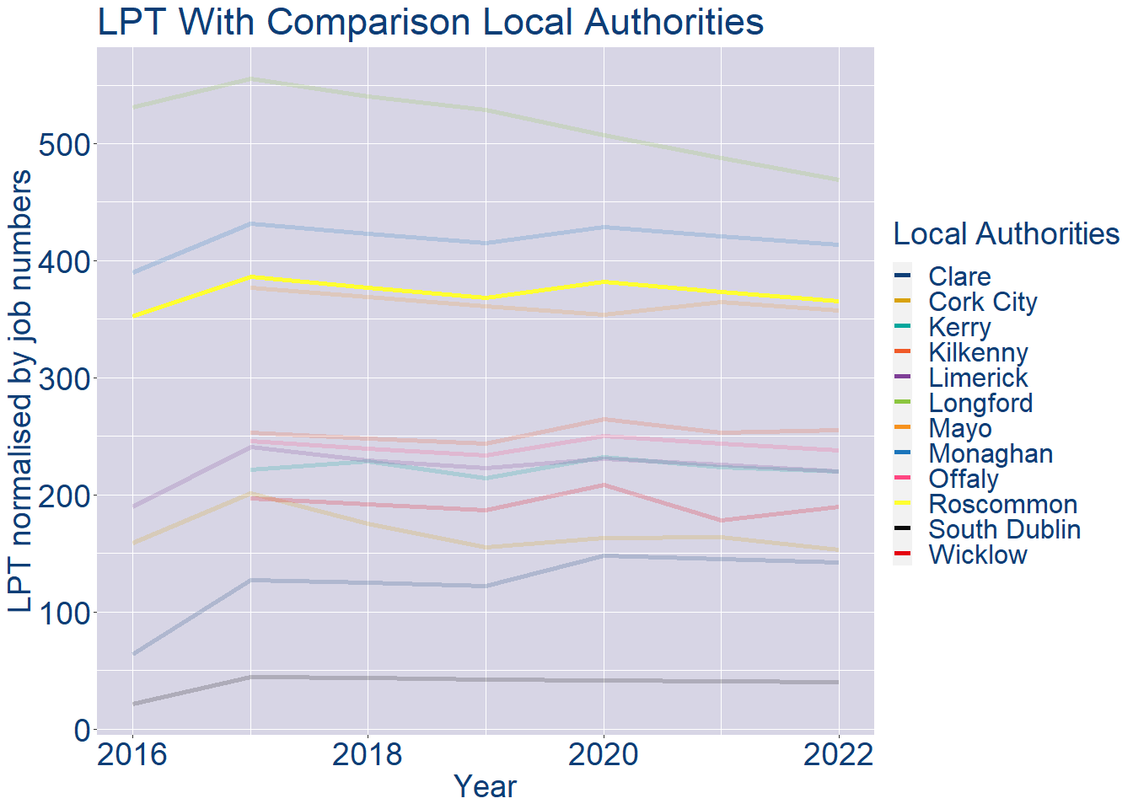
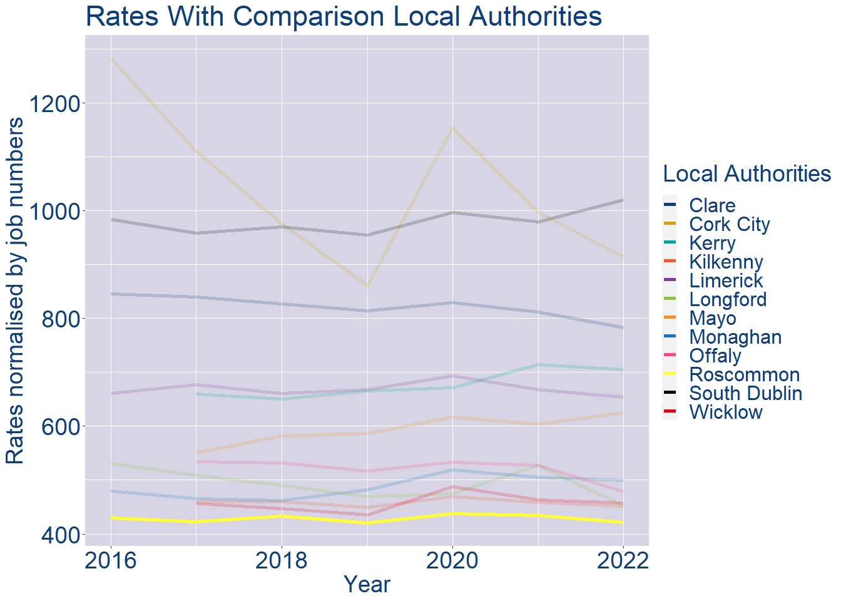
Theme 1: Roscommon County Rates & LPT Income
Roscommon County Local Authority 2022 LPT/employee €366
Roscommon County Local Authority 2022 Rates/employee €422

Slide 5
Theme 2: Roscommon County Workforce Demographics
Audience: Membership/Businesses that are interested in expanding into the local area
Highlights: Workforce details, who is available, education level, population growth
Key messages:
Varies from Local Authority area to area
Important for you to understand the numbers of people who are available to work in your area, their experience levels and the training they have

Slide 6
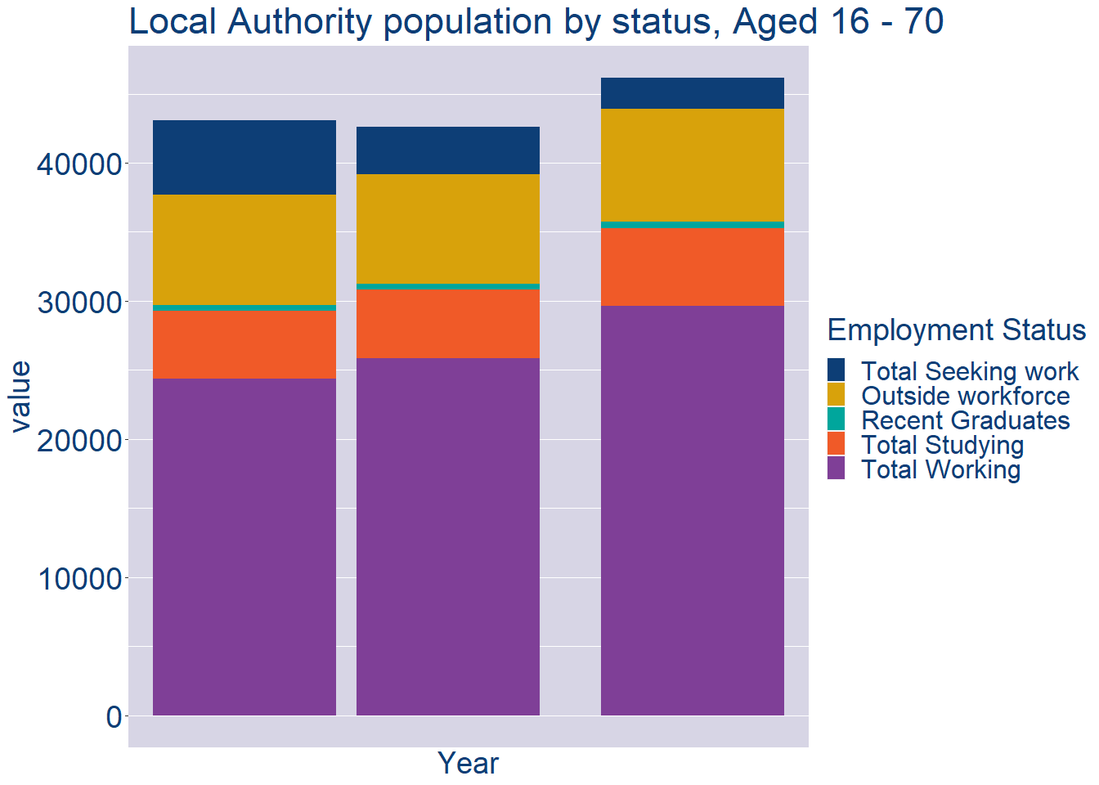
Theme 2: Roscommon County Workforce Demographics
Roscommon County Local Authority Workforce Population
Year | 2022
Total_working | 29611
Total_studying | 5668
Total_recent_grads | 475
Total_job_seeking | 2236
Total_not_seeking | 8160

Slide 7
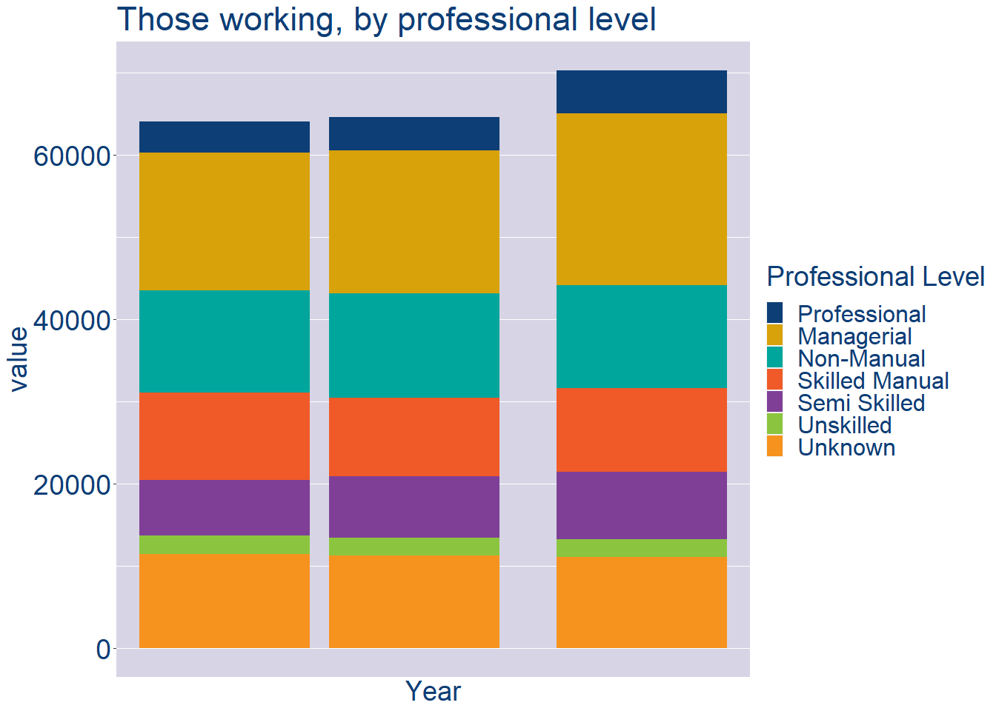
Theme 2: Roscommon County Workforce Demographics
Roscommon County Local Authority Workforce Experience Level
Year | 2022
Professional | 5229
Managerial | 20888
Non_Manual | 12512
Skilled_Manual | 10216
Semi_Skilled | 8234
Unskilled | 2127
All_Others | 11053

Slide 8
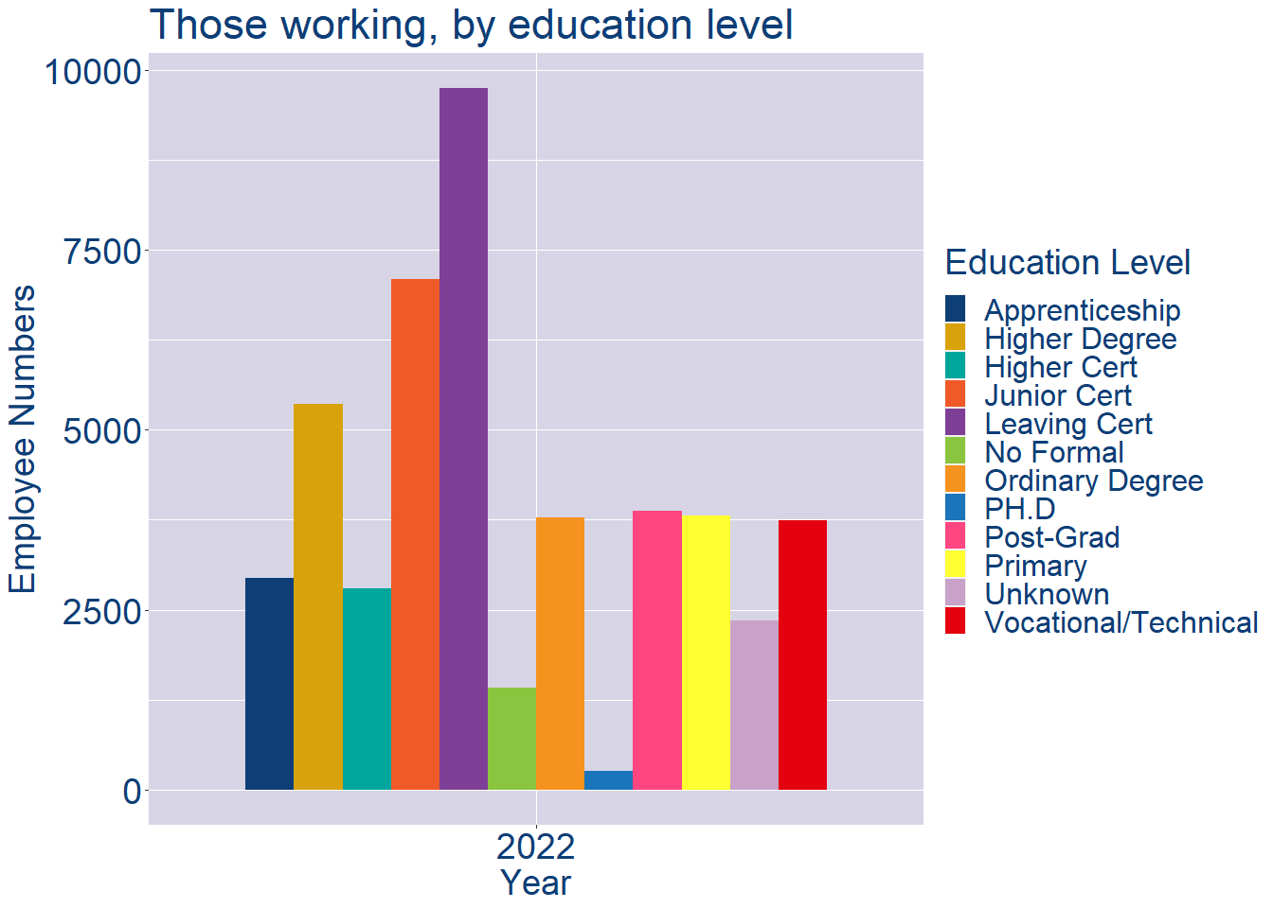
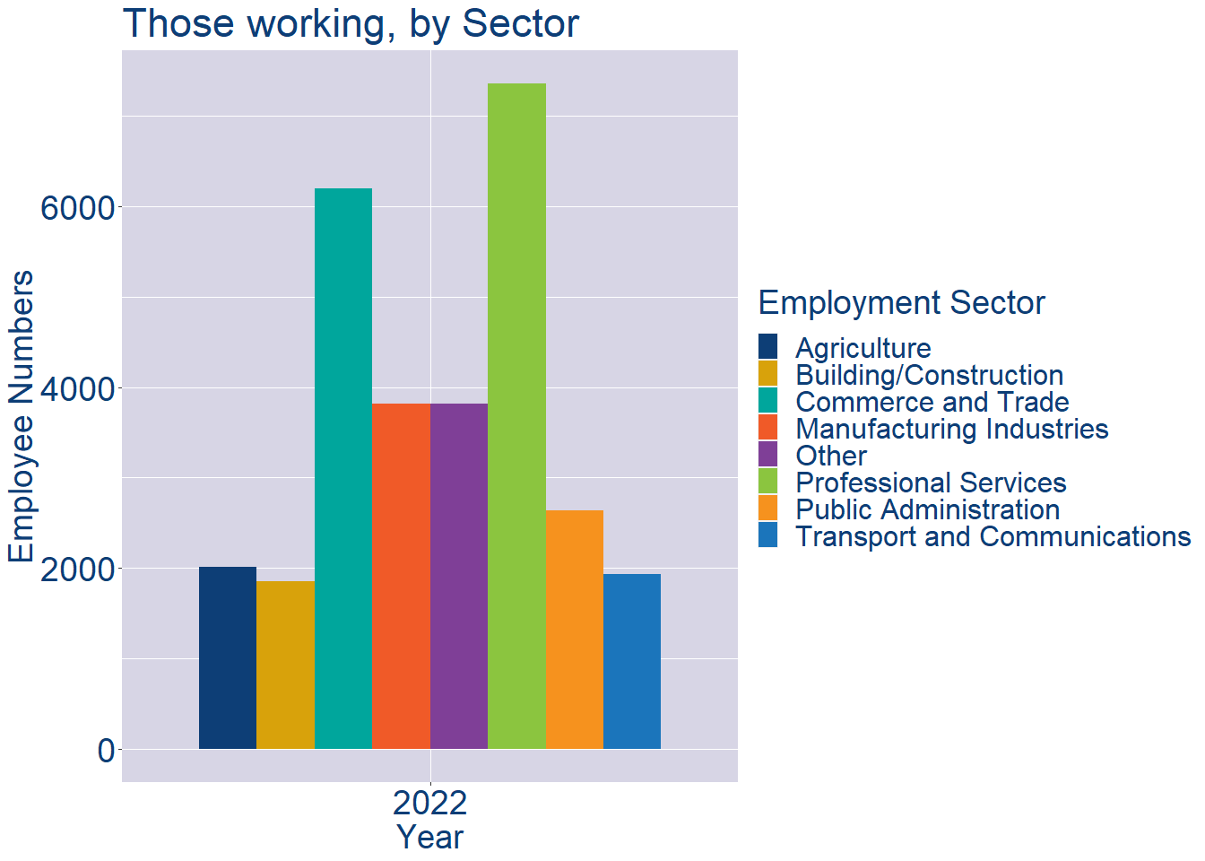
Theme 2: Roscommon County Workforce Demographics
Roscommon County Local Authority Workforce Education Level
Roscommon County Local Authority Workforce Sectors

Slide 9
Theme 3: Co. Roscommon Business Demographics
Audience: Internal to Chambers
Highlights: Local Business Community Information
Key messages:
Varies from Local Authority area to area
Local market intelligence to help you identify trends in your local area’s business community i.e.:
Sectoral activity increasing/decreasing
What sectors the self-employed are active in

Slide 10
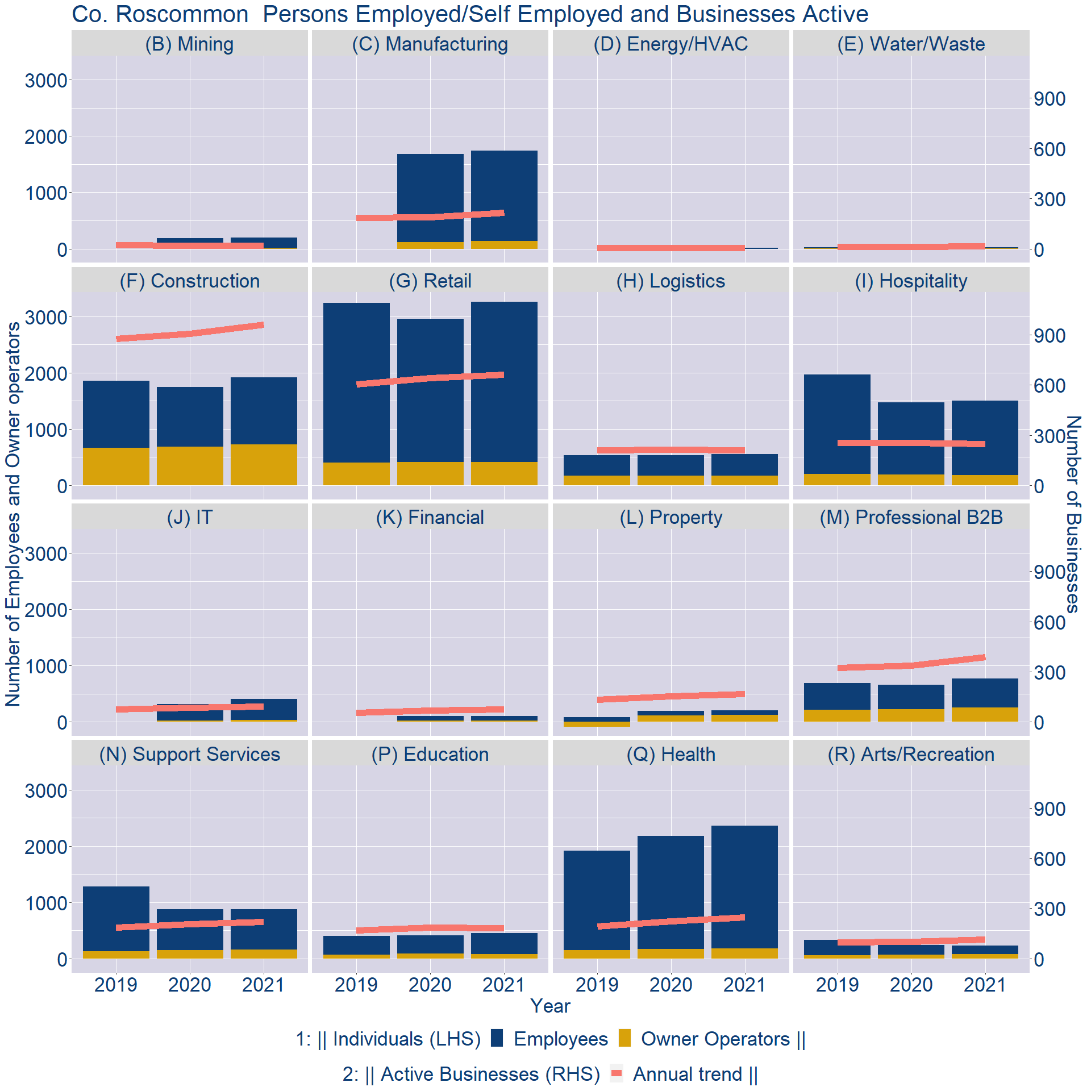
Theme 3: Co. Roscommon Business Demographics

Slide 11
Theme 3: Co. Roscommon Business Demographics
Sectors | Businesses | Owners | Employees
(B) Mining | 19 | 6 | 188
(C) Manufacturing | 224 | 133 | 1606
(D) Energy/HVAC | 5 | 0 | 11
(E) Water/Waste | 16 | 4 | 20
(F) Construction | 1001 | 724 | 1194
(G) Retail | 692 | 410 | 2852
(H) Logistics | 221 | 172 | 382
(I) Hospitality | 259 | 182 | 1317
(J) IT | 97 | 32 | 372
(K) Financial | 79 | 27 | 79
(L) Property | 176 | 122 | 83
(M) Professional B2B | 407 | 254 | 517
(N) Support Services | 231 | 159 | 718
(P) Education | 190 | 84 | 366
(Q) Health | 257 | 185 | 2174
(R) Arts/Recreation | 121 | 79 | 153
Employment in locally registered businesses, by Sector

Slide 12
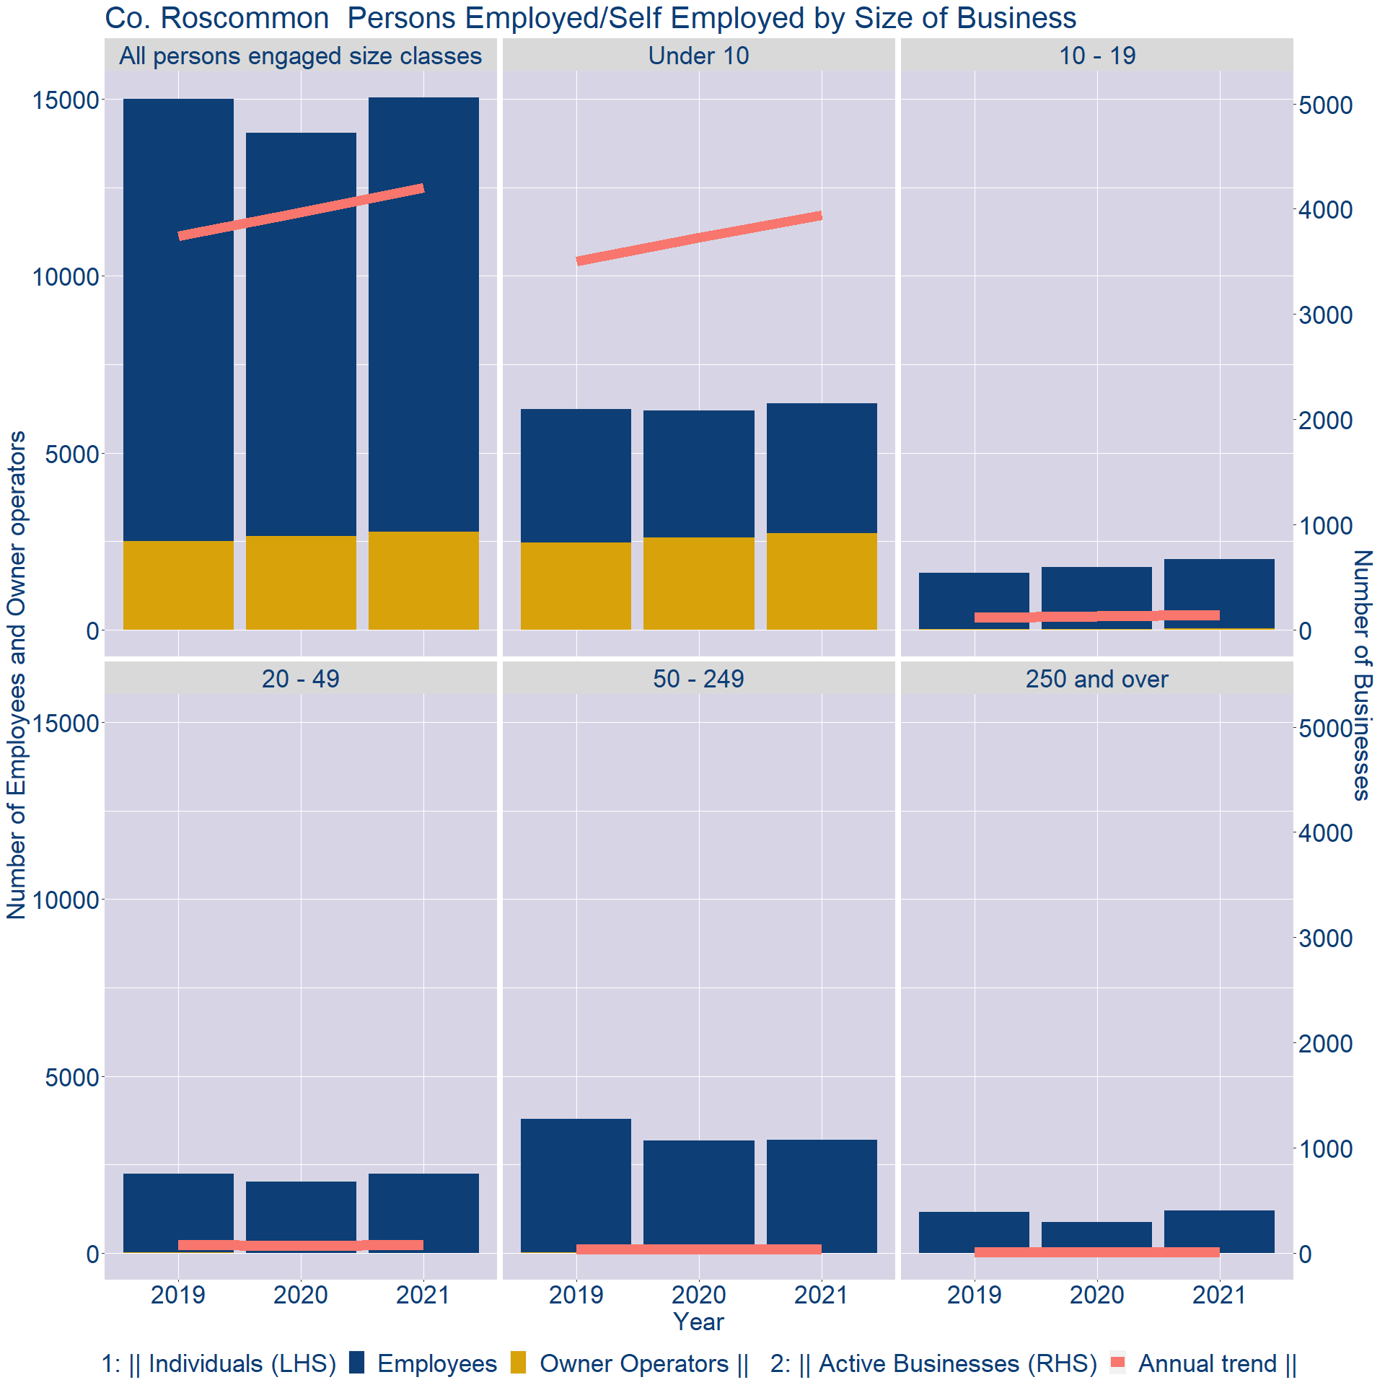
Theme 3: Co. Roscommon Business Demographics
Employment in locally registered businesses, by employer size - 2021

Slide 13
Theme 3: Co. Roscommon Business Demographics
Employment.Size | Businesses | Owners | Employees
All persons engaged size classes | 4203 | 2767 | 12279
Under 10 | 3940 | 2722 | 3681
10 - 19 | 146 | 38 | 1962
20 - 49 | 78 | 6 | 2242
50 - 249 | 35 | 1 | 3195
250 and over | 4 | 0 | 1199
Employment in locally registered businesses, by employer size - 2021

