Slide 1
Offaly County Business & Employment Demographics
Chambers Ireland

Slide 2
Theme 1: Offaly County Rates & LPT Income
Audience: Existing/Prospective Local Authority members
Highlights: Increasing reliance on Commercial Rates to support Local Authority Activities
Key messages:
Local Authority Budget Reform needed
Rates system putting pressure on labour intensive & vulnerable sectors
Hospitality
Retail
Manufacturing
Obligation on Local Authority to use these taxes effectively

Slide 3
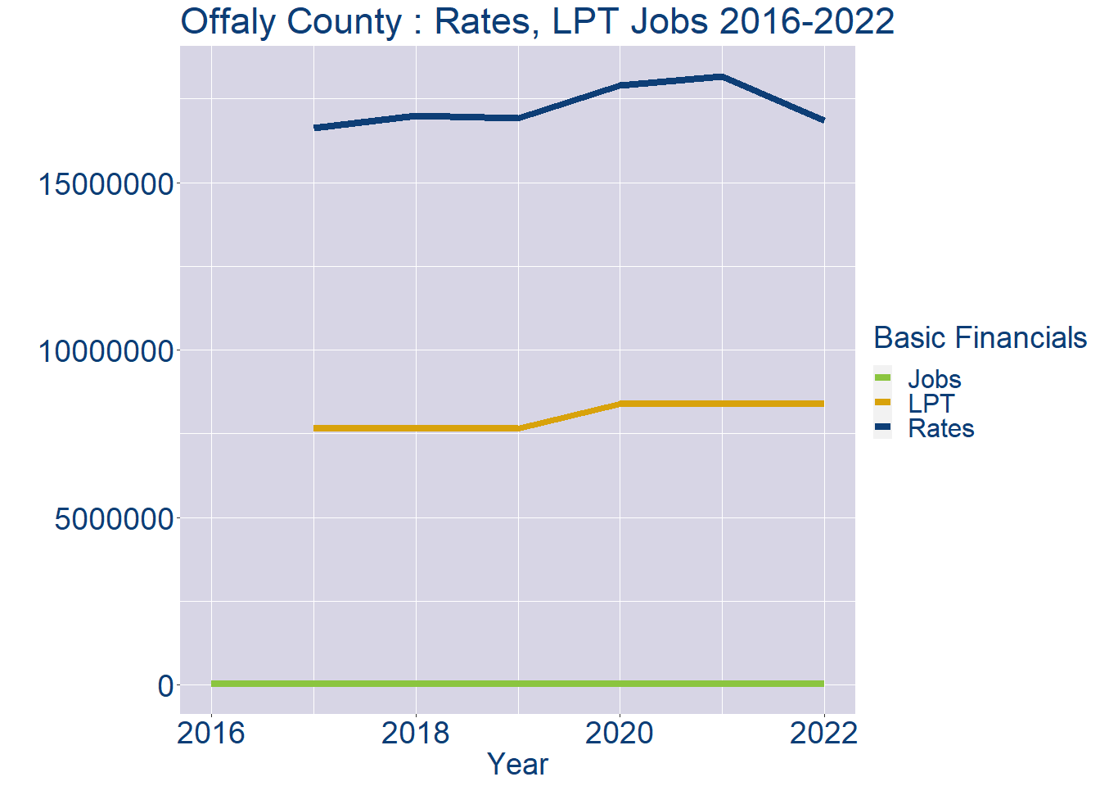
Theme 1: Offaly County Rates & LPT Income
Offaly County Local Authority Rates and LPT: 2016-2022
Year | Jobs | LPT | Rates
2016 | 30287 | NA | NA
2017 | 31114 | 7656288 | 16631937
2018 | 31941 | 7656288 | 16996876
2019 | 32768 | 7656288 | 16928121
2020 | 33595 | 8398668 | 17903391
2021 | 34422 | 8399174 | 18161728
2022 | 35248 | 8401722 | 16856641

Slide 4
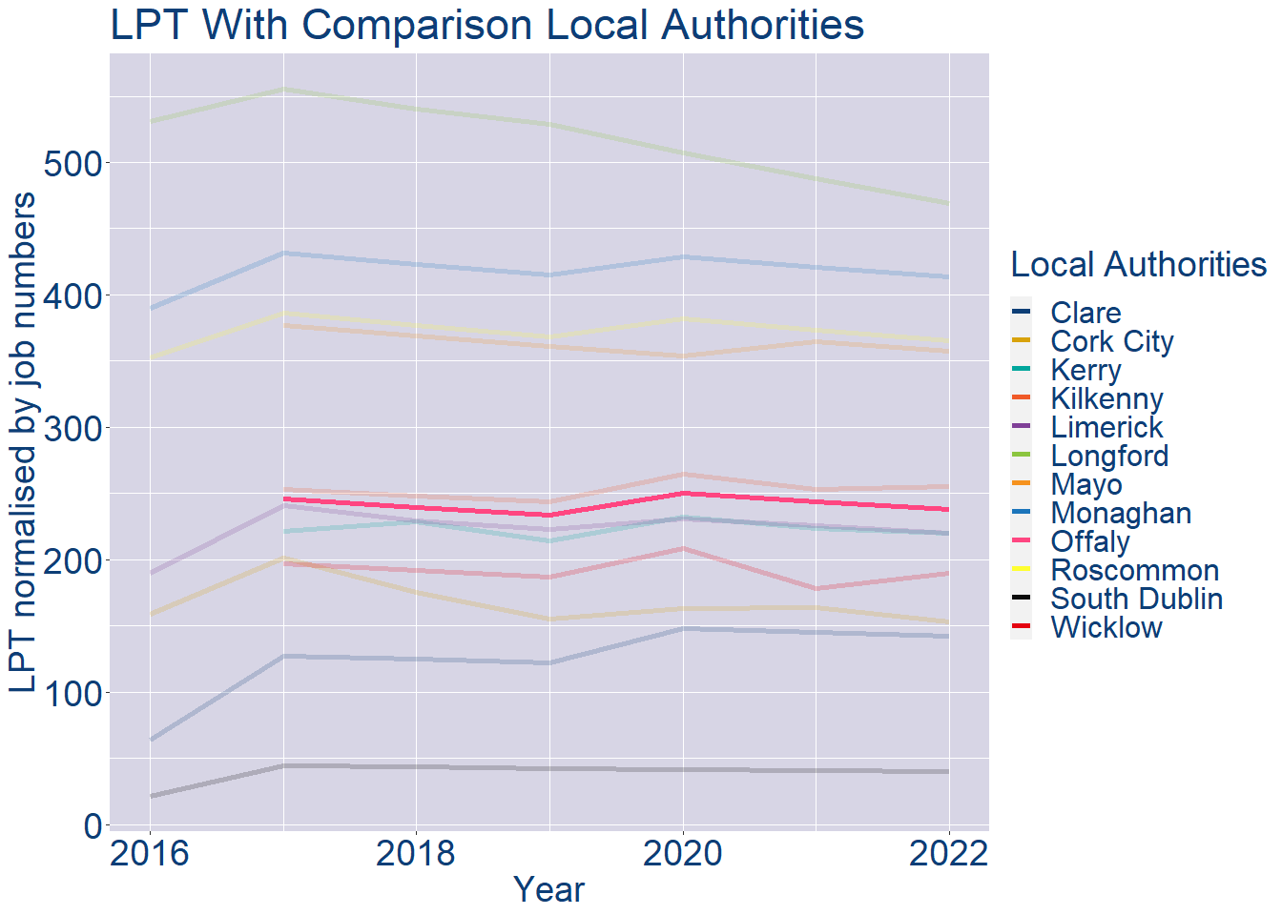
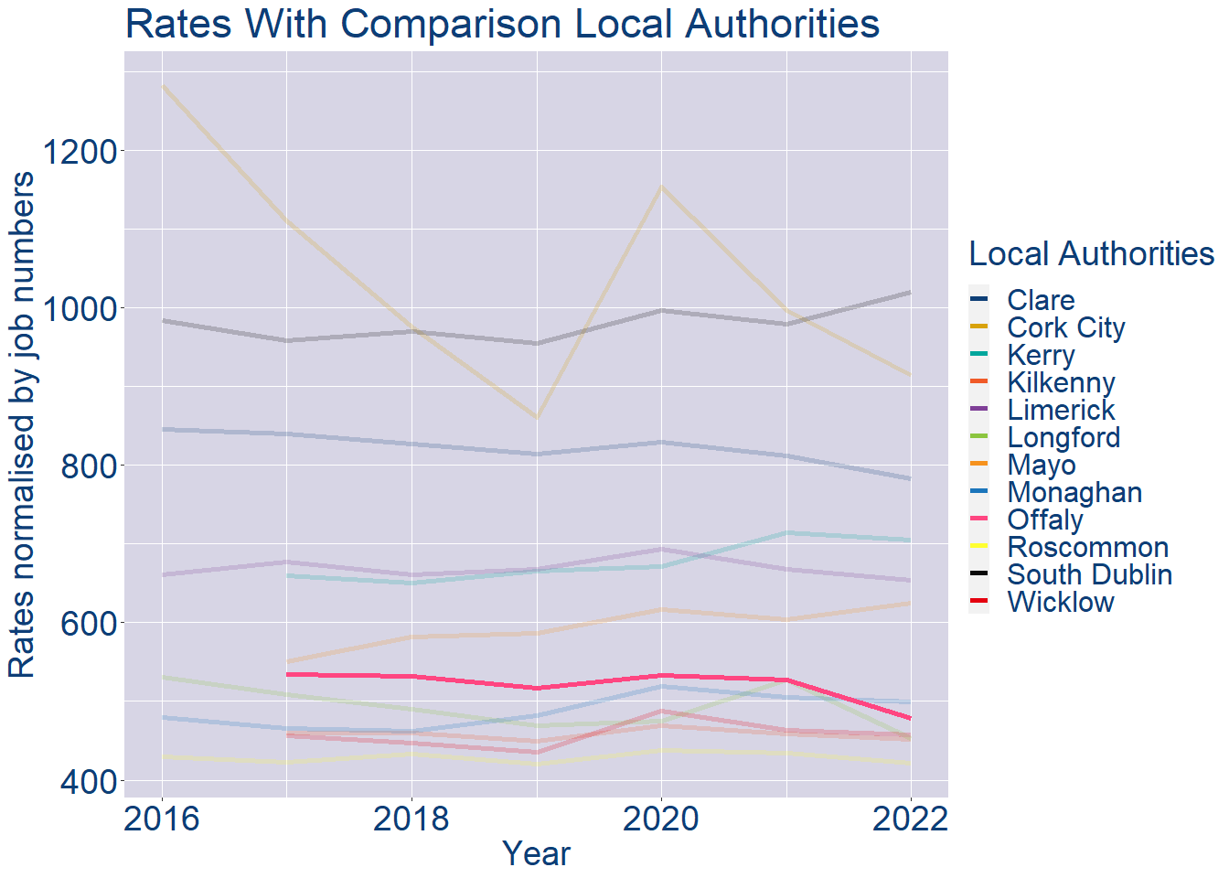
Theme 1: Offaly County Rates & LPT Income
Offaly County Local Authority 2022 LPT/employee €238
Offaly County Local Authority 2022 Rates/employee €478

Slide 5
Theme 2: Offaly County Workforce Demographics
Audience: Membership/Businesses that are interested in expanding into the local area
Highlights: Workforce details, who is available, education level, population growth
Key messages:
Varies from Local Authority area to area
Important for you to understand the numbers of people who are available to work in your area, their experience levels and the training they have

Slide 6
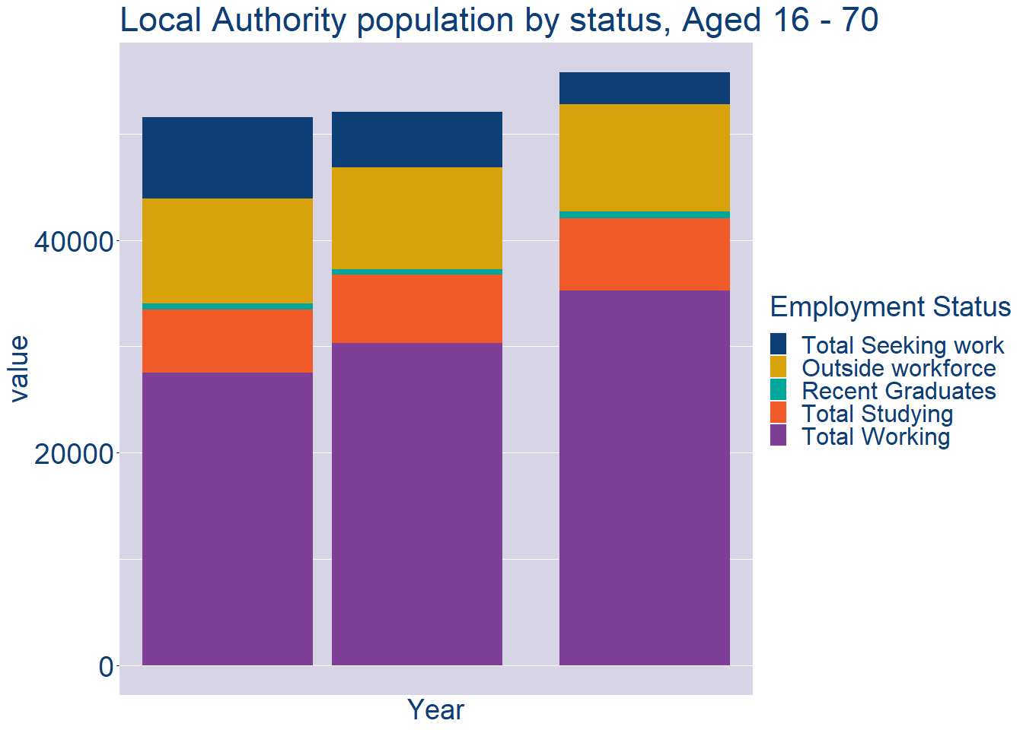
Theme 2: Offaly County Workforce Demographics
Offaly County Local Authority Workforce Population
Year | 2022
Total_working | 35248
Total_studying | 6809
Total_recent_grads | 644
Total_job_seeking | 3007
Total_not_seeking | 10078

Slide 7
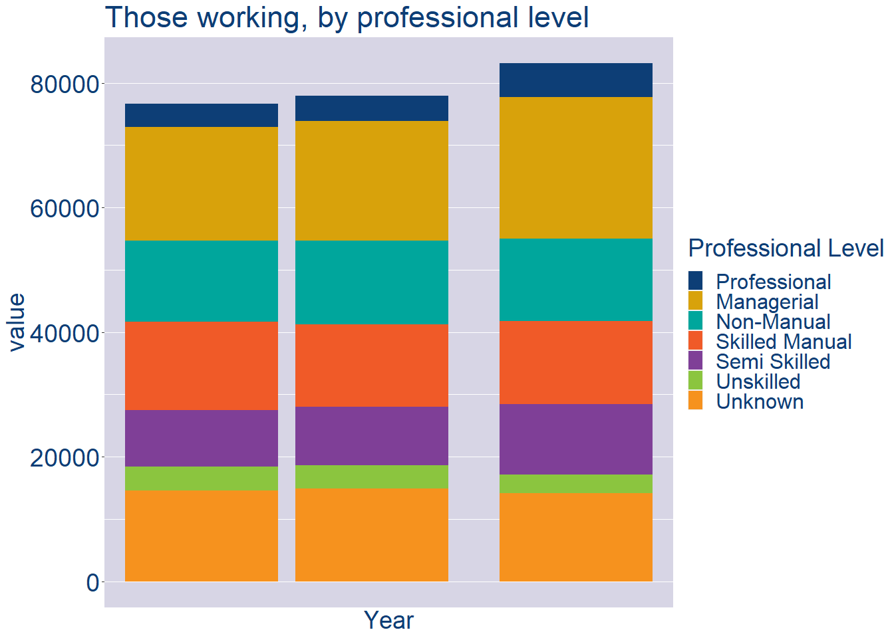
Theme 2: Offaly County Workforce Demographics
Offaly County Local Authority Workforce Experience Level
Year | 2022
Professional | 5435
Managerial | 22705
Non_Manual | 13191
Skilled_Manual | 13407
Semi_Skilled | 11242
Unskilled | 3081
All_Others | 14089

Slide 8
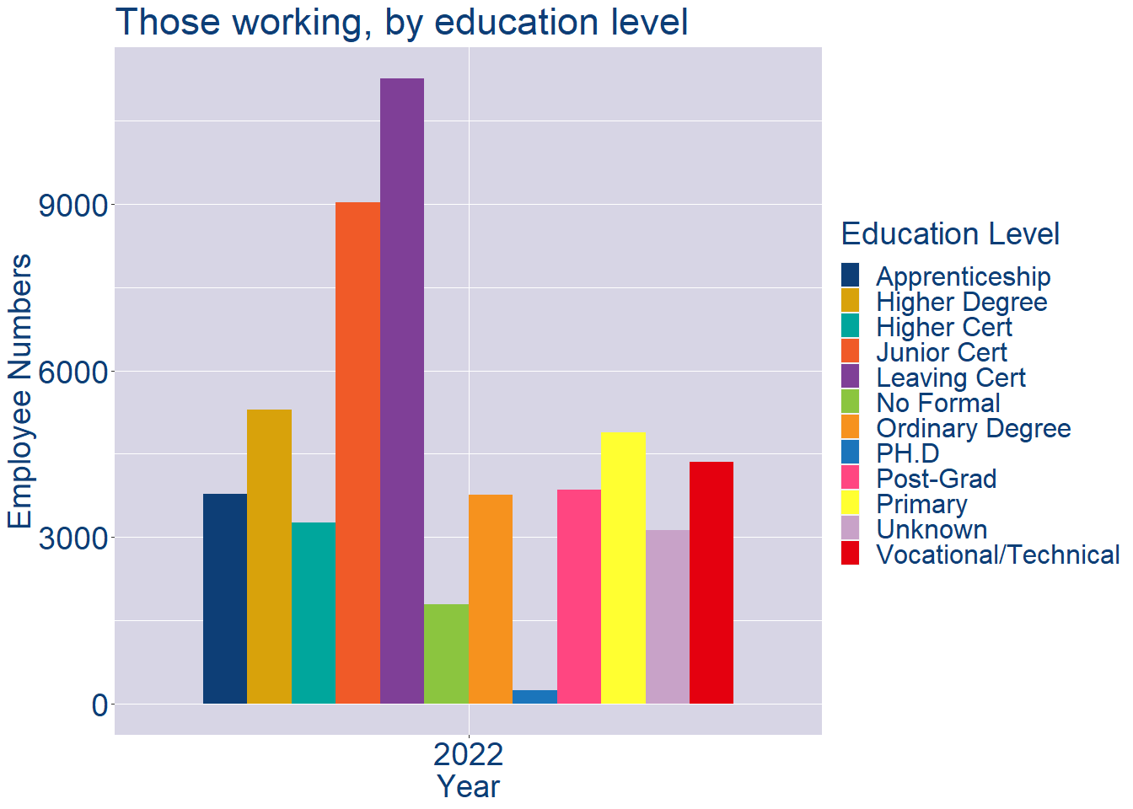
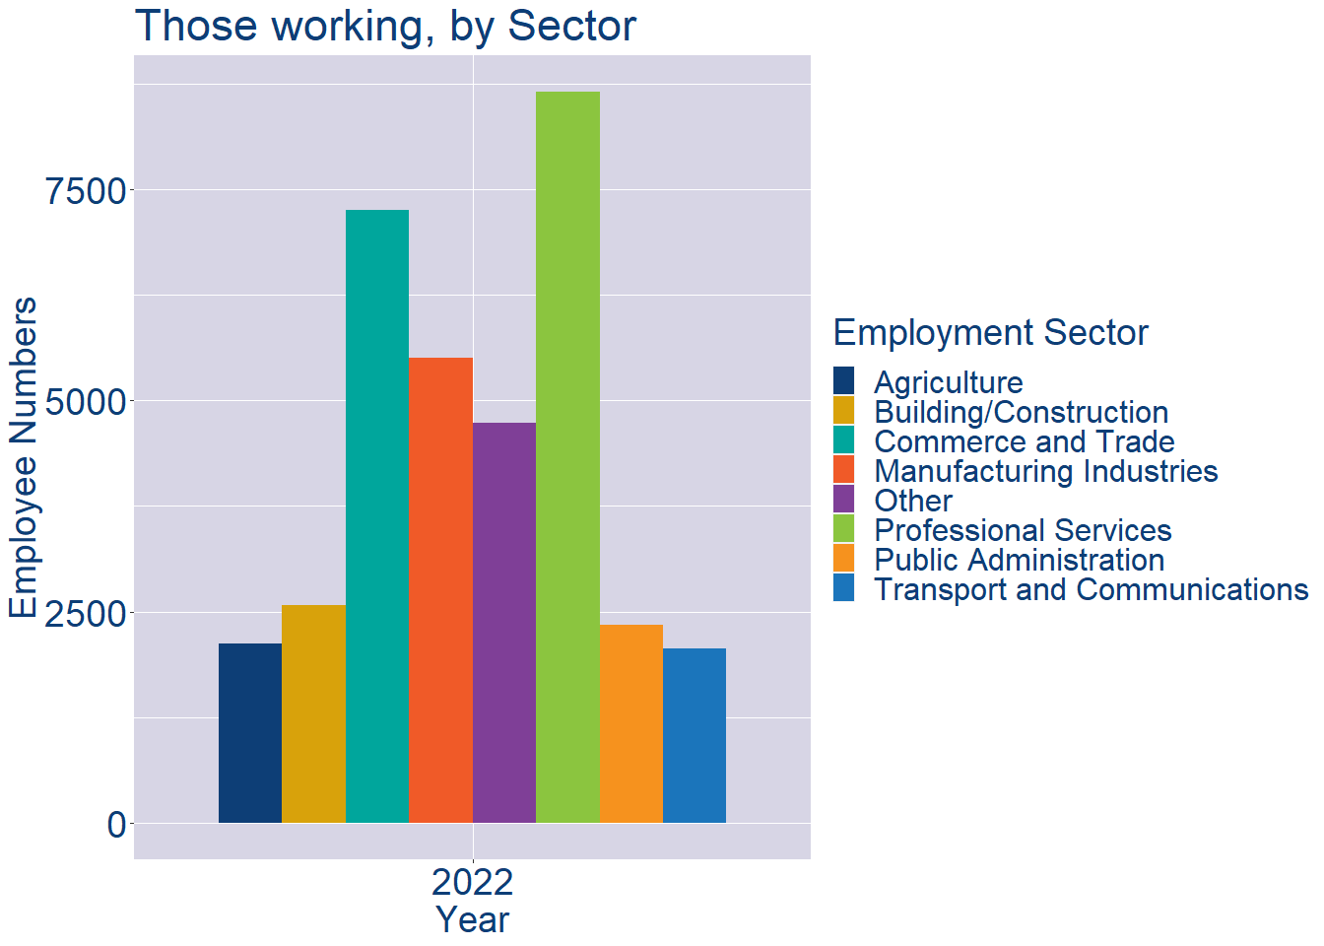
Theme 2: Offaly County Workforce Demographics
Offaly County Local Authority Workforce Education Level
Offaly County Local Authority Workforce Sectors

Slide 9
Theme 3: Co. Offaly Business Demographics
Audience: Internal to Chambers
Highlights: Local Business Community Information
Key messages:
Varies from Local Authority area to area
Local market intelligence to help you identify trends in your local area’s business community i.e.:
Sectoral activity increasing/decreasing
What sectors the self-employed are active in

Slide 10
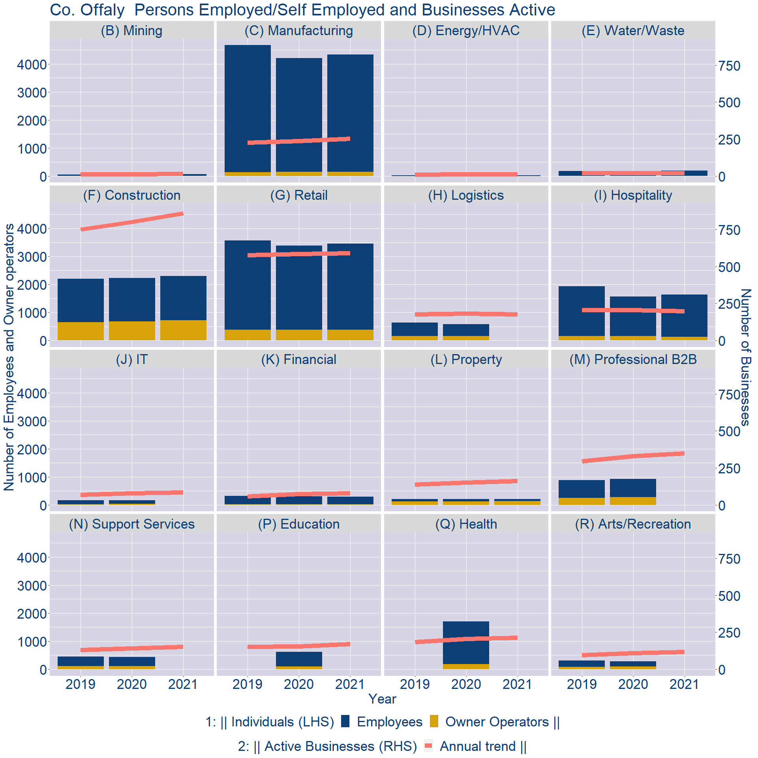
Theme 3: Co. Offaly Business Demographics

Slide 11
Theme 3: Co. Offaly Business Demographics
Sectors | Businesses | Owners | Employees
(B) Mining | 18 | 3 | 62
(C) Manufacturing | 313 | 155 | 4180
(D) Energy/HVAC | 14 | 2 | 24
(E) Water/Waste | 27 | 3 | 195
(F) Construction | 1065 | 718 | 1585
(G) Retail | 733 | 387 | 3066
(H) Logistics | 220 | 0 | 0
(I) Hospitality | 245 | 128 | 1511
(J) IT | 104 | 0 | 0
(K) Financial | 99 | 18 | 274
(L) Property | 200 | 137 | 74
(M) Professional B2B | 432 | 0 | 0
(N) Support Services | 190 | 0 | 0
(P) Education | 212 | 0 | 0
(Q) Health | 264 | 0 | 0
(R) Arts/Recreation | 144 | 0 | 0
Employment in locally registered businesses, by Sector

Slide 12
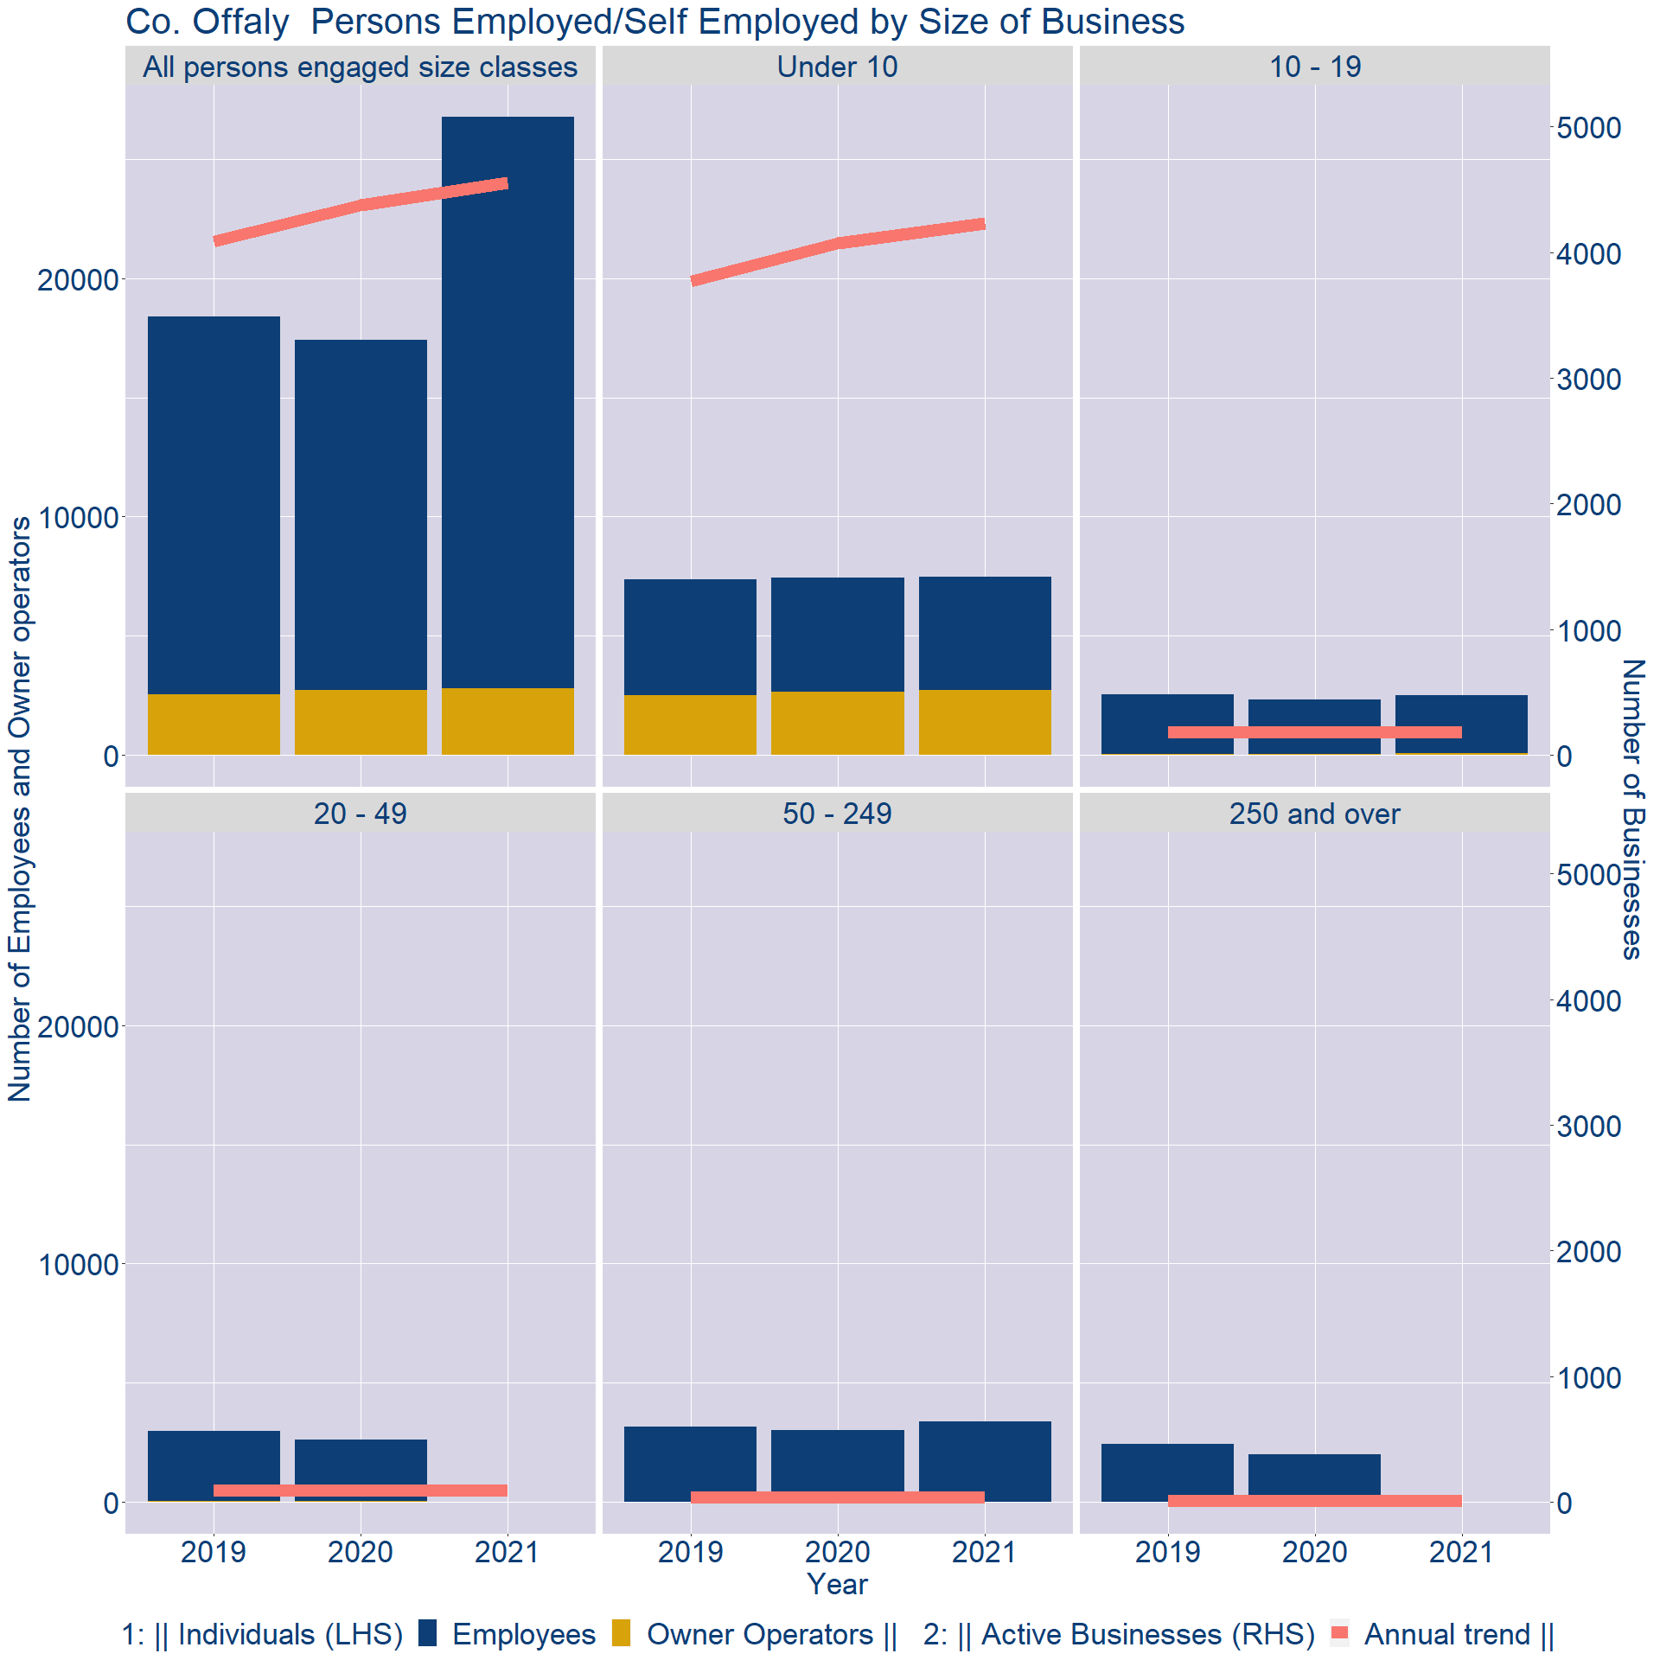
Theme 3: Co. Offaly Business Demographics
Employment in locally registered businesses, by employer size - 2021

Slide 13
Theme 3: Co. Offaly Business Demographics
Employment.Size | Businesses | Owners | Employees
All persons engaged size classes | 4551 | 2786 | 24009
Under 10 | 4232 | 2723 | 4764
10 - 19 | 186 | 55 | 2451
20 - 49 | 94 | 0 | 0
50 - 249 | 35 | 0 | 3369
250 and over | 4 | 0 | 0
Employment in locally registered businesses, by employer size - 2021

