Slide 1
Monaghan County Business & Employment Demographics
Chambers Ireland

Slide 2
Theme 1: Monaghan County Rates & LPT Income
Audience: Existing/Prospective Local Authority members
Highlights: Increasing reliance on Commercial Rates to support Local Authority Activities
Key messages:
Local Authority Budget Reform needed
Rates system putting pressure on labour intensive & vulnerable sectors
Hospitality
Retail
Manufacturing
Obligation on Local Authority to use these taxes effectively

Slide 3
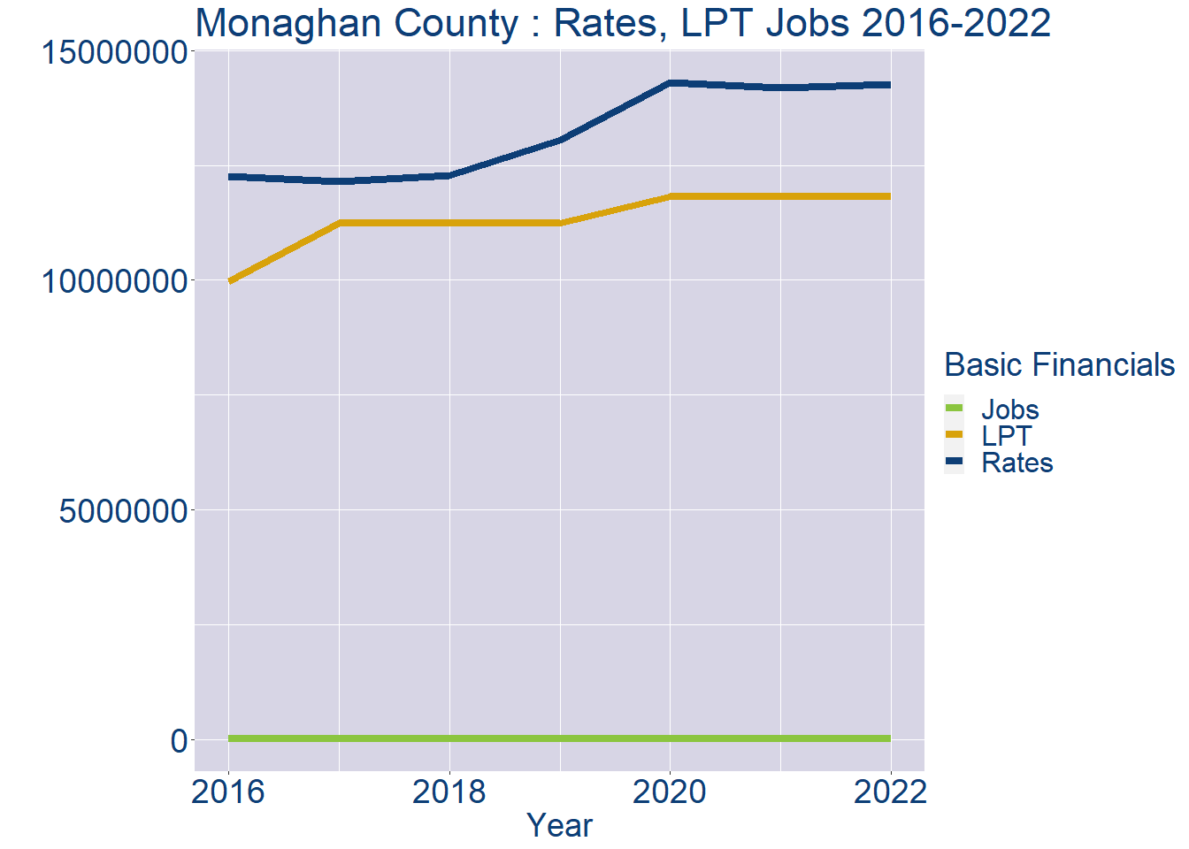
Theme 1: Monaghan County Rates & LPT Income
Monaghan County Local Authority Rates and LPT: 2016-2022
Year | Jobs | LPT | Rates
2016 | 25549 | 9969218 | 12252912
2017 | 26053 | 11238572 | 12143061
2018 | 26557 | 11238572 | 12281534
2019 | 27061 | 11238572 | 13047421
2020 | 27565 | 11813214 | 14295991
2021 | 28069 | 11817331 | 14184663
2022 | 28571 | 11819137 | 14252751

Slide 4
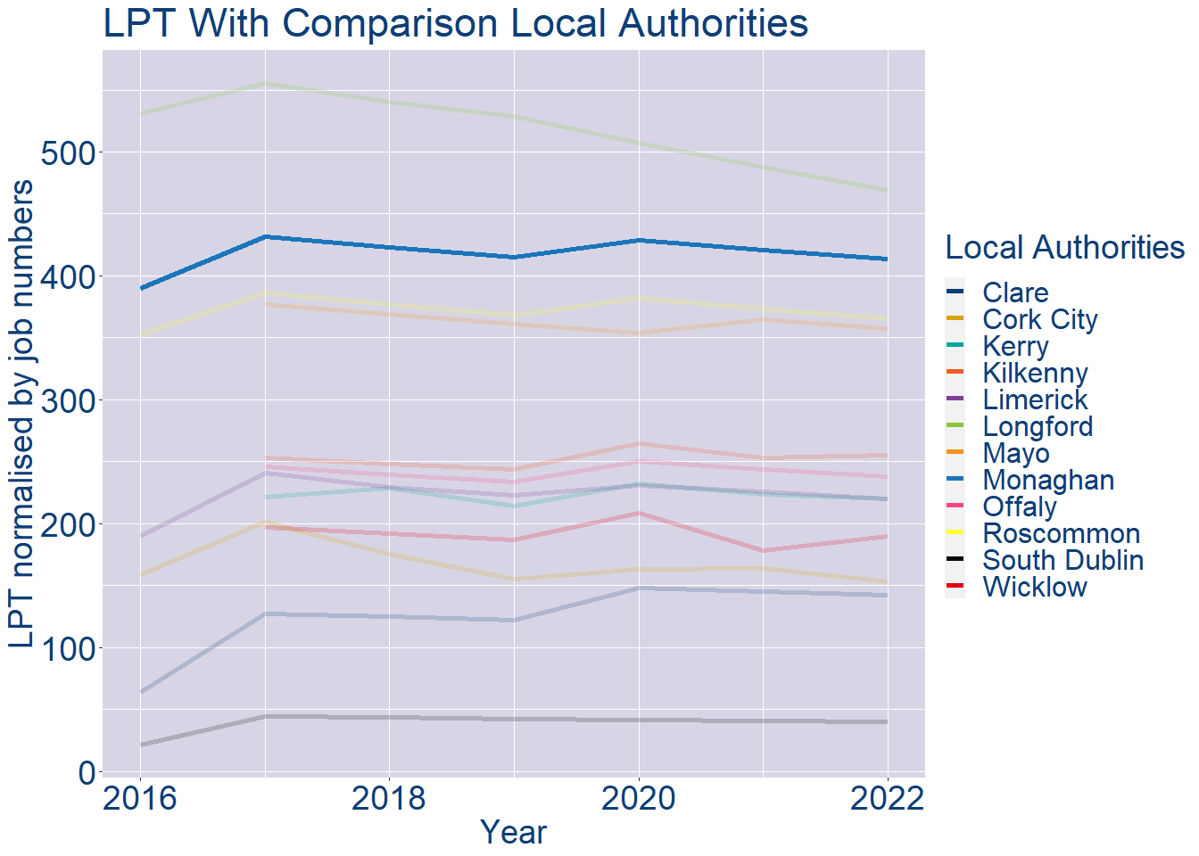
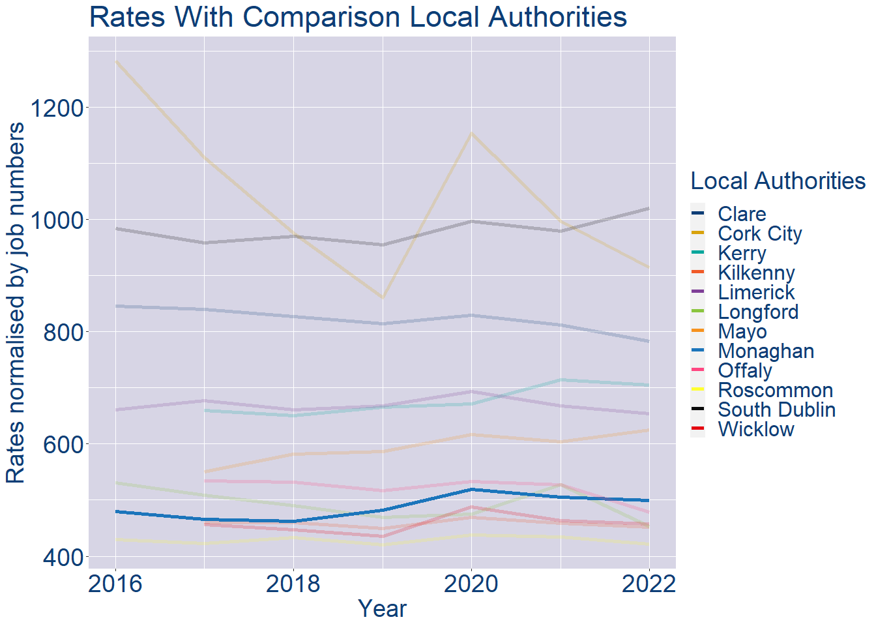
Theme 1: Monaghan County Rates & LPT Income
Monaghan County Local Authority 2022 LPT/employee €414
Monaghan County Local Authority 2022 Rates/employee €499

Slide 5
Theme 2: Monaghan County Workforce Demographics
Audience: Membership/Businesses that are interested in expanding into the local area
Highlights: Workforce details, who is available, education level, population growth
Key messages:
Varies from Local Authority area to area
Important for you to understand the numbers of people who are available to work in your area, their experience levels and the training they have

Slide 6
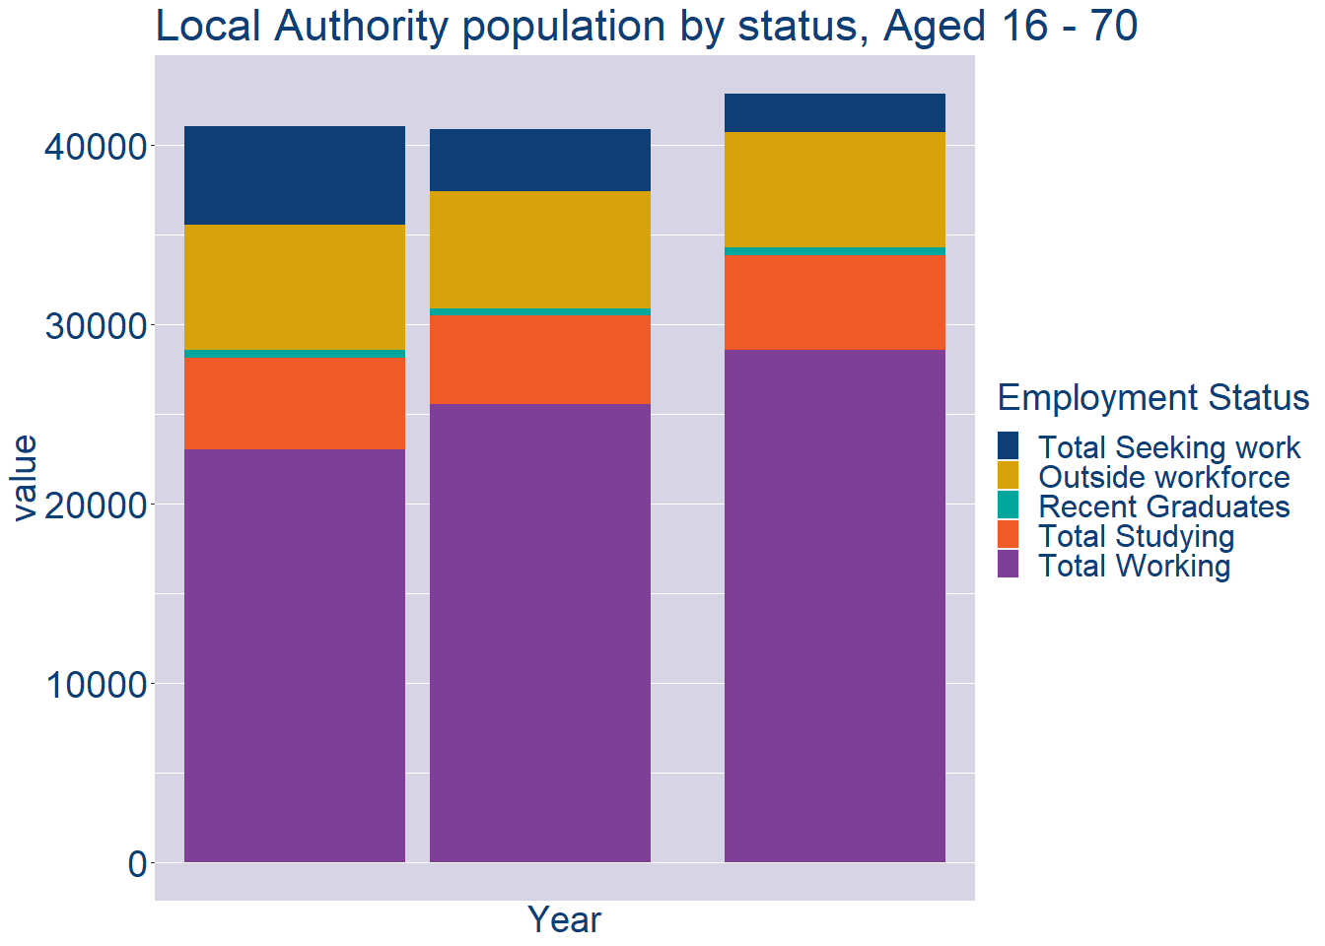
Theme 2: Monaghan County Workforce Demographics
Monaghan County Local Authority Workforce Population
Year | 2022
Total_working | 28571
Total_studying | 5274
Total_recent_grads | 419
Total_job_seeking | 2117
Total_not_seeking | 6444

Slide 7
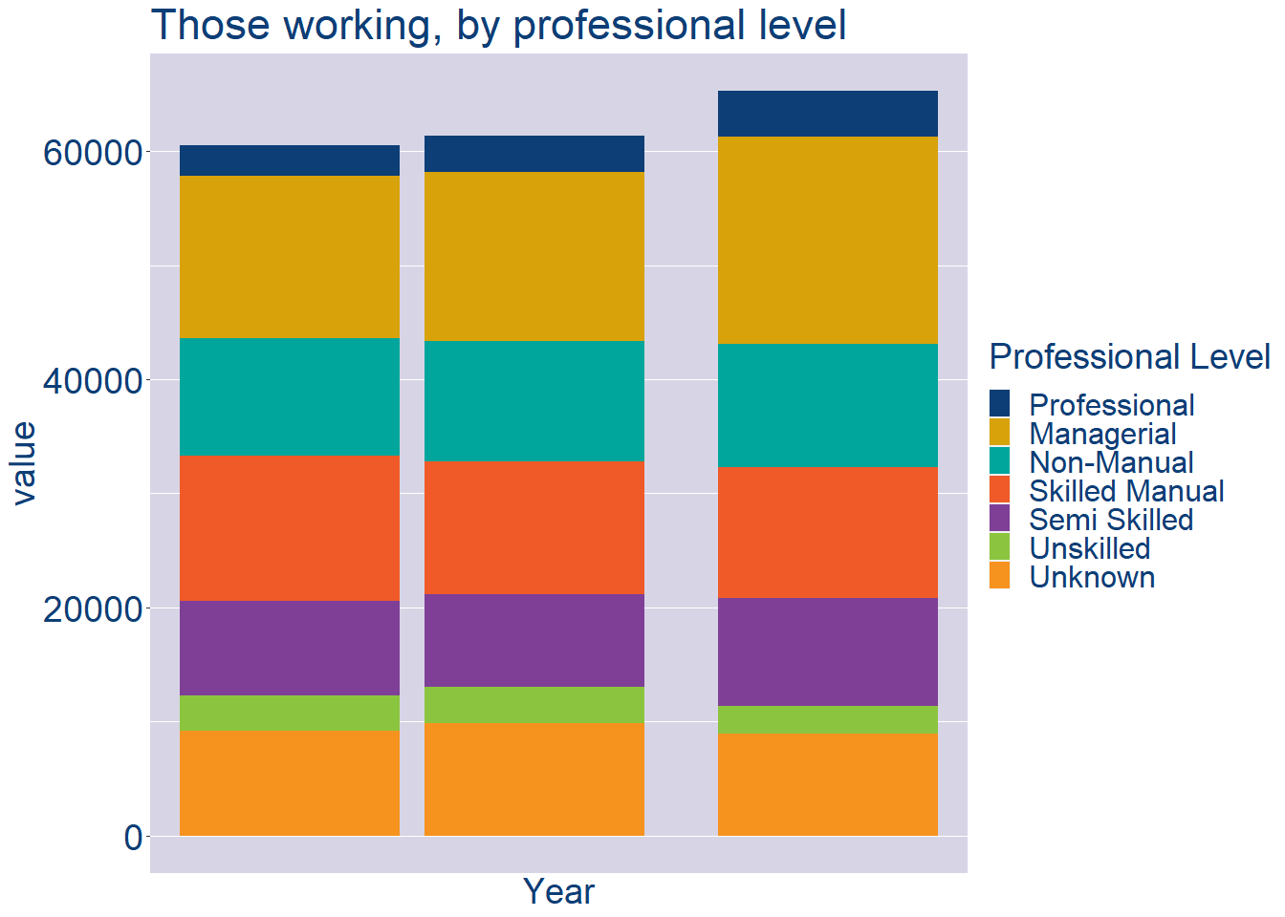
Theme 2: Monaghan County Workforce Demographics
Monaghan County Local Authority Workforce Experience Level
Year | 2022
Professional | 4020
Managerial | 18206
Non_Manual | 10796
Skilled_Manual | 11440
Semi_Skilled | 9484
Unskilled | 2383
All_Others | 8959

Slide 8
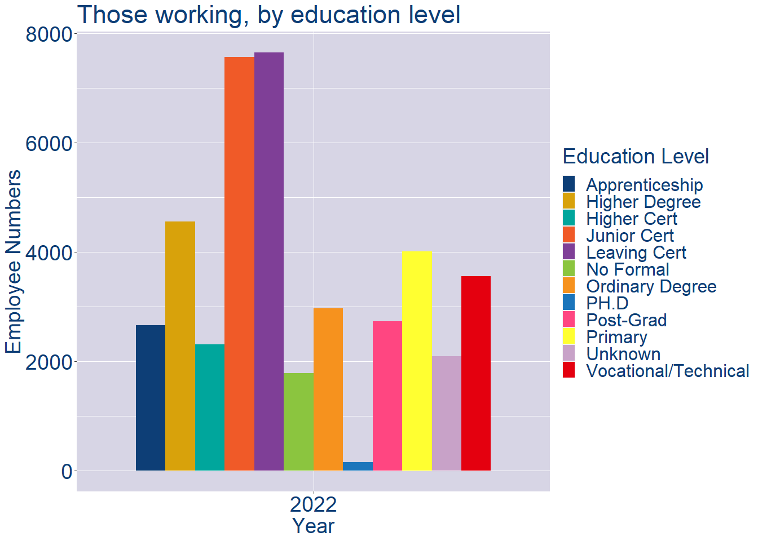
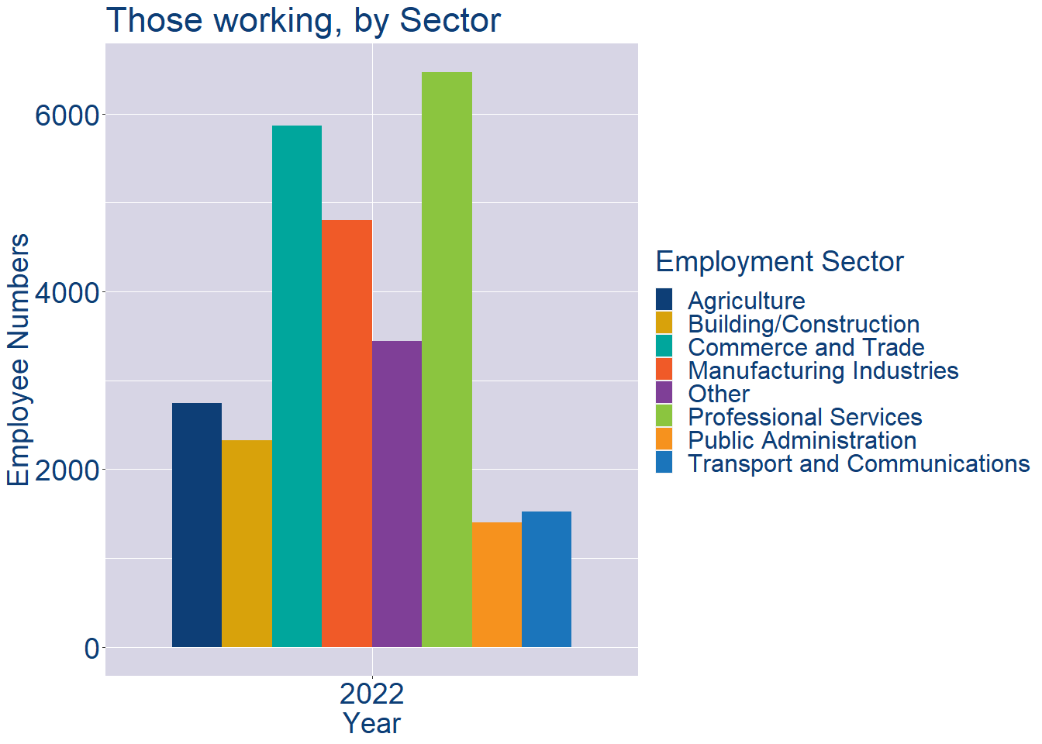
Theme 2: Monaghan County Workforce Demographics
Monaghan County Local Authority Workforce Education Level
Monaghan County Local Authority Workforce Sectors

Slide 9
Theme 3: Co. Monaghan Business Demographics
Audience: Internal to Chambers
Highlights: Local Business Community Information
Key messages:
Varies from Local Authority area to area
Local market intelligence to help you identify trends in your local area’s business community i.e.:
Sectoral activity increasing/decreasing
What sectors the self-employed are active in

Slide 10
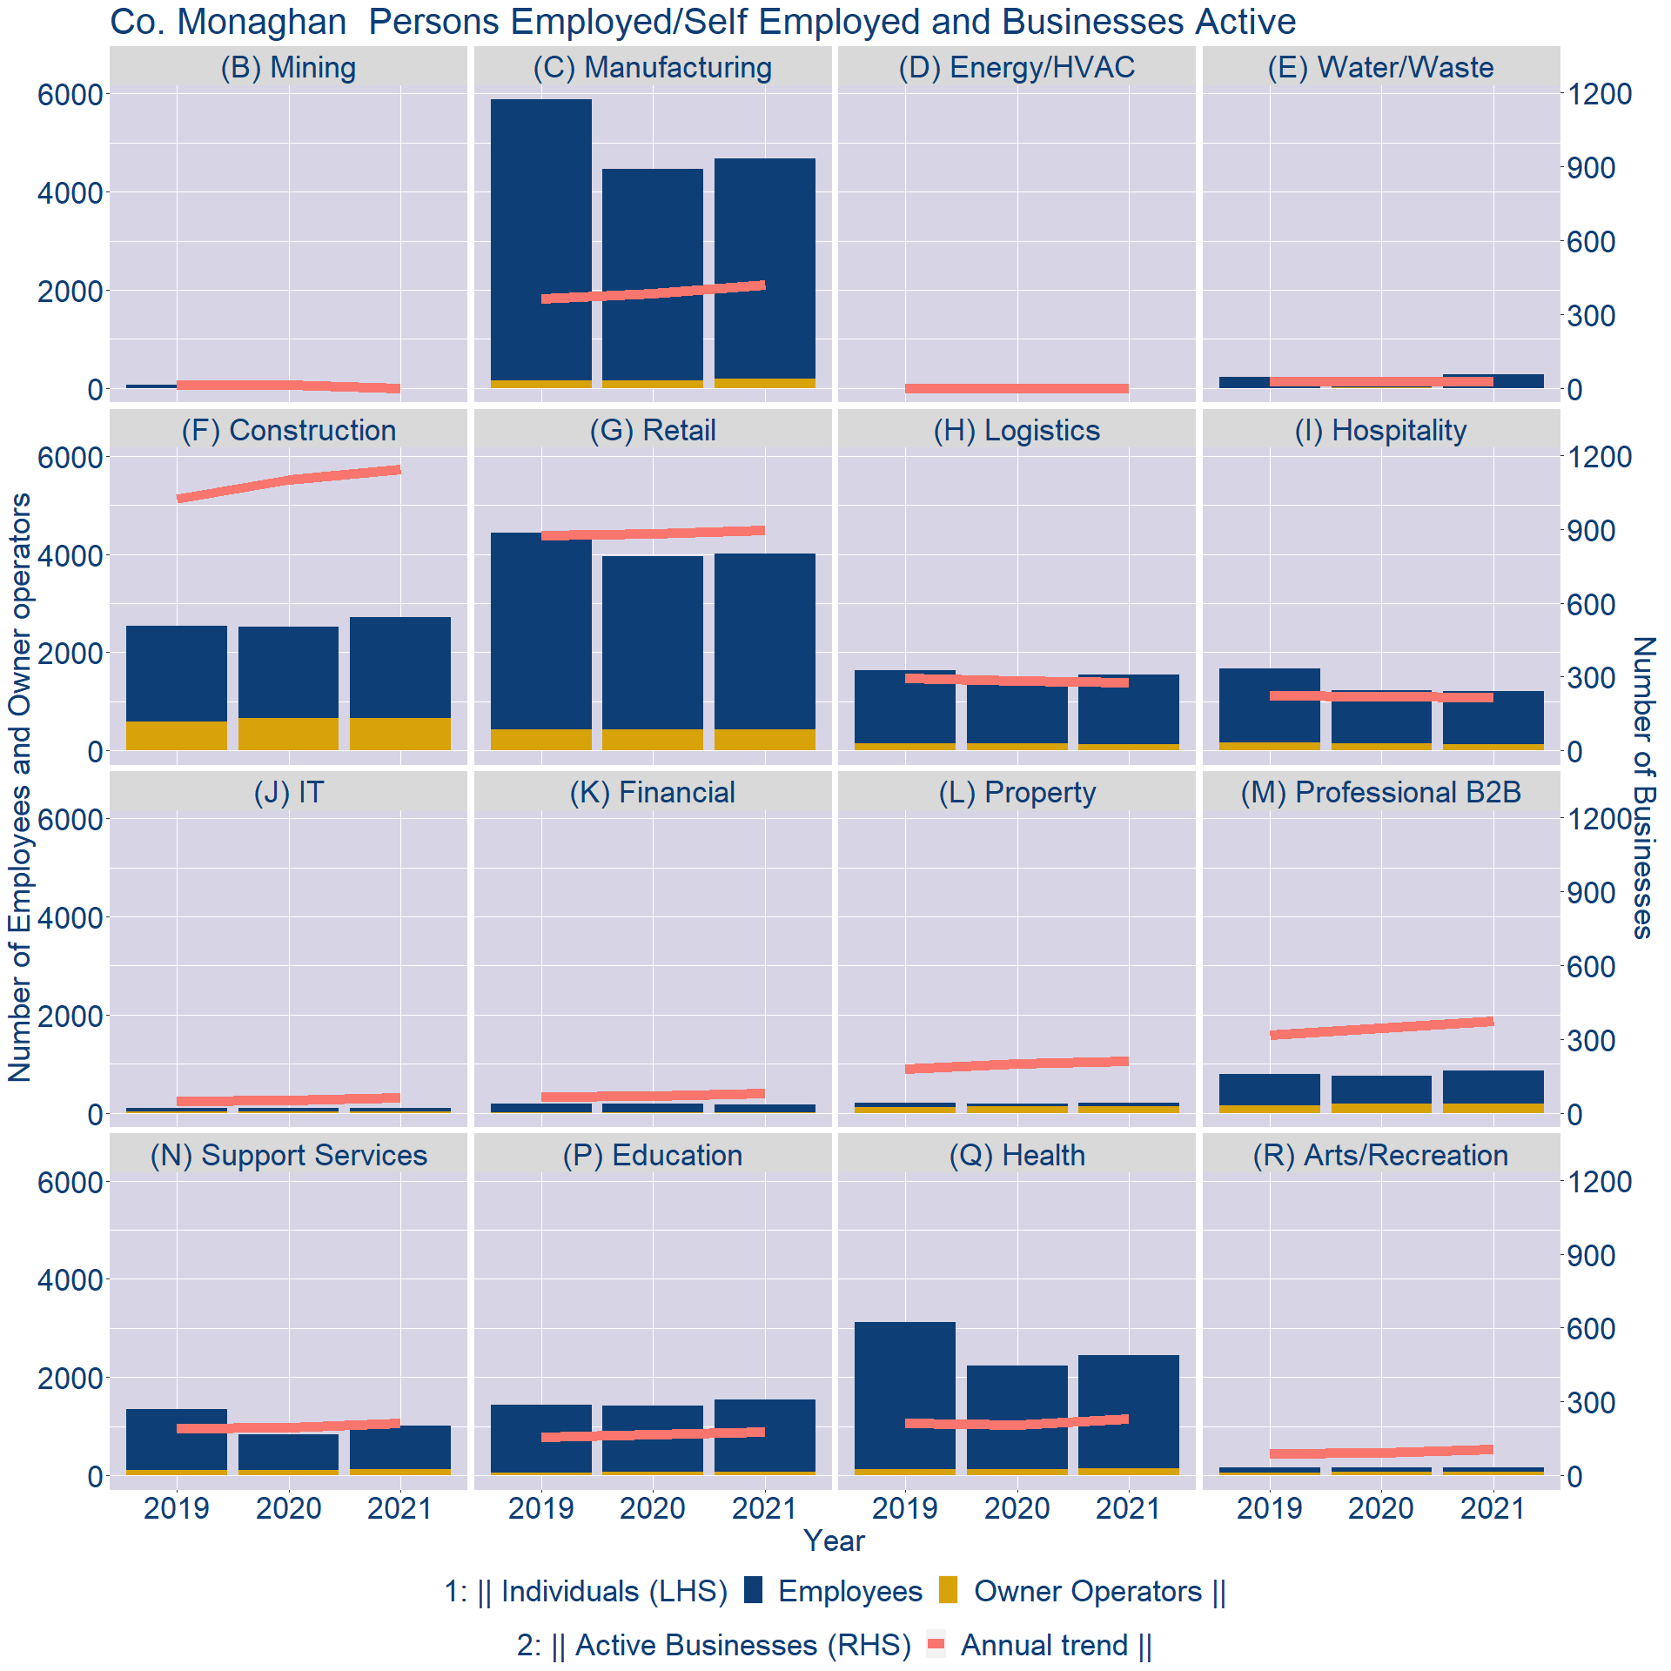
Theme 3: Co. Monaghan Business Demographics

Slide 11
Theme 3: Co. Monaghan Business Demographics
Sectors | Businesses | Owners | Employees
(B) Mining | 0 | 0 | 0
(C) Manufacturing | 387 | 188 | 4493
(D) Energy/HVAC | 0 | 0 | 0
(E) Water/Waste | 24 | 2 | 272
(F) Construction | 1056 | 663 | 2047
(G) Retail | 829 | 423 | 3584
(H) Logistics | 257 | 132 | 1412
(I) Hospitality | 200 | 124 | 1085
(J) IT | 57 | 25 | 74
(K) Financial | 73 | 14 | 161
(L) Property | 194 | 131 | 66
(M) Professional B2B | 345 | 192 | 660
(N) Support Services | 196 | 117 | 891
(P) Education | 165 | 75 | 1473
(Q) Health | 211 | 133 | 2309
(R) Arts/Recreation | 97 | 68 | 92
Employment in locally registered businesses, by Sector

Slide 12
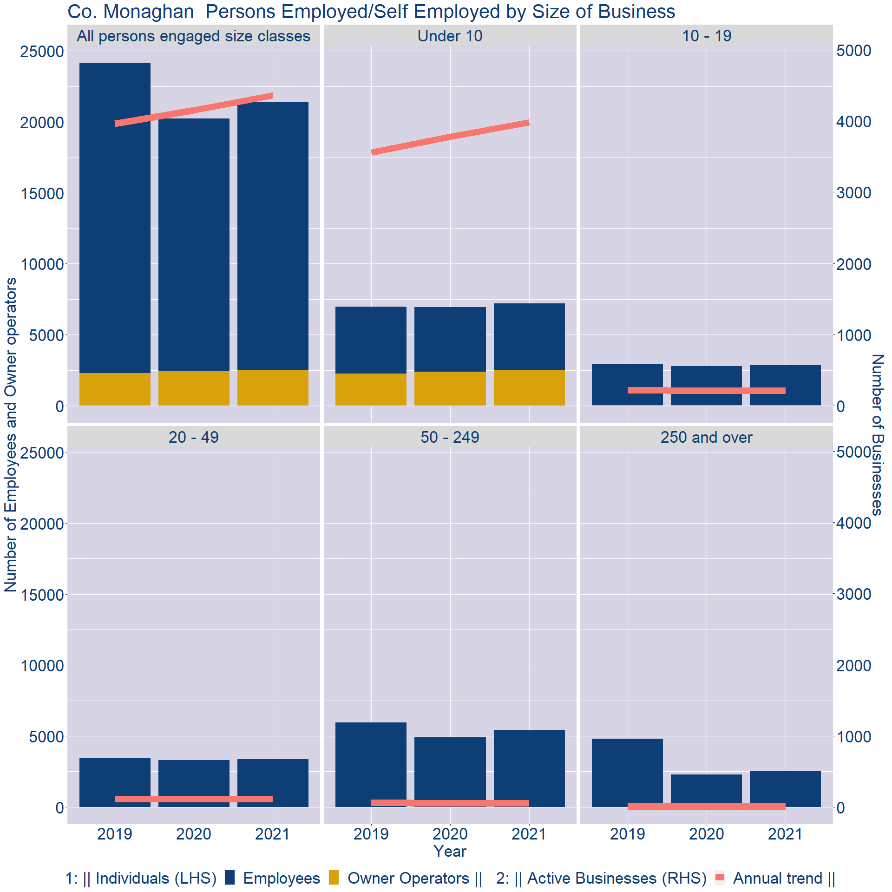
Theme 3: Co. Monaghan Business Demographics
Employment in locally registered businesses, by employer size - 2021

Slide 13
Theme 3: Co. Monaghan Business Demographics
Employment.Size | Businesses | Owners | Employees
All persons engaged size classes | 4361 | 2521 | 18892
Under 10 | 3979 | 2475 | 4733
10 - 19 | 211 | 42 | 2799
20 - 49 | 112 | 2 | 3378
50 - 249 | 56 | 2 | 5432
250 and over | 3 | 0 | 2550
Employment in locally registered businesses, by employer size - 2021

