Slide 1
Meath County Business & Employment Demographics
Chambers Ireland

Slide 2
Theme 1: Meath County Rates & LPT Income
Audience: Existing/Prospective Local Authority members
Highlights: Increasing reliance on Commercial Rates to support Local Authority Activities
Key messages:
Local Authority Budget Reform needed
Rates system putting pressure on labour intensive & vulnerable sectors
Hospitality
Retail
Manufacturing
Obligation on Local Authority to use these taxes effectively

Slide 3
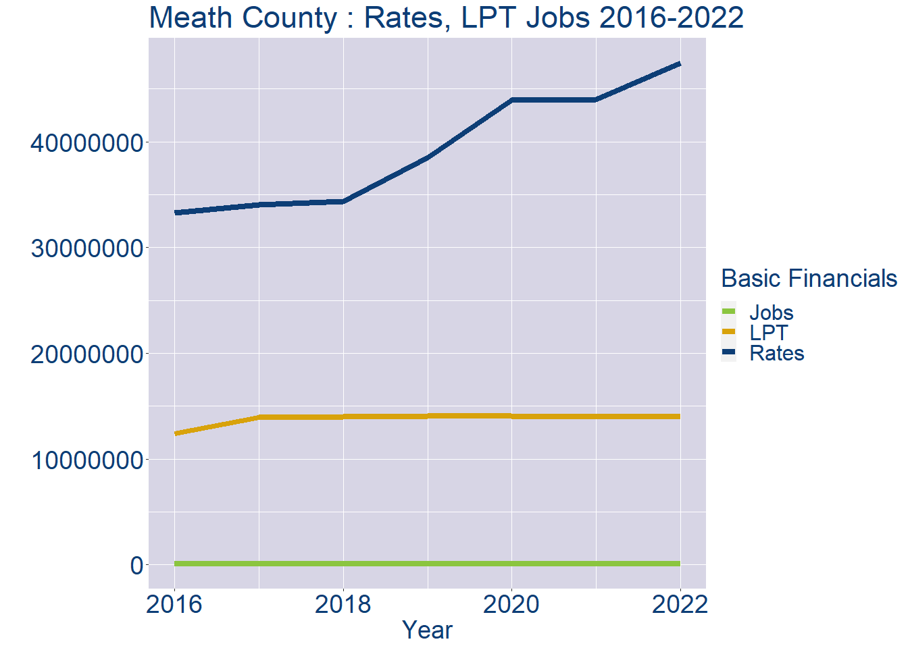
Theme 1: Meath County Rates & LPT Income
Meath County Local Authority Rates and LPT: 2016-2022
Year | Jobs | LPT | Rates
2016 | 83259 | 12390795 | 33271020
2017 | 86247 | 13954242 | 34014459
2018 | 89235 | 13991814 | 34340888
2019 | 92223 | 14037467 | 38497235
2020 | 95211 | 14054136 | 43938613
2021 | 98199 | 14022808 | 43988837
2022 | 101189 | 14059169 | 47442807

Slide 4
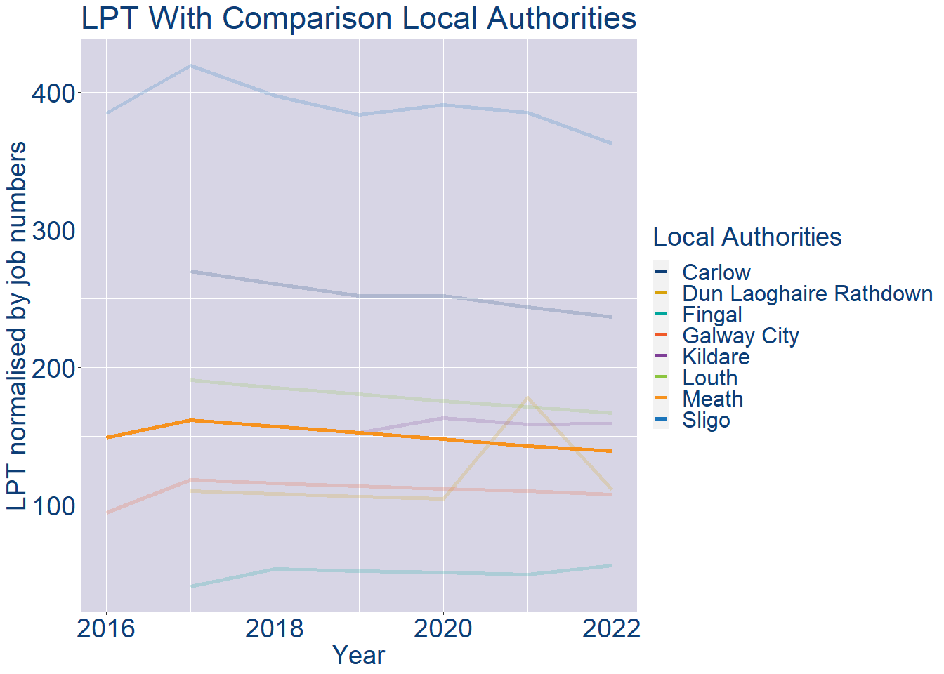
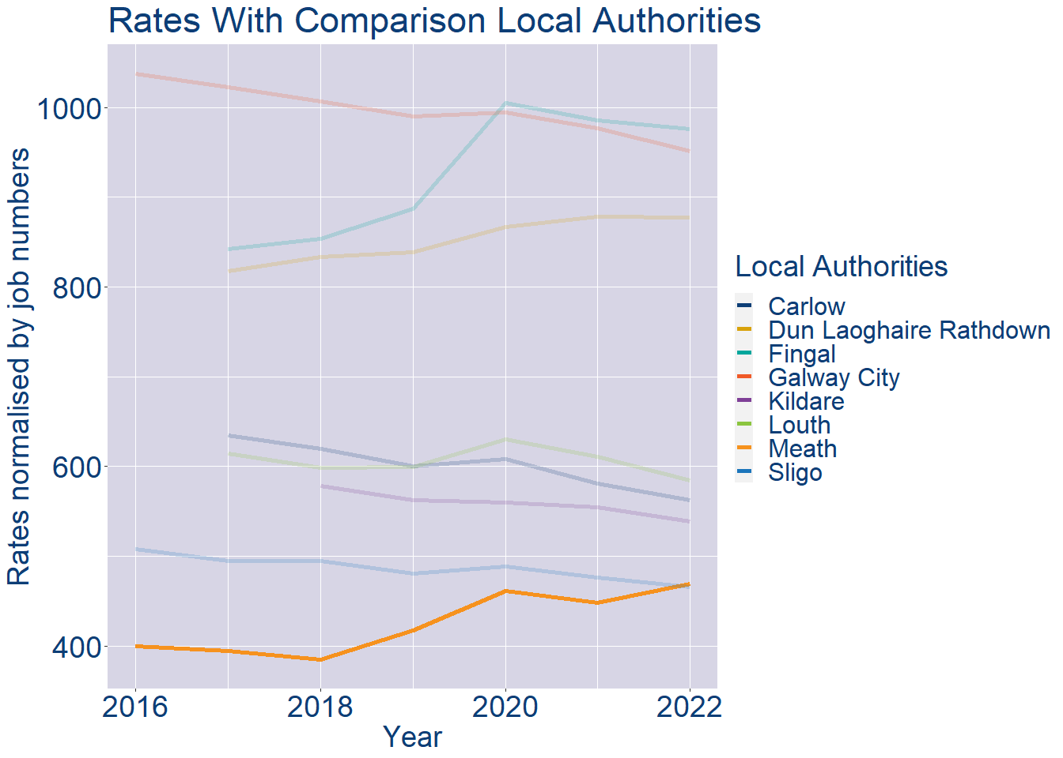
Theme 1: Meath County Rates & LPT Income
Meath County Local Authority 2022 LPT/employee €139
Meath County Local Authority 2022 Rates/employee €469

Slide 5
Theme 2: Meath County Workforce Demographics
Audience: Membership/Businesses that are interested in expanding into the local area
Highlights: Workforce details, who is available, education level, population growth
Key messages:
Varies from Local Authority area to area
Important for you to understand the numbers of people who are available to work in your area, their experience levels and the training they have

Slide 6
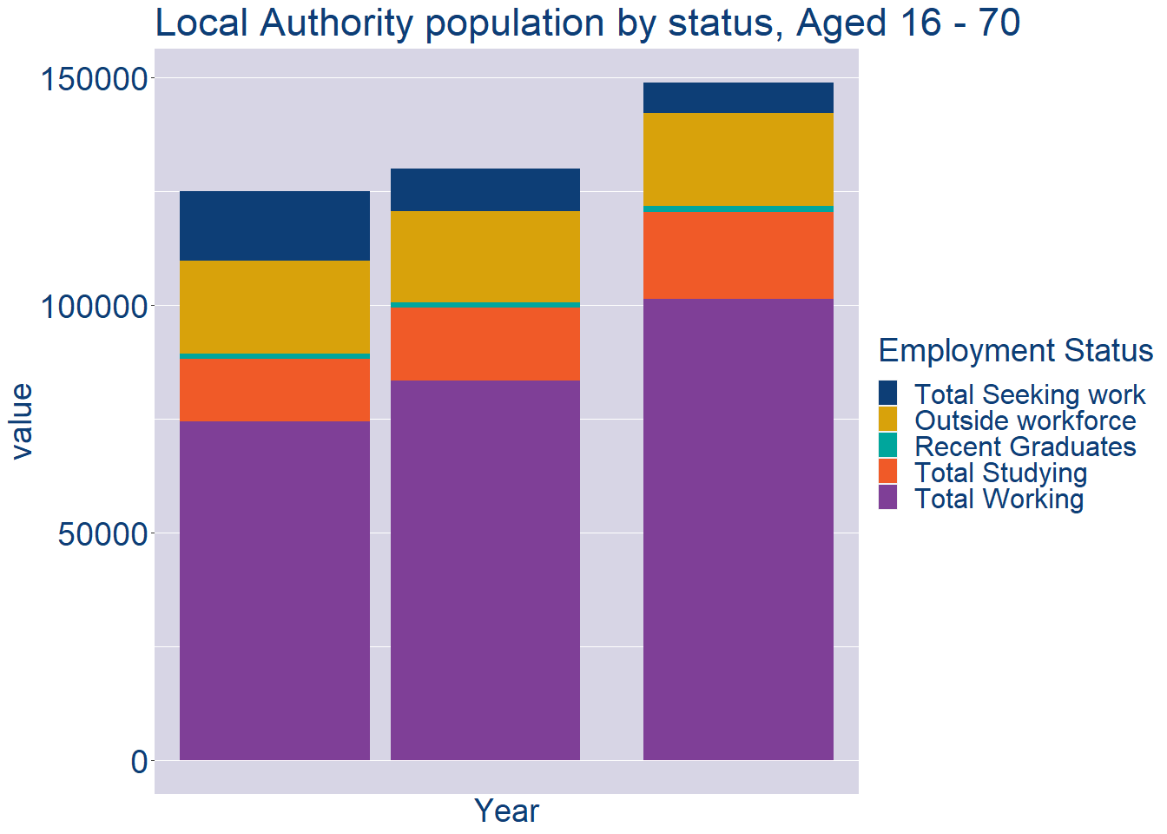
Theme 2: Meath County Workforce Demographics
Meath County Local Authority Workforce Population
Year | 2022
Total_working | 101189
Total_studying | 19188
Total_recent_grads | 1373
Total_job_seeking | 6751
Total_not_seeking | 20266

Slide 7
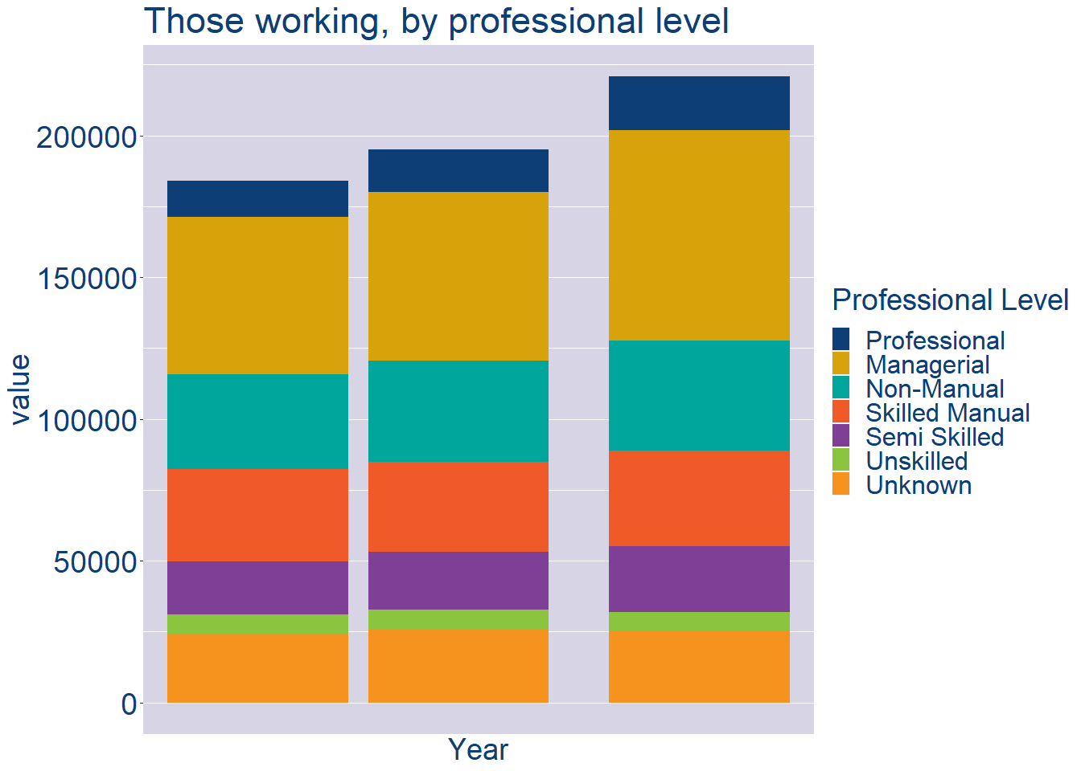
Theme 2: Meath County Workforce Demographics
Meath County Local Authority Workforce Experience Level
Year | 2022
Professional | 18970
Managerial | 74239
Non_Manual | 38683
Skilled_Manual | 33701
Semi_Skilled | 23265
Unskilled | 6643
All_Others | 25325

Slide 8
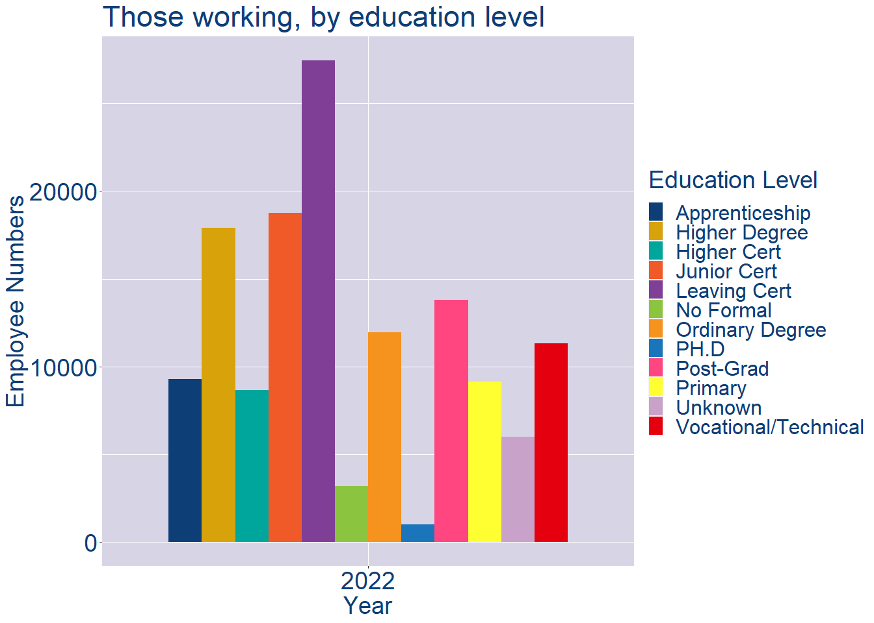
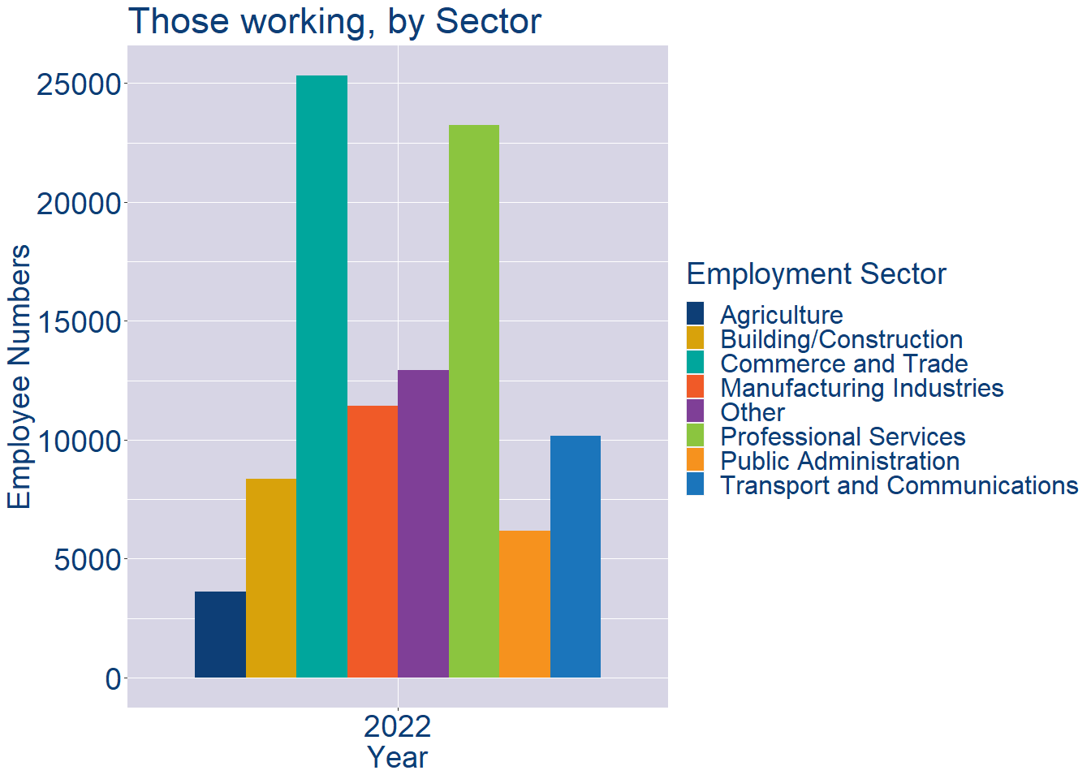
Theme 2: Meath County Workforce Demographics
Meath County Local Authority Workforce Education Level
Meath County Local Authority Workforce Sectors

Slide 9
Theme 3: Co. Meath Business Demographics
Audience: Internal to Chambers
Highlights: Local Business Community Information
Key messages:
Varies from Local Authority area to area
Local market intelligence to help you identify trends in your local area’s business community i.e.:
Sectoral activity increasing/decreasing
What sectors the self-employed are active in

Slide 10
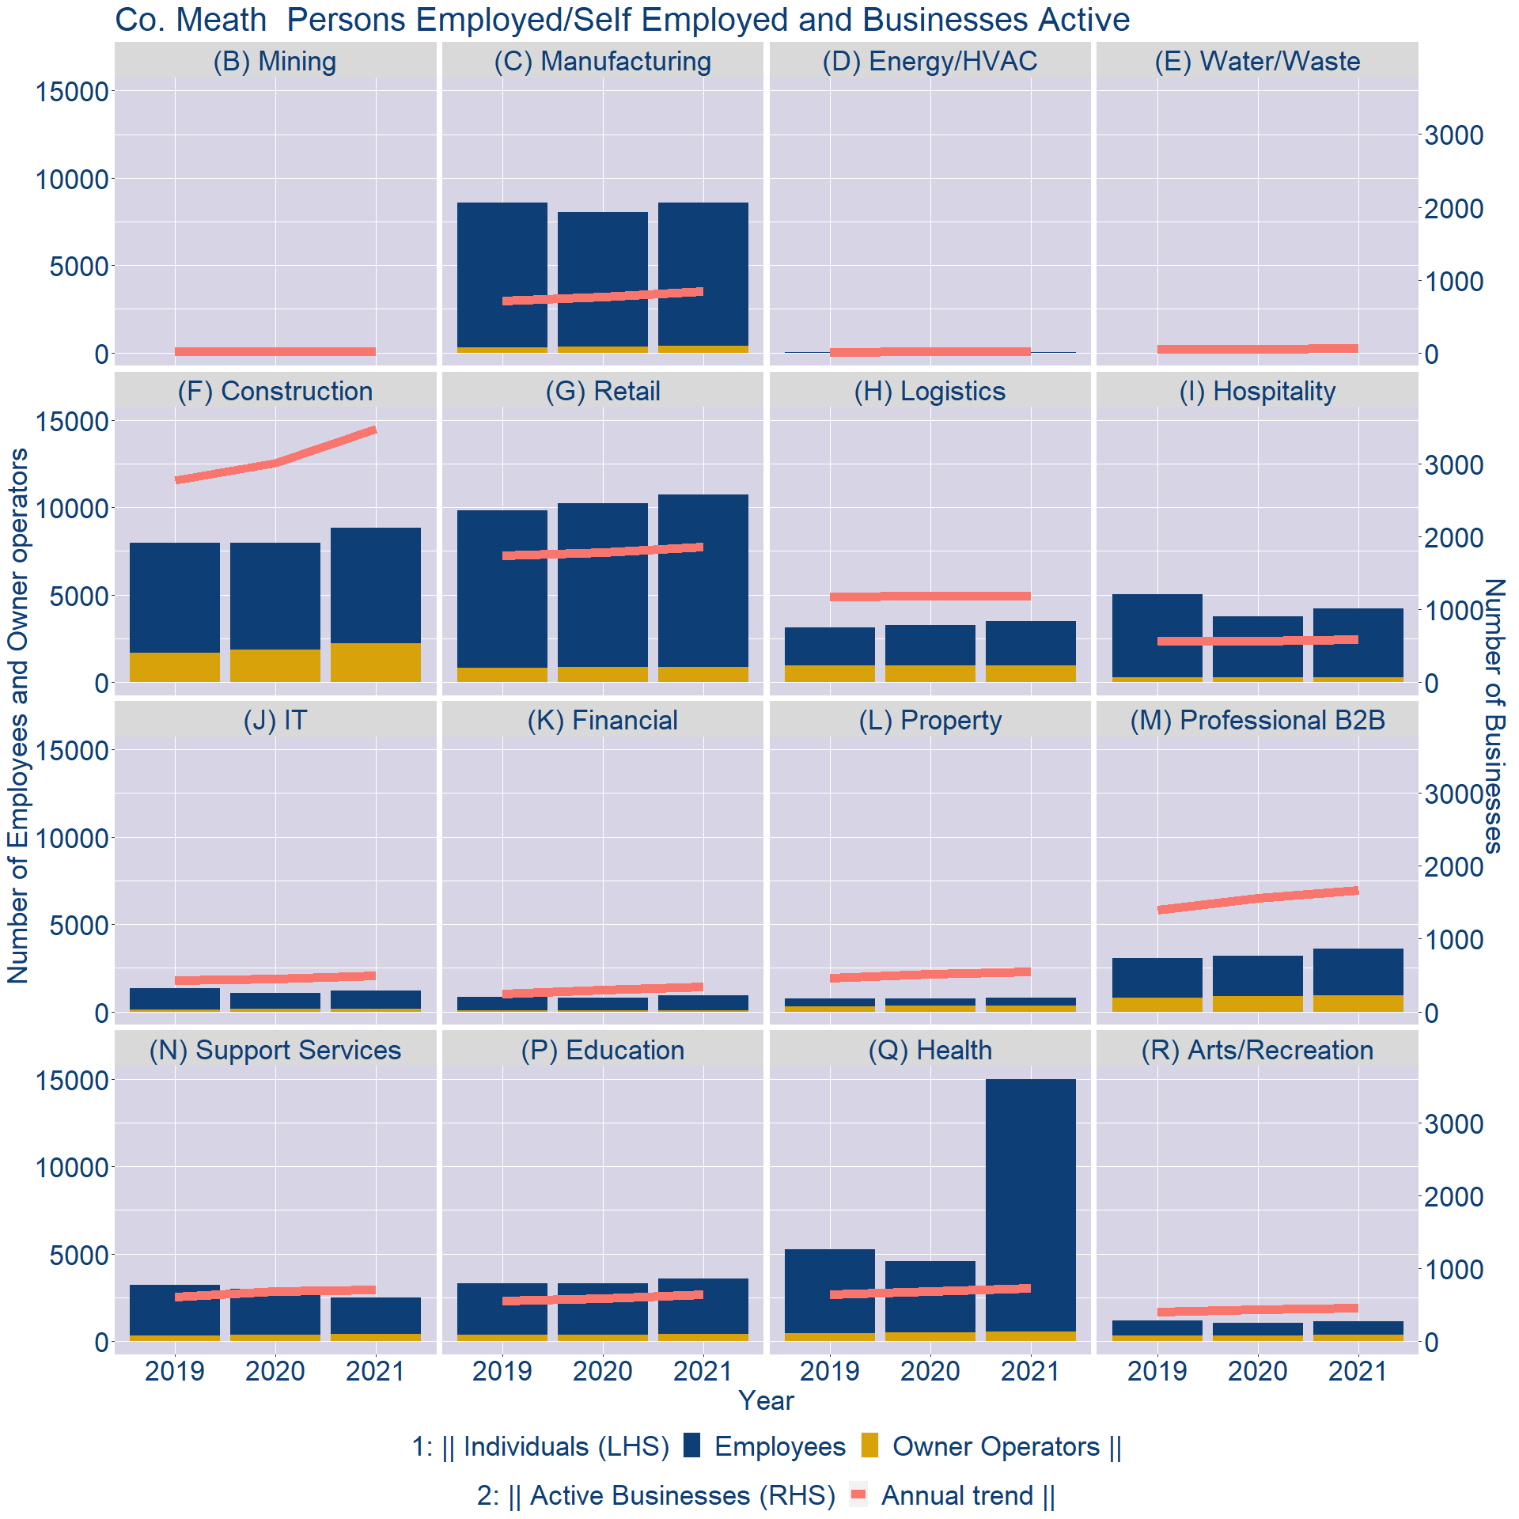
Theme 3: Co. Meath Business Demographics

Slide 11
Theme 3: Co. Meath Business Demographics
Sectors | Businesses | Owners | Employees
(B) Mining | 23 | 0 | 0
(C) Manufacturing | 827 | 391 | 8185
(D) Energy/HVAC | 17 | 2 | 14
(E) Water/Waste | 58 | 0 | 0
(F) Construction | 3393 | 2231 | 6586
(G) Retail | 1815 | 864 | 9885
(H) Logistics | 1153 | 952 | 2521
(I) Hospitality | 575 | 277 | 3928
(J) IT | 486 | 164 | 1043
(K) Financial | 336 | 55 | 891
(L) Property | 536 | 336 | 446
(M) Professional B2B | 1630 | 914 | 2683
(N) Support Services | 692 | 390 | 2084
(P) Education | 628 | 422 | 3165
(Q) Health | 708 | 522 | 14479
(R) Arts/Recreation | 445 | 347 | 771
Employment in locally registered businesses, by Sector

Slide 12
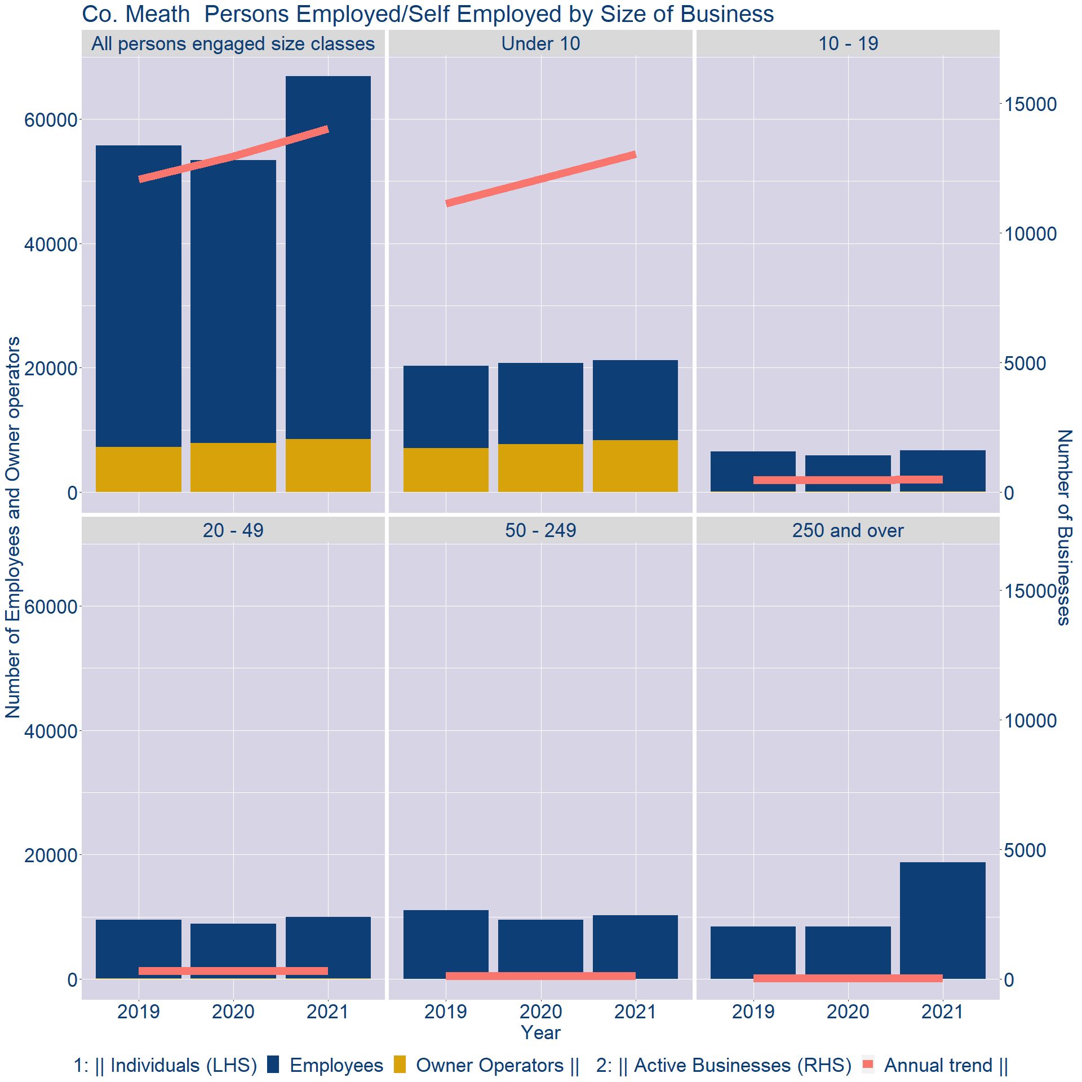
Theme 3: Co. Meath Business Demographics
Employment in locally registered businesses, by employer size - 2021

Slide 13
Theme 3: Co. Meath Business Demographics
Employment.Size | Businesses | Owners | Employees
All persons engaged size classes | 14014 | 8498 | 58416
Under 10 | 13051 | 8351 | 12855
10 - 19 | 507 | 105 | 6632
20 - 49 | 330 | 39 | 9906
50 - 249 | 108 | 3 | 10262
250 and over | 18 | 0 | 18761
Employment in locally registered businesses, by employer size - 2021

