Slide 1
Mayo County Business & Employment Demographics
Chambers Ireland

Slide 2
Theme 1: Mayo County Rates & LPT Income
Audience: Existing/Prospective Local Authority members
Highlights: Increasing reliance on Commercial Rates to support Local Authority Activities
Key messages:
Local Authority Budget Reform needed
Rates system putting pressure on labour intensive & vulnerable sectors
Hospitality
Retail
Manufacturing
Obligation on Local Authority to use these taxes effectively

Slide 3
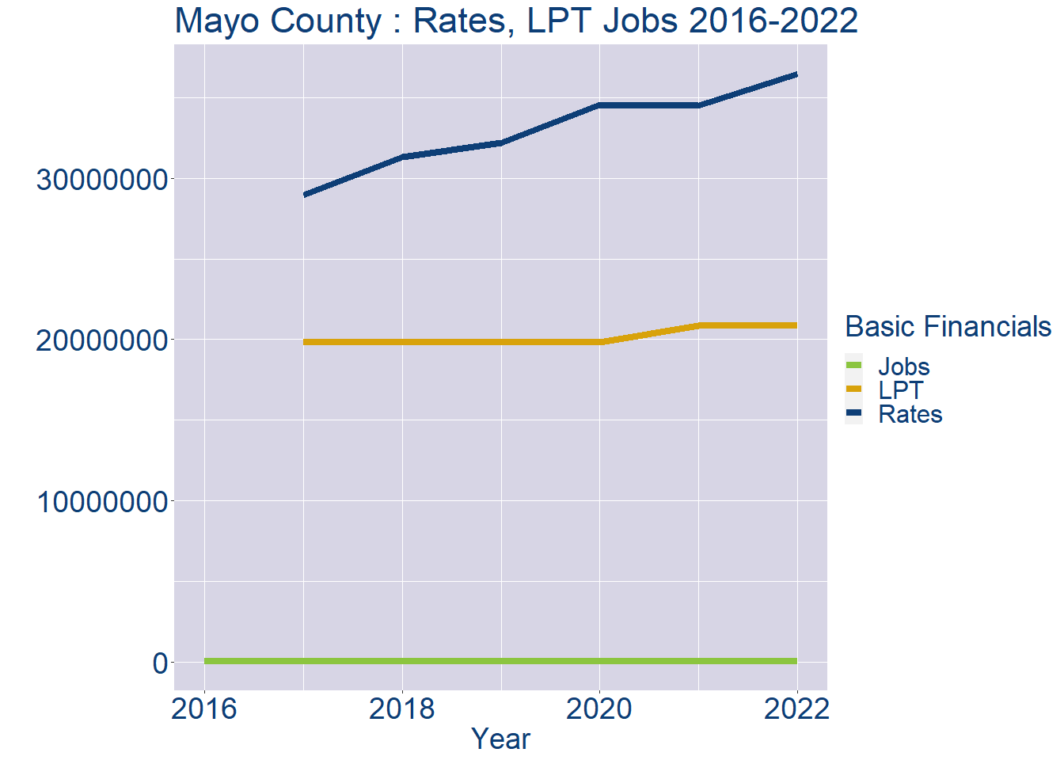
Theme 1: Mayo County Rates & LPT Income
Mayo County Local Authority Rates and LPT: 2016-2022
Year | Jobs | LPT | Rates
2016 | 51439 | NA | NA
2017 | 52588 | 19812344 | 28973107
2018 | 53737 | 19812344 | 31296415
2019 | 54886 | 19812344 | 32194404
2020 | 56035 | 19812342 | 34542787
2021 | 57184 | 20856905 | 34518132
2022 | 58334 | 20858436 | 36449602

Slide 4
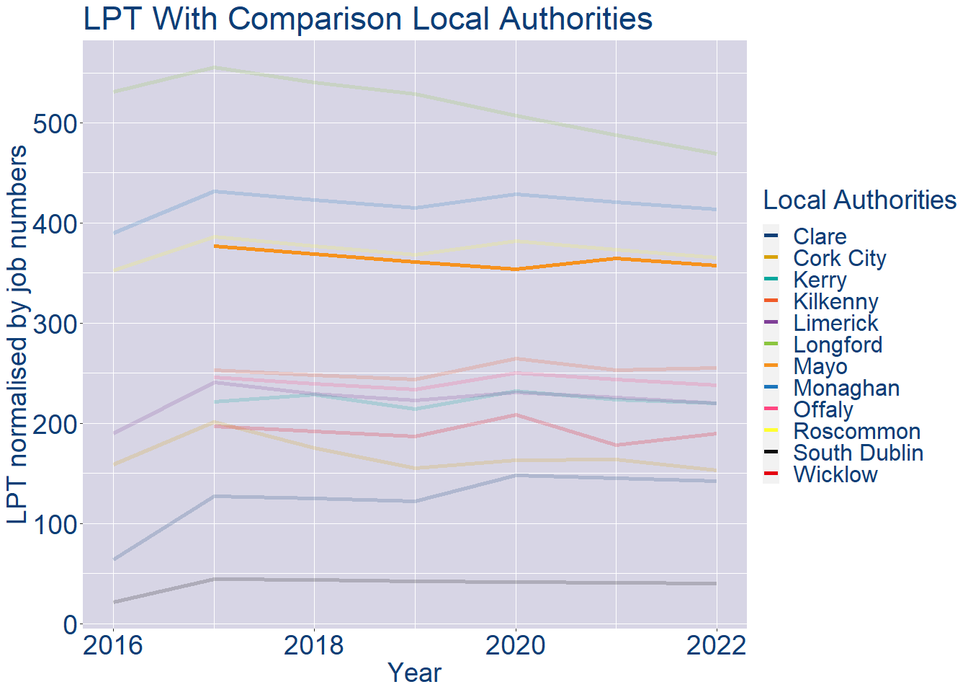
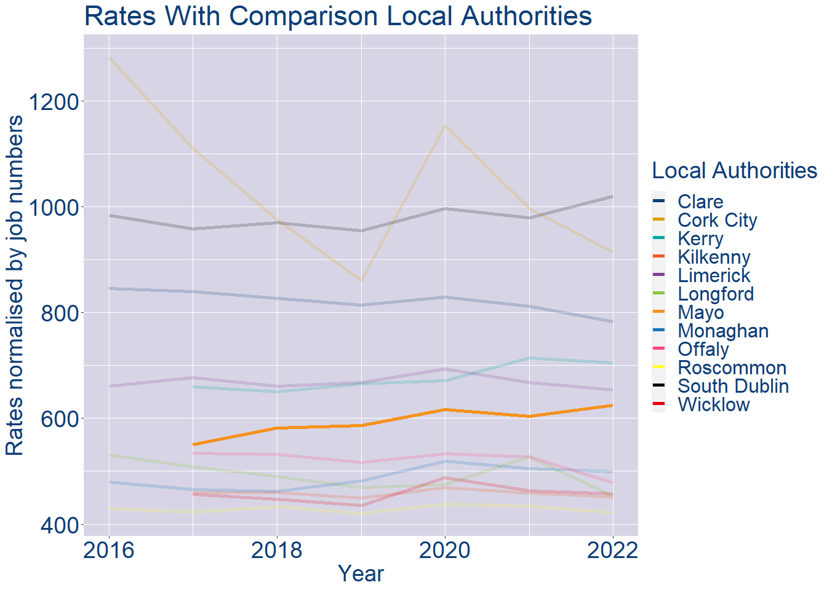
Theme 1: Mayo County Rates & LPT Income
Mayo County Local Authority 2022 LPT/employee €358
Mayo County Local Authority 2022 Rates/employee €625

Slide 5
Theme 2: Mayo County Workforce Demographics
Audience: Membership/Businesses that are interested in expanding into the local area
Highlights: Workforce details, who is available, education level, population growth
Key messages:
Varies from Local Authority area to area
Important for you to understand the numbers of people who are available to work in your area, their experience levels and the training they have

Slide 6
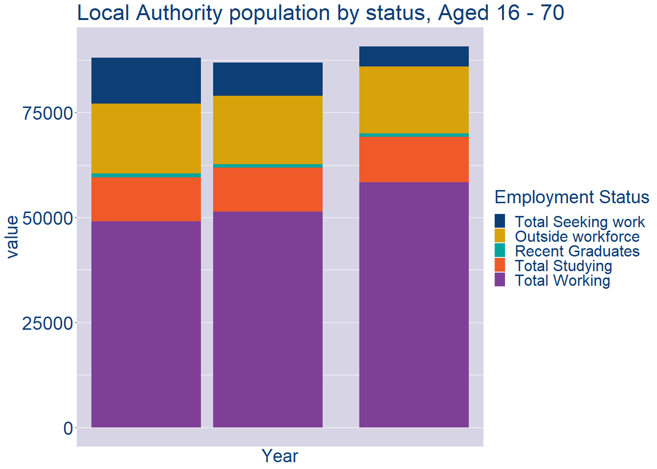
Theme 2: Mayo County Workforce Demographics
Mayo County Local Authority Workforce Population
Year | 2022
Total_working | 58334
Total_studying | 10823
Total_recent_grads | 905
Total_job_seeking | 4778
Total_not_seeking | 15901

Slide 7
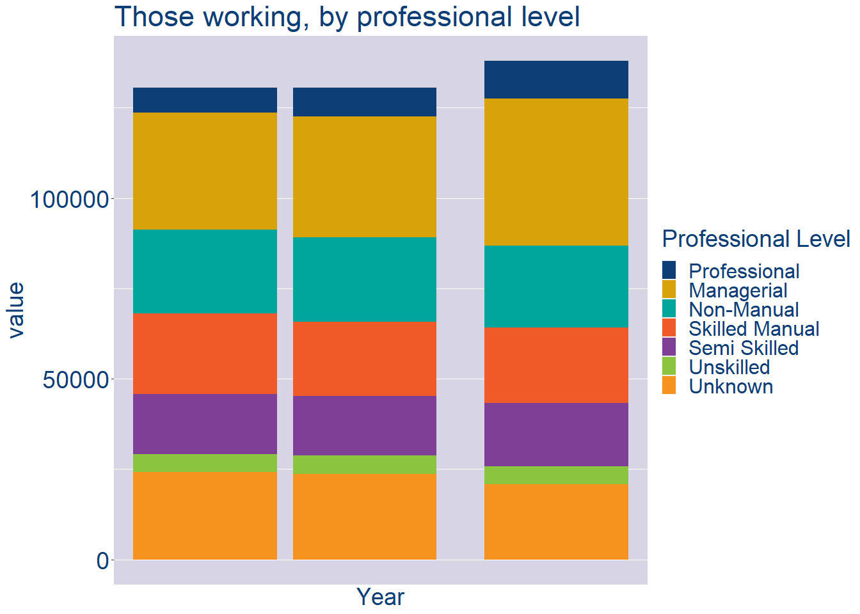
Theme 2: Mayo County Workforce Demographics
Mayo County Local Authority Workforce Experience Level
Year | 2022
Professional | 10467
Managerial | 40613
Non_Manual | 22780
Skilled_Manual | 20742
Semi_Skilled | 17633
Unskilled | 5000
All_Others | 20735

Slide 8
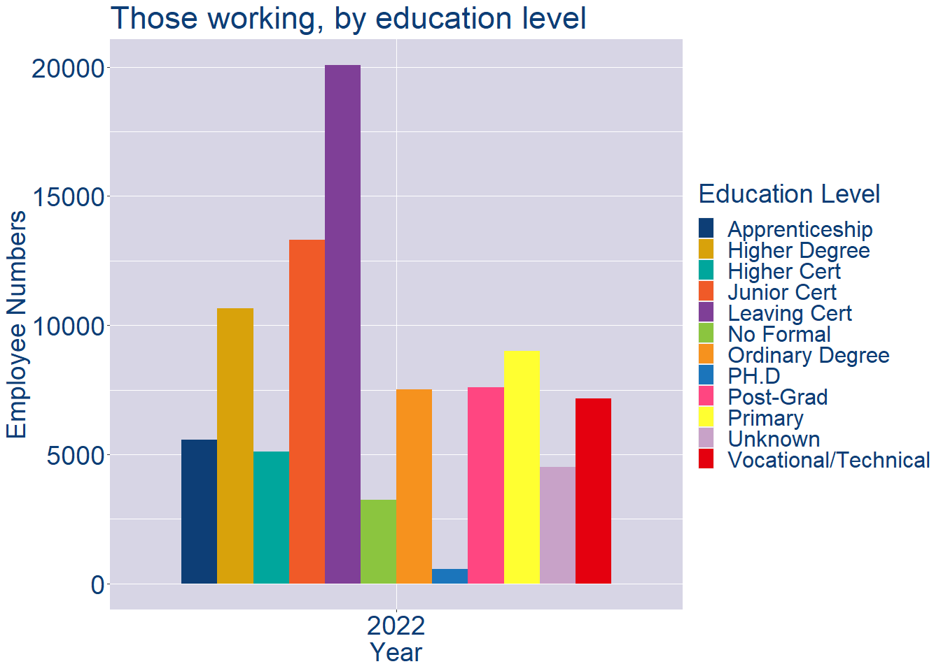
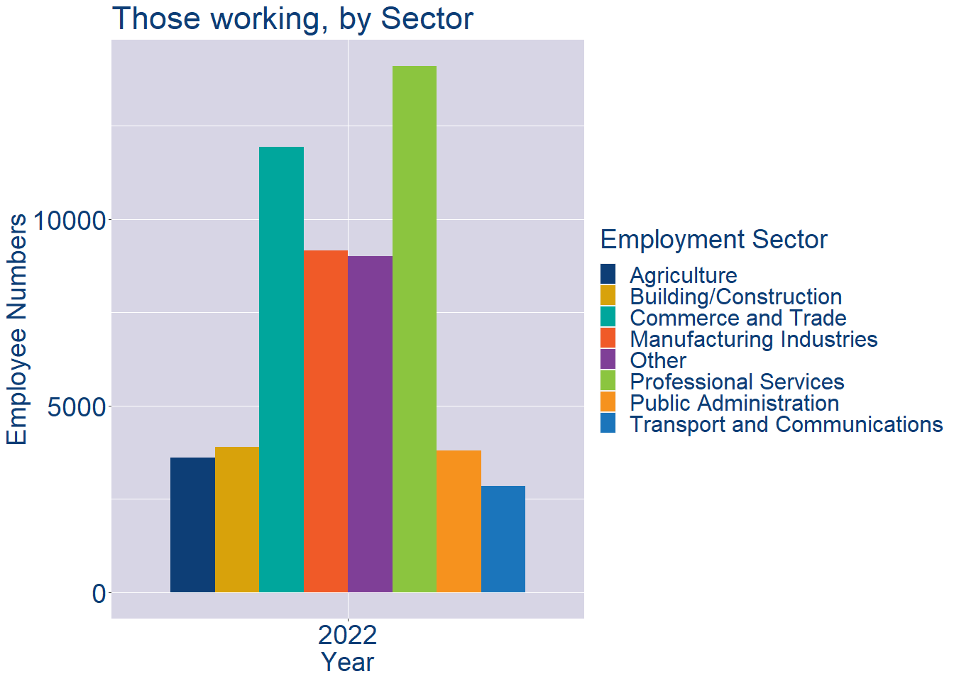
Theme 2: Mayo County Workforce Demographics
Mayo County Local Authority Workforce Education Level
Mayo County Local Authority Workforce Sectors

Slide 9
Theme 3: Co. Mayo Business Demographics
Audience: Internal to Chambers
Highlights: Local Business Community Information
Key messages:
Varies from Local Authority area to area
Local market intelligence to help you identify trends in your local area’s business community i.e.:
Sectoral activity increasing/decreasing
What sectors the self-employed are active in

Slide 10
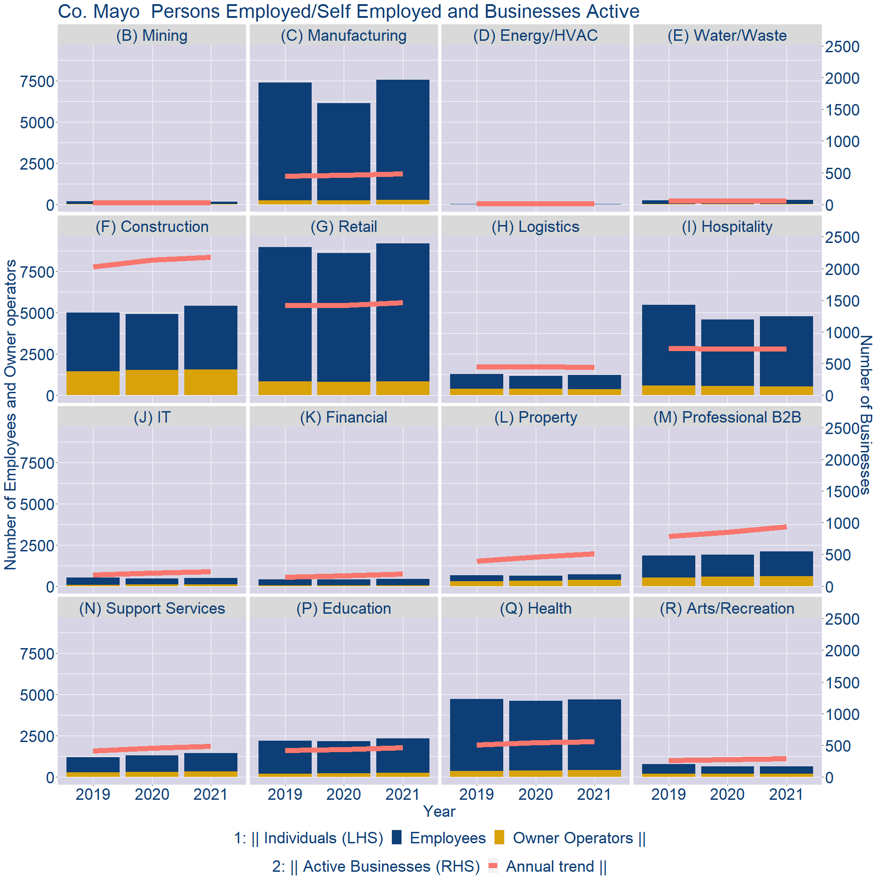
Theme 3: Co. Mayo Business Demographics

Slide 11
Theme 3: Co. Mayo Business Demographics
Sectors | Businesses | Owners | Employees
(B) Mining | 26 | 11 | 153
(C) Manufacturing | 476 | 266 | 7303
(D) Energy/HVAC | 13 | 0 | 14
(E) Water/Waste | 53 | 14 | 250
(F) Construction | 2149 | 1565 | 3871
(G) Retail | 1442 | 838 | 8376
(H) Logistics | 435 | 368 | 869
(I) Hospitality | 722 | 545 | 4247
(J) IT | 225 | 99 | 393
(K) Financial | 192 | 48 | 373
(L) Property | 506 | 373 | 333
(M) Professional B2B | 924 | 605 | 1488
(N) Support Services | 480 | 331 | 1117
(P) Education | 453 | 242 | 2095
(Q) Health | 547 | 404 | 4304
(R) Arts/Recreation | 285 | 203 | 433
Employment in locally registered businesses, by Sector

Slide 12
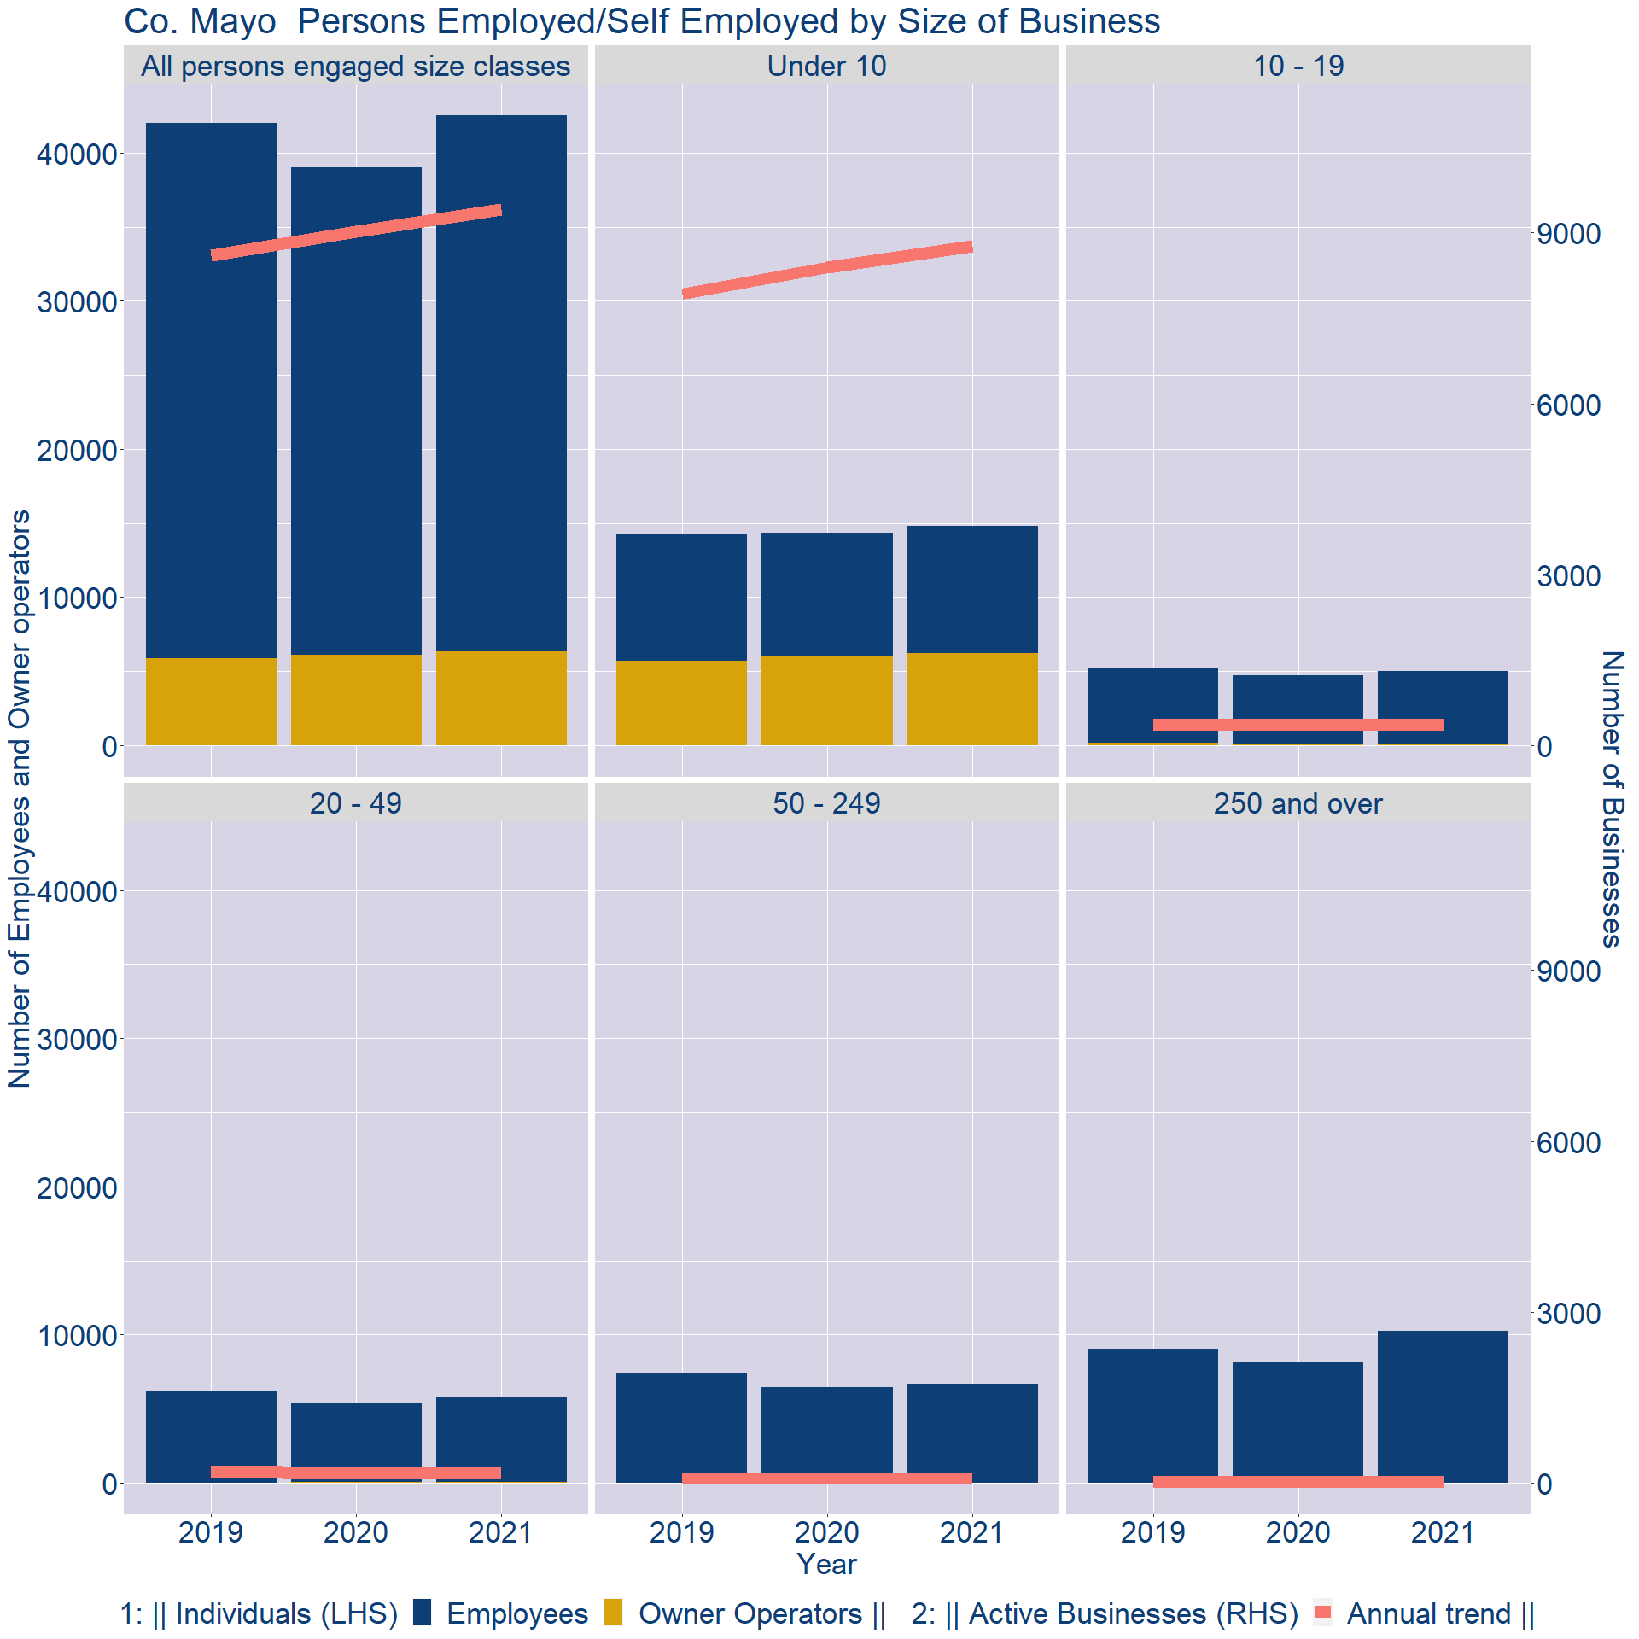
Theme 3: Co. Mayo Business Demographics
Employment in locally registered businesses, by employer size - 2021

Slide 13
Theme 3: Co. Mayo Business Demographics
Employment.Size | Businesses | Owners | Employees
All persons engaged size classes | 9416 | 6335 | 36202
Under 10 | 8766 | 6204 | 8605
10 - 19 | 364 | 107 | 4917
20 - 49 | 192 | 21 | 5752
50 - 249 | 77 | 3 | 6696
250 and over | 17 | 0 | 10232
Employment in locally registered businesses, by employer size - 2021

