Slide 1
Limerick County Business & Employment Demographics
Chambers Ireland

Slide 2
Theme 1: Limerick County Rates & LPT Income
Audience: Existing/Prospective Local Authority members
Highlights: Increasing reliance on Commercial Rates to support Local Authority Activities
Key messages:
Local Authority Budget Reform needed
Rates system putting pressure on labour intensive & vulnerable sectors
Hospitality
Retail
Manufacturing
Obligation on Local Authority to use these taxes effectively

Slide 3
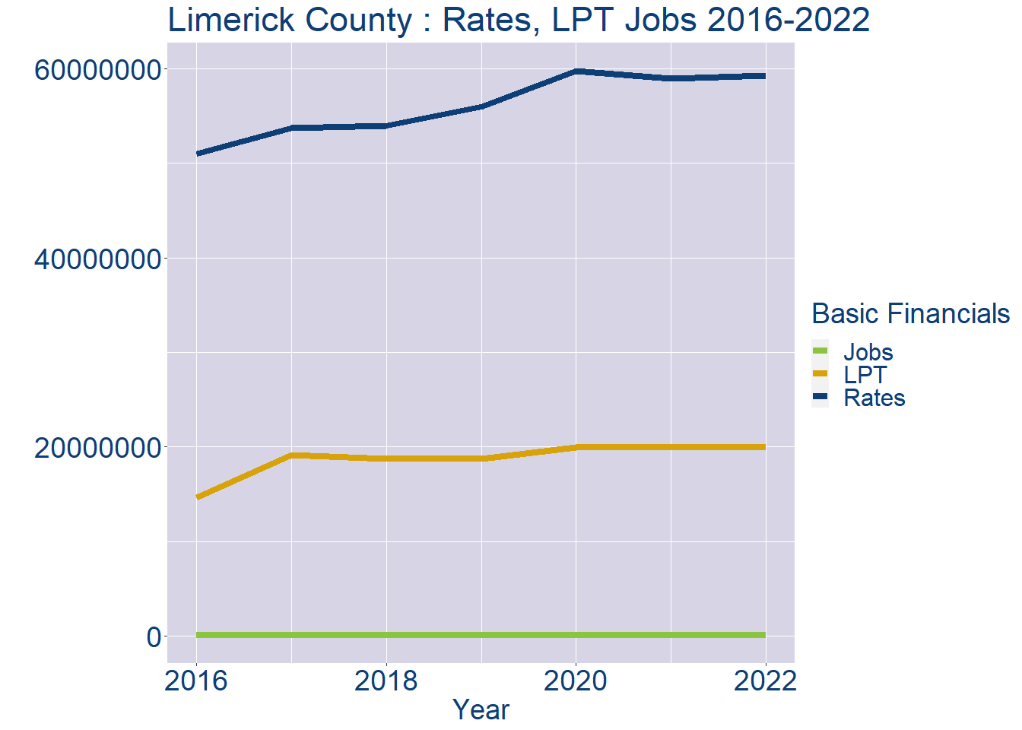
Theme 1: Limerick County Rates & LPT Income
Limerick County Local Authority Rates and LPT: 2016-2022
Year | Jobs | LPT | Rates
2016 | 77185 | 14625159 | 50965698
2017 | 79425 | 19121272 | 53750219
2018 | 81665 | 18730912 | 53997093
2019 | 83905 | 18732067 | 56019388
2020 | 86145 | 19914252 | 59744550
2021 | 88385 | 19952508 | 58989310
2022 | 90623 | 19952507 | 59279408

Slide 4
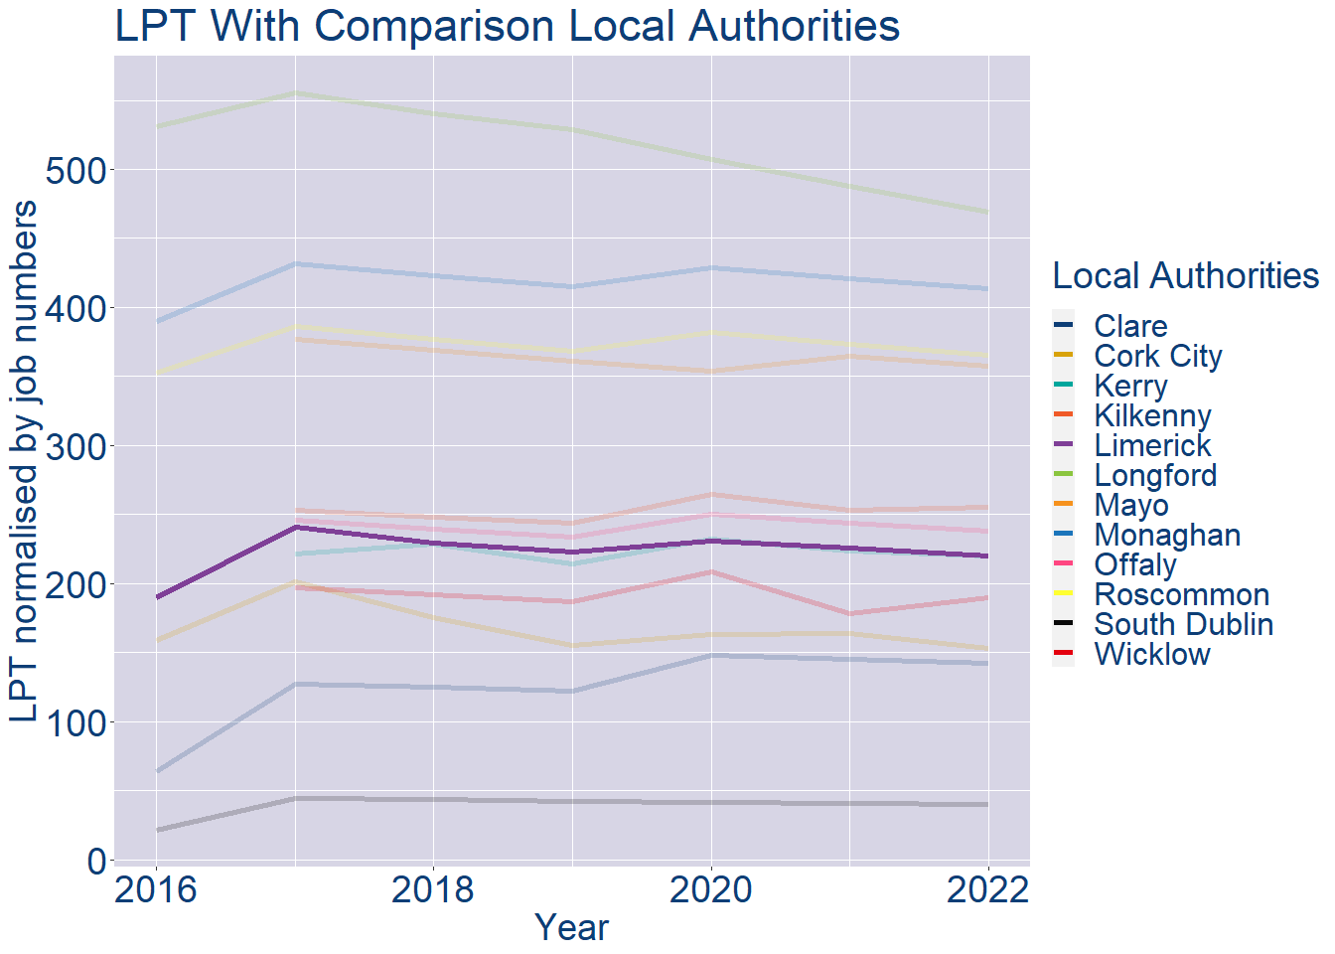
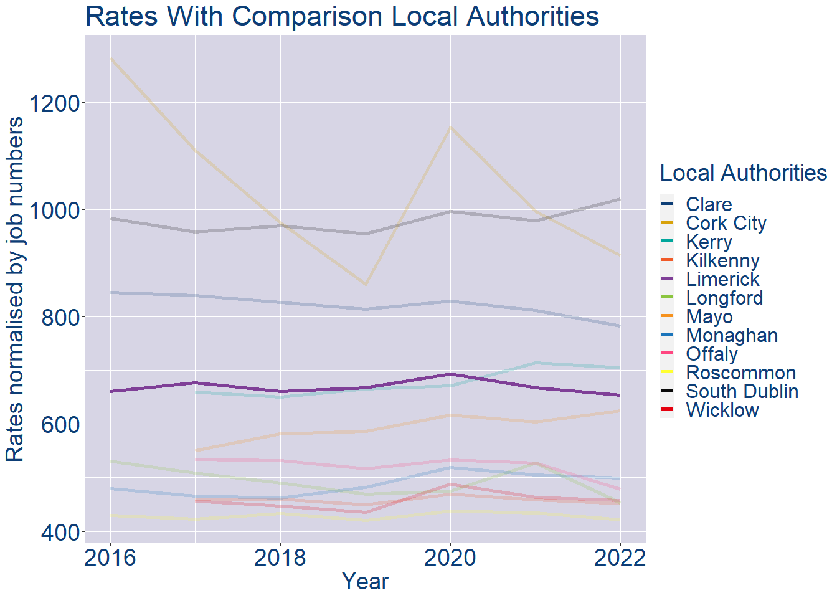
Theme 1: Limerick County Rates & LPT Income
Limerick County Local Authority 2022 LPT/employee €220
Limerick County Local Authority 2022 Rates/employee €654

Slide 5
Theme 2: Limerick County Workforce Demographics
Audience: Membership/Businesses that are interested in expanding into the local area
Highlights: Workforce details, who is available, education level, population growth
Key messages:
Varies from Local Authority area to area
Important for you to understand the numbers of people who are available to work in your area, their experience levels and the training they have

Slide 6
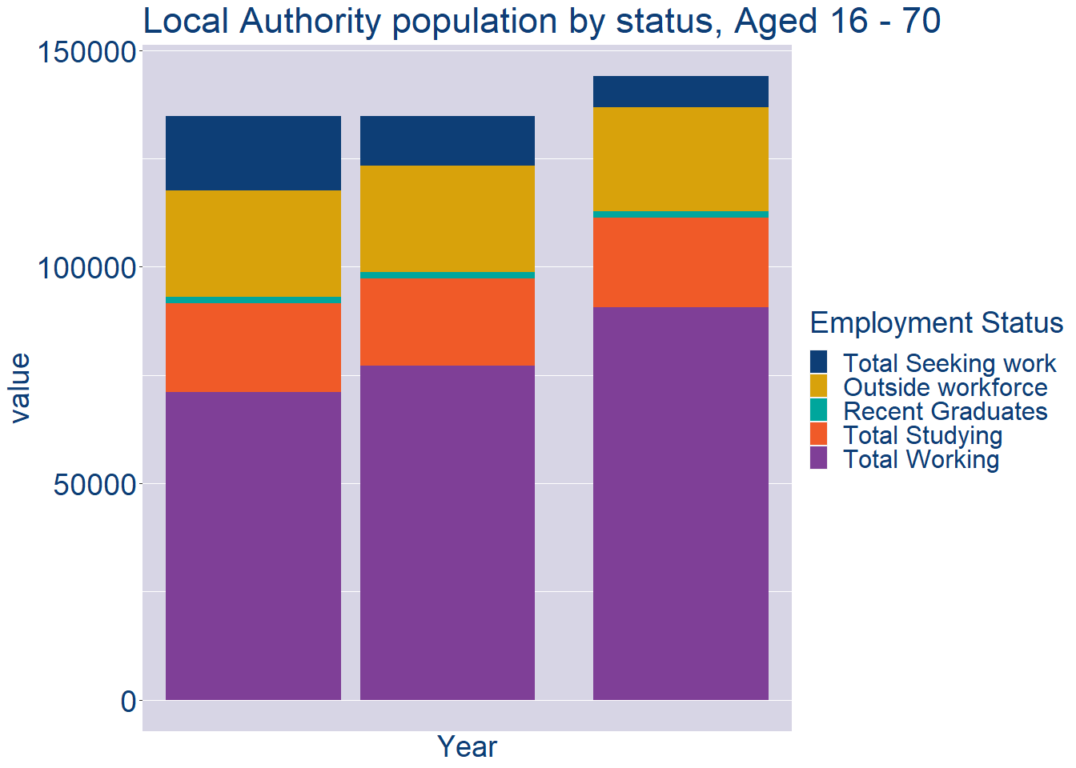
Theme 2: Limerick County Workforce Demographics
Limerick County Local Authority Workforce Population
Year | 2022
Total_working | 90623
Total_studying | 20759
Total_recent_grads | 1351
Total_job_seeking | 7211
Total_not_seeking | 24088

Slide 7
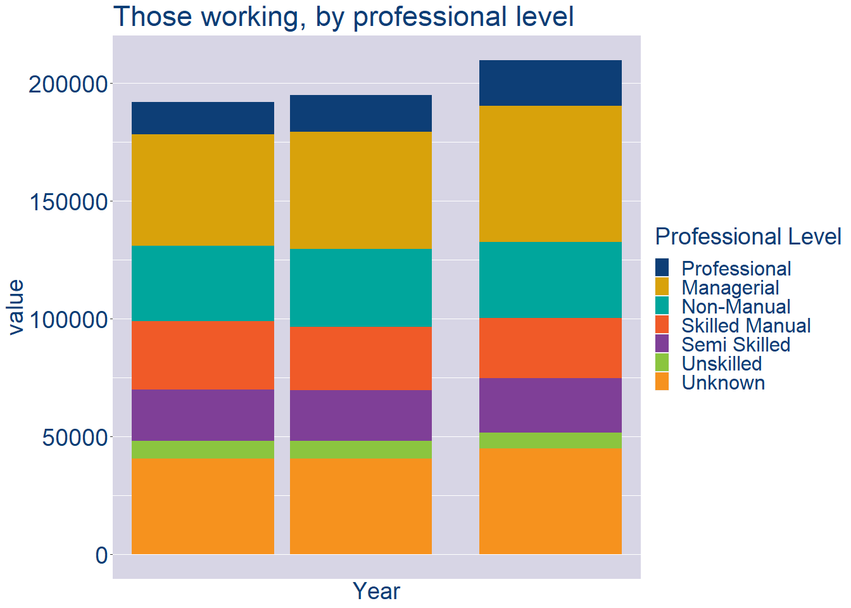
Theme 2: Limerick County Workforce Demographics
Limerick County Local Authority Workforce Experience Level
Year | 2022
Professional | 19417
Managerial | 57582
Non_Manual | 32258
Skilled_Manual | 25544
Semi_Skilled | 23153
Unskilled | 6857
All_Others | 44725

Slide 8
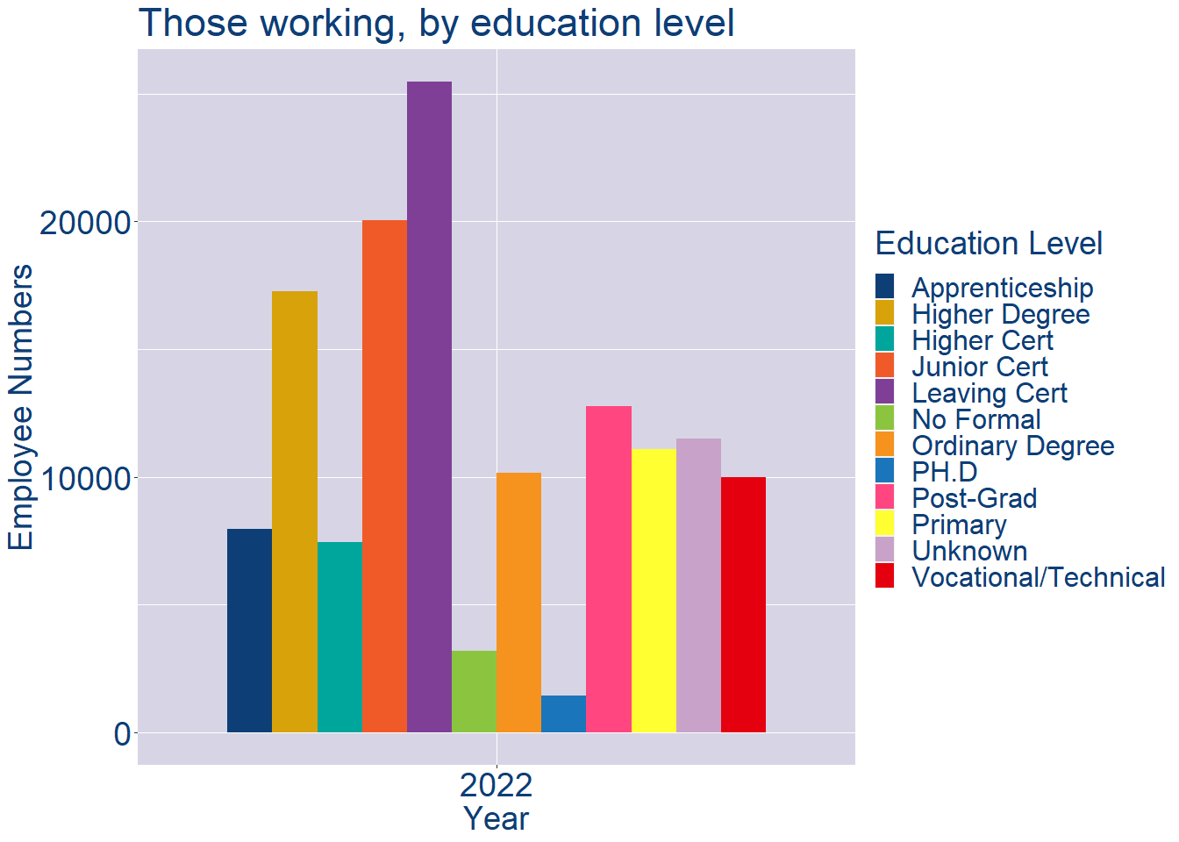
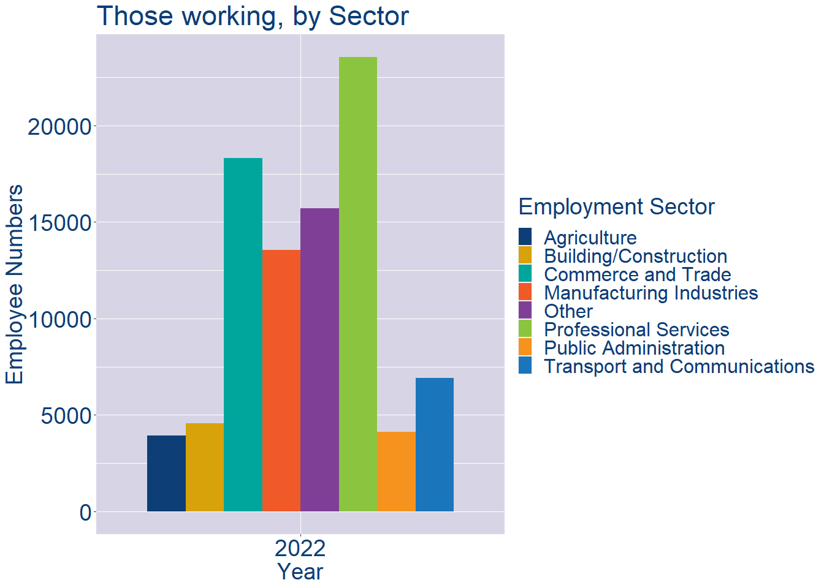
Theme 2: Limerick County Workforce Demographics
Limerick County Local Authority Workforce Education Level
Limerick County Local Authority Workforce Sectors

Slide 9
Theme 3: Co. Limerick Business Demographics
Audience: Internal to Chambers
Highlights: Local Business Community Information
Key messages:
Varies from Local Authority area to area
Local market intelligence to help you identify trends in your local area’s business community i.e.:
Sectoral activity increasing/decreasing
What sectors the self-employed are active in

Slide 10
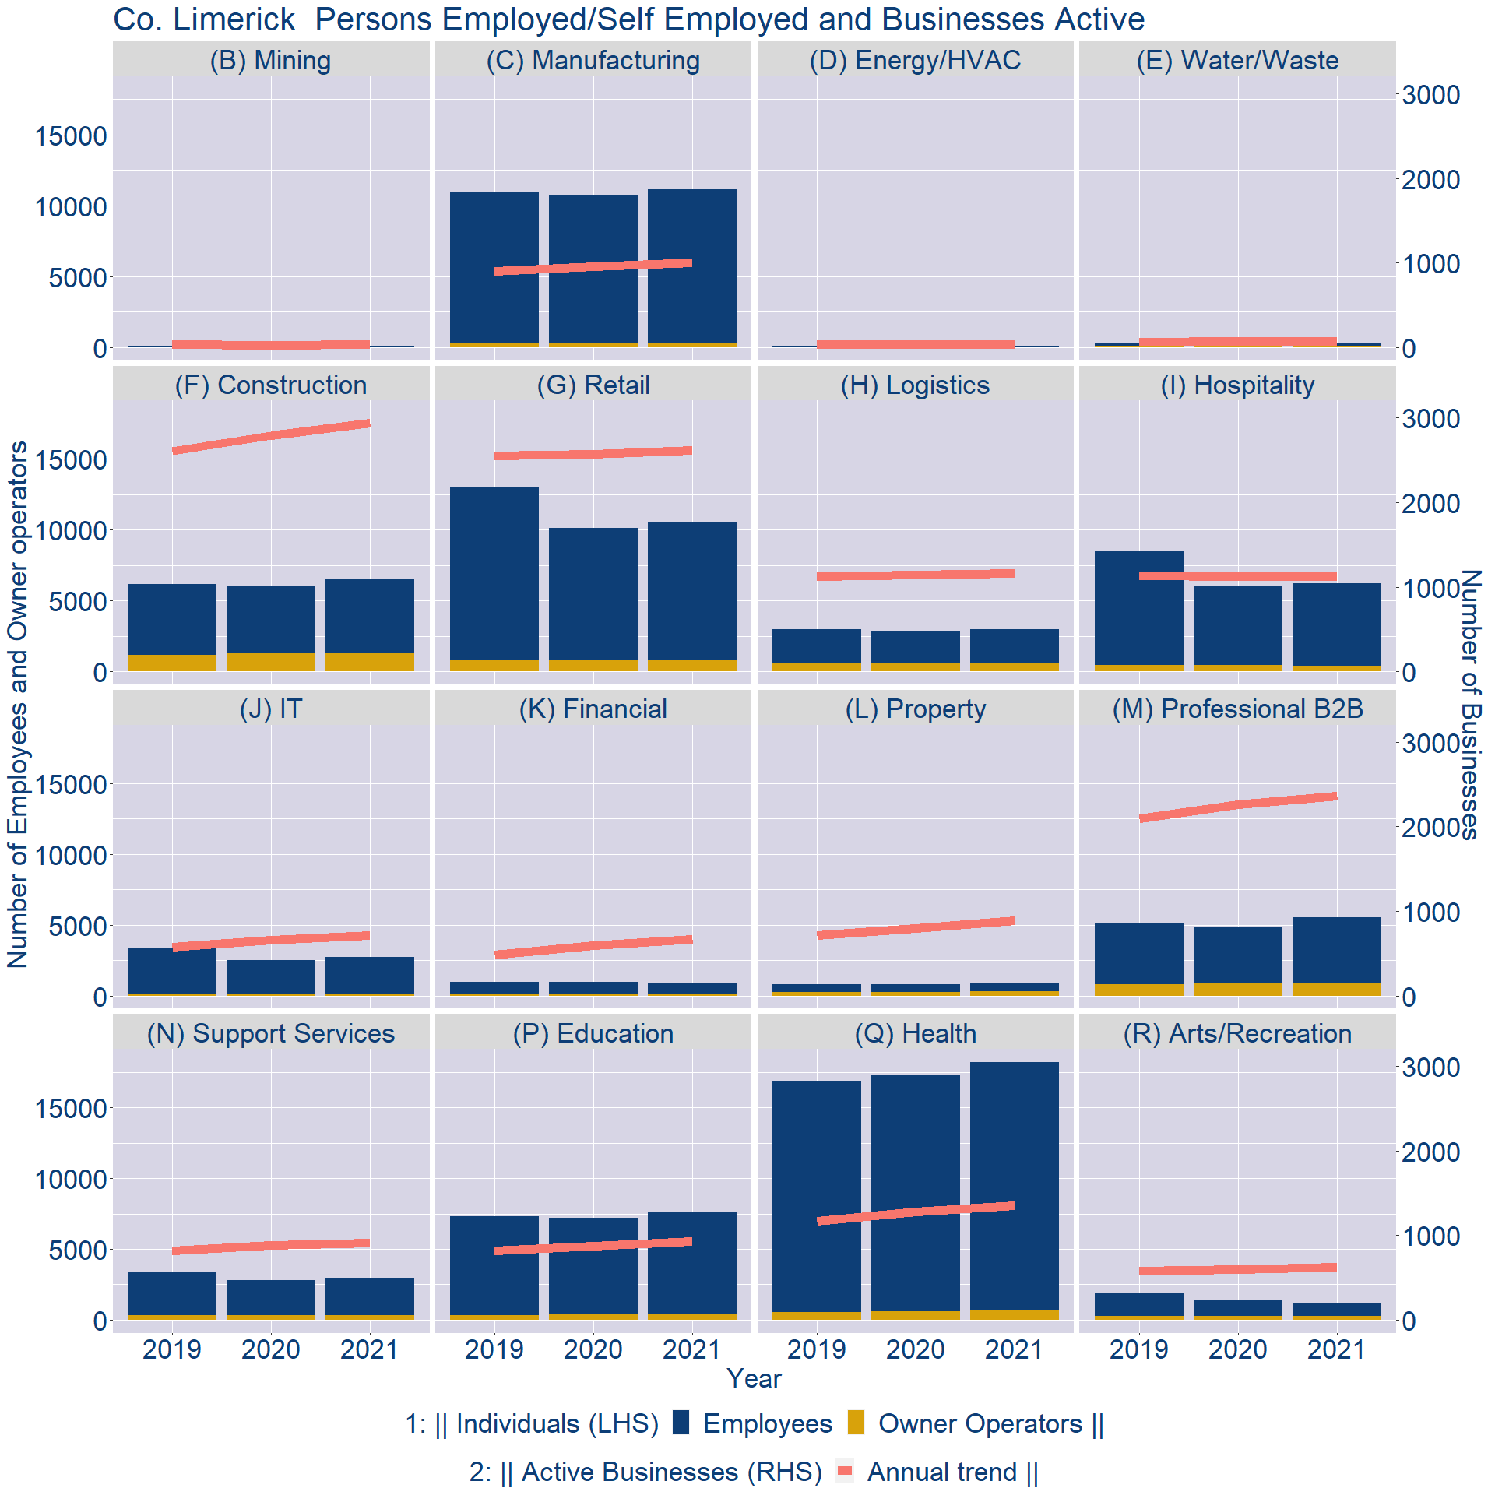
Theme 3: Co. Limerick Business Demographics

Slide 11
Theme 3: Co. Limerick Business Demographics
Sectors | Businesses | Owners | Employees
(B) Mining | 24 | 6 | 93
(C) Manufacturing | 696 | 288 | 10871
(D) Energy/HVAC | 25 | 3 | 21
(E) Water/Waste | 51 | 20 | 291
(F) Construction | 2048 | 1294 | 5241
(G) Retail | 1820 | 803 | 9762
(H) Logistics | 812 | 626 | 2366
(I) Hospitality | 782 | 405 | 5824
(J) IT | 500 | 153 | 2555
(K) Financial | 463 | 85 | 828
(L) Property | 621 | 291 | 625
(M) Professional B2B | 1646 | 842 | 4658
(N) Support Services | 633 | 329 | 2658
(P) Education | 651 | 390 | 7198
(Q) Health | 940 | 669 | 17541
(R) Arts/Recreation | 435 | 281 | 952
Employment in locally registered businesses, by Sector

Slide 12
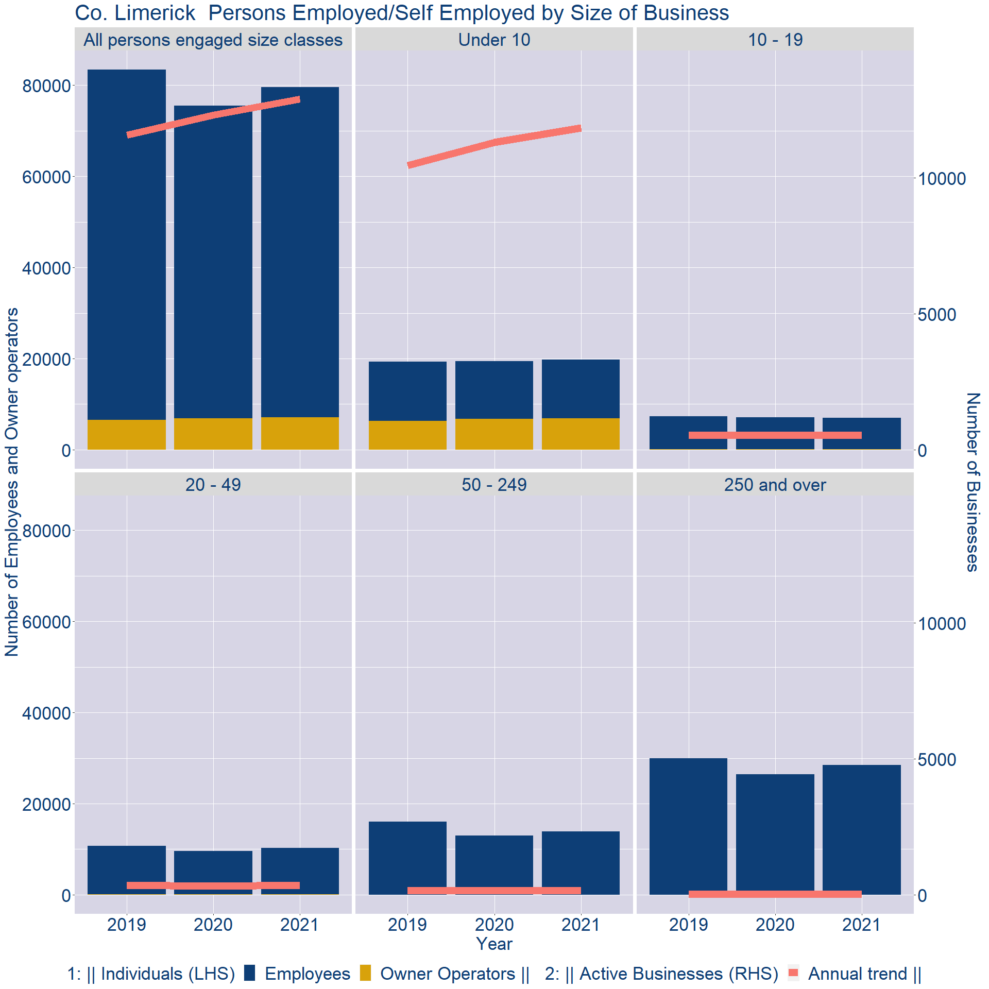
Theme 3: Co. Limerick Business Demographics
Employment in locally registered businesses, by employer size - 2021

Slide 13
Theme 3: Co. Limerick Business Demographics
Employment.Size | Businesses | Owners | Employees
All persons engaged size classes | 12896 | 7101 | 72451
Under 10 | 11835 | 6928 | 12807
10 - 19 | 526 | 110 | 6926
20 - 49 | 355 | 48 | 10267
50 - 249 | 154 | 15 | 13932
250 and over | 26 | 0 | 28519
Employment in locally registered businesses, by employer size - 2021

