Slide 1
Leitrim County Business & Employment Demographics
Chambers Ireland

Slide 2
Theme 1: Leitrim County Rates & LPT Income
Audience: Existing/Prospective Local Authority members
Highlights: Increasing reliance on Commercial Rates to support Local Authority Activities
Key messages:
Local Authority Budget Reform needed
Rates system putting pressure on labour intensive & vulnerable sectors
Hospitality
Retail
Manufacturing
Obligation on Local Authority to use these taxes effectively

Slide 3
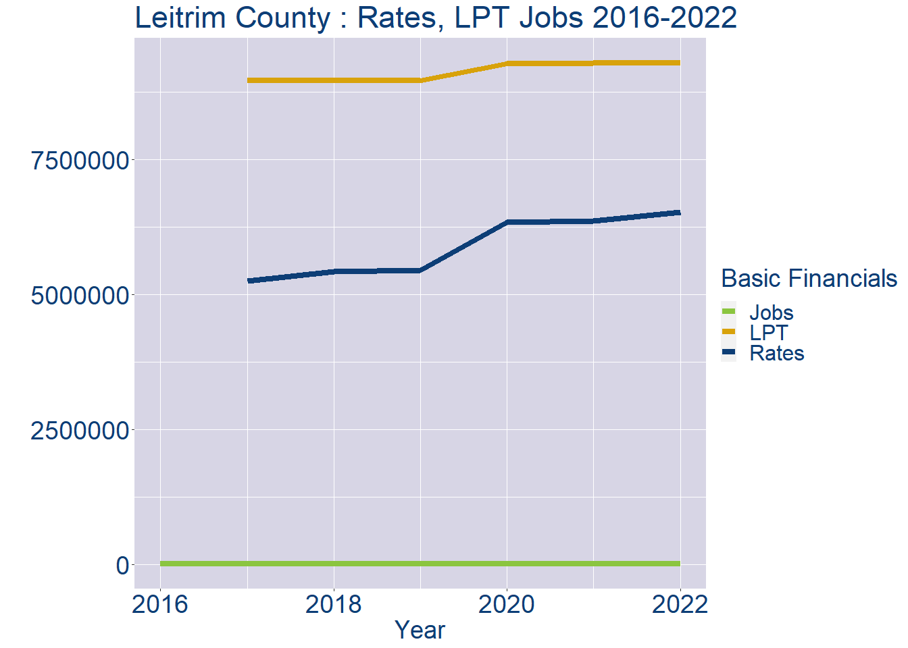
Theme 1: Leitrim County Rates & LPT Income
Leitrim County Local Authority Rates and LPT: 2016-2022
Year | Jobs | LPT | Rates
2016 | 12728 | NA | NA
2017 | 13076 | 8956315 | 5243704
2018 | 13424 | 8956315 | 5427117
2019 | 13772 | 8956315 | 5454979
2020 | 14120 | 9277230 | 6331385
2021 | 14468 | 9282747 | 6364252
2022 | 14816 | 9283968 | 6525465

Slide 4
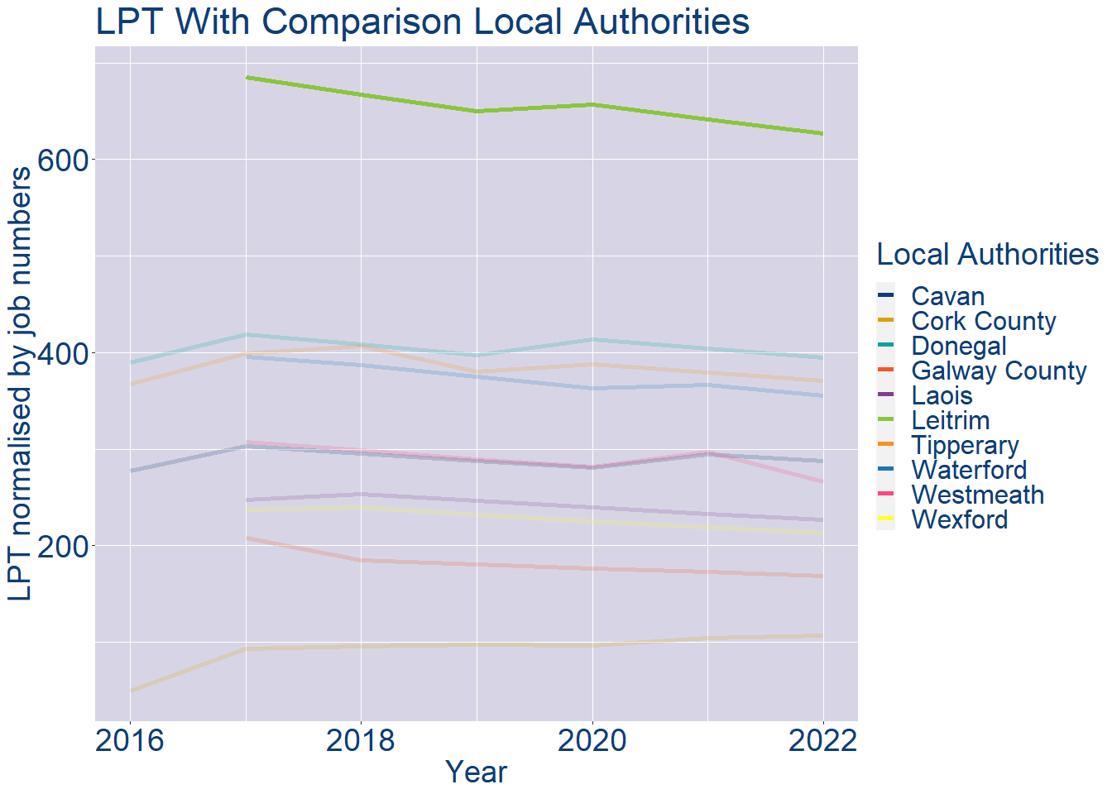
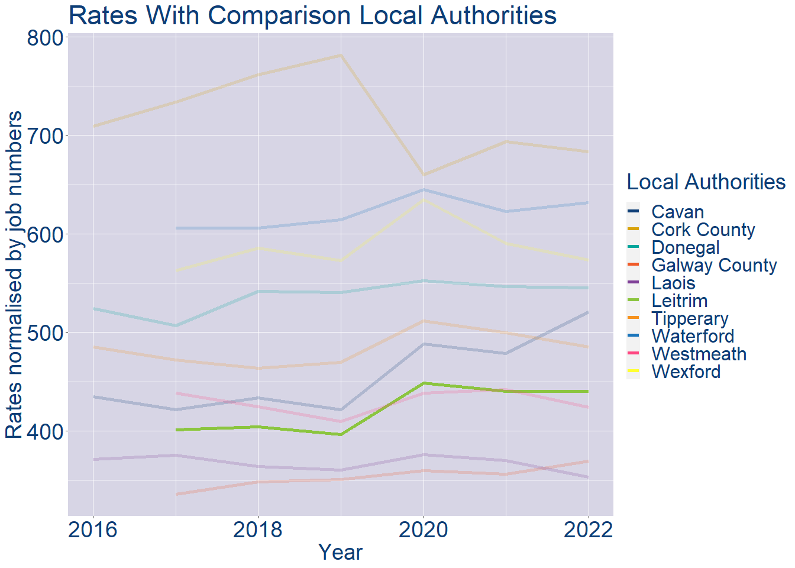
Theme 1: Leitrim County Rates & LPT Income
Leitrim County Local Authority 2022 LPT/employee €627
Leitrim County Local Authority 2022 Rates/employee €440

Slide 5
Theme 2: Leitrim County Workforce Demographics
Audience: Membership/Businesses that are interested in expanding into the local area
Highlights: Workforce details, who is available, education level, population growth
Key messages:
Varies from Local Authority area to area
Important for you to understand the numbers of people who are available to work in your area, their experience levels and the training they have

Slide 6
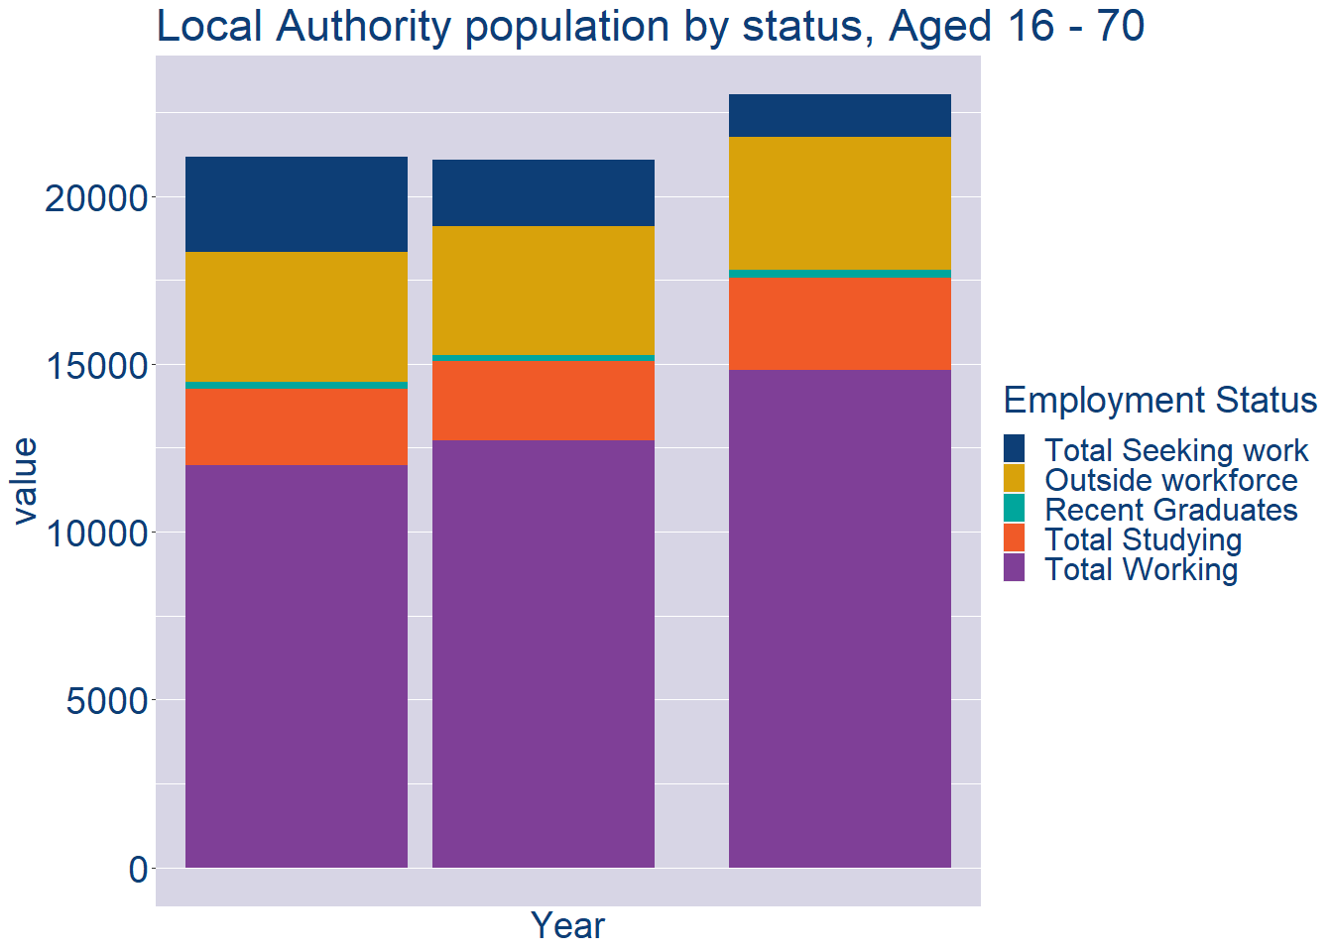
Theme 2: Leitrim County Workforce Demographics
Leitrim County Local Authority Workforce Population
Year | 2022
Total_working | 14816
Total_studying | 2749
Total_recent_grads | 242
Total_job_seeking | 1271
Total_not_seeking | 3948

Slide 7
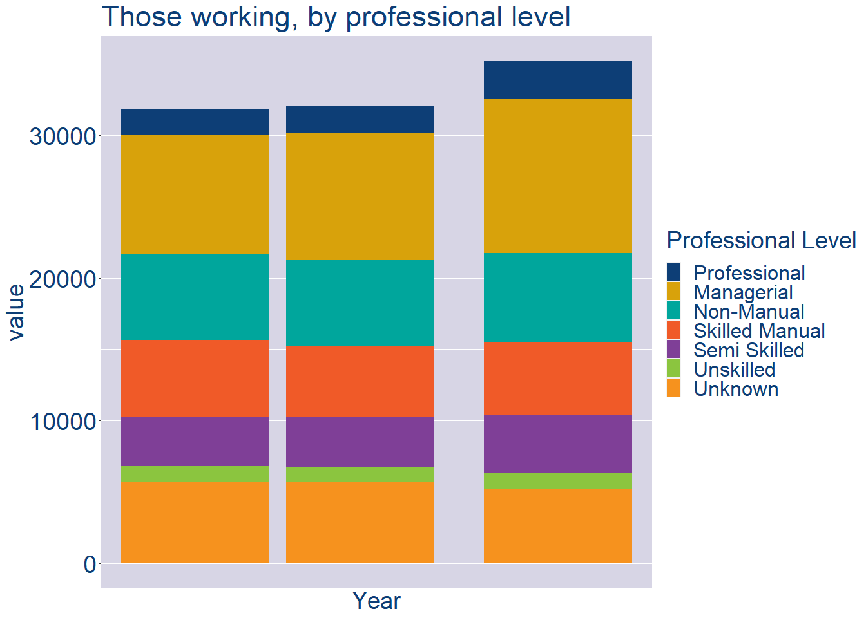
Theme 2: Leitrim County Workforce Demographics
Leitrim County Local Authority Workforce Experience Level
Year | 2022
Professional | 2675
Managerial | 10773
Non_Manual | 6261
Skilled_Manual | 5085
Semi_Skilled | 4059
Unskilled | 1107
All_Others | 5239

Slide 8
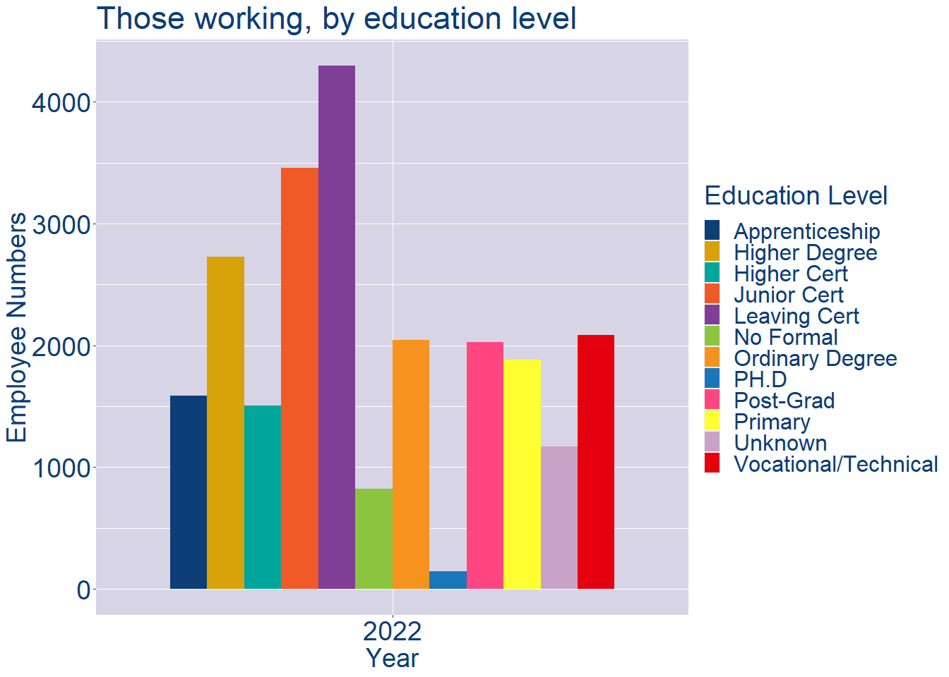
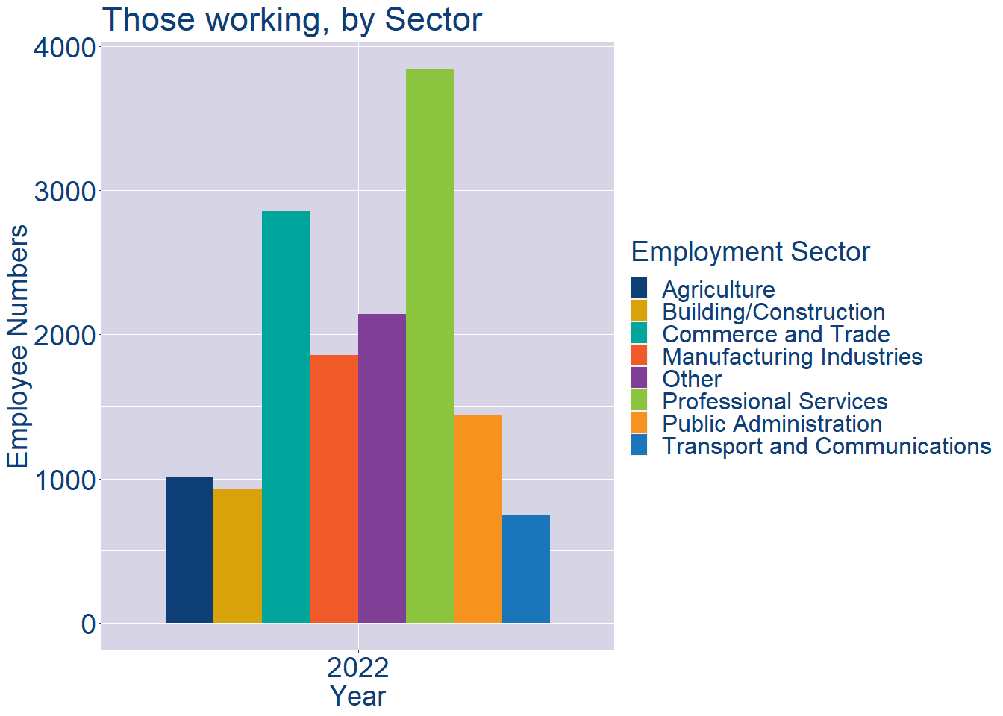
Theme 2: Leitrim County Workforce Demographics
Leitrim County Local Authority Workforce Education Level
Leitrim County Local Authority Workforce Sectors

Slide 9
Theme 3: Co. Leitrim Business Demographics
Audience: Internal to Chambers
Highlights: Local Business Community Information
Key messages:
Varies from Local Authority area to area
Local market intelligence to help you identify trends in your local area’s business community i.e.:
Sectoral activity increasing/decreasing
What sectors the self-employed are active in

Slide 10
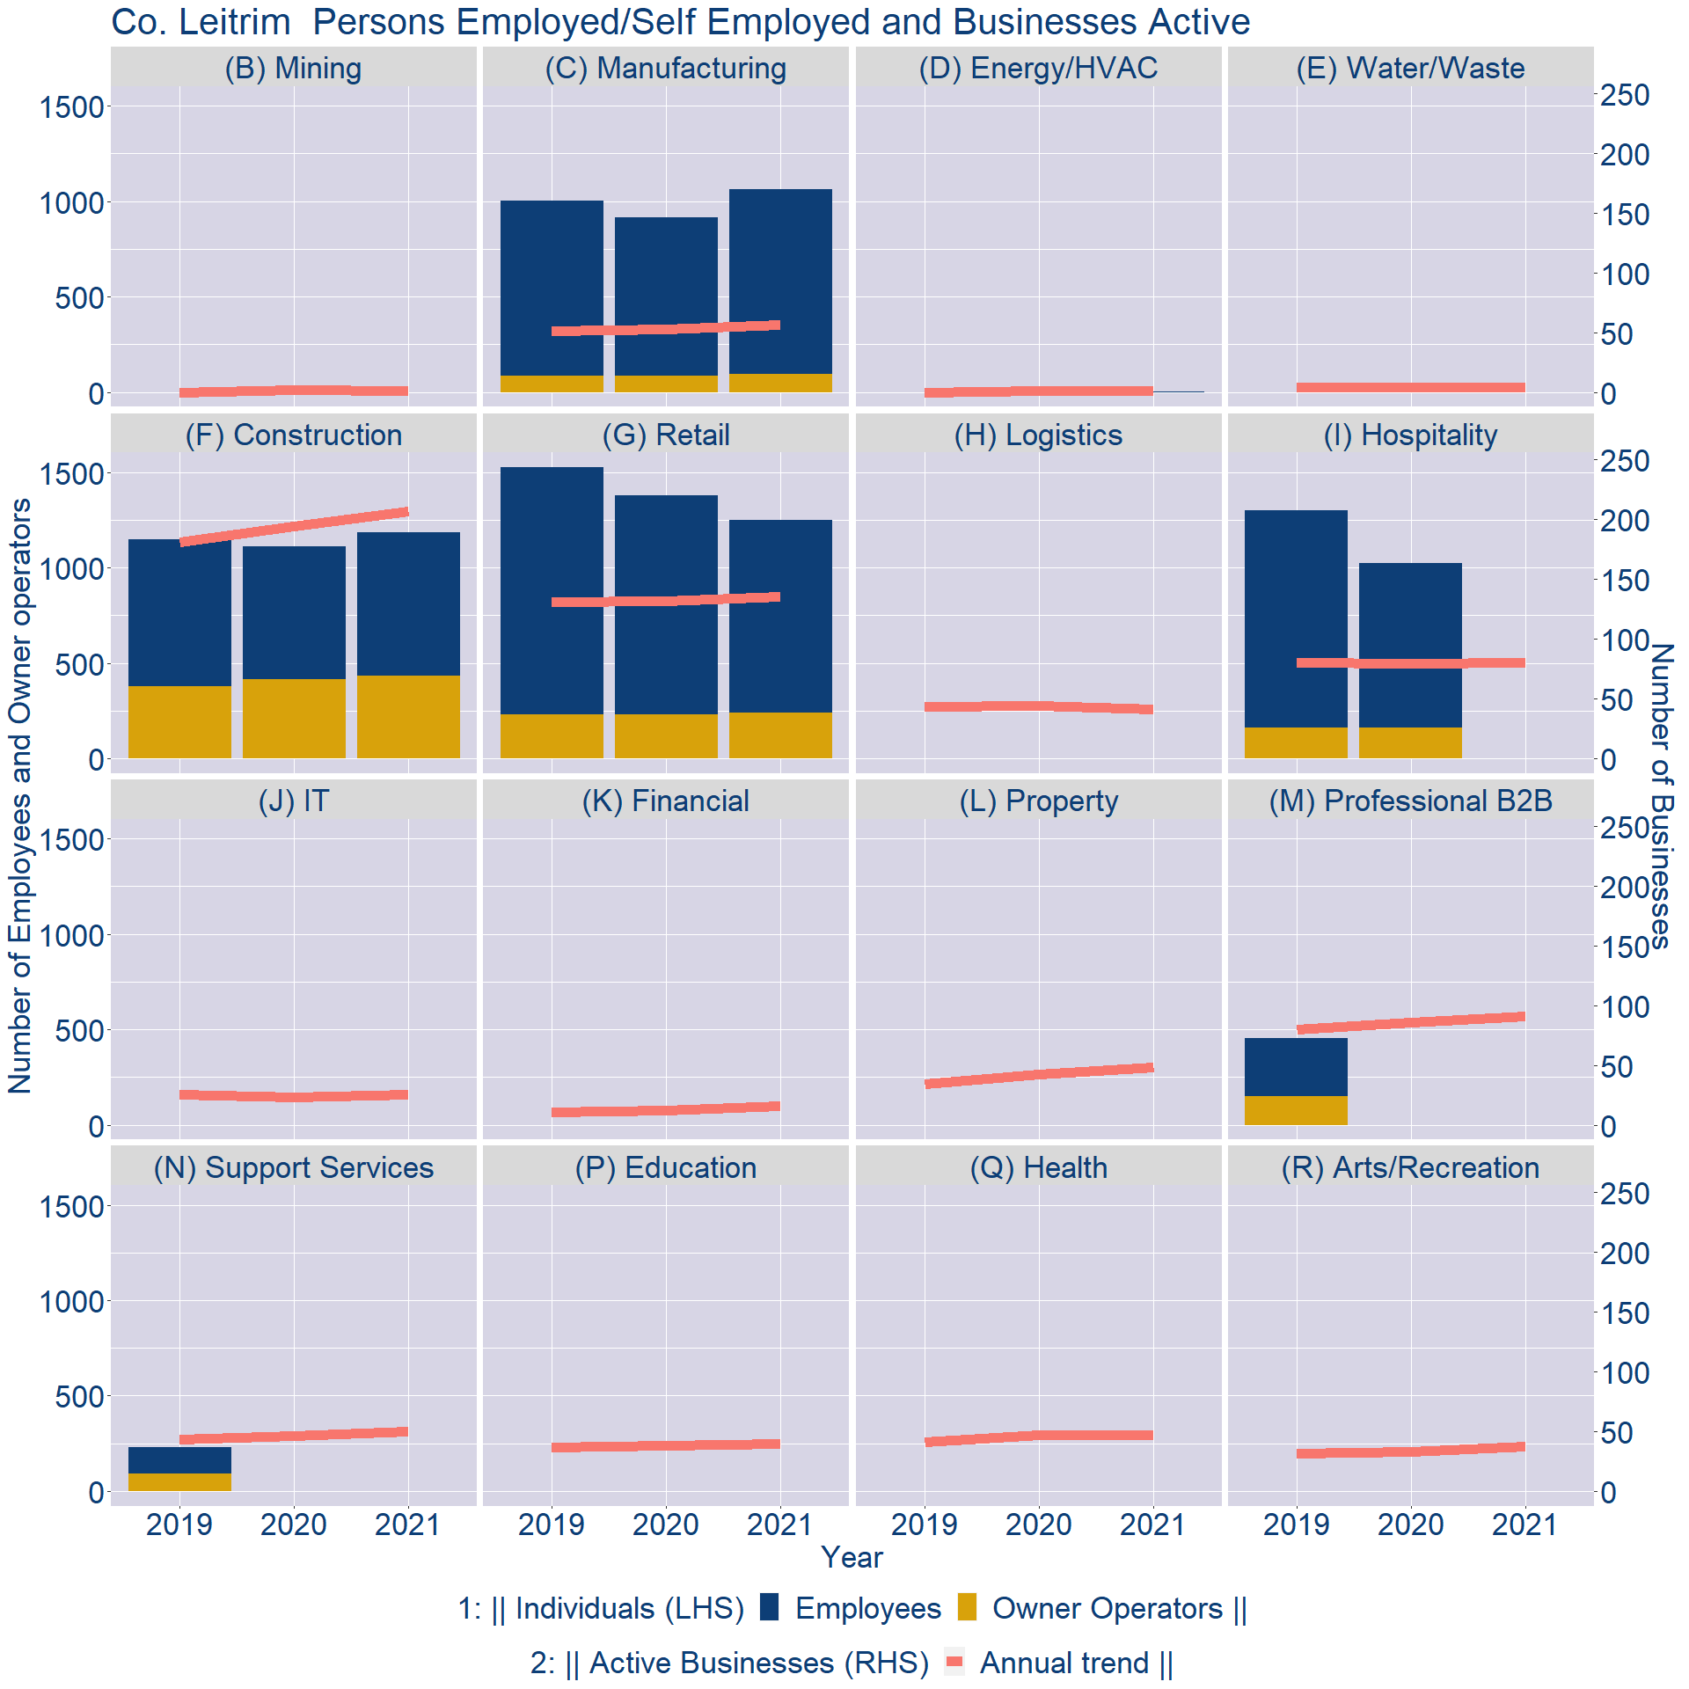
Theme 3: Co. Leitrim Business Demographics

Slide 11
Theme 3: Co. Leitrim Business Demographics
Sectors | Businesses | Owners | Employees
(B) Mining | 3 | 0 | 0
(C) Manufacturing | 156 | 93 | 970
(D) Energy/HVAC | 4 | 0 | 5
(E) Water/Waste | 12 | 0 | 0
(F) Construction | 573 | 434 | 751
(G) Retail | 375 | 239 | 1012
(H) Logistics | 114 | 0 | 0
(I) Hospitality | 223 | 0 | 0
(J) IT | 71 | 0 | 0
(K) Financial | 44 | 0 | 0
(L) Property | 133 | 0 | 0
(M) Professional B2B | 252 | 0 | 0
(N) Support Services | 139 | 0 | 0
(P) Education | 110 | 0 | 0
(Q) Health | 131 | 0 | 0
(R) Arts/Recreation | 103 | 0 | 0
Employment in locally registered businesses, by Sector

Slide 12
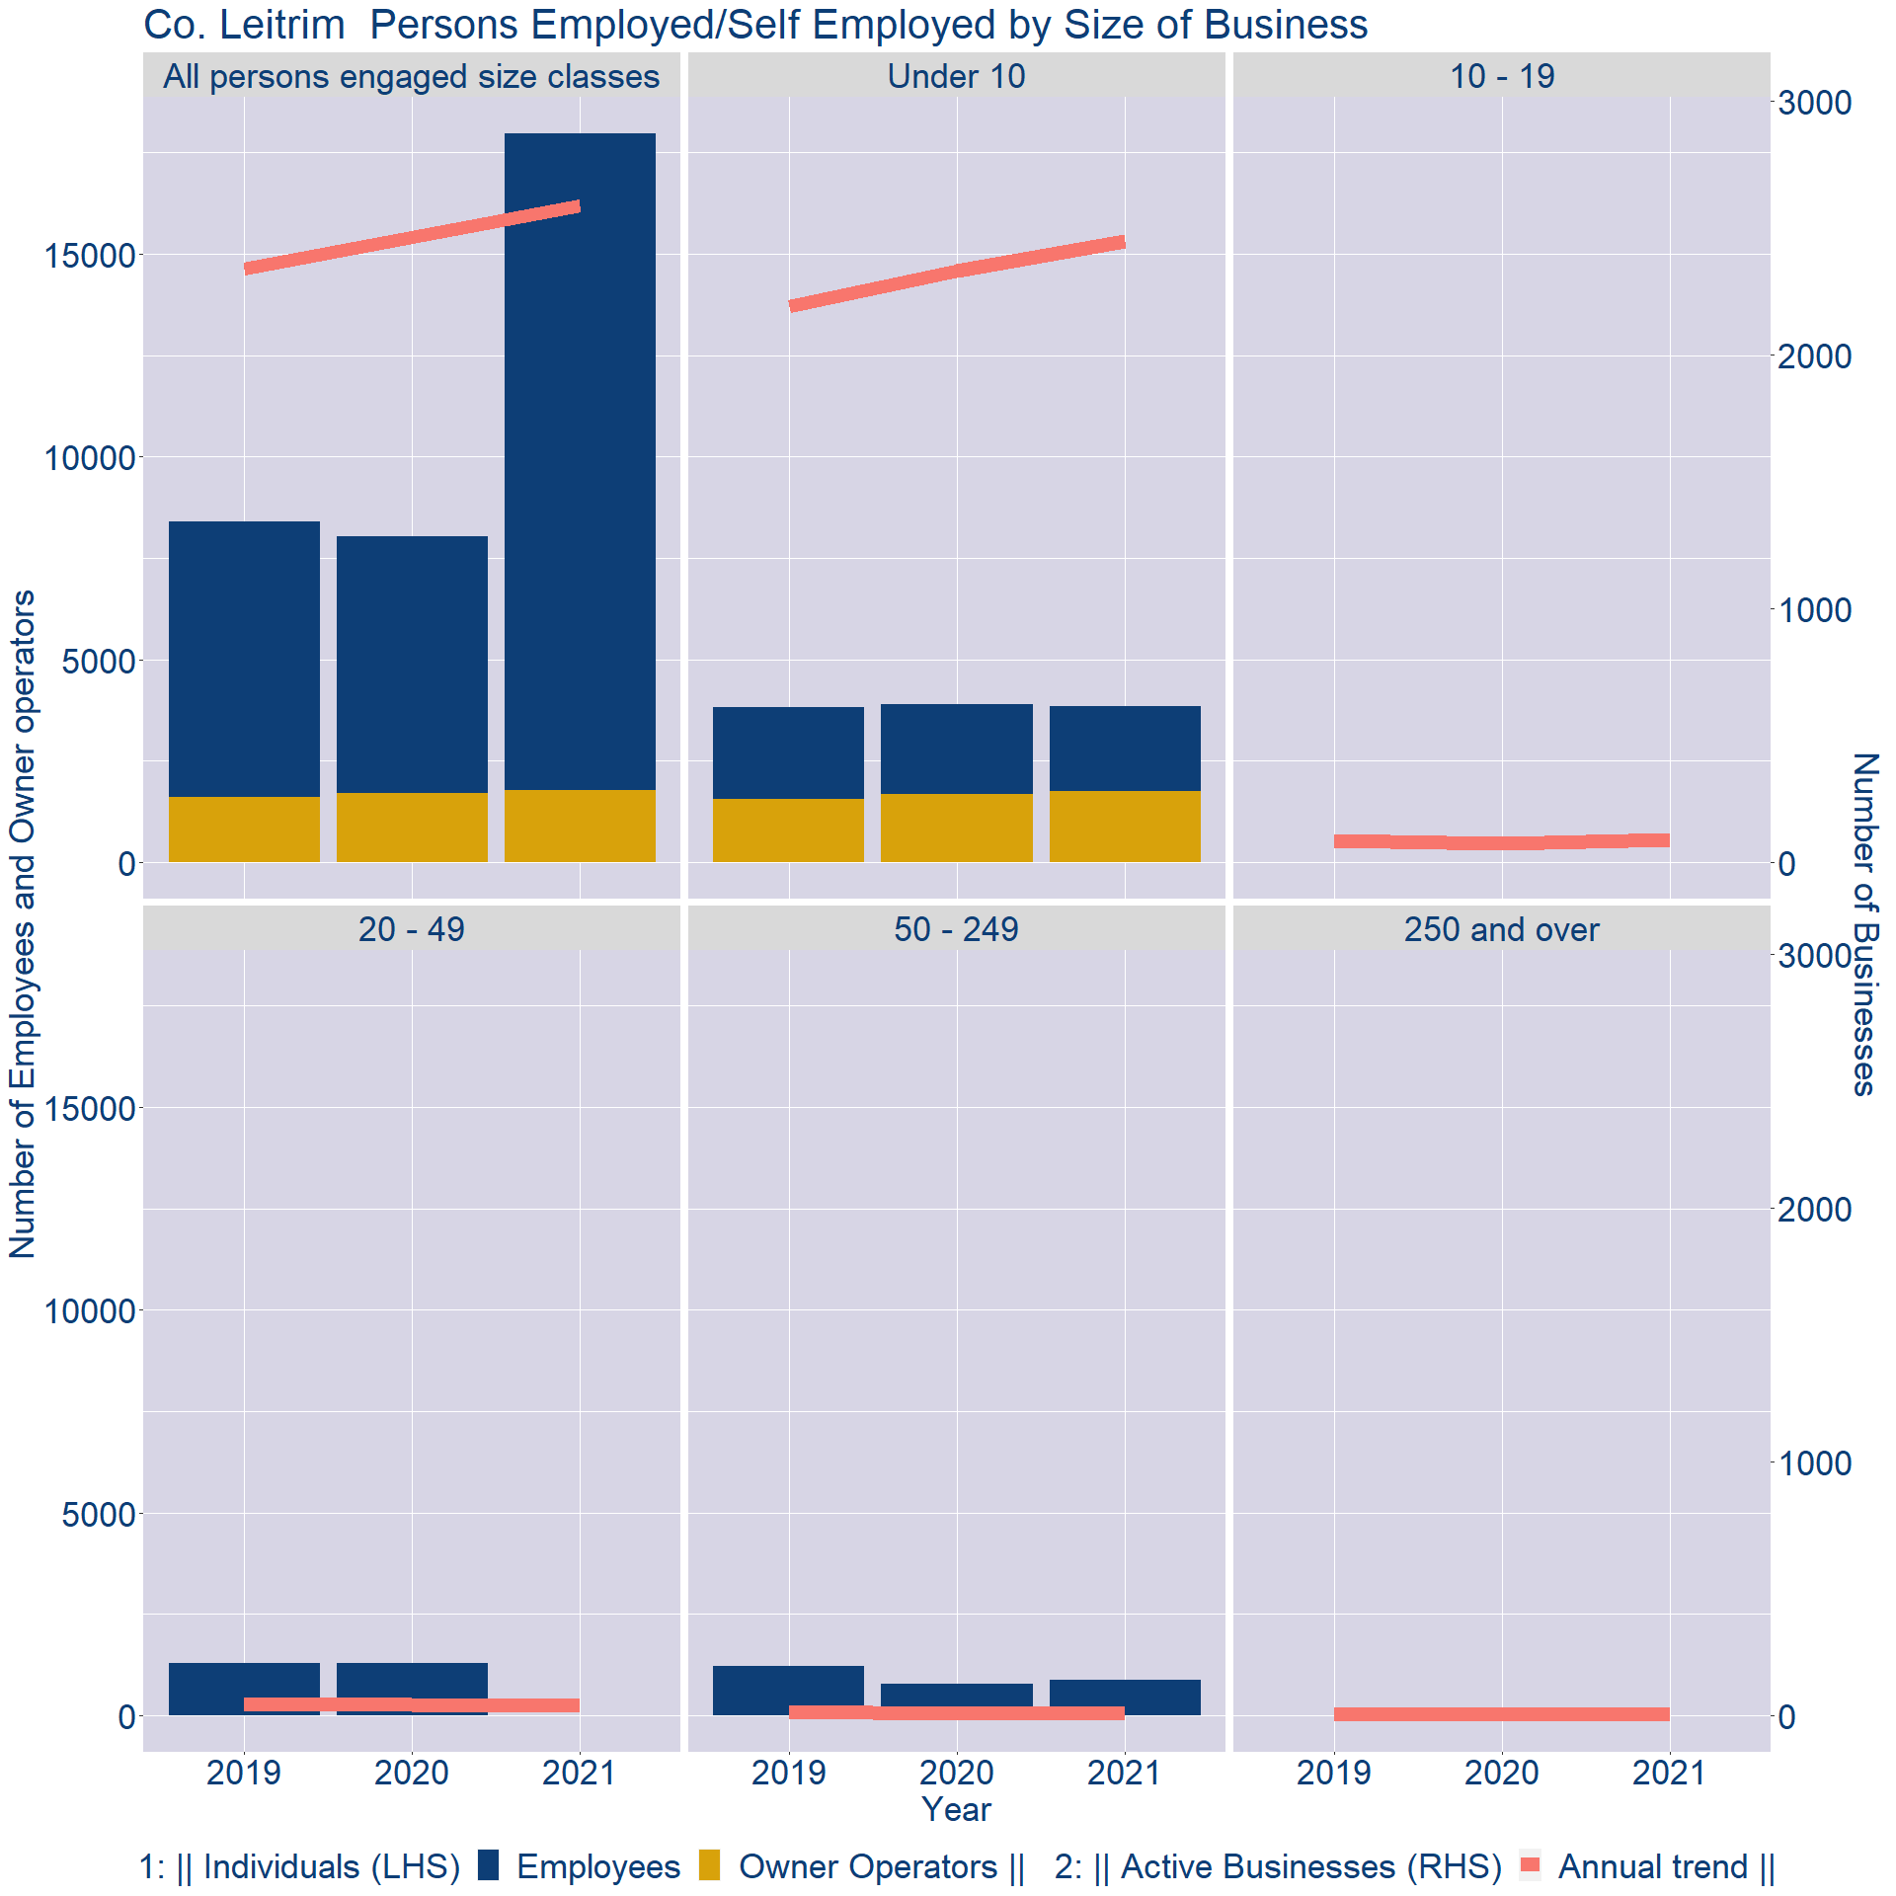
Theme 3: Co. Leitrim Business Demographics
Employment in locally registered businesses, by employer size - 2021

Slide 13
Theme 3: Co. Leitrim Business Demographics
Employment.Size | Businesses | Owners | Employees
All persons engaged size classes | 2588 | 1774 | 16206
Under 10 | 2448 | 1740 | 2104
10 - 19 | 89 | 0 | 0
20 - 49 | 39 | 0 | 0
50 - 249 | 9 | 0 | 864
250 and over | 3 | 0 | 0
Employment in locally registered businesses, by employer size - 2021

