Slide 1
Laois County Business & Employment Demographics
Chambers Ireland

Slide 2
Theme 1: Laois County Rates & LPT Income
Audience: Existing/Prospective Local Authority members
Highlights: Increasing reliance on Commercial Rates to support Local Authority Activities
Key messages:
Local Authority Budget Reform needed
Rates system putting pressure on labour intensive & vulnerable sectors
Hospitality
Retail
Manufacturing
Obligation on Local Authority to use these taxes effectively

Slide 3
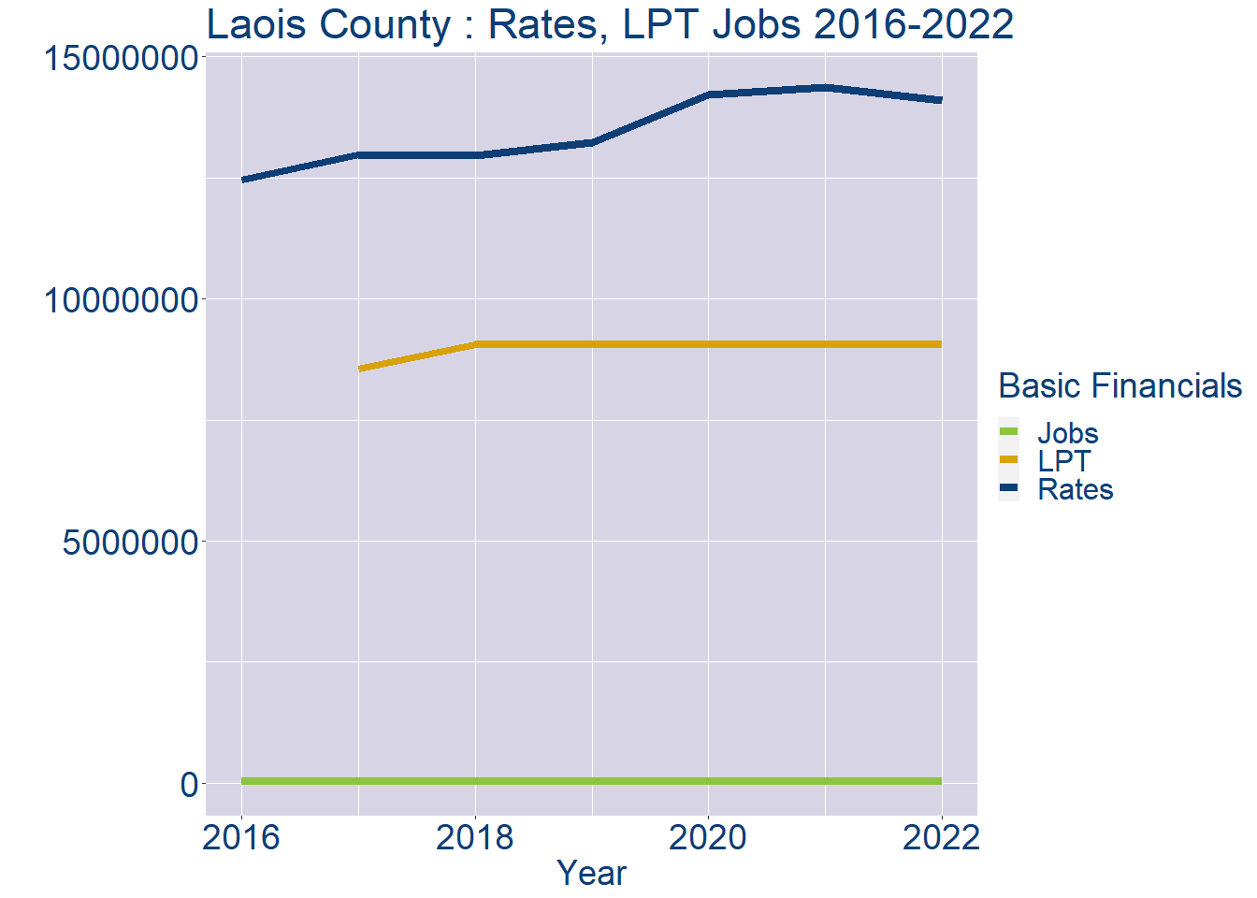
Theme 1: Laois County Rates & LPT Income
Laois County Local Authority Rates and LPT: 2016-2022
Year | Jobs | LPT | Rates
2016 | 33541 | NA | 12453983
2017 | 34607 | 8558877 | 12982287
2018 | 35673 | 9051699 | 12970376
2019 | 36739 | 9052793 | 13237004
2020 | 37805 | 9054132 | 14213255
2021 | 38871 | 9063079 | 14367844
2022 | 39934 | 9065148 | 14103225

Slide 4
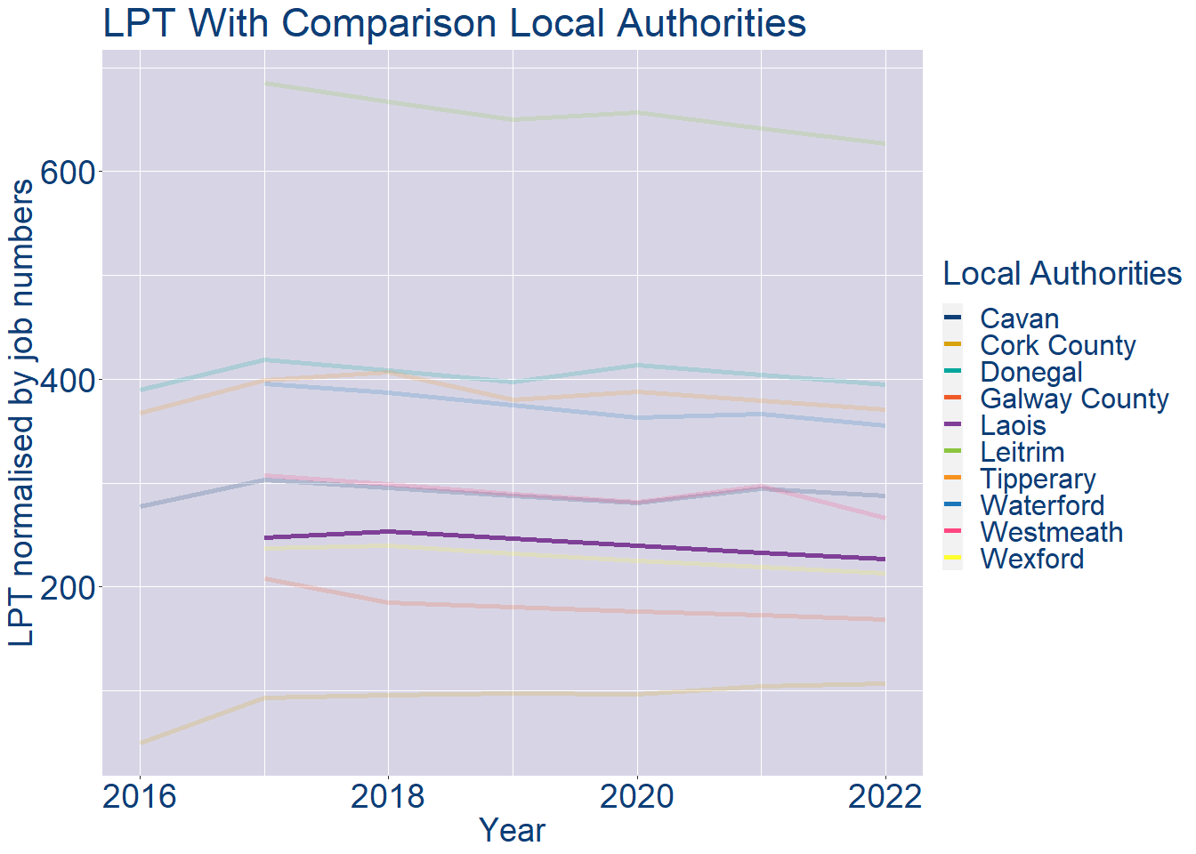
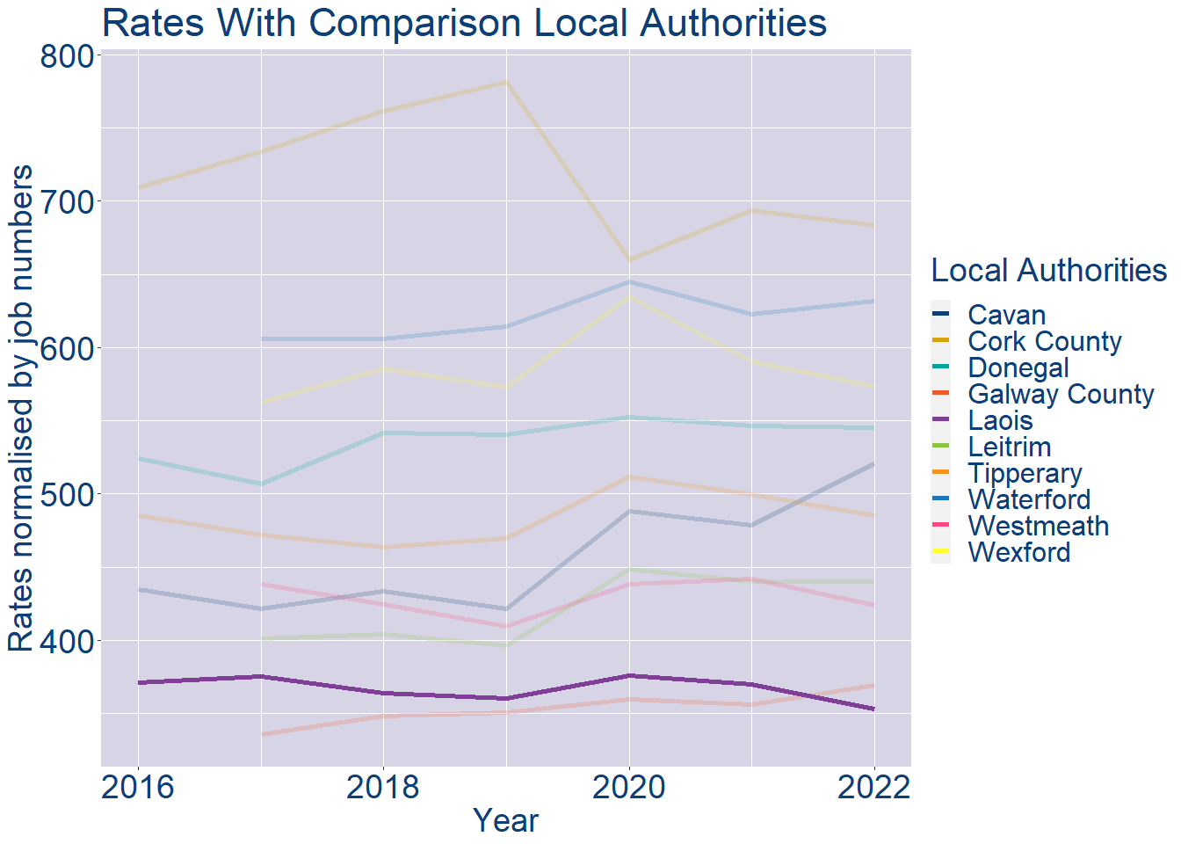
Theme 1: Laois County Rates & LPT Income
Laois County Local Authority 2022 LPT/employee €227
Laois County Local Authority 2022 Rates/employee €353

Slide 5
Theme 2: Laois County Workforce Demographics
Audience: Membership/Businesses that are interested in expanding into the local area
Highlights: Workforce details, who is available, education level, population growth
Key messages:
Varies from Local Authority area to area
Important for you to understand the numbers of people who are available to work in your area, their experience levels and the training they have

Slide 6
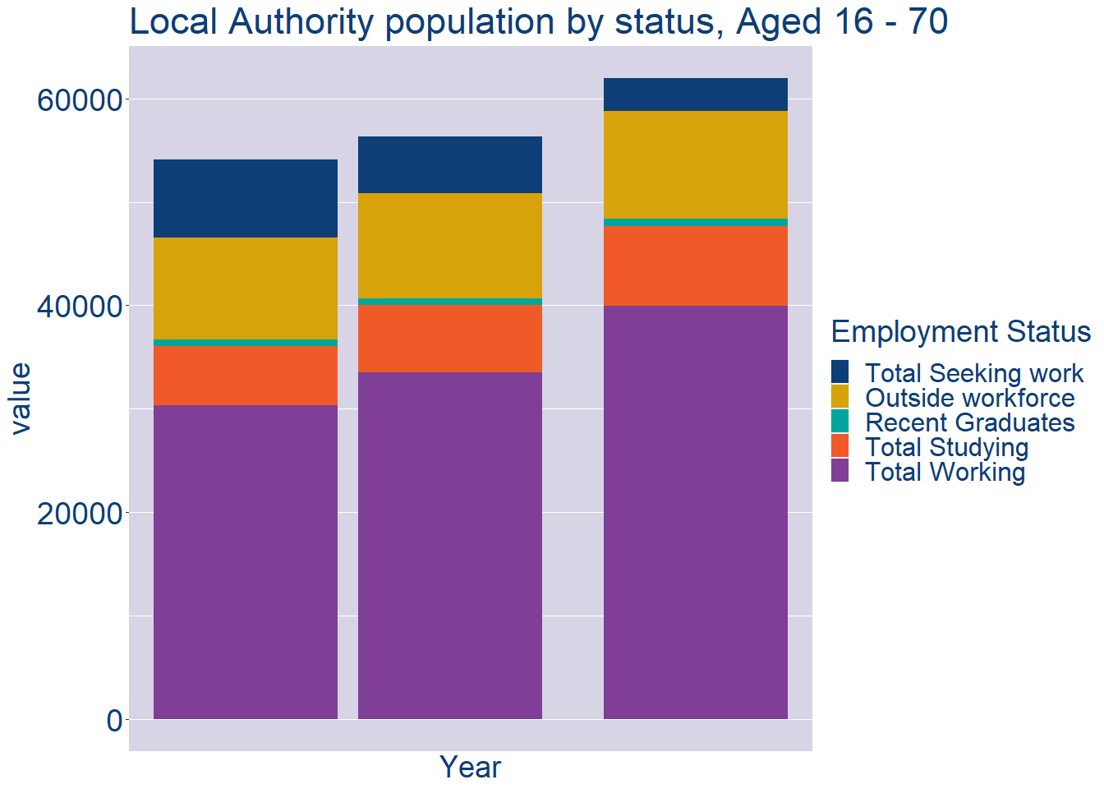
Theme 2: Laois County Workforce Demographics
Laois County Local Authority Workforce Population
Year | 2022
Total_working | 39934
Total_studying | 7703
Total_recent_grads | 727
Total_job_seeking | 3172
Total_not_seeking | 10440

Slide 7
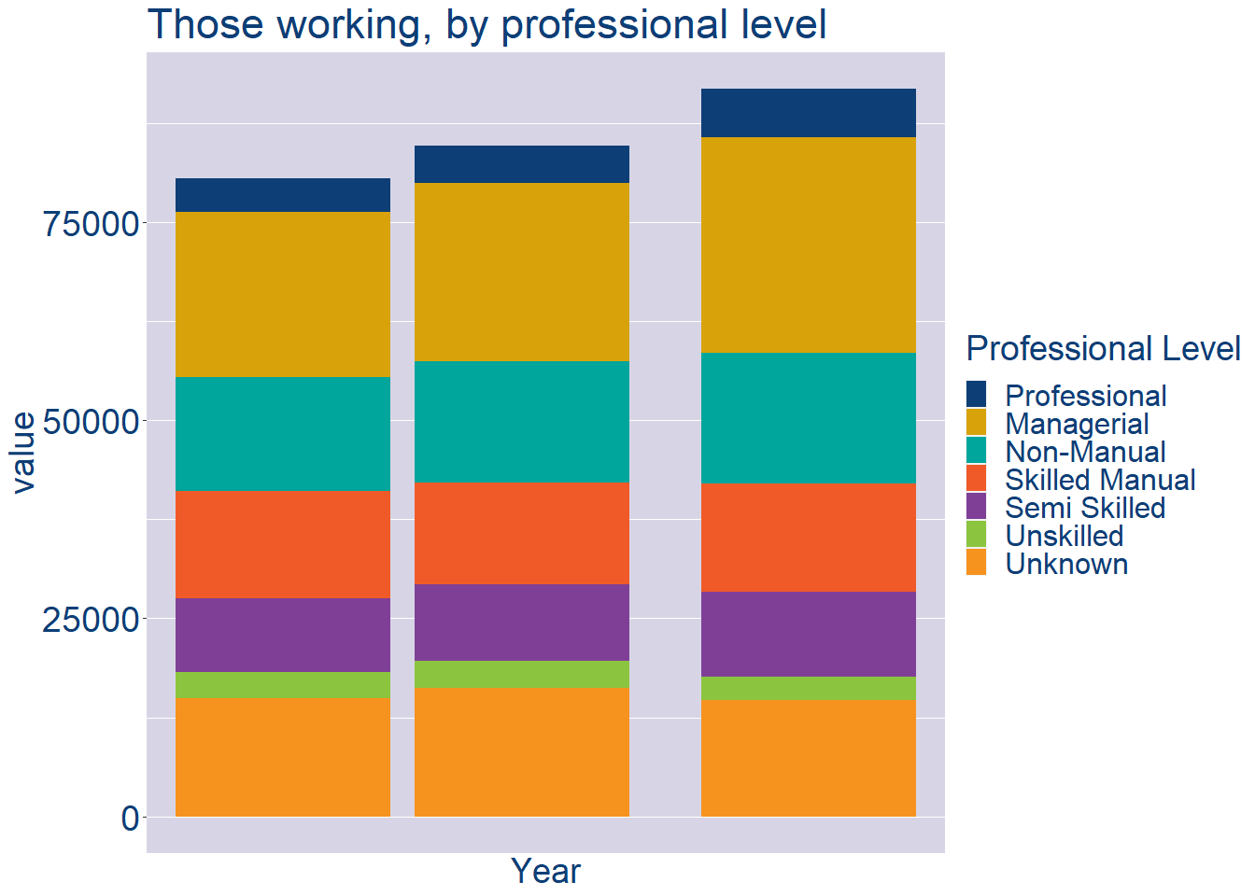
Theme 2: Laois County Workforce Demographics
Laois County Local Authority Workforce Experience Level
Year | 2022
Professional | 6085
Managerial | 27310
Non_Manual | 16400
Skilled_Manual | 13673
Semi_Skilled | 10800
Unskilled | 2911
All_Others | 14698

Slide 8
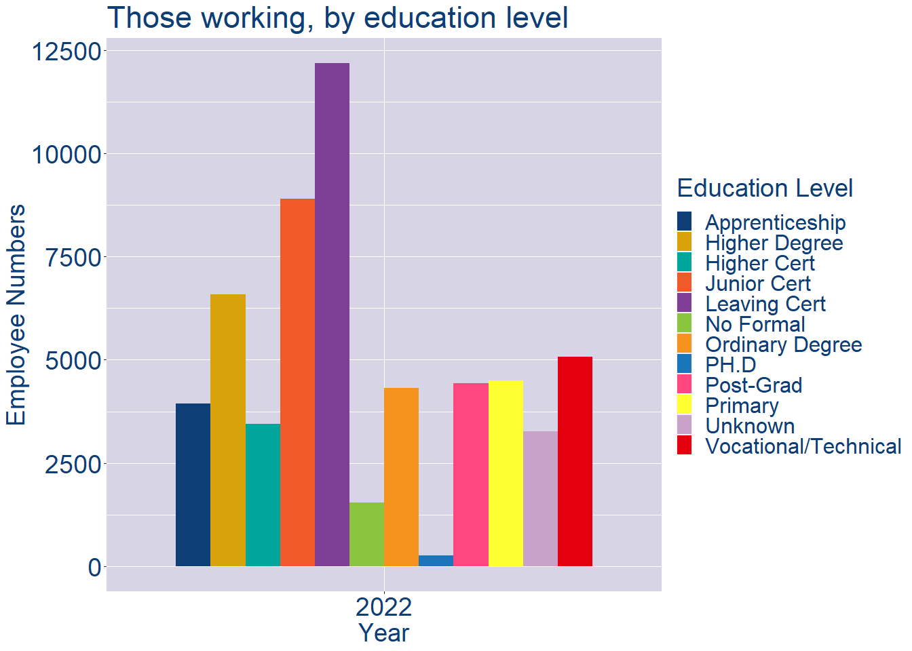
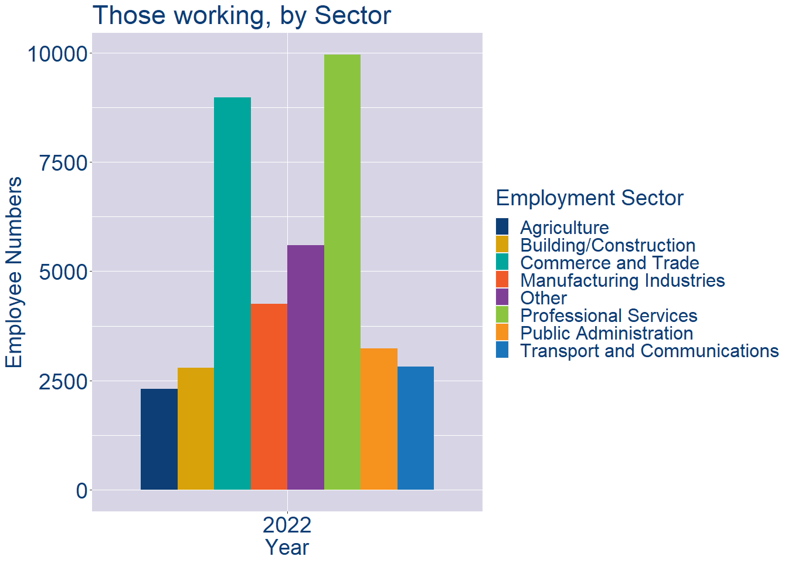
Theme 2: Laois County Workforce Demographics
Laois County Local Authority Workforce Education Level
Laois County Local Authority Workforce Sectors

Slide 9
Theme 3: Co. Laois Business Demographics
Audience: Internal to Chambers
Highlights: Local Business Community Information
Key messages:
Varies from Local Authority area to area
Local market intelligence to help you identify trends in your local area’s business community i.e.:
Sectoral activity increasing/decreasing
What sectors the self-employed are active in

Slide 10
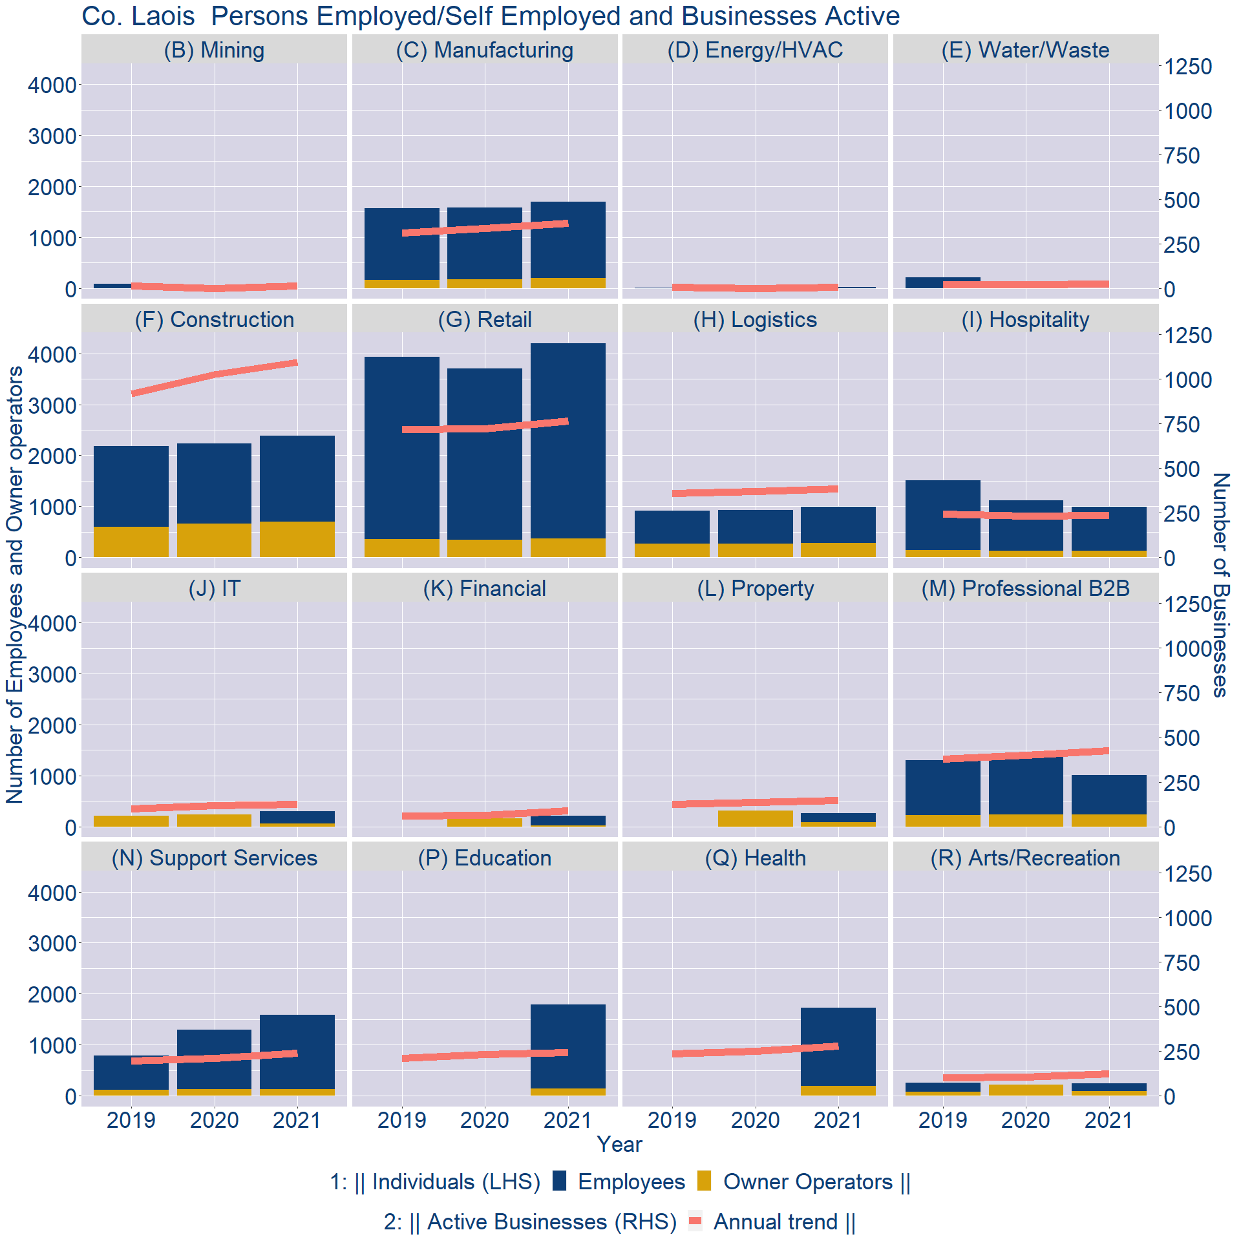
Theme 3: Co. Laois Business Demographics

Slide 11
Theme 3: Co. Laois Business Demographics
Sectors | Businesses | Owners | Employees
(B) Mining | 11 | 0 | 0
(C) Manufacturing | 332 | 195 | 1498
(D) Energy/HVAC | 6 | 0 | 18
(E) Water/Waste | 21 | 0 | 0
(F) Construction | 993 | 702 | 1683
(G) Retail | 693 | 370 | 3831
(H) Logistics | 350 | 276 | 708
(I) Hospitality | 215 | 122 | 862
(J) IT | 114 | 53 | 242
(K) Financial | 80 | 20 | 190
(L) Property | 132 | 84 | 182
(M) Professional B2B | 387 | 240 | 767
(N) Support Services | 218 | 130 | 1453
(P) Education | 221 | 138 | 1652
(Q) Health | 253 | 185 | 1545
(R) Arts/Recreation | 111 | 82 | 158
Employment in locally registered businesses, by Sector

Slide 12
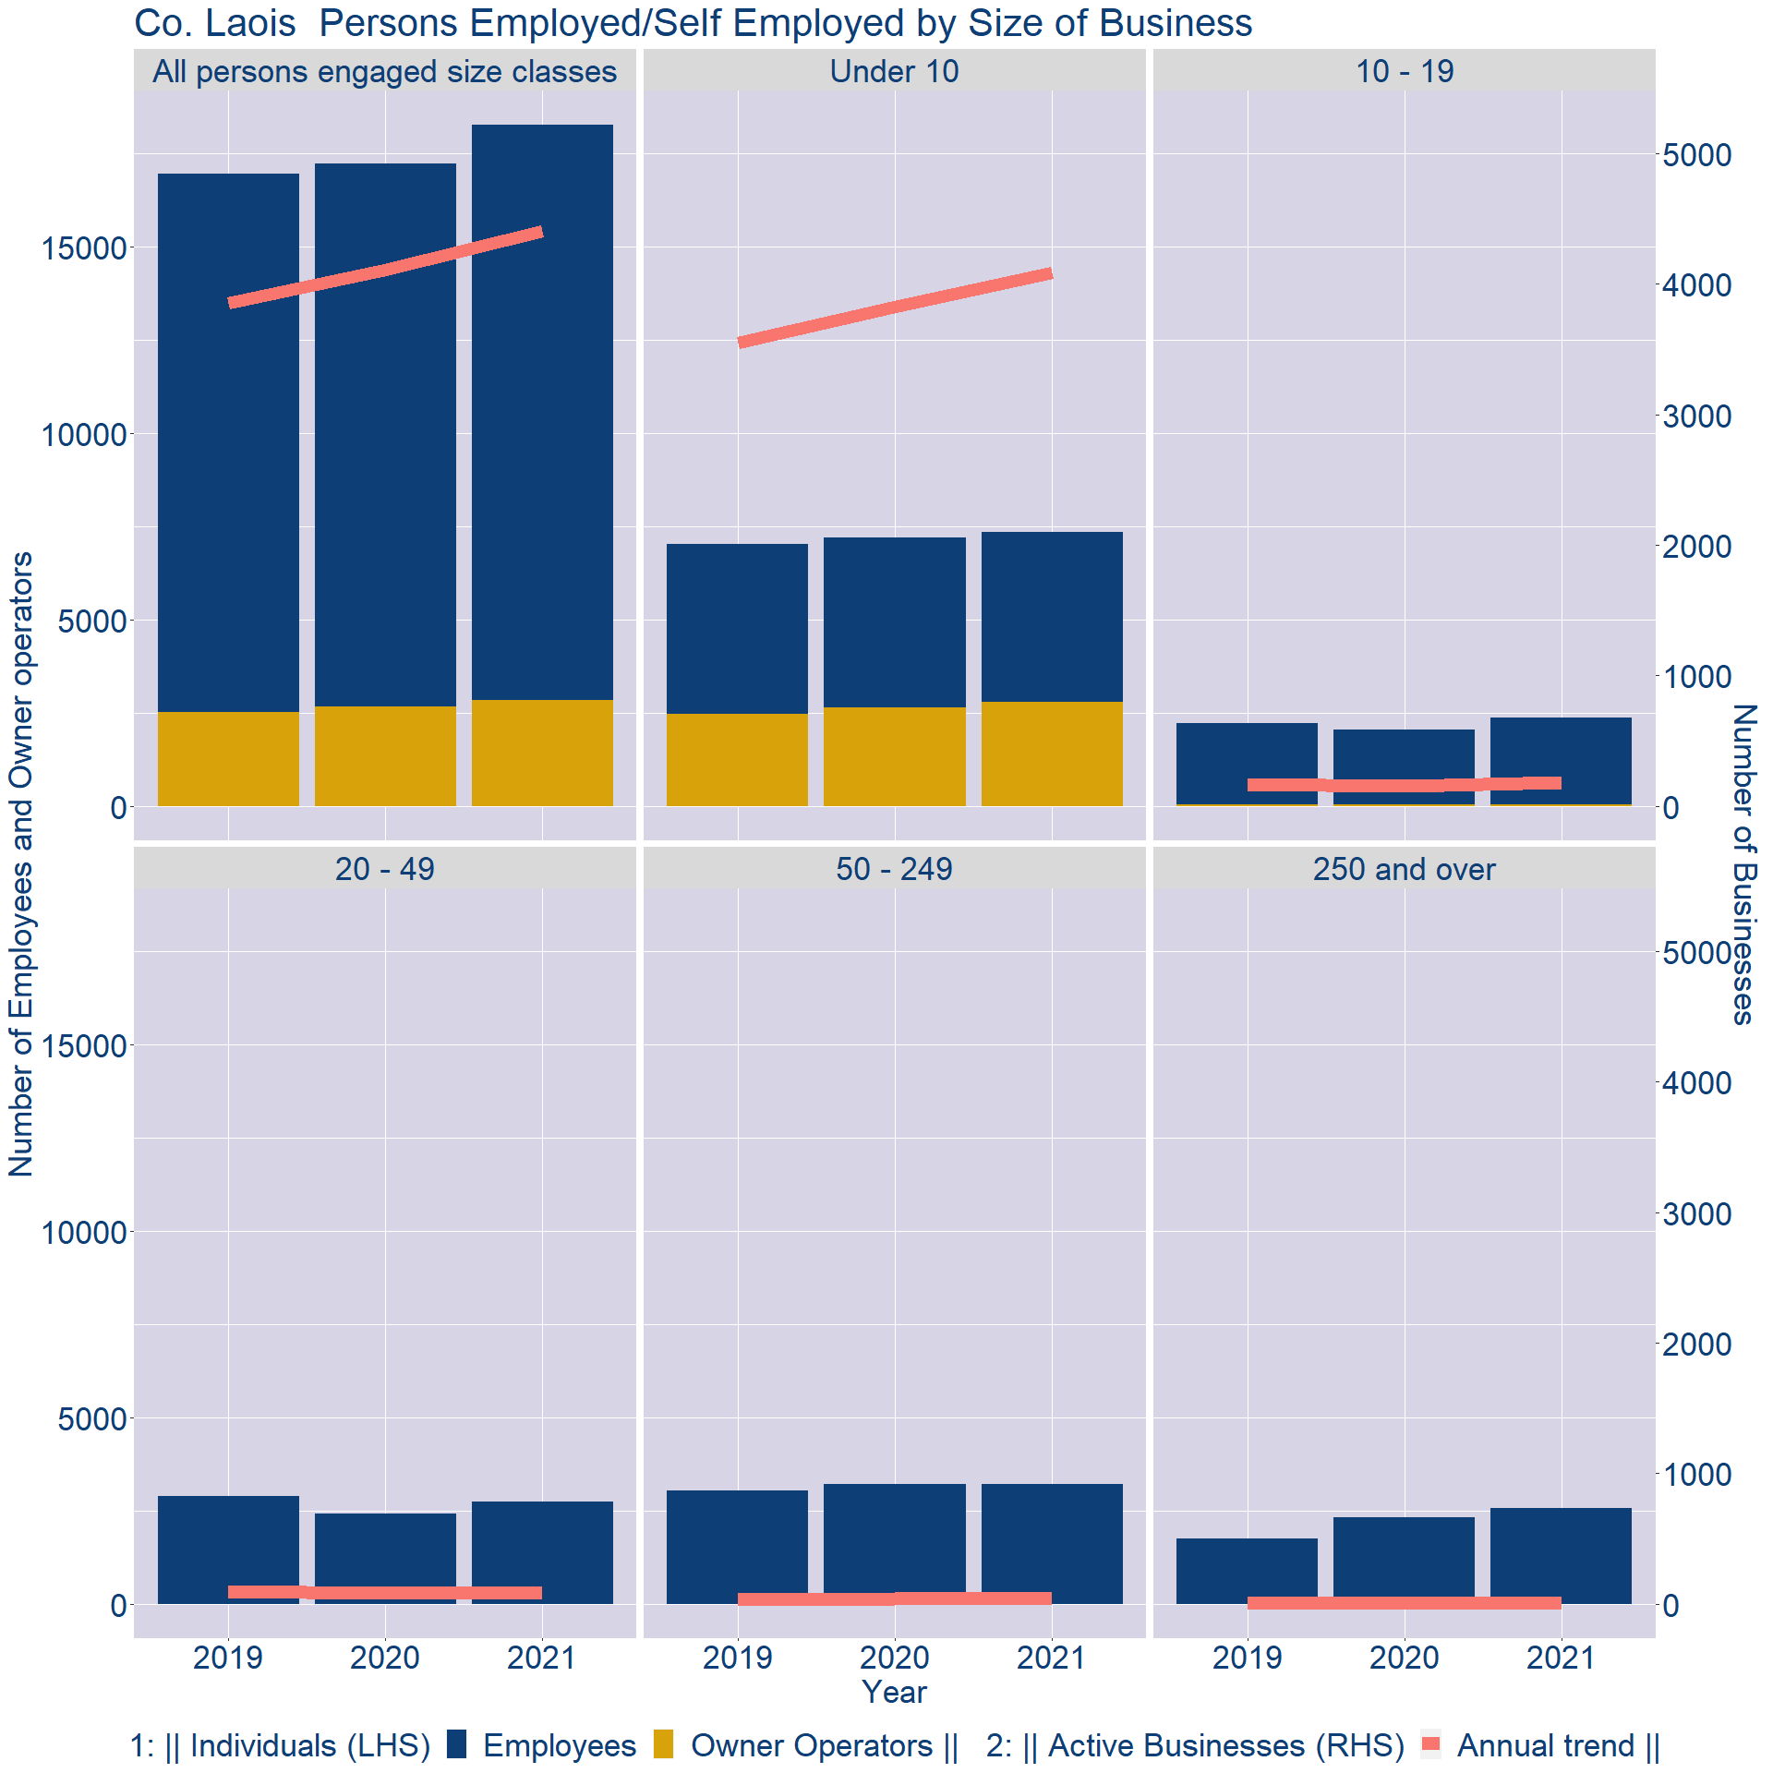
Theme 3: Co. Laois Business Demographics
Employment in locally registered businesses, by employer size - 2021

Slide 13
Theme 3: Co. Laois Business Demographics
Employment.Size | Businesses | Owners | Employees
All persons engaged size classes | 4404 | 2852 | 15417
Under 10 | 4088 | 2804 | 4553
10 - 19 | 180 | 42 | 2326
20 - 49 | 94 | 6 | 2748
50 - 249 | 38 | 0 | 3221
250 and over | 4 | 0 | 2569
Employment in locally registered businesses, by employer size - 2021

