Slide 1
Kildare County Business & Employment Demographics
Chambers Ireland

Slide 2
Theme 1: Kildare County Rates & LPT Income
Audience: Existing/Prospective Local Authority members
Highlights: Increasing reliance on Commercial Rates to support Local Authority Activities
Key messages:
Local Authority Budget Reform needed
Rates system putting pressure on labour intensive & vulnerable sectors
Hospitality
Retail
Manufacturing
Obligation on Local Authority to use these taxes effectively

Slide 3
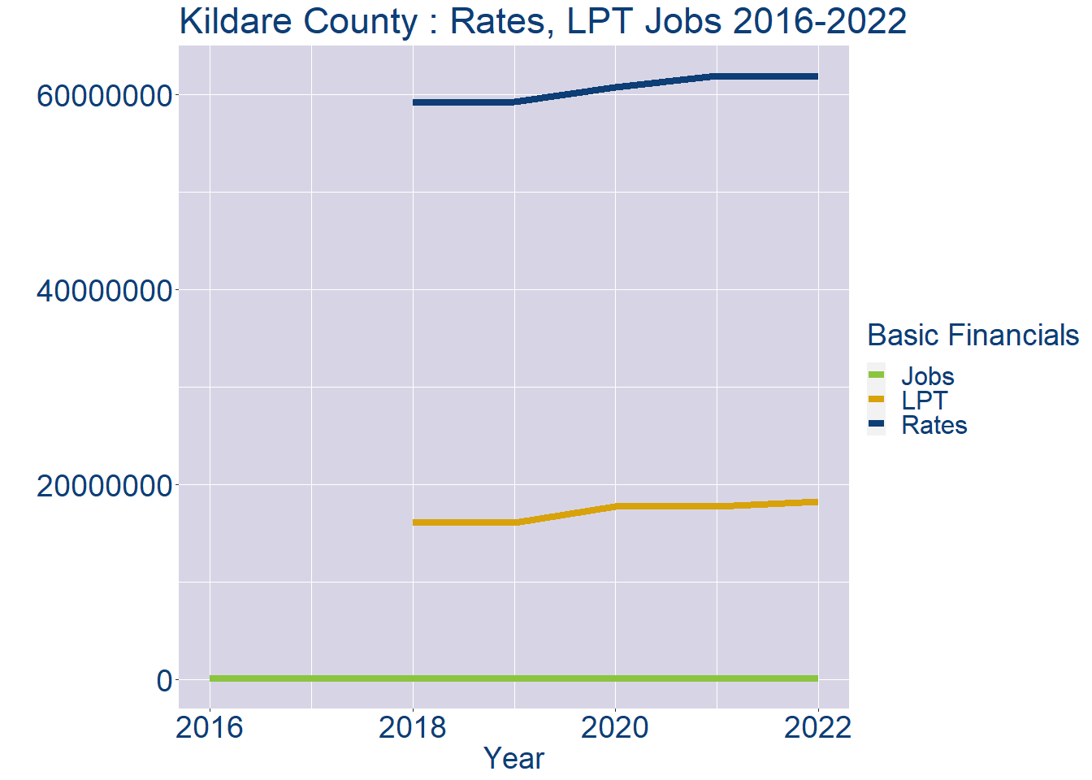
Theme 1: Kildare County Rates & LPT Income
Kildare County Local Authority Rates and LPT: 2016-2022
Year | Jobs | LPT | Rates
2016 | 95947 | NA | NA
2017 | 99094 | NA | NA
2018 | 102241 | 16079635 | 59154552
2019 | 105388 | 16090559 | 59276480
2020 | 108535 | 17731578 | 60785745
2021 | 111682 | 17726658 | 61913937
2022 | 114829 | 18289092 | 61837115

Slide 4
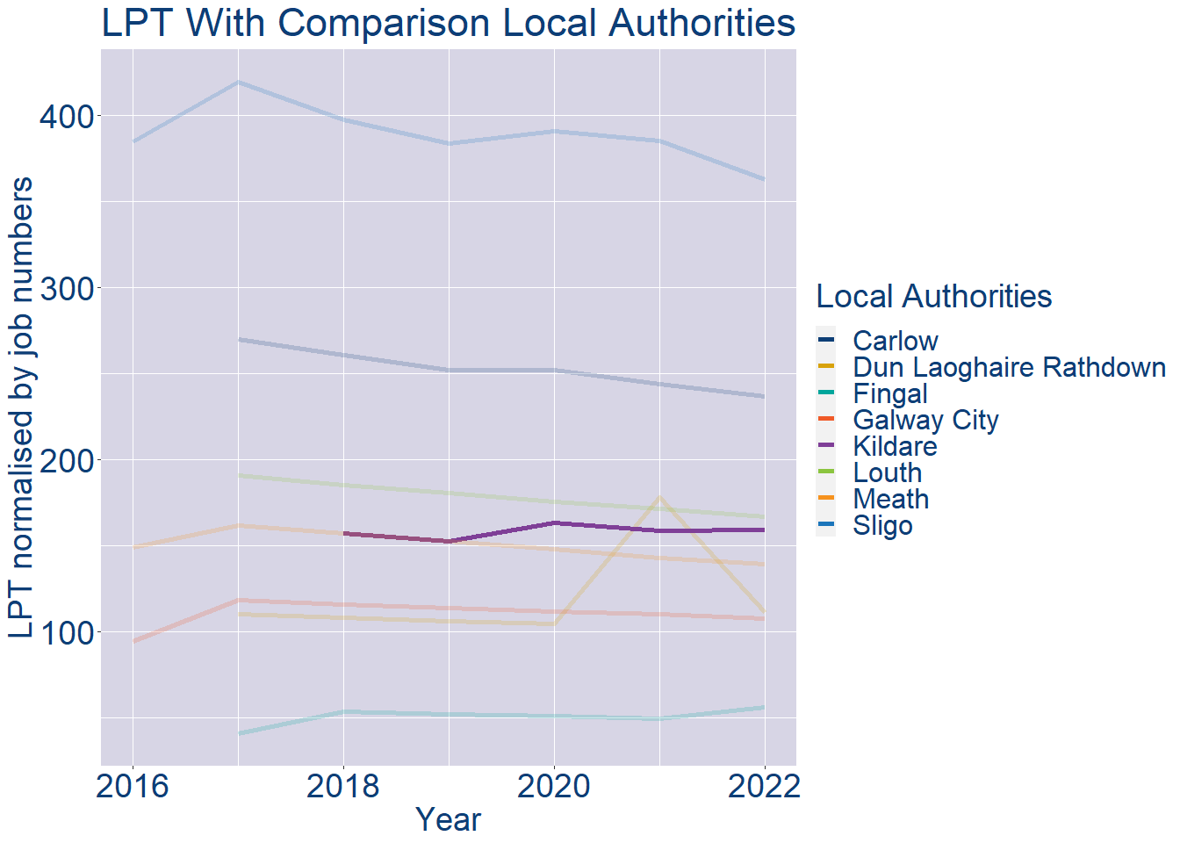
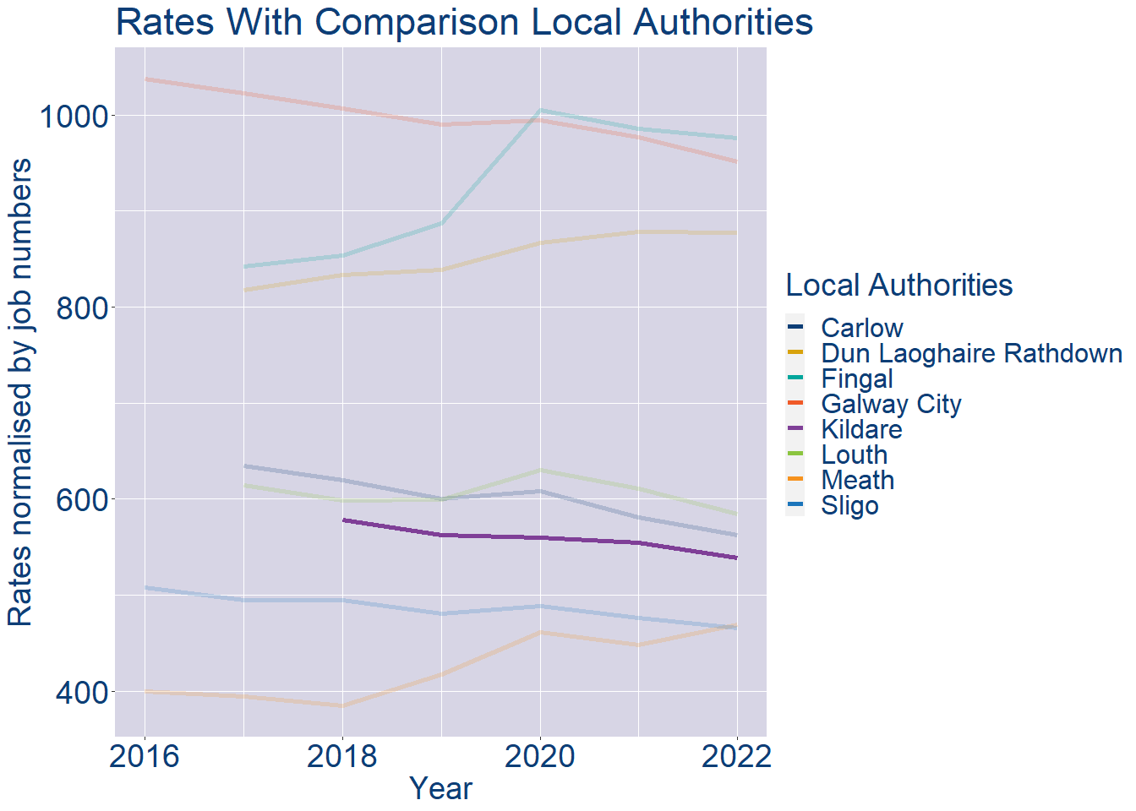
Theme 1: Kildare County Rates & LPT Income
Kildare County Local Authority 2022 LPT/employee €159
Kildare County Local Authority 2022 Rates/employee €539

Slide 5
Theme 2: Kildare County Workforce Demographics
Audience: Membership/Businesses that are interested in expanding into the local area
Highlights: Workforce details, who is available, education level, population growth
Key messages:
Varies from Local Authority area to area
Important for you to understand the numbers of people who are available to work in your area, their experience levels and the training they have

Slide 6
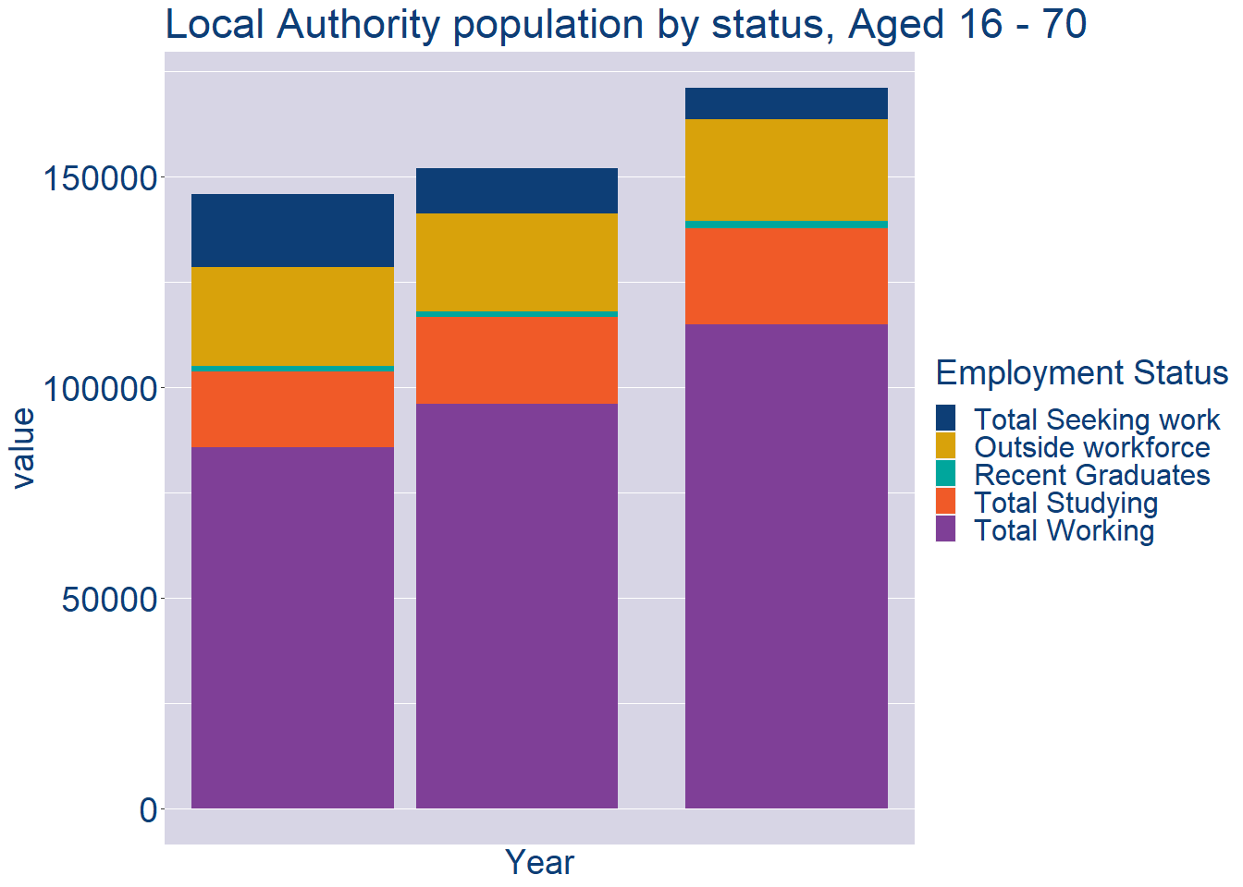
Theme 2: Kildare County Workforce Demographics
Kildare County Local Authority Workforce Population
Year | 2022
Total_working | 114829
Total_studying | 22926
Total_recent_grads | 1580
Total_job_seeking | 7419
Total_not_seeking | 24236

Slide 7
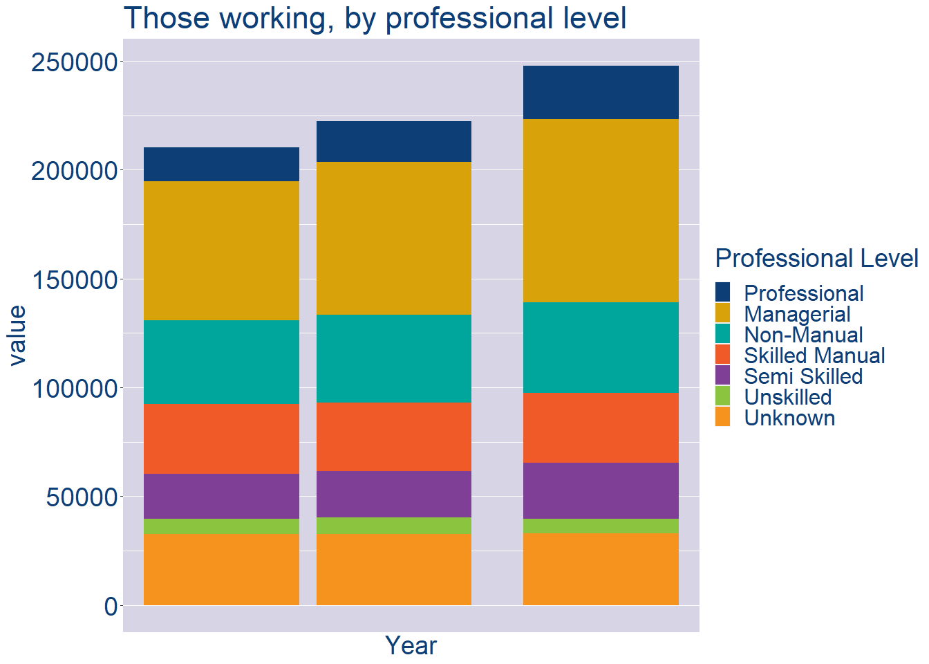
Theme 2: Kildare County Workforce Demographics
Kildare County Local Authority Workforce Experience Level
Year | 2022
Professional | 24388
Managerial | 84186
Non_Manual | 41686
Skilled_Manual | 32172
Semi_Skilled | 25712
Unskilled | 6816
All_Others | 32814

Slide 8
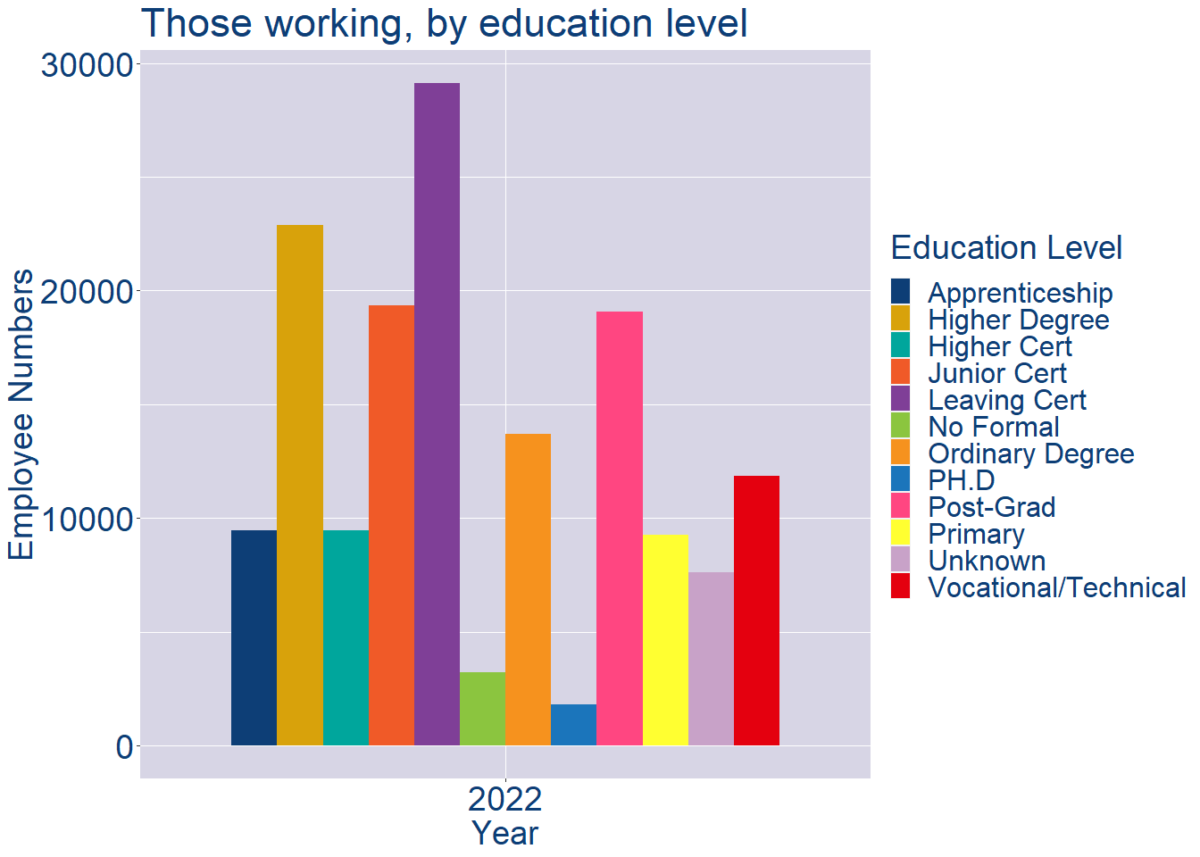
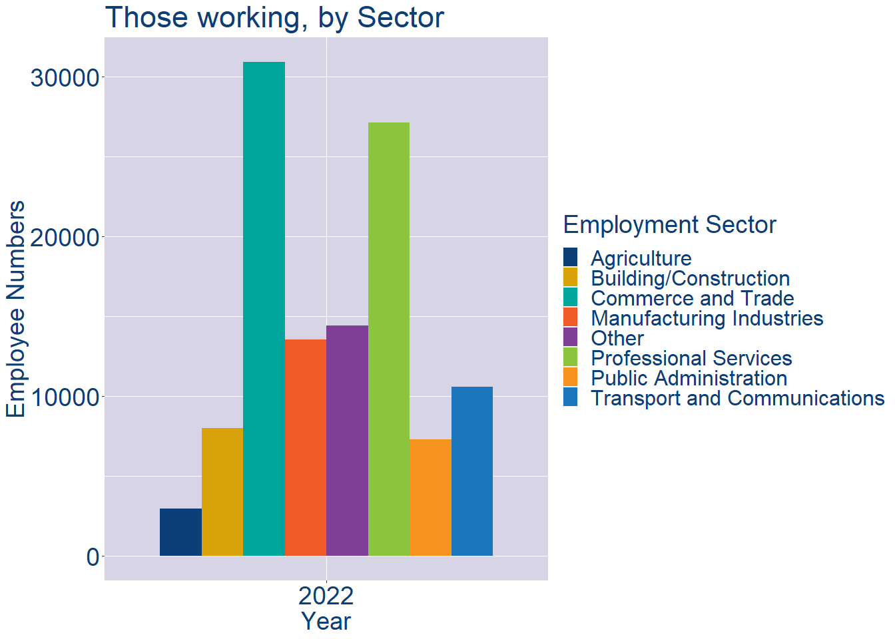
Theme 2: Kildare County Workforce Demographics
Kildare County Local Authority Workforce Education Level
Kildare County Local Authority Workforce Sectors

Slide 9
Theme 3: Co. Kildare Business Demographics
Audience: Internal to Chambers
Highlights: Local Business Community Information
Key messages:
Varies from Local Authority area to area
Local market intelligence to help you identify trends in your local area’s business community i.e.:
Sectoral activity increasing/decreasing
What sectors the self-employed are active in

Slide 10
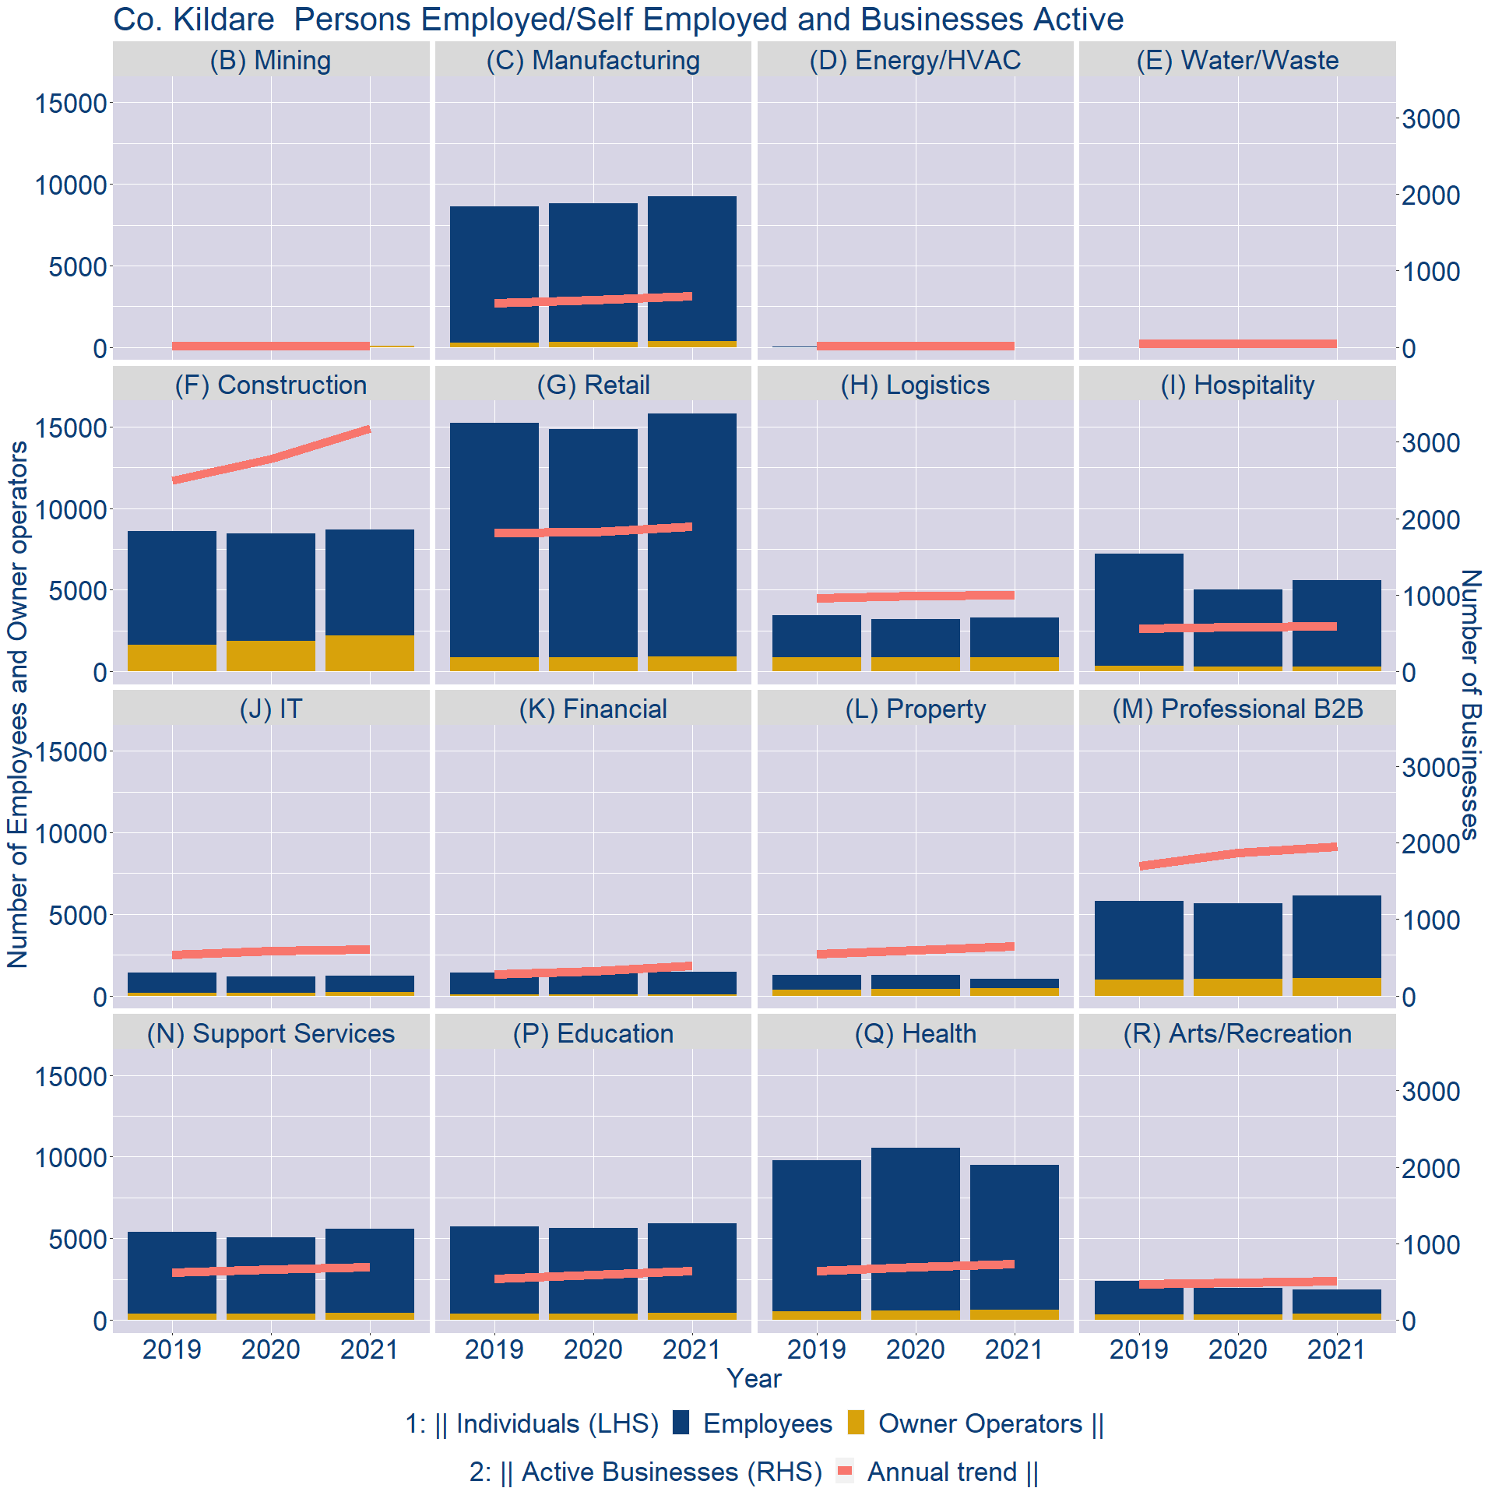
Theme 3: Co. Kildare Business Demographics

Slide 11
Theme 3: Co. Kildare Business Demographics
Sectors | Businesses | Owners | Employees
(B) Mining | 18 | 89 | 0
(C) Manufacturing | 722 | 382 | 8847
(D) Energy/HVAC | 23 | 0 | 0
(E) Water/Waste | 53 | 0 | 0
(F) Construction | 3417 | 2223 | 6474
(G) Retail | 2030 | 894 | 14916
(H) Logistics | 1068 | 848 | 2426
(I) Hospitality | 635 | 304 | 5286
(J) IT | 654 | 208 | 994
(K) Financial | 419 | 86 | 1379
(L) Property | 698 | 439 | 602
(M) Professional B2B | 2096 | 1060 | 5059
(N) Support Services | 746 | 417 | 5160
(P) Education | 686 | 444 | 5493
(Q) Health | 791 | 600 | 8884
(R) Arts/Recreation | 547 | 369 | 1478
Employment in locally registered businesses, by Sector

Slide 12
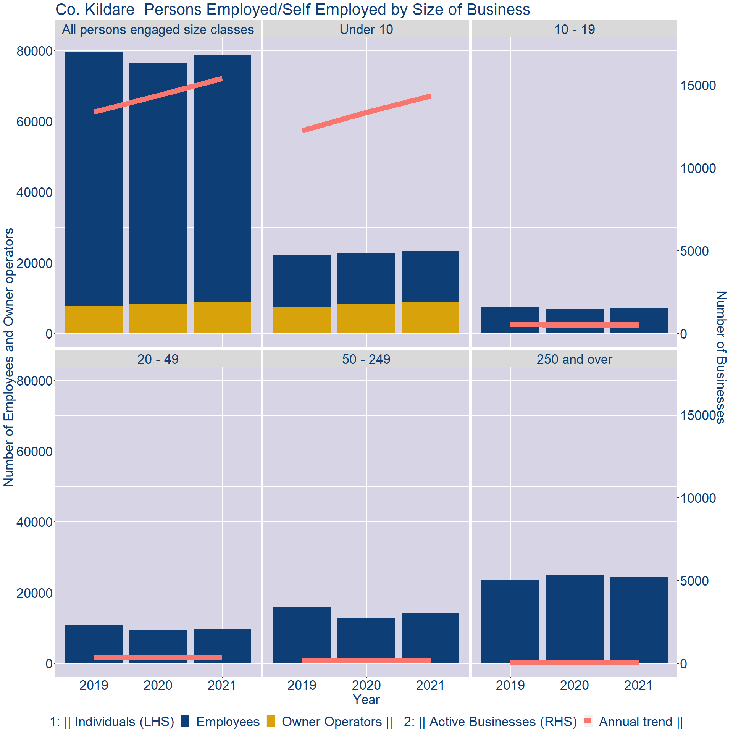
Theme 3: Co. Kildare Business Demographics
Employment in locally registered businesses, by employer size - 2021

Slide 13
Theme 3: Co. Kildare Business Demographics
Employment.Size | Businesses | Owners | Employees
All persons engaged size classes | 15372 | 8943 | 69699
Under 10 | 14325 | 8801 | 14548
10 - 19 | 538 | 108 | 7112
20 - 49 | 329 | 31 | 9660
50 - 249 | 153 | 2 | 14077
250 and over | 27 | 1 | 24302
Employment in locally registered businesses, by employer size - 2021

