Slide 1
Kerry County Business & Employment Demographics
Chambers Ireland

Slide 2
Theme 1: Kerry County Rates & LPT Income
Audience: Existing/Prospective Local Authority members
Highlights: Increasing reliance on Commercial Rates to support Local Authority Activities
Key messages:
Local Authority Budget Reform needed
Rates system putting pressure on labour intensive & vulnerable sectors
Hospitality
Retail
Manufacturing
Obligation on Local Authority to use these taxes effectively

Slide 3
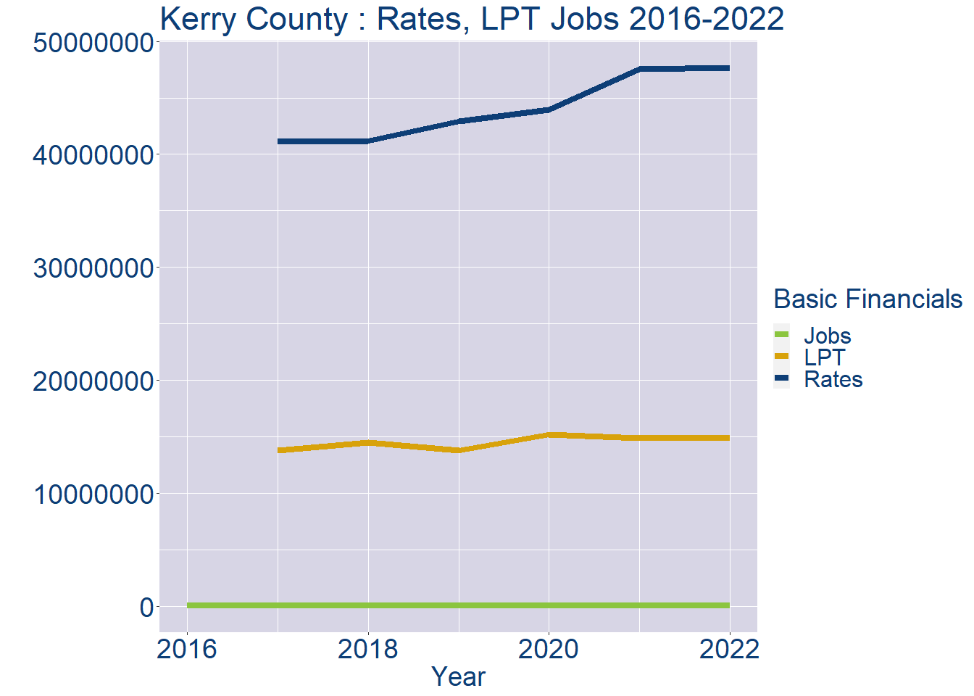
Theme 1: Kerry County Rates & LPT Income
Kerry County Local Authority Rates and LPT: 2016-2022
Year | Jobs | LPT | Rates
2016 | 61222 | NA | NA
2017 | 62276 | 13776761 | 41095755
2018 | 63330 | 14480857 | 41190291
2019 | 64384 | 13776761 | 42885893
2020 | 65438 | 15189516 | 43924722
2021 | 66492 | 14847950 | 47518571
2022 | 67545 | 14848668 | 47650785

Slide 4
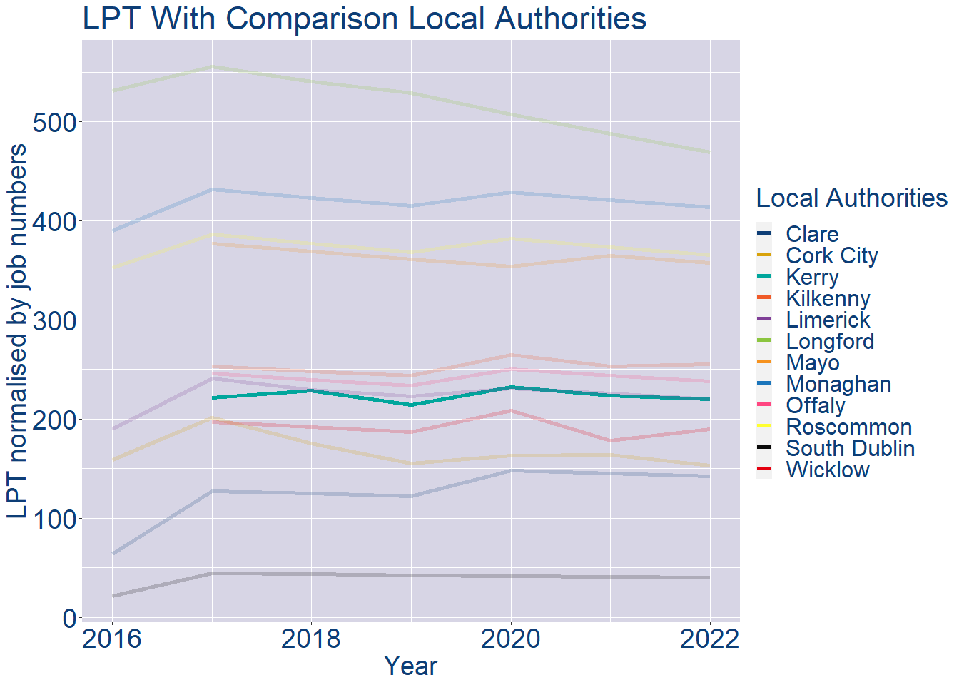
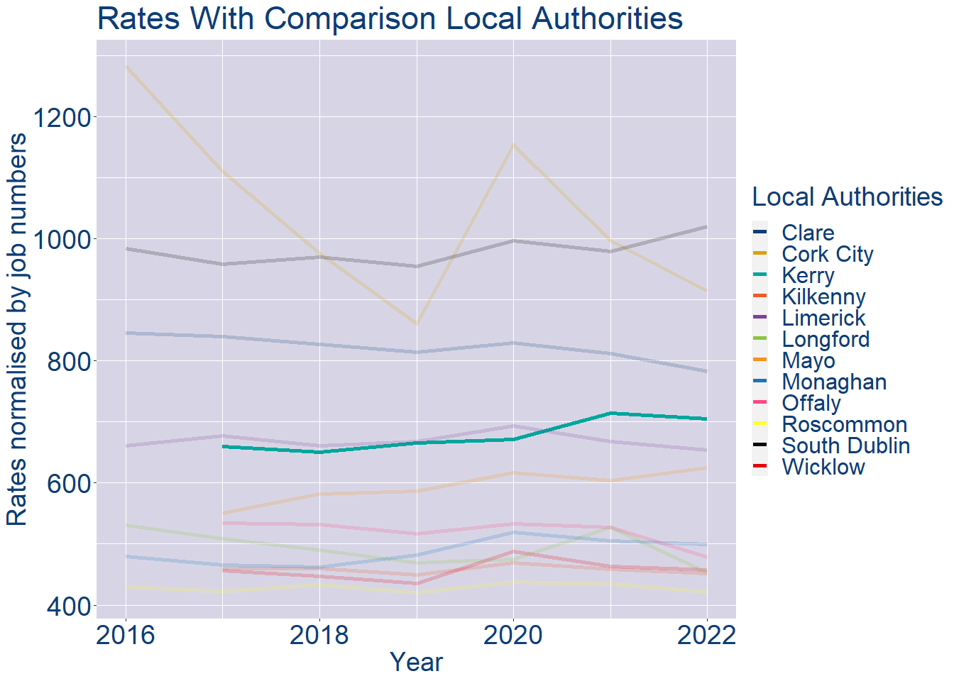
Theme 1: Kerry County Rates & LPT Income
Kerry County Local Authority 2022 LPT/employee €220
Kerry County Local Authority 2022 Rates/employee €705

Slide 5
Theme 2: Kerry County Workforce Demographics
Audience: Membership/Businesses that are interested in expanding into the local area
Highlights: Workforce details, who is available, education level, population growth
Key messages:
Varies from Local Authority area to area
Important for you to understand the numbers of people who are available to work in your area, their experience levels and the training they have

Slide 6
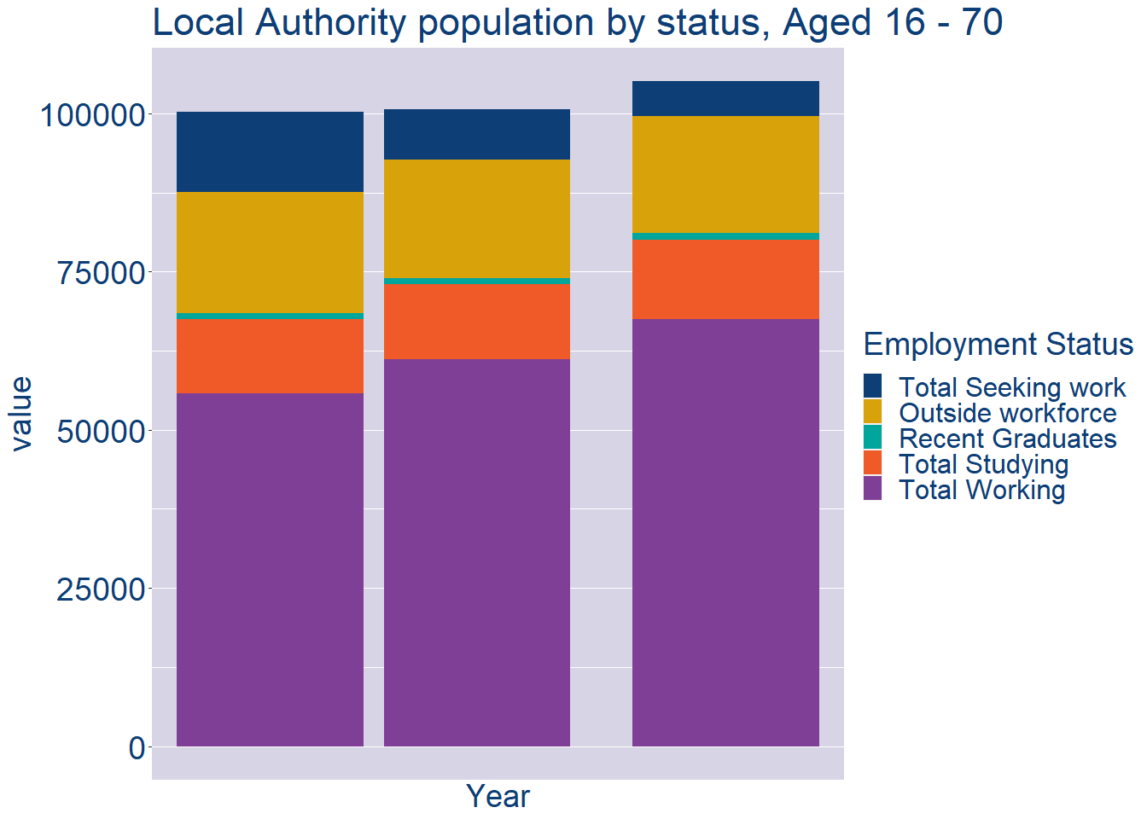
Theme 2: Kerry County Workforce Demographics
Kerry County Local Authority Workforce Population
Year | 2022
Total_working | 67545
Total_studying | 12465
Total_recent_grads | 1132
Total_job_seeking | 5566
Total_not_seeking | 18398

Slide 7
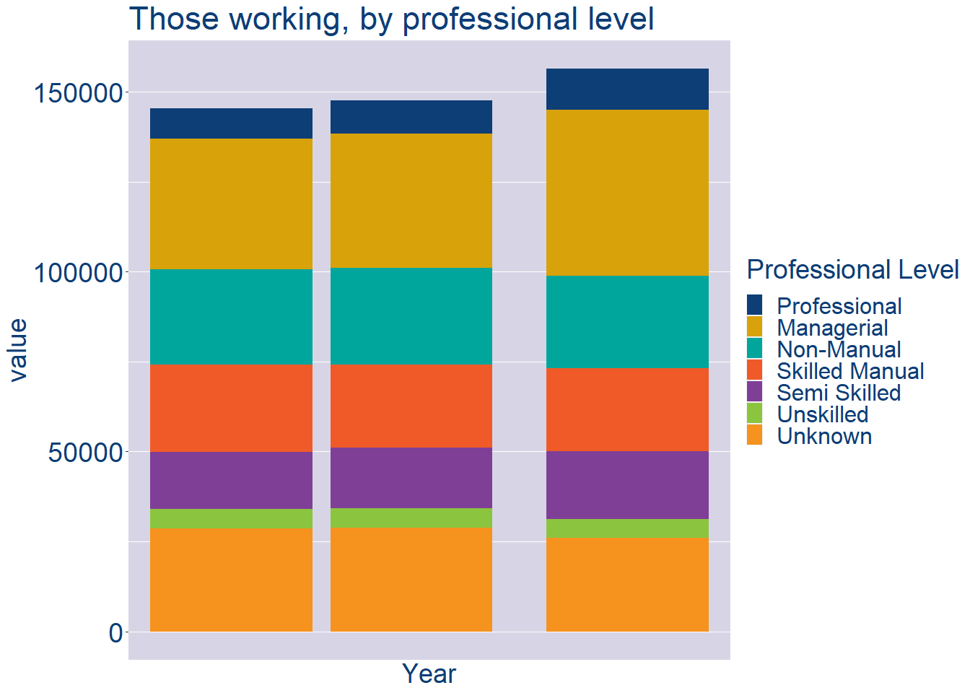
Theme 2: Kerry County Workforce Demographics
Kerry County Local Authority Workforce Experience Level
Year | 2022
Professional | 11342
Managerial | 46166
Non_Manual | 25852
Skilled_Manual | 22981
Semi_Skilled | 18831
Unskilled | 5199
All_Others | 26087

Slide 8
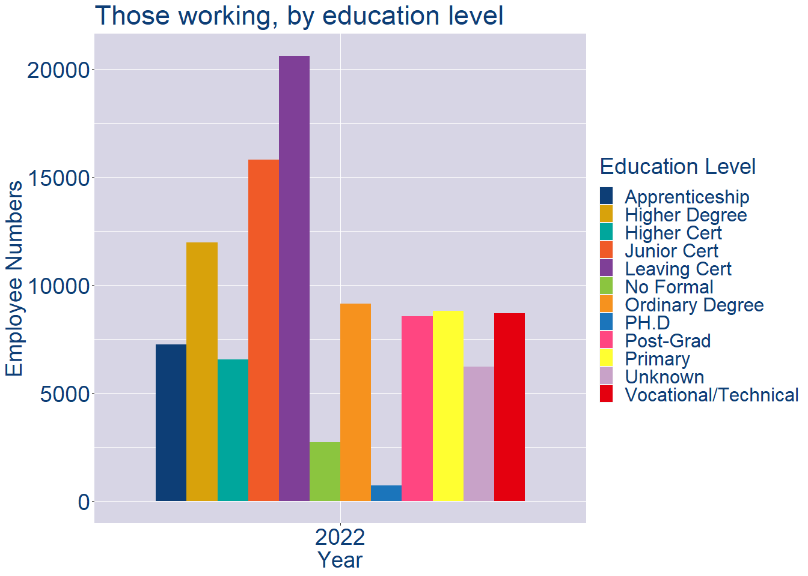
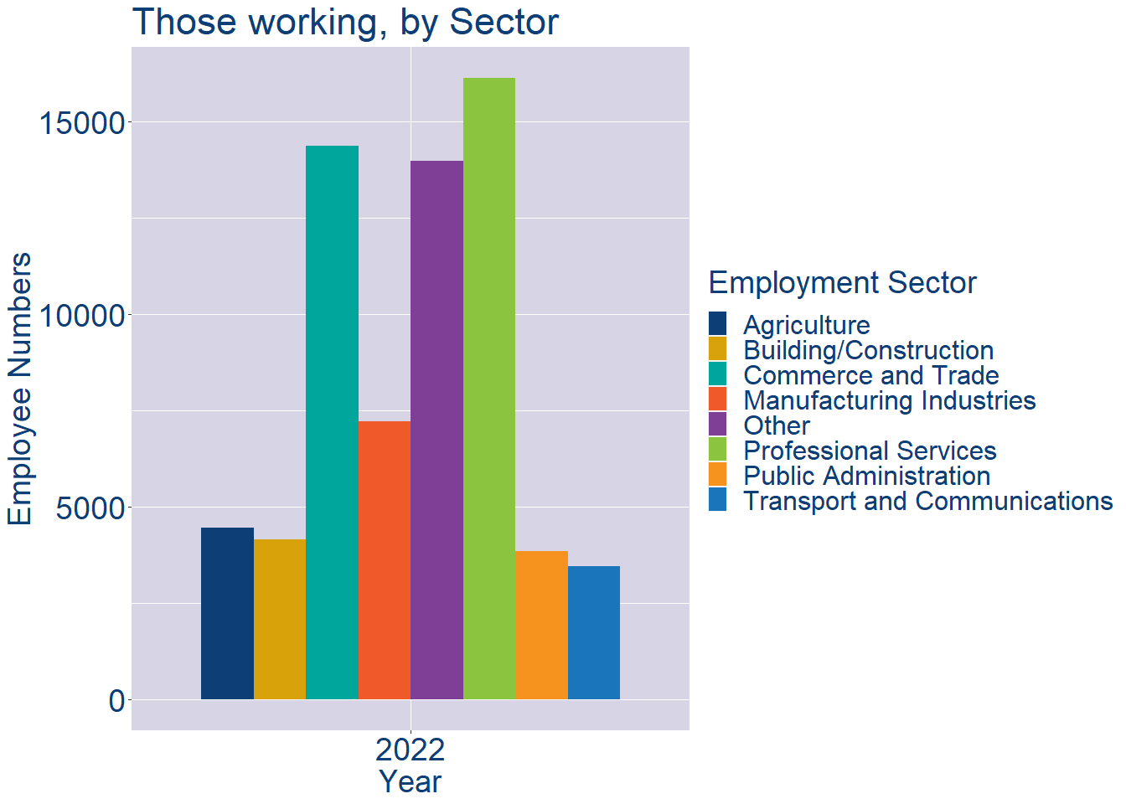
Theme 2: Kerry County Workforce Demographics
Kerry County Local Authority Workforce Education Level
Kerry County Local Authority Workforce Sectors

Slide 9
Theme 3: Co. Kerry Business Demographics
Audience: Internal to Chambers
Highlights: Local Business Community Information
Key messages:
Varies from Local Authority area to area
Local market intelligence to help you identify trends in your local area’s business community i.e.:
Sectoral activity increasing/decreasing
What sectors the self-employed are active in

Slide 10
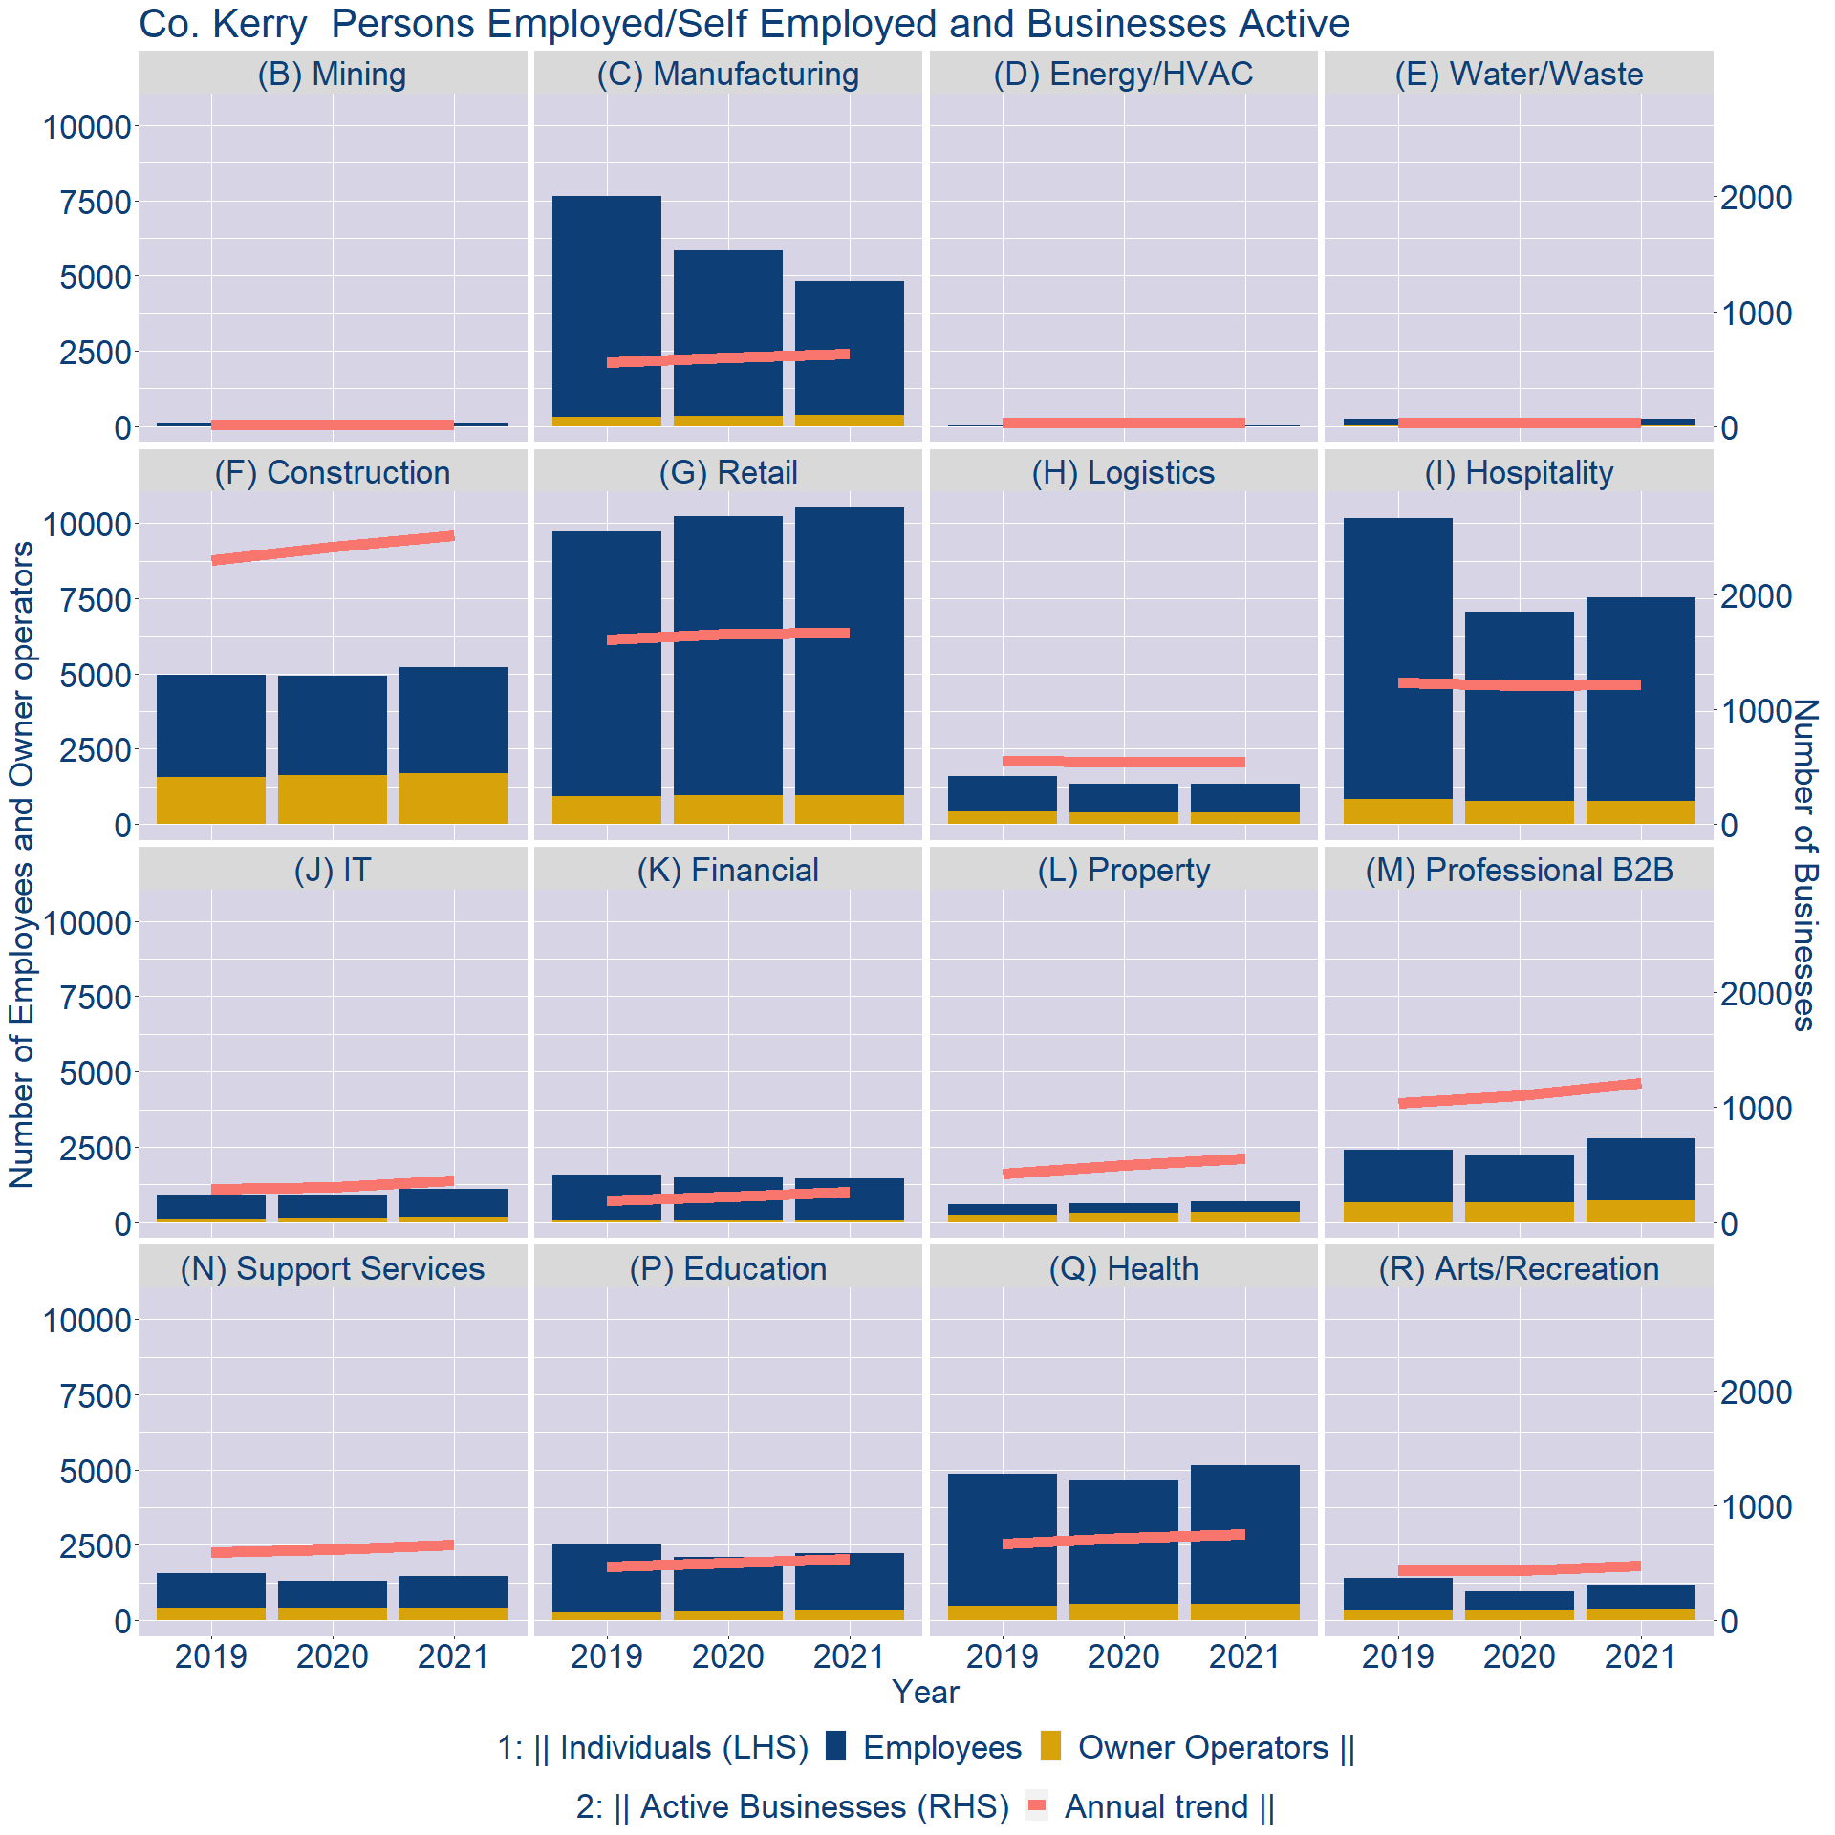
Theme 3: Co. Kerry Business Demographics

Slide 11
Theme 3: Co. Kerry Business Demographics
Sectors | Businesses | Owners | Employees
(B) Mining | 16 | 5 | 70
(C) Manufacturing | 606 | 363 | 4469
(D) Energy/HVAC | 28 | 2 | 9
(E) Water/Waste | 29 | 8 | 243
(F) Construction | 2417 | 1683 | 3520
(G) Retail | 1606 | 941 | 9586
(H) Logistics | 524 | 388 | 953
(I) Hospitality | 1170 | 767 | 6780
(J) IT | 350 | 164 | 926
(K) Financial | 252 | 48 | 1398
(L) Property | 531 | 322 | 357
(M) Professional B2B | 1162 | 710 | 2068
(N) Support Services | 635 | 404 | 1054
(P) Education | 511 | 304 | 1925
(Q) Health | 720 | 548 | 4613
(R) Arts/Recreation | 453 | 336 | 843
Employment in locally registered businesses, by Sector

Slide 12
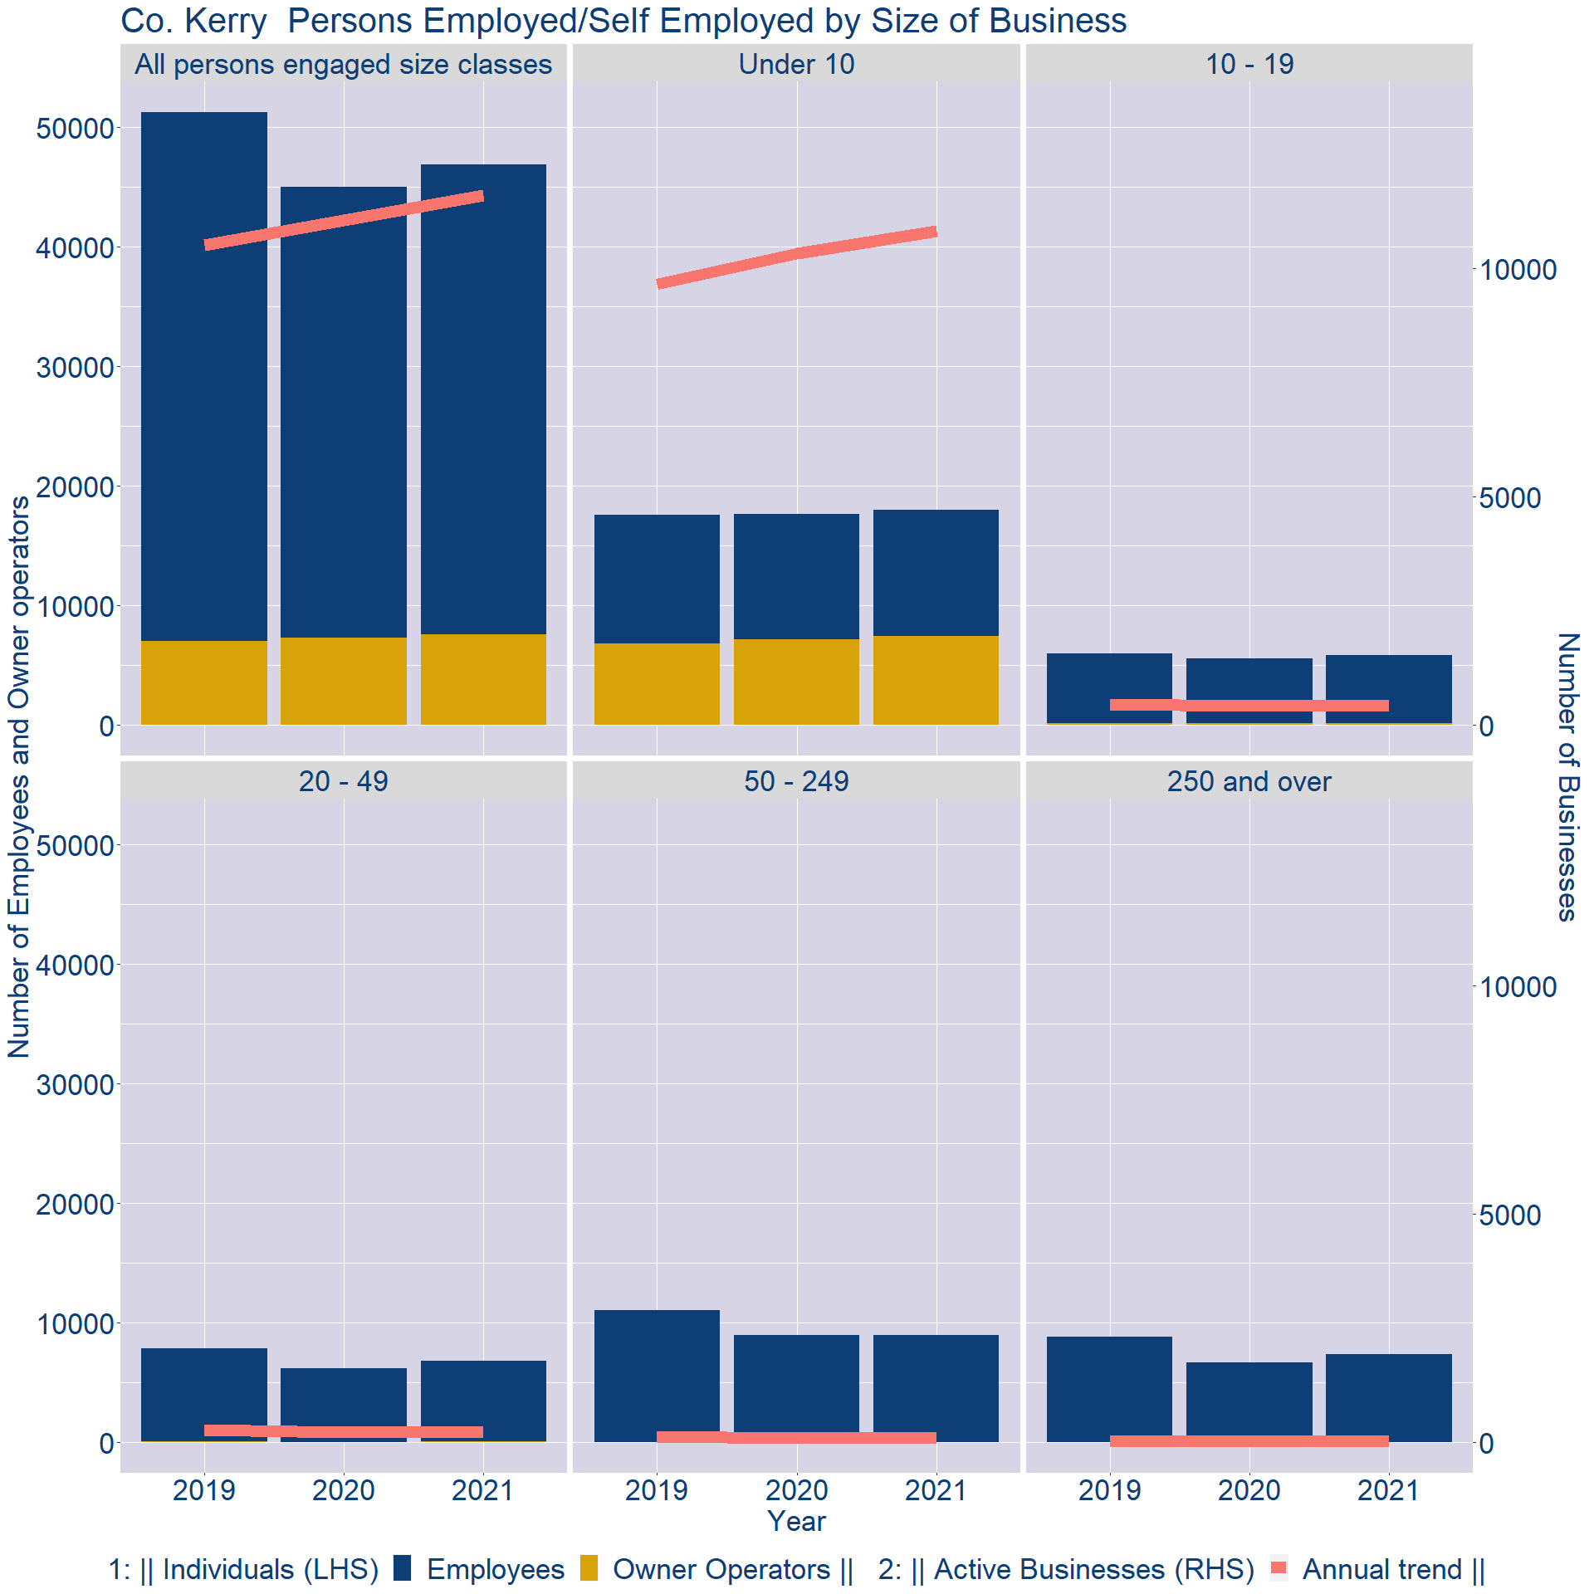
Theme 3: Co. Kerry Business Demographics
Employment in locally registered businesses, by employer size - 2021

Slide 13
Theme 3: Co. Kerry Business Demographics
Employment.Size | Businesses | Owners | Employees
All persons engaged size classes | 11596 | 7533 | 39316
Under 10 | 10818 | 7390 | 10605
10 - 19 | 431 | 108 | 5718
20 - 49 | 236 | 31 | 6738
50 - 249 | 98 | 0 | 8921
250 and over | 13 | 4 | 7334
Employment in locally registered businesses, by employer size - 2021

