Slide 1
Galway County Business & Employment Demographics
Chambers Ireland

Slide 2
Theme 1: Galway County Rates & LPT Income
Audience: Existing/Prospective Local Authority members
Highlights: Increasing reliance on Commercial Rates to support Local Authority Activities
Key messages:
Local Authority Budget Reform needed
Rates system putting pressure on labour intensive & vulnerable sectors
Hospitality
Retail
Manufacturing
Obligation on Local Authority to use these taxes effectively

Slide 3
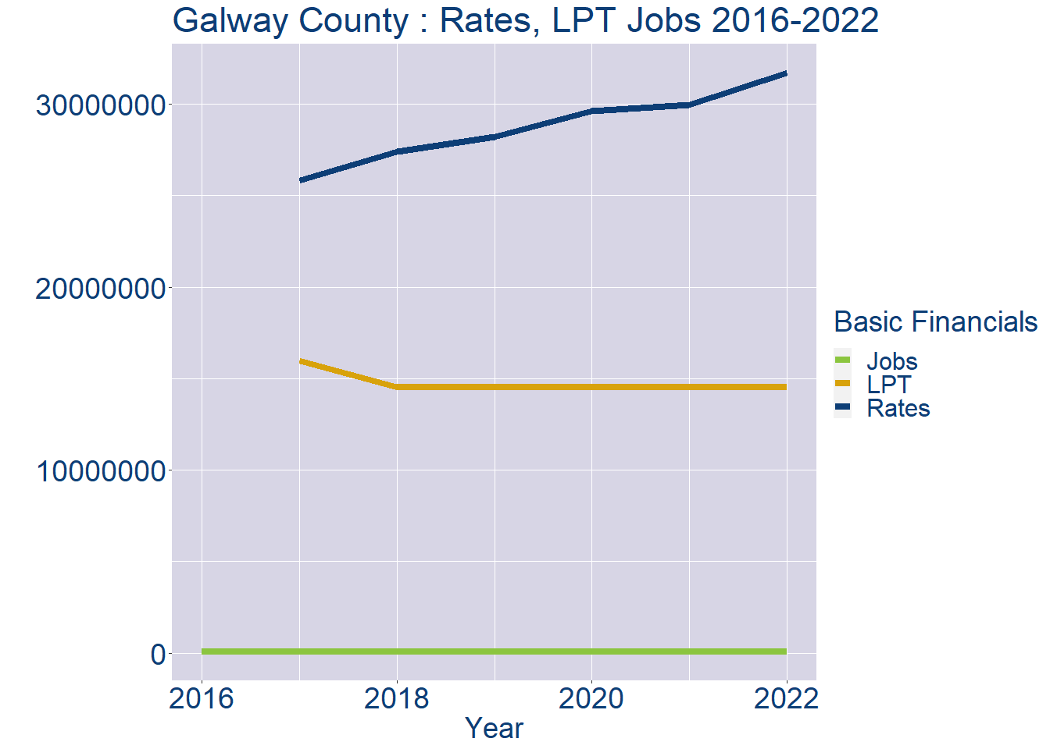
Theme 1: Galway County Rates & LPT Income
Galway County Local Authority Rates and LPT: 2016-2022
Year | Jobs | LPT | Rates
2016 | 75116 | NA | NA
2017 | 76914 | 15973317 | 25820849
2018 | 78712 | 14517890 | 27402722
2019 | 80510 | 14517890 | 28231157
2020 | 82308 | 14517890 | 29627324
2021 | 84106 | 14517890 | 29965500
2022 | 85901 | 14517890 | 31709028

Slide 4
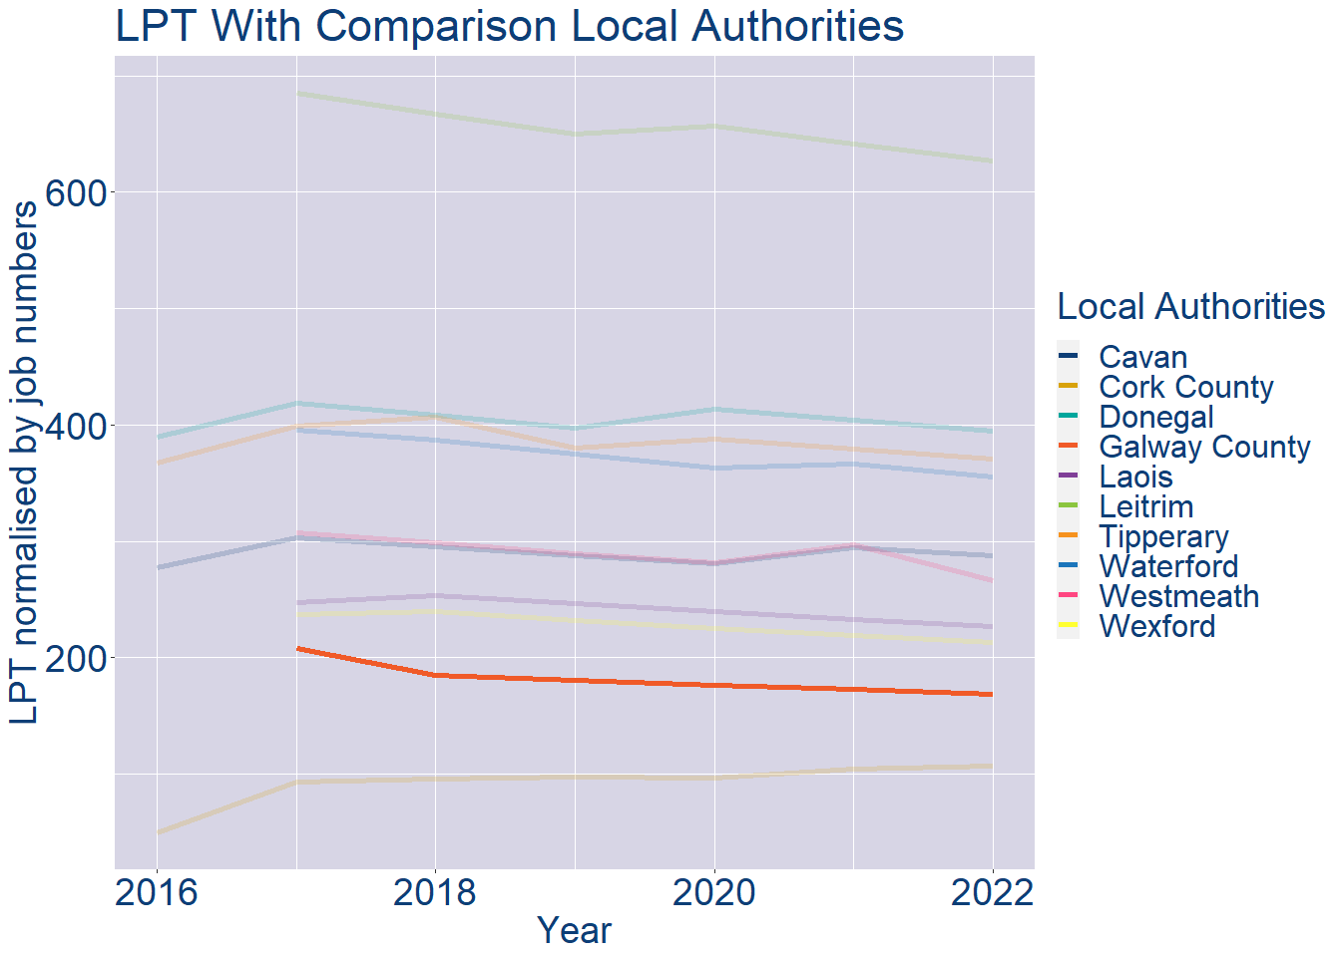
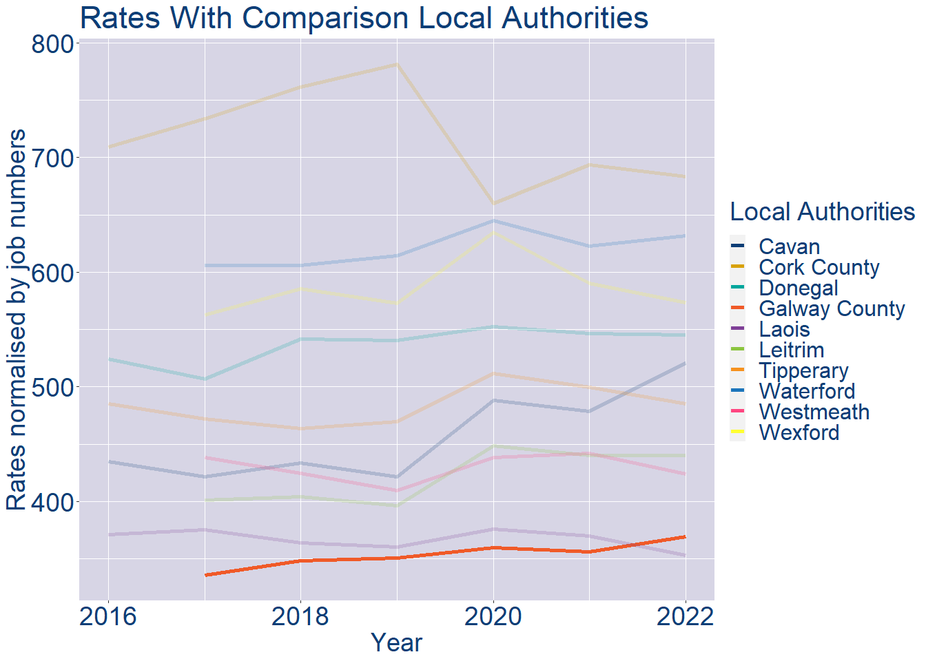
Theme 1: Galway County Rates & LPT Income
Galway County Local Authority 2022 LPT/employee €169
Galway County Local Authority 2022 Rates/employee €369

Slide 5
Theme 2: Galway County Workforce Demographics
Audience: Membership/Businesses that are interested in expanding into the local area
Highlights: Workforce details, who is available, education level, population growth
Key messages:
Varies from Local Authority area to area
Important for you to understand the numbers of people who are available to work in your area, their experience levels and the training they have

Slide 6
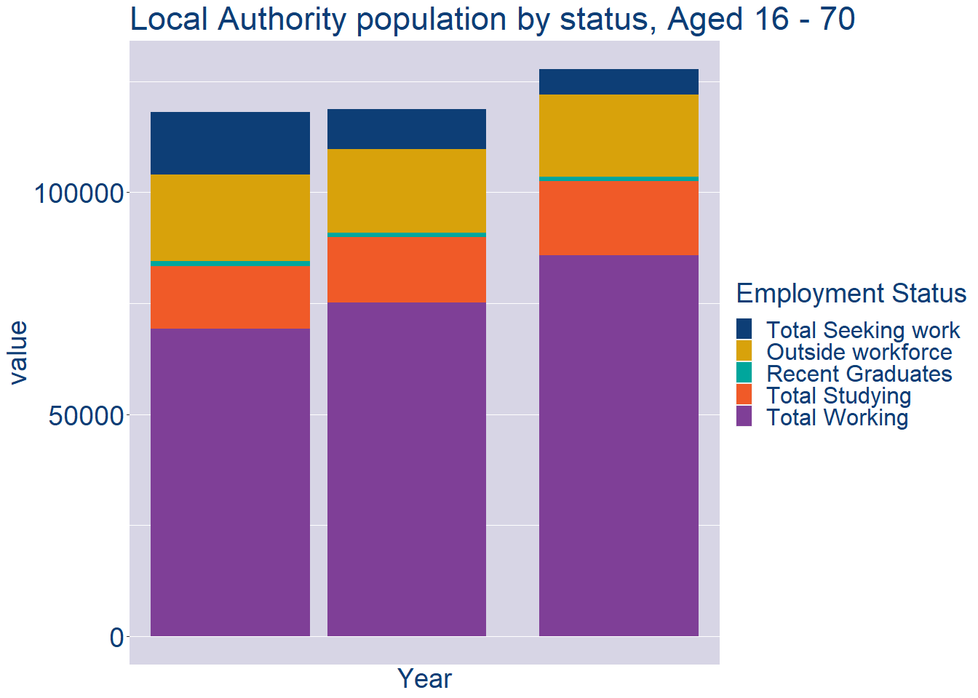
Theme 2: Galway County Workforce Demographics
Galway County Local Authority Workforce Population
Year | 2022
Total_working | 85901
Total_studying | 16691
Total_recent_grads | 984
Total_job_seeking | 5708
Total_not_seeking | 18485

Slide 7
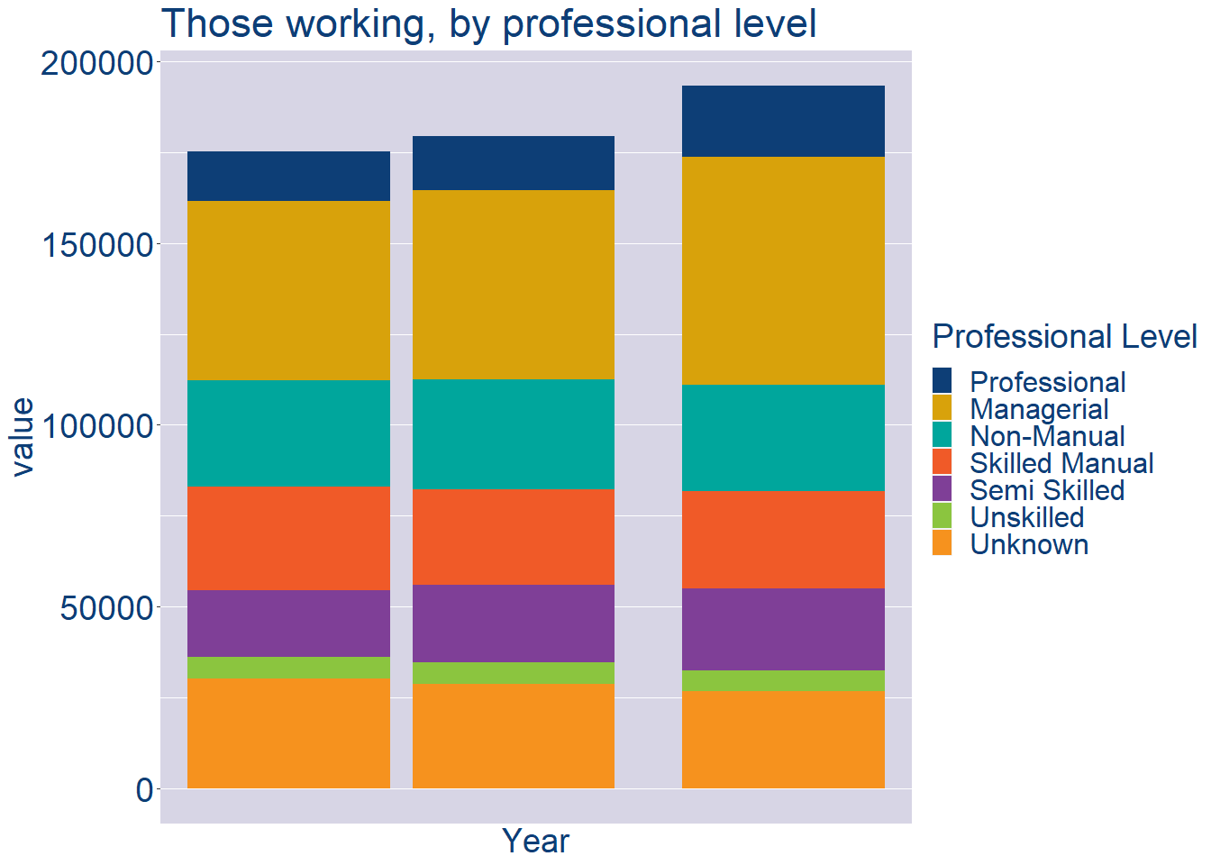
Theme 2: Galway County Workforce Demographics
Galway County Local Authority Workforce Experience Level
Year | 2022
Professional | 19493
Managerial | 62794
Non_Manual | 29217
Skilled_Manual | 26747
Semi_Skilled | 22786
Unskilled | 5717
All_Others | 26569

Slide 8
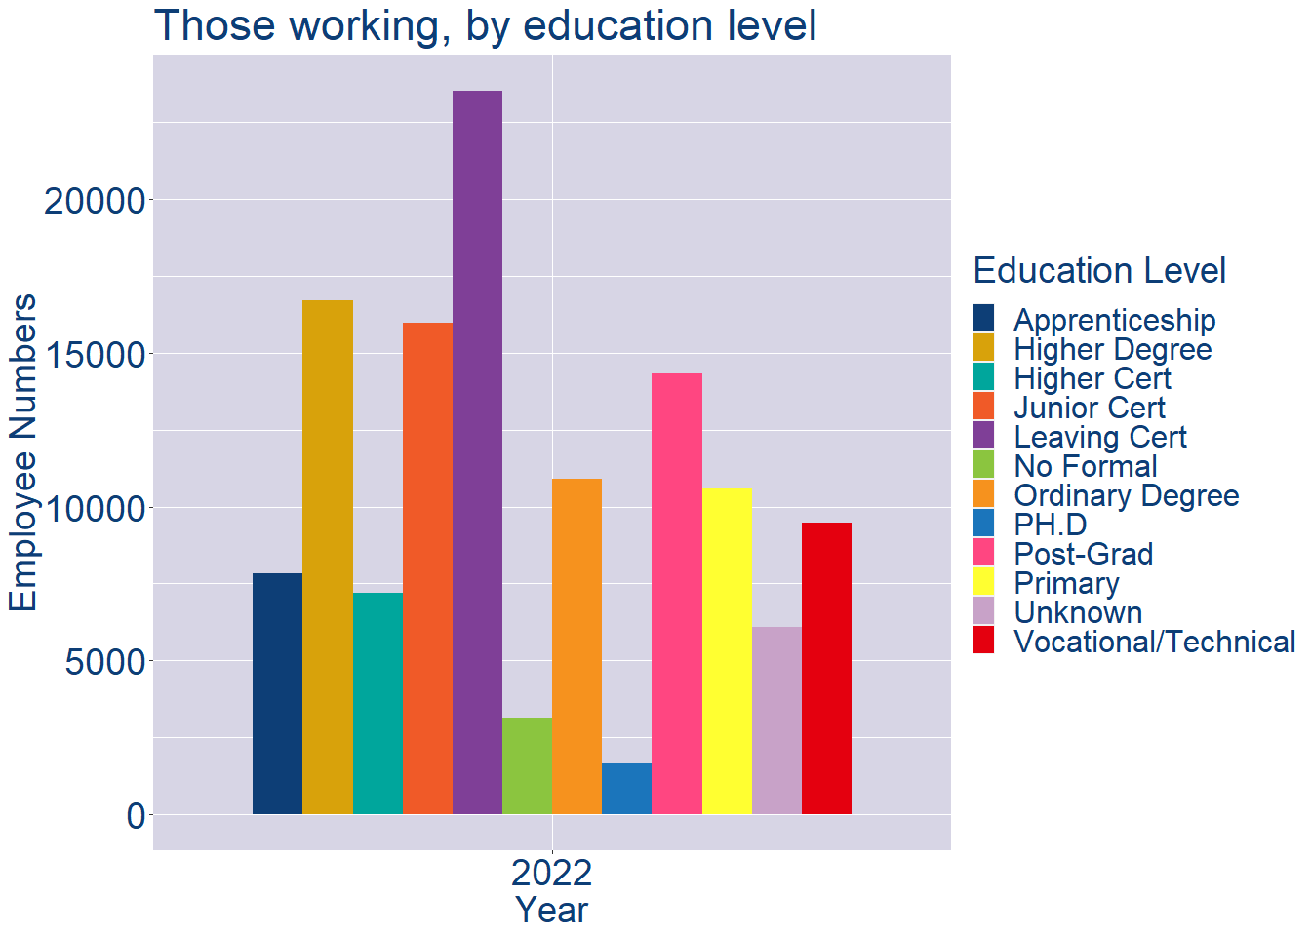
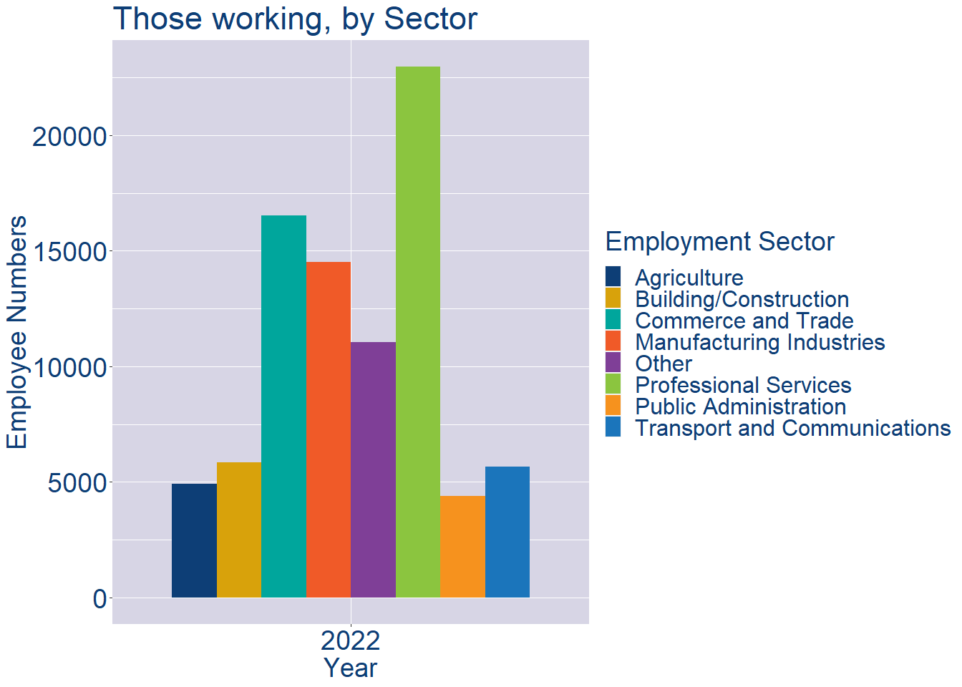
Theme 2: Galway County Workforce Demographics
Galway County Local Authority Workforce Education Level
Galway County Local Authority Workforce Sectors

Slide 9
Theme 3: Co. Galway Business Demographics
Audience: Internal to Chambers
Highlights: Local Business Community Information
Key messages:
Varies from Local Authority area to area
Local market intelligence to help you identify trends in your local area’s business community i.e.:
Sectoral activity increasing/decreasing
What sectors the self-employed are active in

Slide 10
Theme 3: Co. Galway Business Demographics

Slide 11
Theme 3: Co. Galway Business Demographics
Sectors | Businesses | Owners | Employees
(B) Mining | 32 | 5 | 100
(C) Manufacturing | 990 | 491 | 16852
(D) Energy/HVAC | 19 | 4 | 18
(E) Water/Waste | 61 | 13 | 864
(F) Construction | 3992 | 2722 | 6225
(G) Retail | 2562 | 1242 | 14979
(H) Logistics | 1094 | 875 | 2066
(I) Hospitality | 1316 | 708 | 10012
(J) IT | 831 | 314 | 2685
(K) Financial | 520 | 94 | 1626
(L) Property | 1215 | 648 | 664
(M) Professional B2B | 2278 | 1355 | 4788
(N) Support Services | 865 | 528 | 6852
(P) Education | 1002 | 579 | 6853
(Q) Health | 1481 | 1157 | 26179
(R) Arts/Recreation | 785 | 586 | 1090
Employment in locally registered businesses, by Sector

Slide 12
Theme 3: Co. Galway Business Demographics
Employment in locally registered businesses, by employer size - 2021

Slide 13
Theme 3: Co. Galway Business Demographics
Employment.Size | Businesses | Owners | Employees
All persons engaged size classes | 19967 | 12109 | 102881
Under 10 | 18555 | 11869 | 17313
10 - 19 | 754 | 210 | 10057
20 - 49 | 421 | 24 | 12330
50 - 249 | 202 | 6 | 19524
250 and over | 35 | 0 | 43657
Employment in locally registered businesses, by employer size - 2021

