Slide 1
Dublin City Business & Employment Demographics
Chambers Ireland

Slide 2
Theme 1: Dublin City Rates & LPT Income
Audience: Existing/Prospective Local Authority members
Highlights: Increasing reliance on Commercial Rates to support Local Authority Activities
Key messages:
Local Authority Budget Reform needed
Rates system putting pressure on labour intensive & vulnerable sectors
Hospitality
Retail
Manufacturing
Obligation on Local Authority to use these taxes effectively

Slide 3
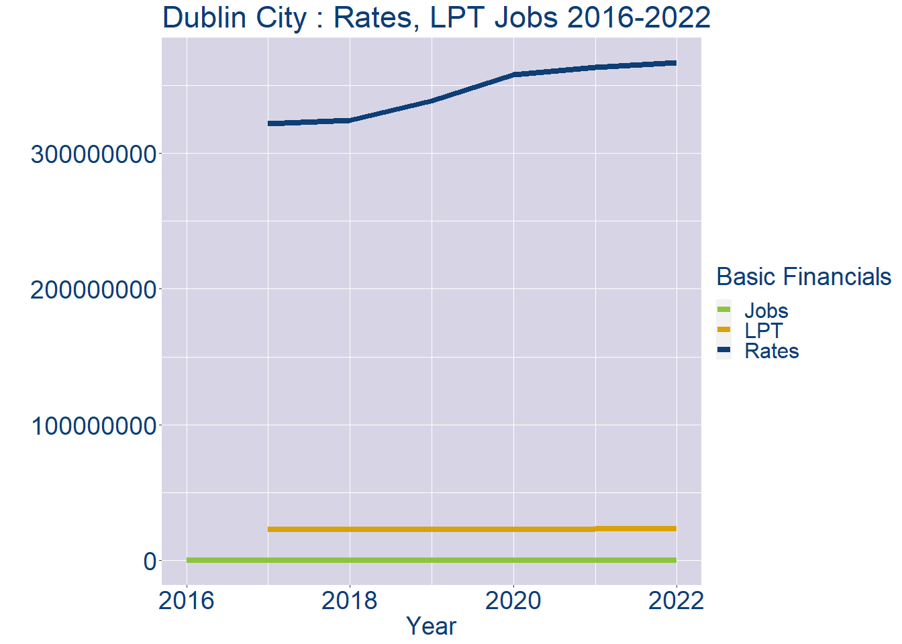
Theme 1: Dublin City Rates & LPT Income
Dublin City Local Authority Rates and LPT: 2016-2022
Year | Jobs | LPT | Rates
2016 | 265670 | NA | NA
2017 | 271426 | 23068969 | 321481363
2018 | 277182 | 23085069 | 324255552
2019 | 282938 | 23098626 | 338299502
2020 | 288694 | 23110517 | 357693512
2021 | 294450 | 23178320 | 362887342
2022 | 300209 | 23198705 | 366446962

Slide 4
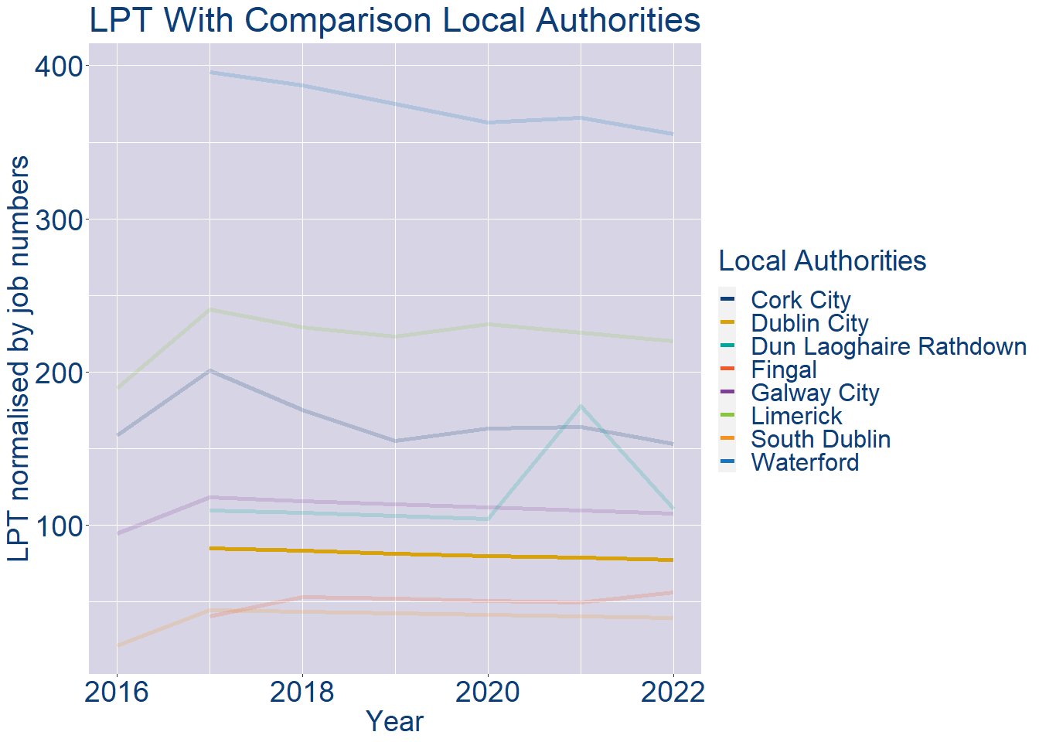
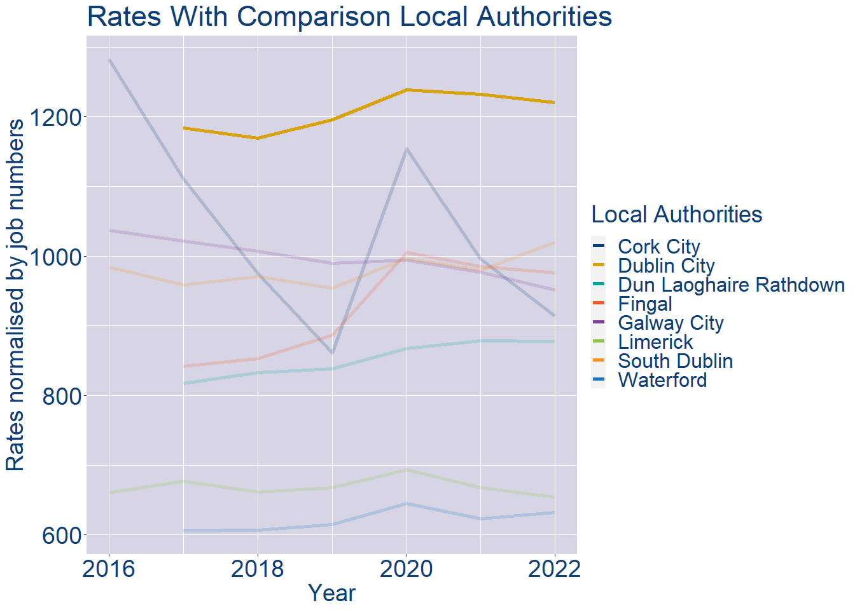
Theme 1: Dublin City Rates & LPT Income
Dublin City Local Authority 2022 LPT/employee €77
Dublin City Local Authority 2022 Rates/employee €1221

Slide 5
Theme 2: Dublin City Workforce Demographics
Audience: Membership/Businesses that are interested in expanding into the local area
Highlights: Workforce details, who is available, education level, population growth
Key messages:
Varies from Local Authority area to area
Important for you to understand the numbers of people who are available to work in your area, their experience levels and the training they have

Slide 6
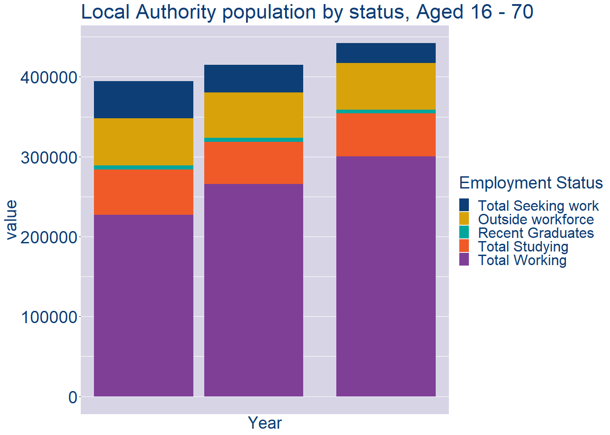
Theme 2: Dublin City Workforce Demographics
Dublin City Local Authority Workforce Population
Year | 2022
Total_working | 300209
Total_studying | 54195
Total_recent_grads | 4600
Total_job_seeking | 24646
Total_not_seeking | 58533

Slide 7
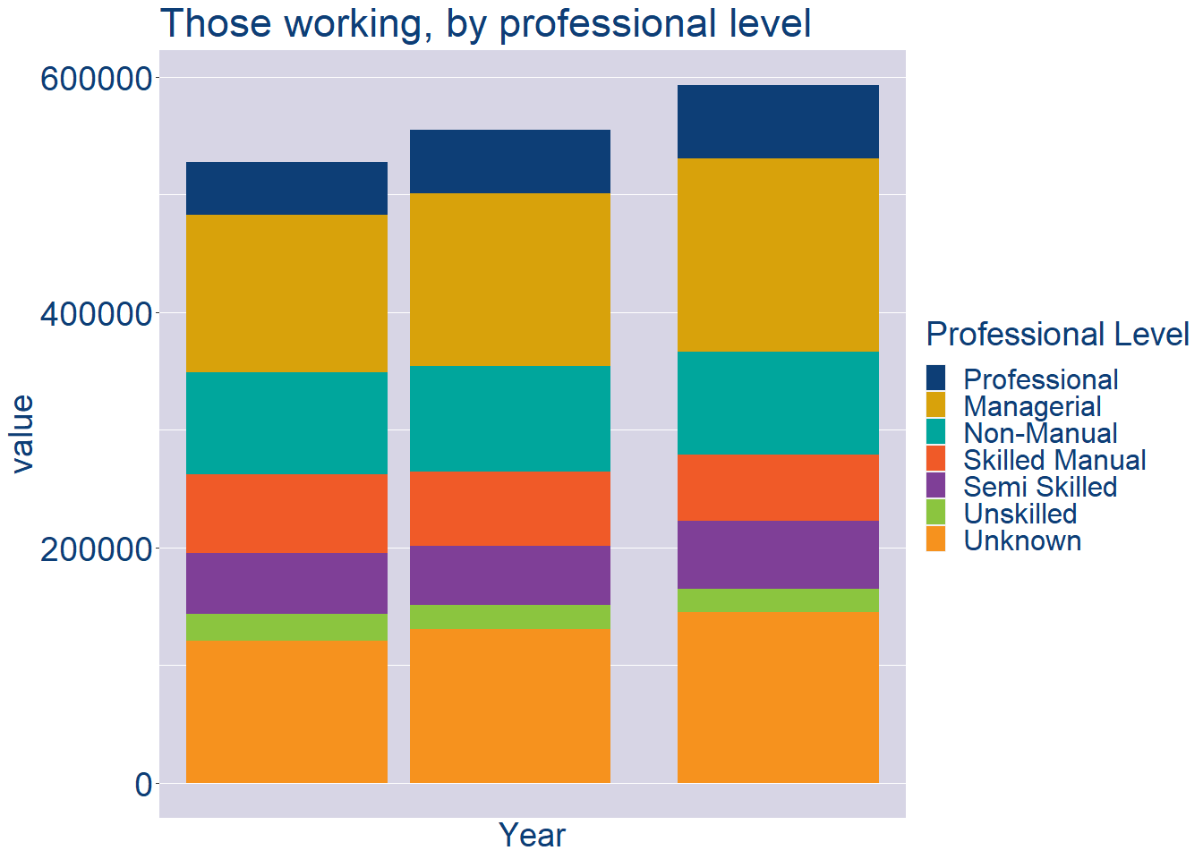
Theme 2: Dublin City Workforce Demographics
Dublin City Local Authority Workforce Experience Level
Year | 2022
Professional | 62383
Managerial | 163909
Non_Manual | 87361
Skilled_Manual | 56514
Semi_Skilled | 57990
Unskilled | 19717
All_Others | 144839

Slide 8
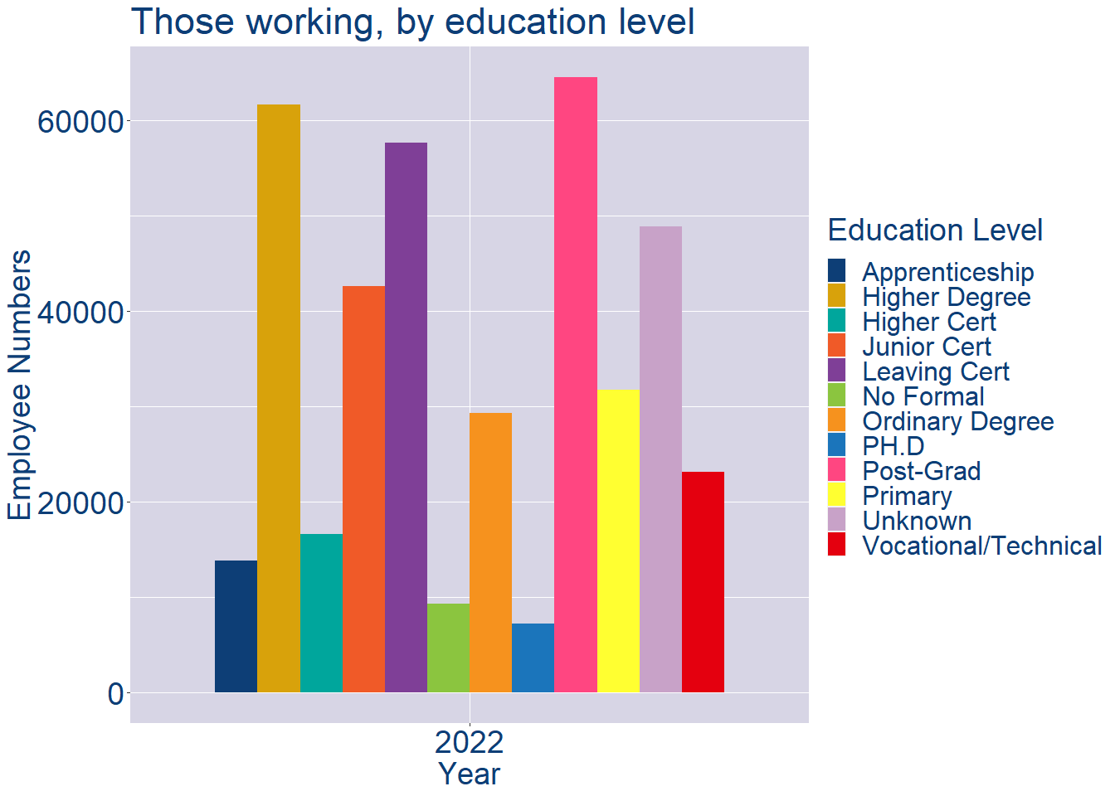
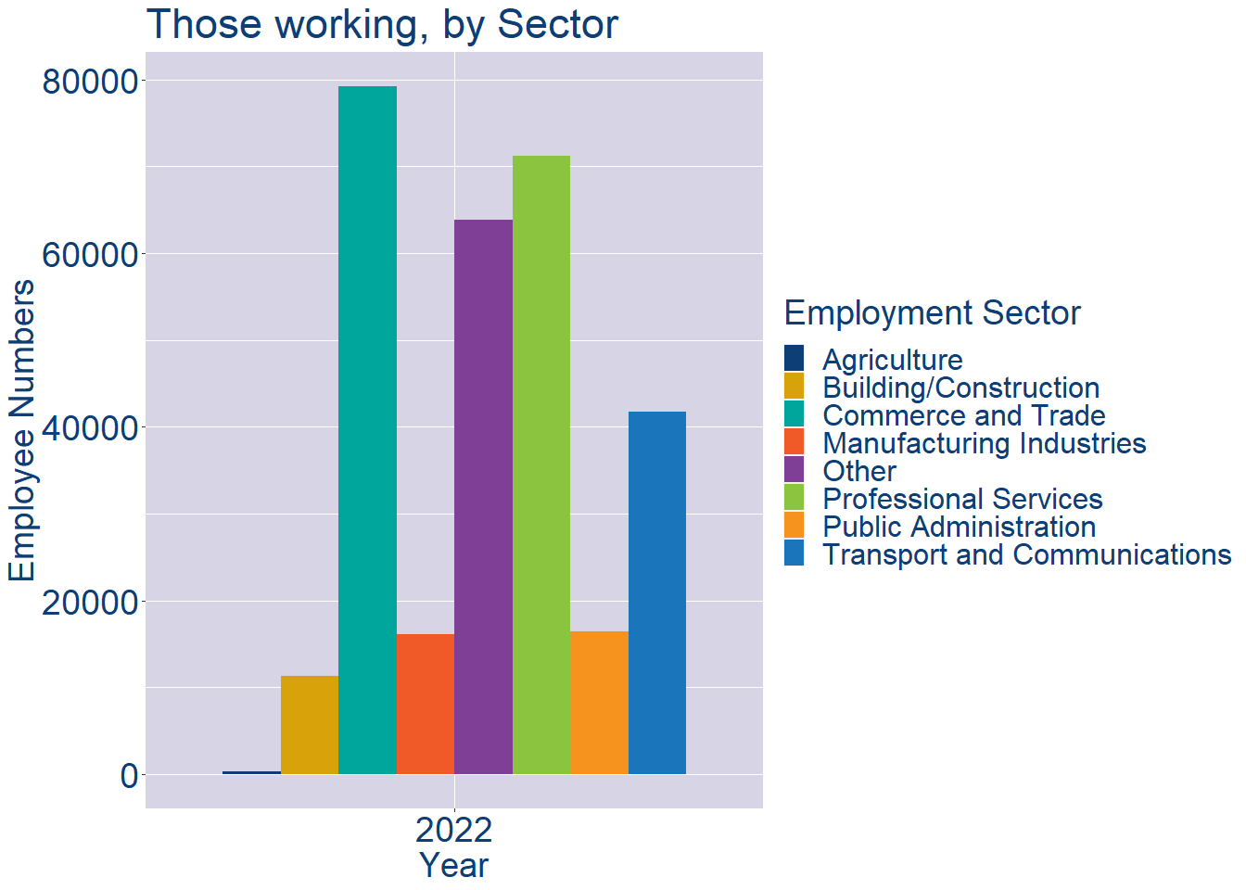
Theme 2: Dublin City Workforce Demographics
Dublin City Local Authority Workforce Education Level
Dublin City Local Authority Workforce Sectors

Slide 9
Theme 3: Co. Dublin Business Demographics
Audience: Internal to Chambers
Highlights: Local Business Community Information
Key messages:
Varies from Local Authority area to area
Local market intelligence to help you identify trends in your local area’s business community i.e.:
Sectoral activity increasing/decreasing
What sectors the self-employed are active in

Slide 10
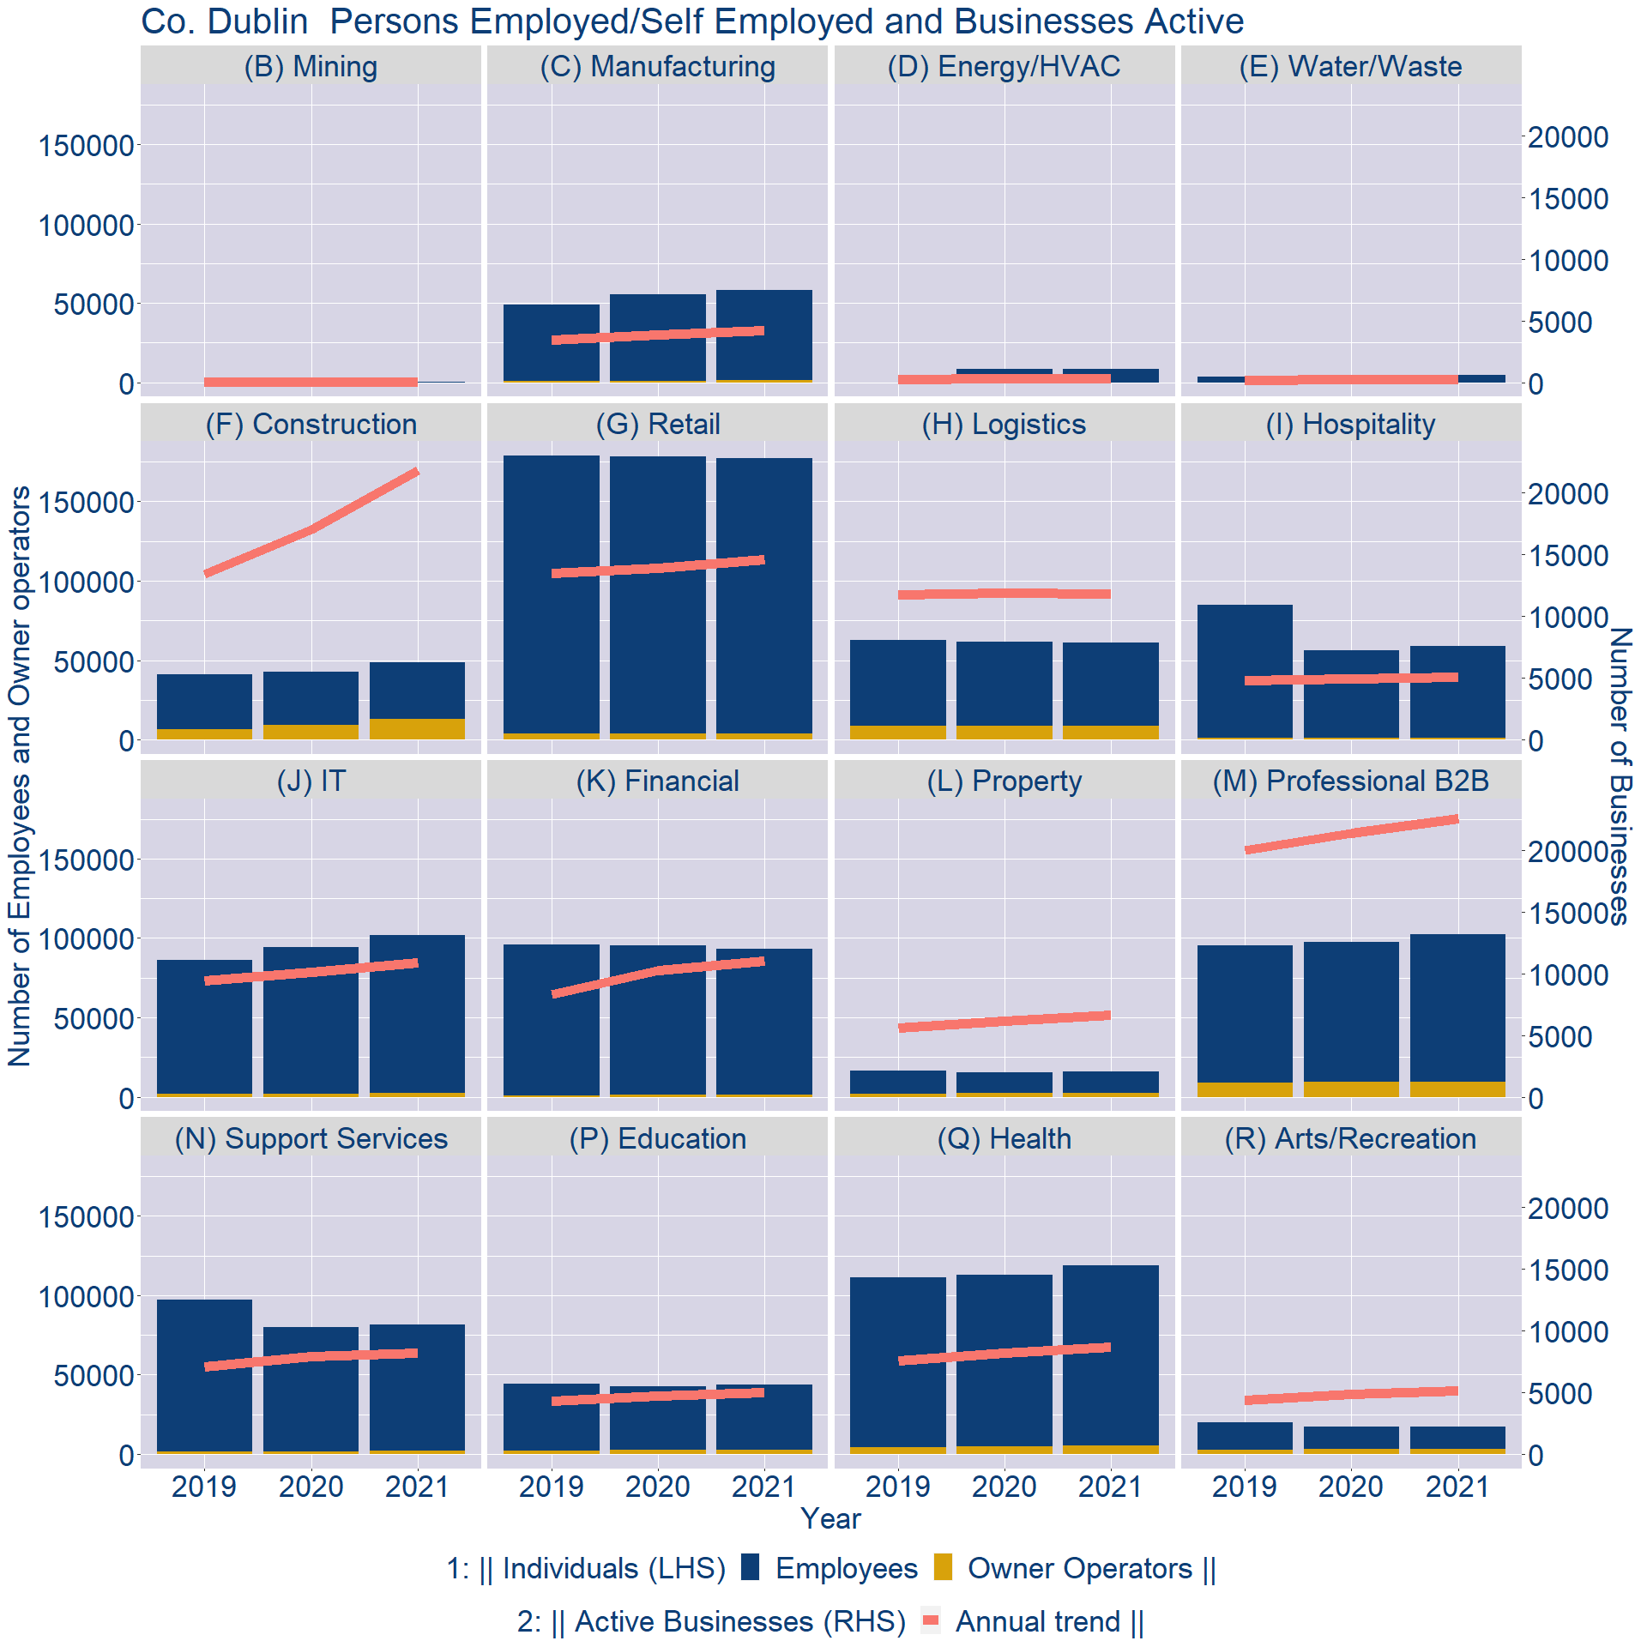
Theme 3: Co. Dublin Business Demographics

Slide 11
Theme 3: Co. Dublin Business Demographics
Sectors | Businesses | Owners | Employees
(B) Mining | 48 | 6 | 313
(C) Manufacturing | 3725 | 1355 | 56844
(D) Energy/HVAC | 293 | 7 | 8572
(E) Water/Waste | 231 | 49 | 4732
(F) Construction | 19142 | 13042 | 35473
(G) Retail | 12820 | 3883 | 173264
(H) Logistics | 10341 | 8621 | 52661
(I) Hospitality | 4485 | 1247 | 57655
(J) IT | 9529 | 2280 | 99739
(K) Financial | 9641 | 1152 | 91965
(L) Property | 5800 | 2411 | 13275
(M) Professional B2B | 19778 | 9628 | 92635
(N) Support Services | 7194 | 1965 | 79467
(P) Education | 4384 | 2701 | 41294
(Q) Health | 7638 | 5245 | 113727
(R) Arts/Recreation | 4504 | 3249 | 14142
Employment in locally registered businesses, by Sector

Slide 12
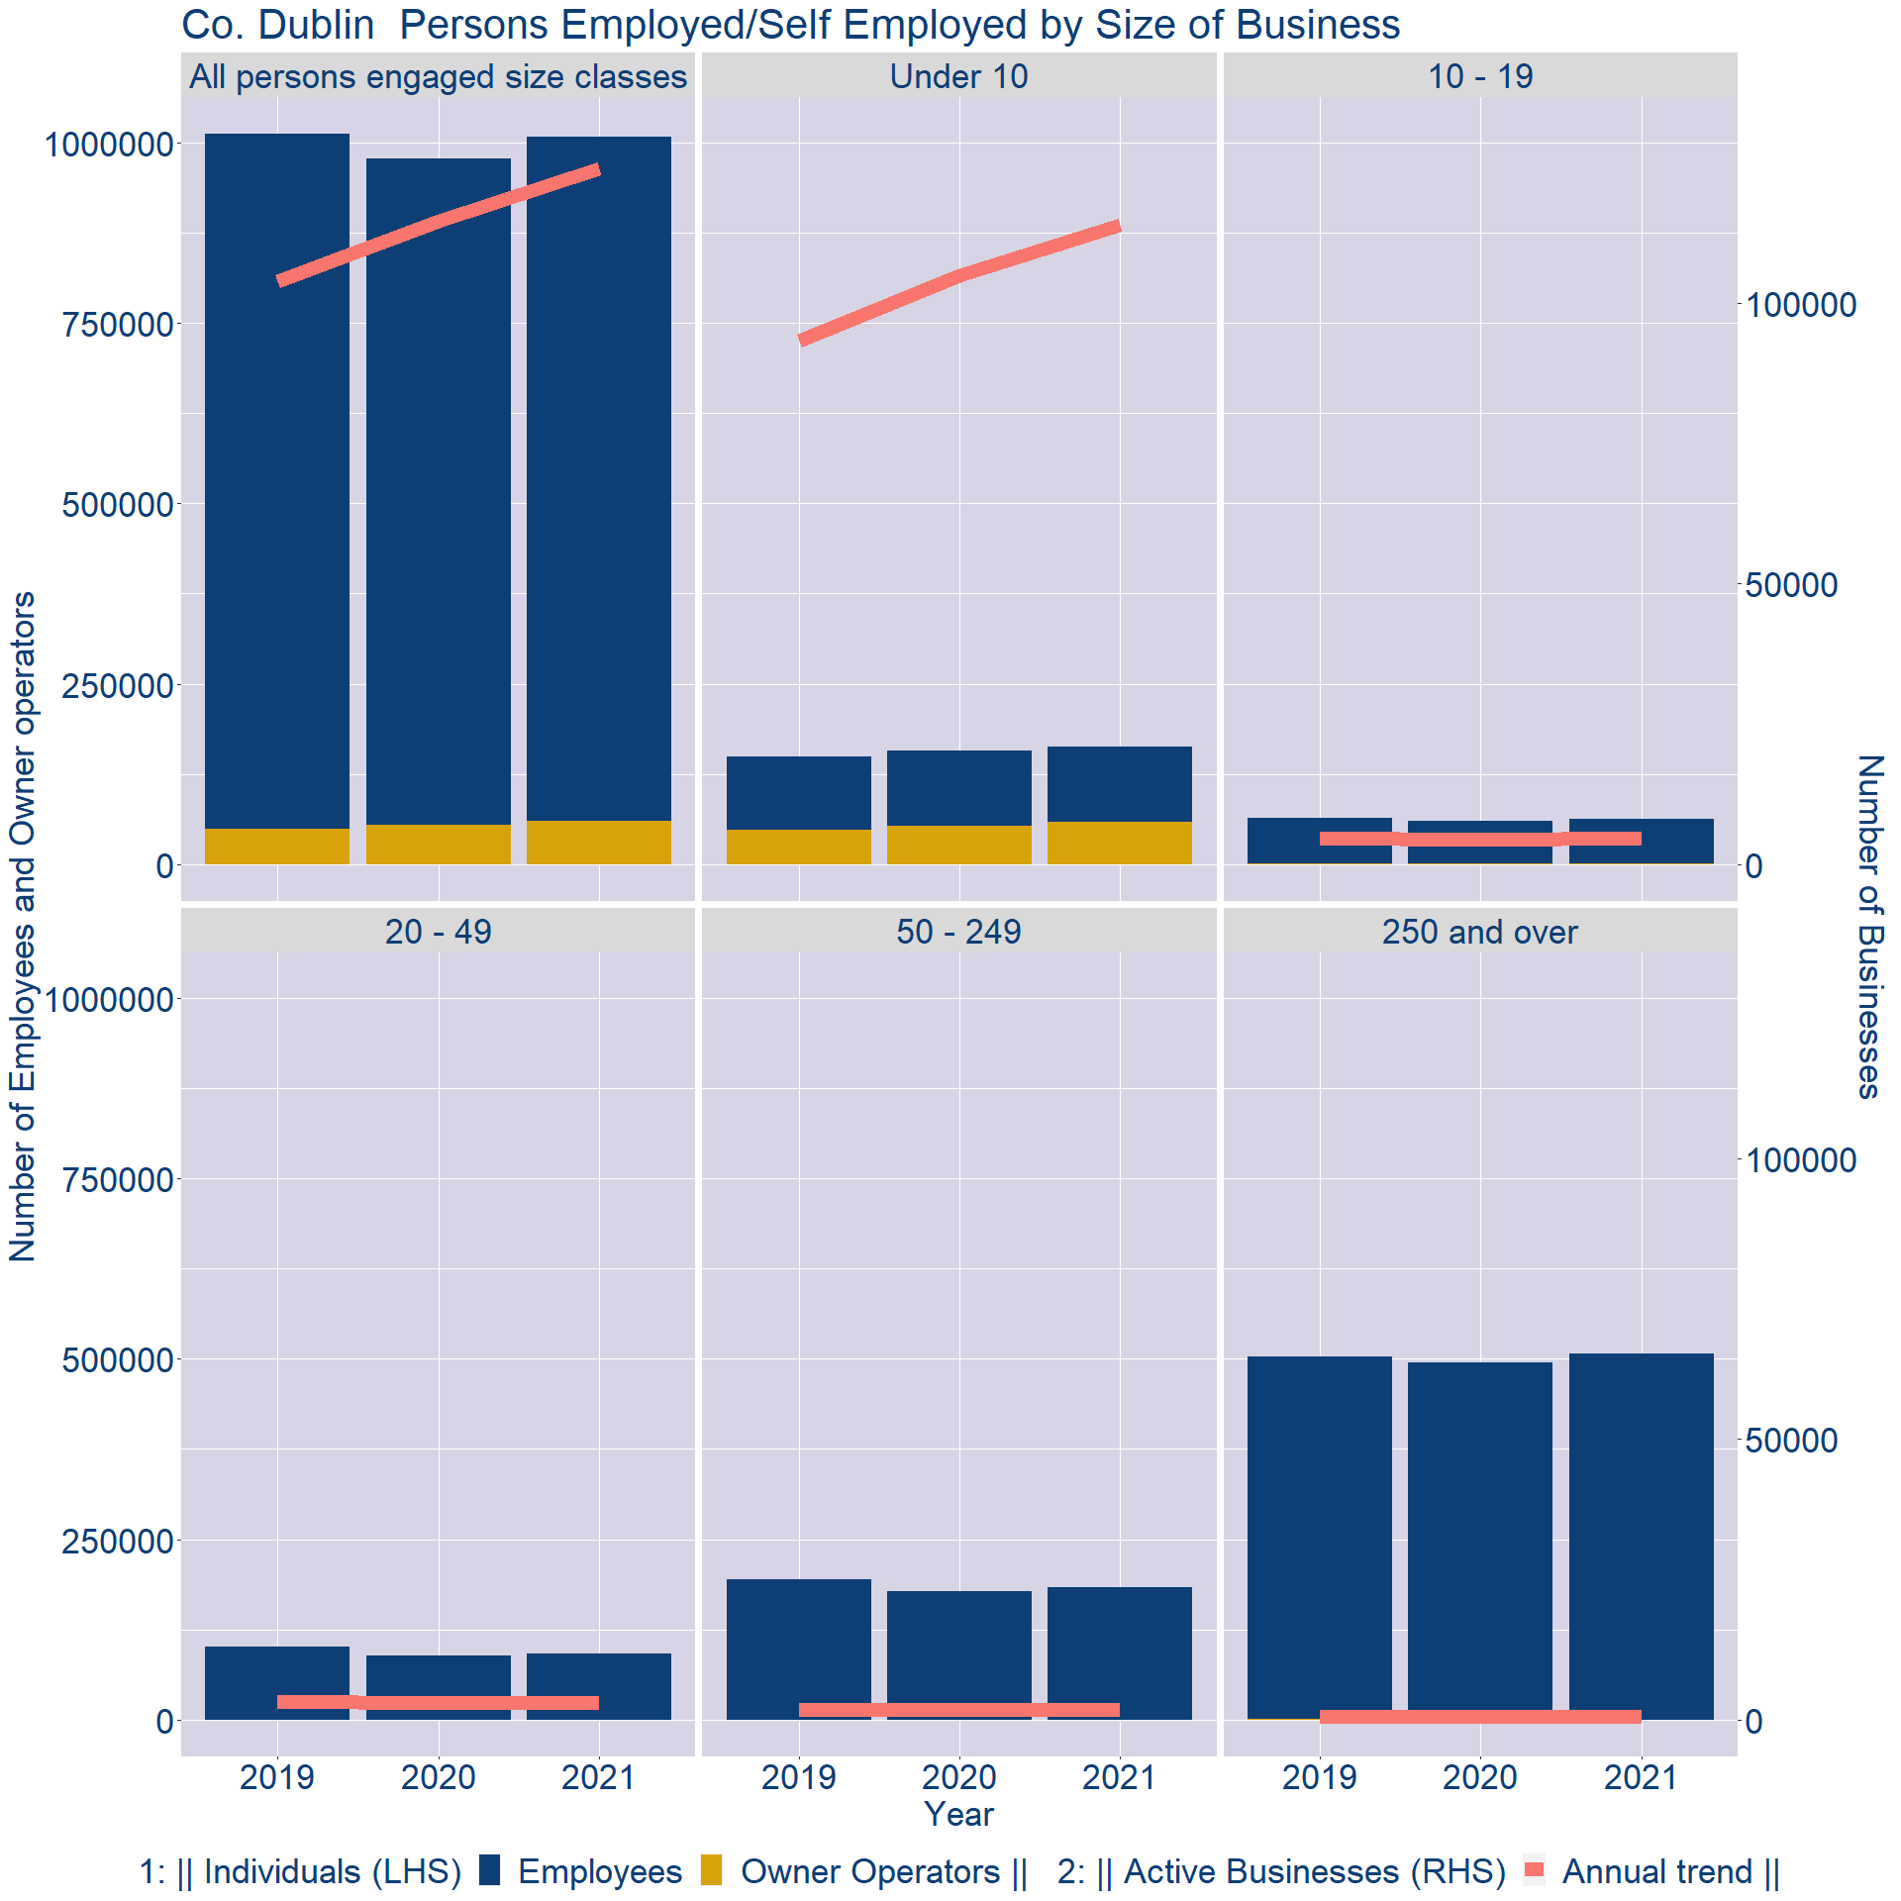
Theme 3: Co. Dublin Business Demographics
Employment in locally registered businesses, by employer size - 2021

Slide 13
Theme 3: Co. Dublin Business Demographics
Employment.Size | Businesses | Owners | Employees
All persons engaged size classes | 123874 | 59999 | 947794
Under 10 | 113877 | 58685 | 104583
10 - 19 | 4657 | 718 | 62095
20 - 49 | 3018 | 282 | 90944
50 - 249 | 1811 | 161 | 182776
250 and over | 511 | 153 | 507396
Employment in locally registered businesses, by employer size - 2021

