Slide 1
Donegal Business & Employment Demographics
Chambers Ireland

Slide 2
Theme 1: Donegal Rates & LPT Income
Audience: Existing/Prospective Local Authority members
Highlights: Increasing reliance on Commercial Rates to support Local Authority Activities
Key messages:
Local Authority Budget Reform needed
Rates system putting pressure on labour intensive & vulnerable sectors
Hospitality
Retail
Manufacturing
Obligation on Local Authority to use these taxes effectively

Slide 3
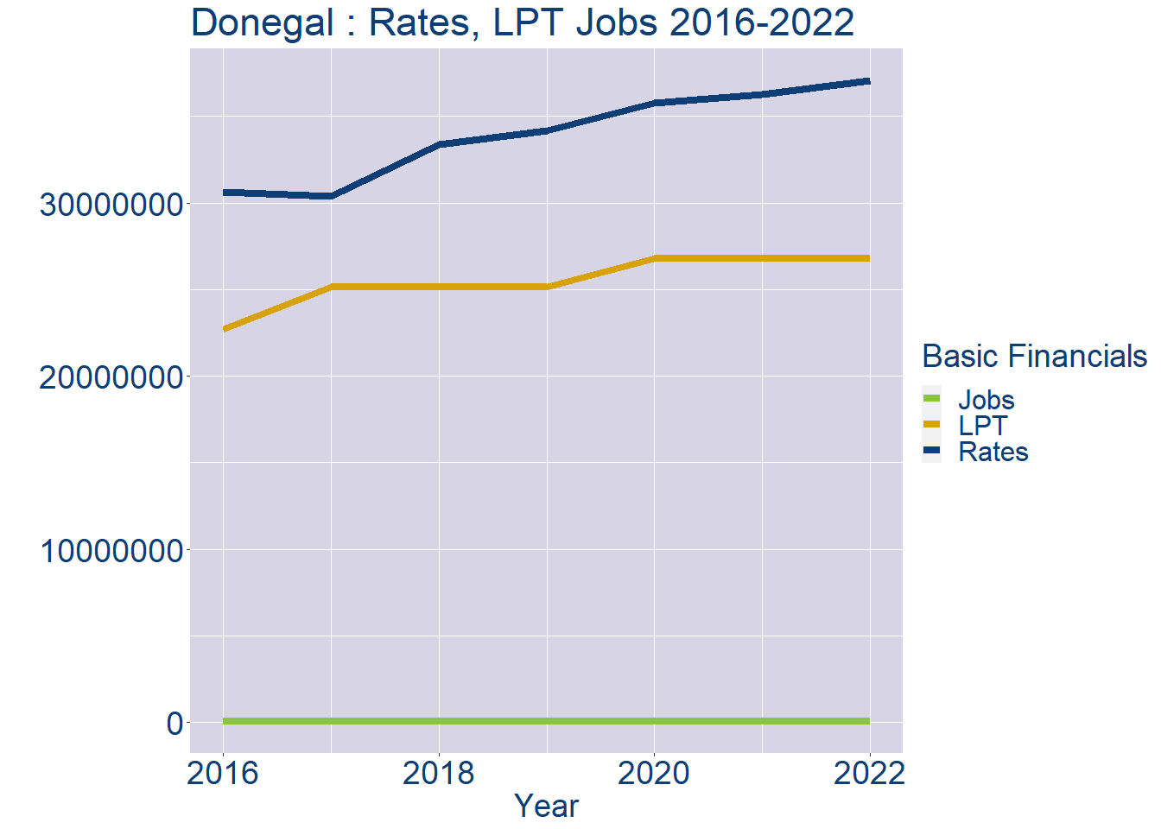
Theme 1: Donegal Rates & LPT Income
Donegal Local Authority Rates and LPT: 2016-2022
Year | Jobs | LPT | Rates
2016 | 58353 | 22720760 | 30605929
2017 | 59957 | 25119850 | 30400611
2018 | 61561 | 25119850 | 33360538
2019 | 63165 | 25119850 | 34153707
2020 | 64769 | 26775480 | 35782979
2021 | 66373 | 26797753 | 36270187
2022 | 67977 | 26809502 | 37052373

Slide 4
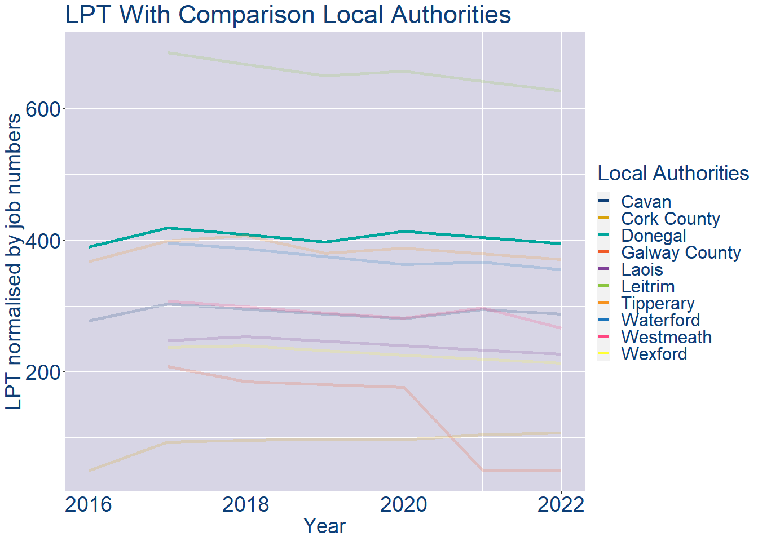
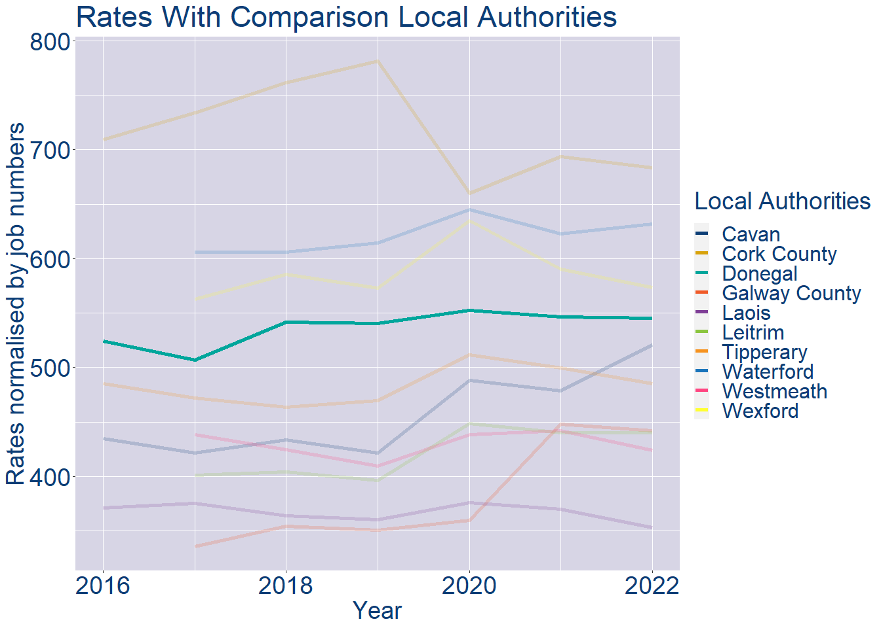
Theme 1: Donegal Rates & LPT Income
Donegal Local Authority 2022 LPT/employee €394
Donegal Local Authority 2022 Rates/employee €545

Slide 5
Theme 2: Donegal Workforce Demographics
Audience: Membership/Businesses that are interested in expanding into the local area
Highlights: Workforce details, who is available, education level, population growth
Key messages:
Varies from Local Authority area to area
Important for you to understand the numbers of people who are available to work in your area, their experience levels and the training they have

Slide 6
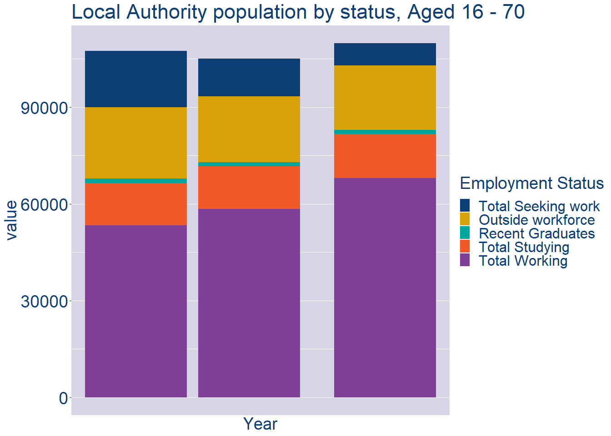
Theme 2: Donegal Workforce Demographics
Donegal Local Authority Workforce Population
Year | 2022
Total_working | 67977
Total_studying | 13674
Total_recent_grads | 1185
Total_job_seeking | 6907
Total_not_seeking | 20033

Slide 7
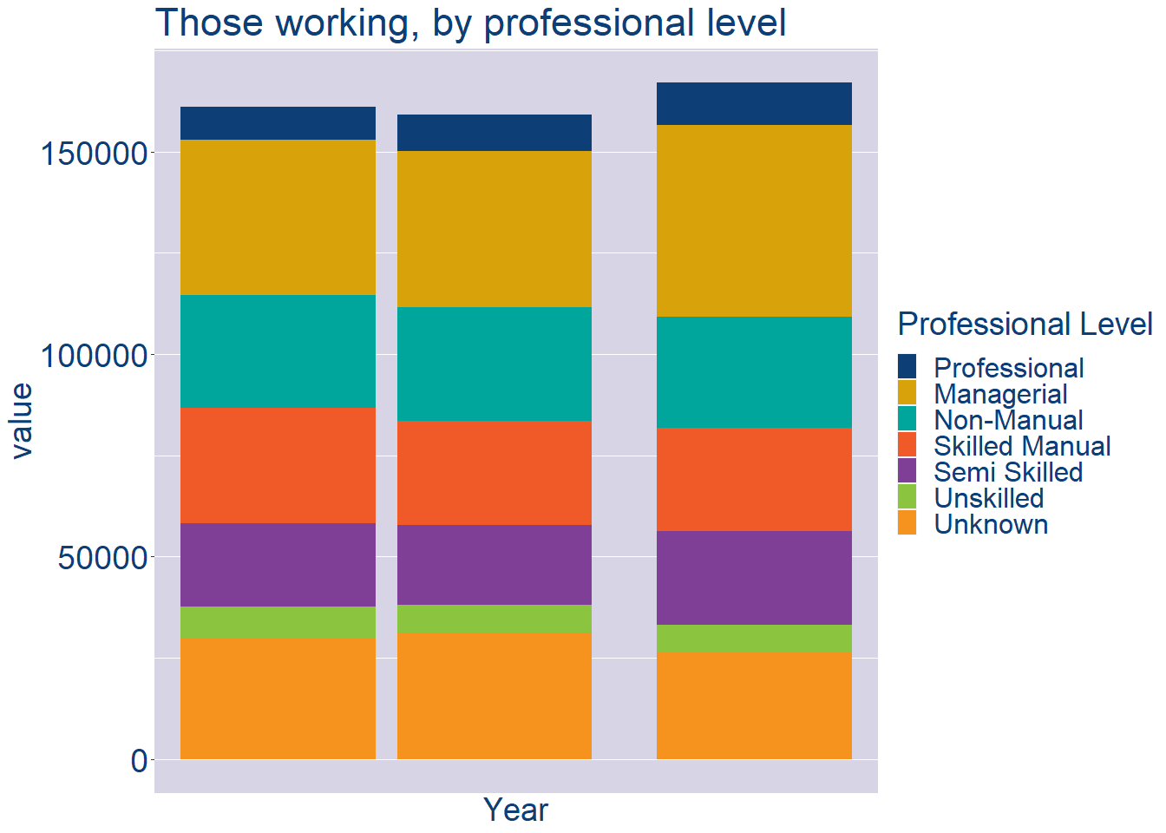
Theme 2: Donegal Workforce Demographics
Donegal Local Authority Workforce Experience Level
Year | 2022
Professional | 10559
Managerial | 47288
Non_Manual | 27440
Skilled_Manual | 25418
Semi_Skilled | 23197
Unskilled | 6873
All_Others | 26309

Slide 8
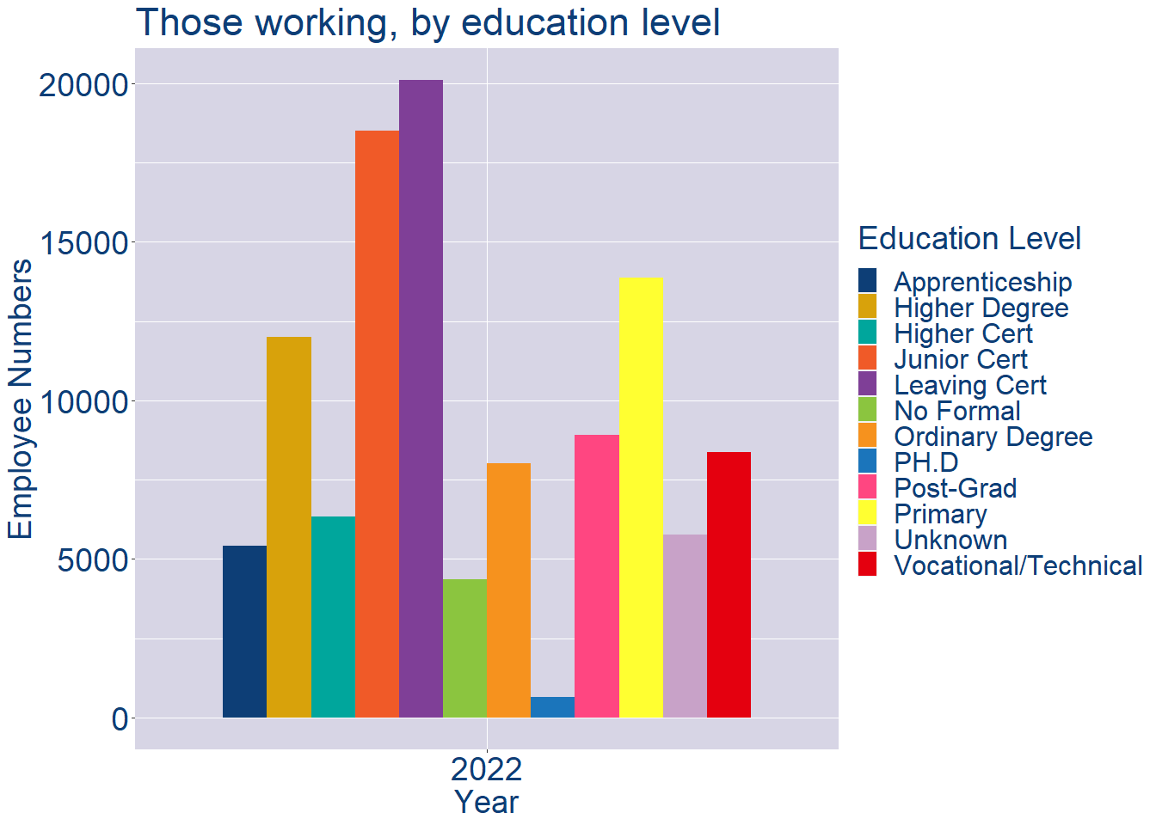
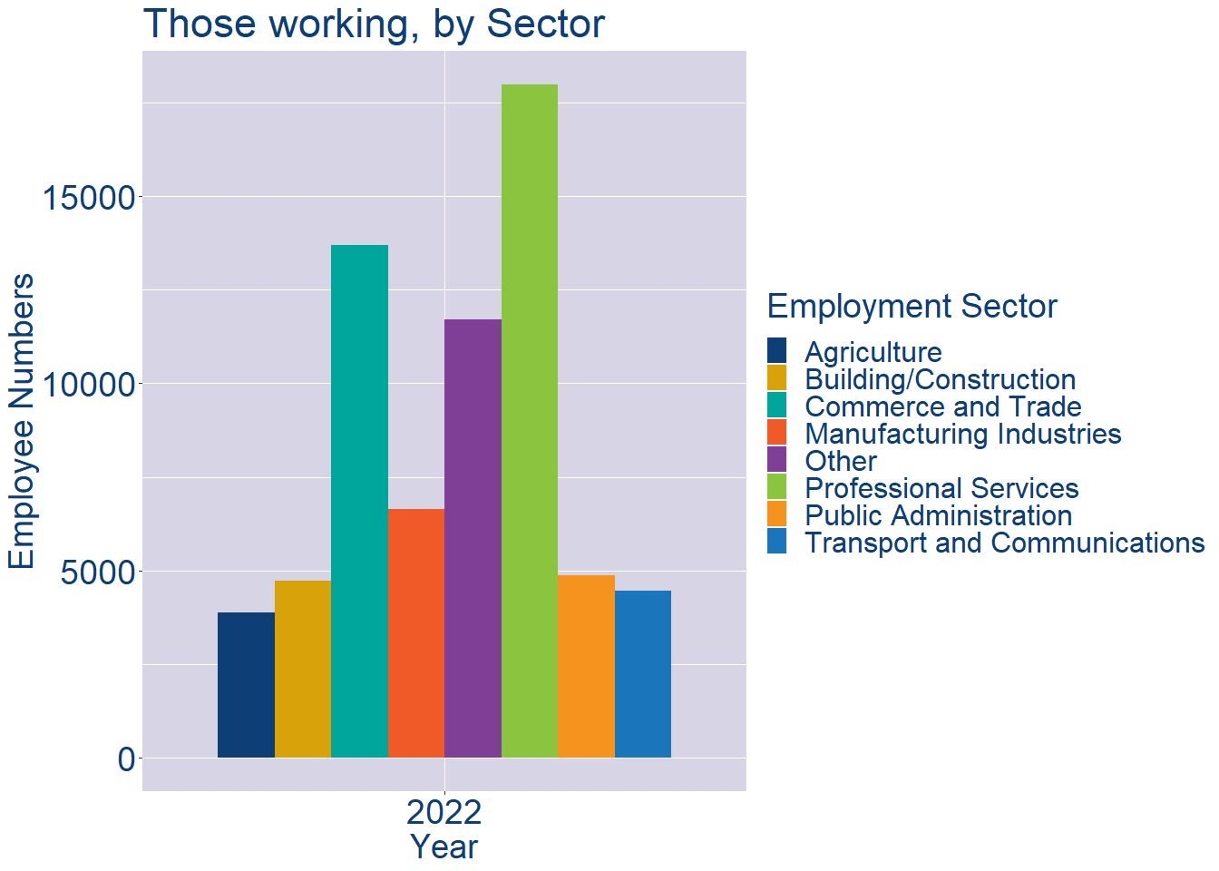
Theme 2: Donegal Workforce Demographics
Donegal Local Authority Workforce Education Level
Donegal Local Authority Workforce Sectors

Slide 9
Theme 3: Co. Donegal Business Demographics
Audience: Internal to Chambers
Highlights: Local Business Community Information
Key messages:
Varies from Local Authority area to area
Local market intelligence to help you identify trends in your local area’s business community i.e.:
Sectoral activity increasing/decreasing
What sectors the self-employed are active in

Slide 10
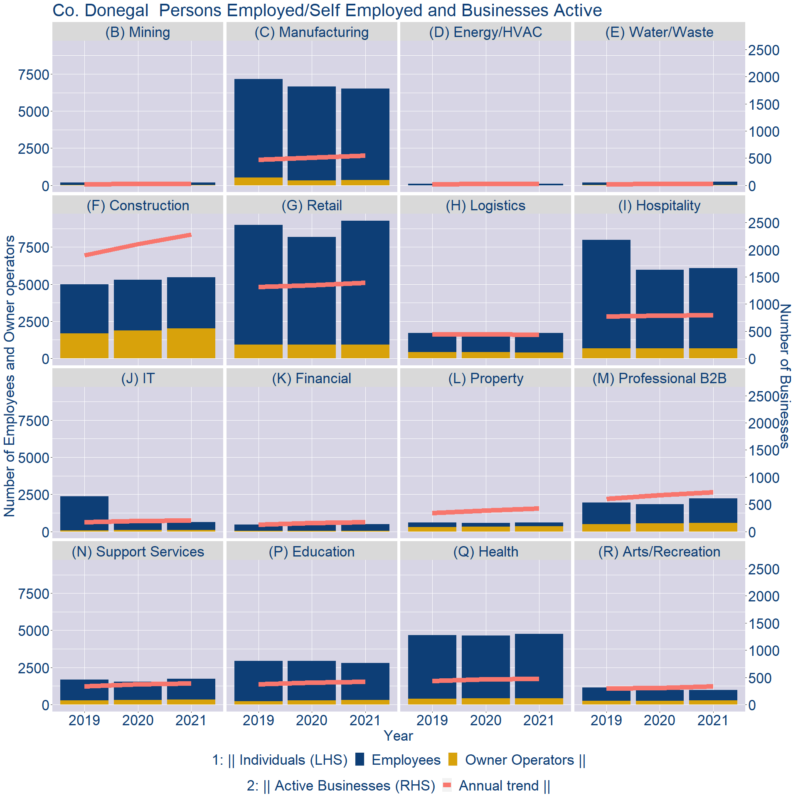
Theme 3: Co. Donegal Business Demographics

Slide 11
Theme 3: Co. Donegal Business Demographics
Sectors | Businesses | Owners | Employees
(B) Mining | 31 | 11 | 179
(C) Manufacturing | 675 | 346 | 6163
(D) Energy/HVAC | 38 | 3 | 104
(E) Water/Waste | 33 | 12 | 218
(F) Construction | 2801 | 2012 | 3457
(G) Retail | 1714 | 941 | 8340
(H) Logistics | 535 | 399 | 1311
(I) Hospitality | 984 | 676 | 5393
(J) IT | 253 | 104 | 521
(K) Financial | 214 | 55 | 422
(L) Property | 519 | 362 | 241
(M) Professional B2B | 888 | 575 | 1657
(N) Support Services | 484 | 330 | 1406
(P) Education | 519 | 293 | 2501
(Q) Health | 586 | 430 | 4330
(R) Arts/Recreation | 414 | 285 | 708
Employment in locally registered businesses, by Sector

Slide 12
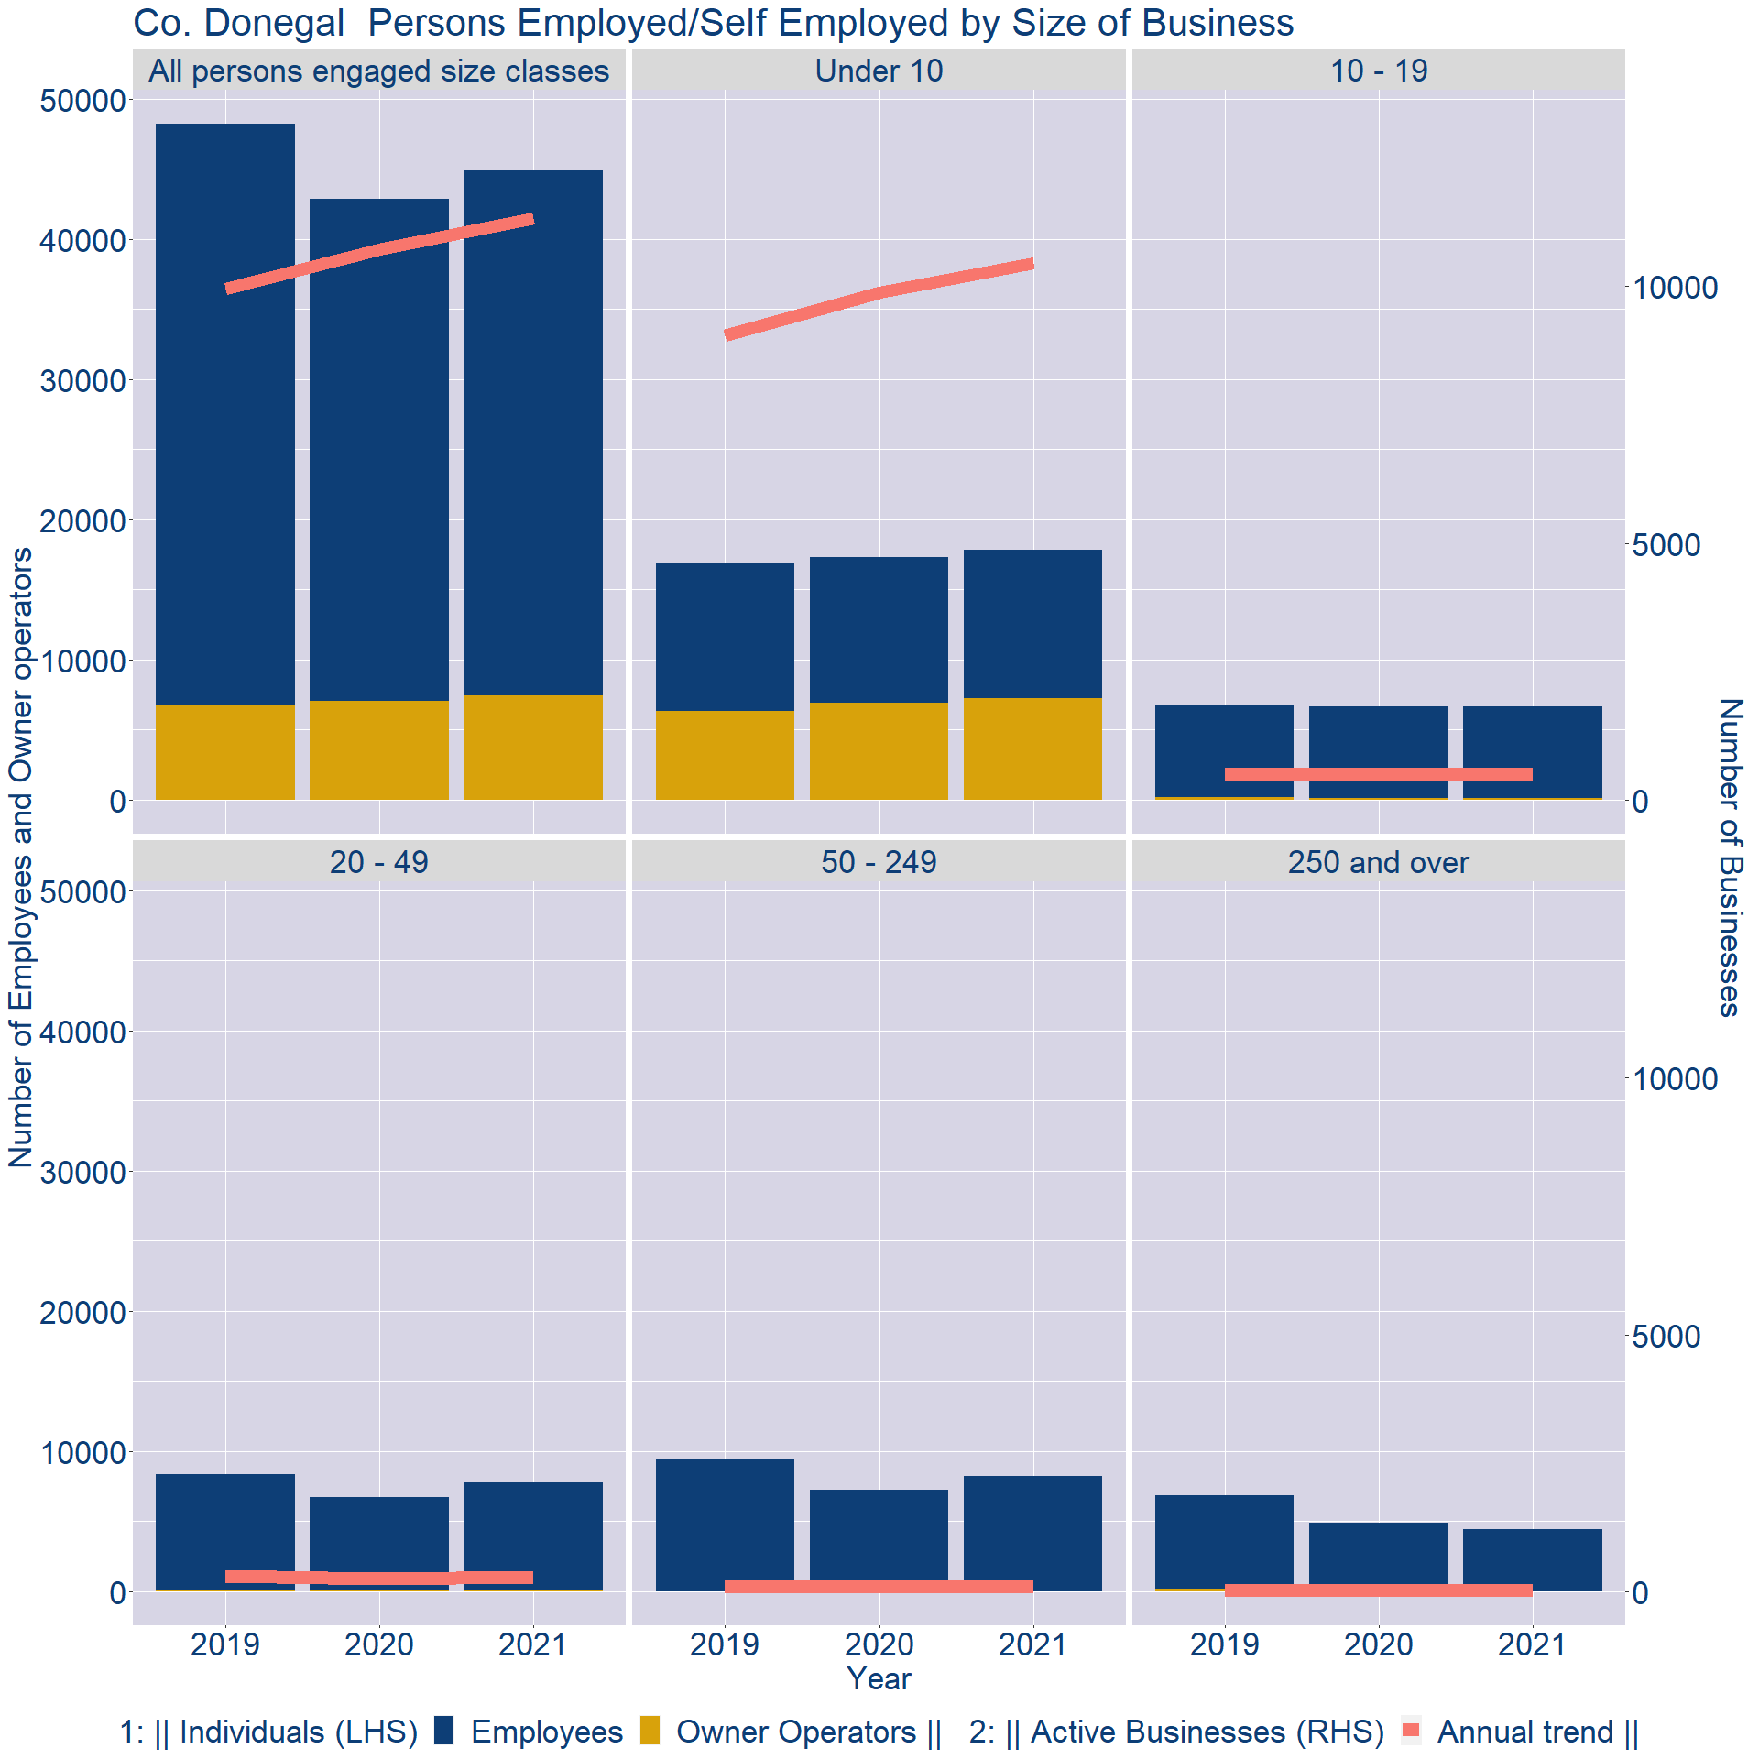
Theme 3: Co. Donegal Business Demographics
Employment in locally registered businesses, by employer size - 2021

Slide 13
Theme 3: Co. Donegal Business Demographics
Employment.Size | Businesses | Owners | Employees
All persons engaged size classes | 11320 | 7419 | 37469
Under 10 | 10450 | 7238 | 10623
10 - 19 | 495 | 126 | 6510
20 - 49 | 274 | 50 | 7710
50 - 249 | 93 | 5 | 8200
250 and over | 8 | 0 | 4426
Employment in locally registered businesses, by employer size - 2021

