Slide 1
Dun Laoghaire Rathdown Business & Employment Demographics
Chambers Ireland

Slide 2
Theme 1: DLR Rates & LPT Income
Audience: Existing/Prospective Local Authority members
Highlights: Increasing reliance on Commercial Rates to support Local Authority Activities
Key messages:
Local Authority Budget Reform needed
Rates system putting pressure on labour intensive & vulnerable sectors
Hospitality
Retail
Manufacturing
Obligation on Local Authority to use these taxes effectively

Slide 3
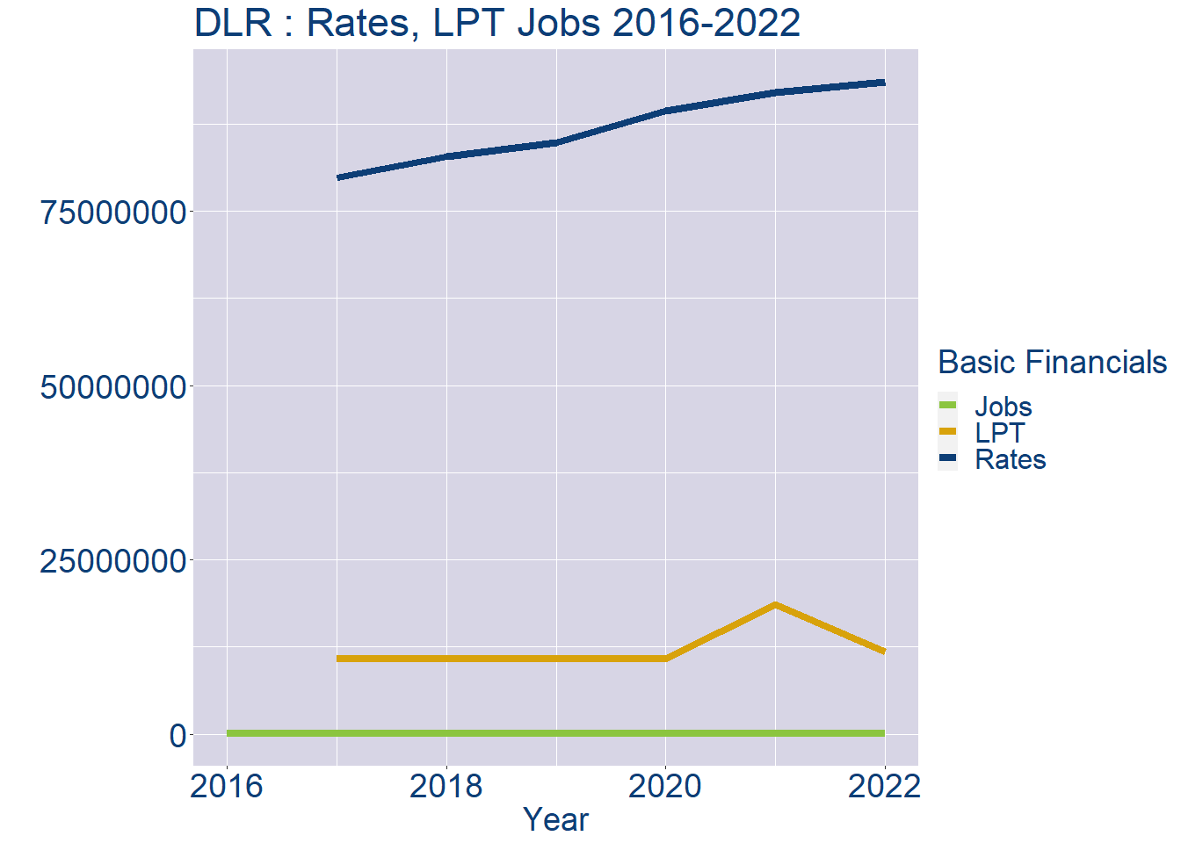
Theme 1: DLR Rates & LPT Income
DLR Local Authority Rates and LPT: 2016-2022
Year | Jobs | LPT | Rates
2016 | 95925 | NA | NA
2017 | 97695 | 10734510 | 79834567
2018 | 99465 | 10741329 | 82877520
2019 | 101235 | 10743340 | 84875186
2020 | 103005 | 10743645 | 89309549
2021 | 104775 | 18633673 | 92026671
2022 | 106548 | 11818975 | 93497908

Slide 4
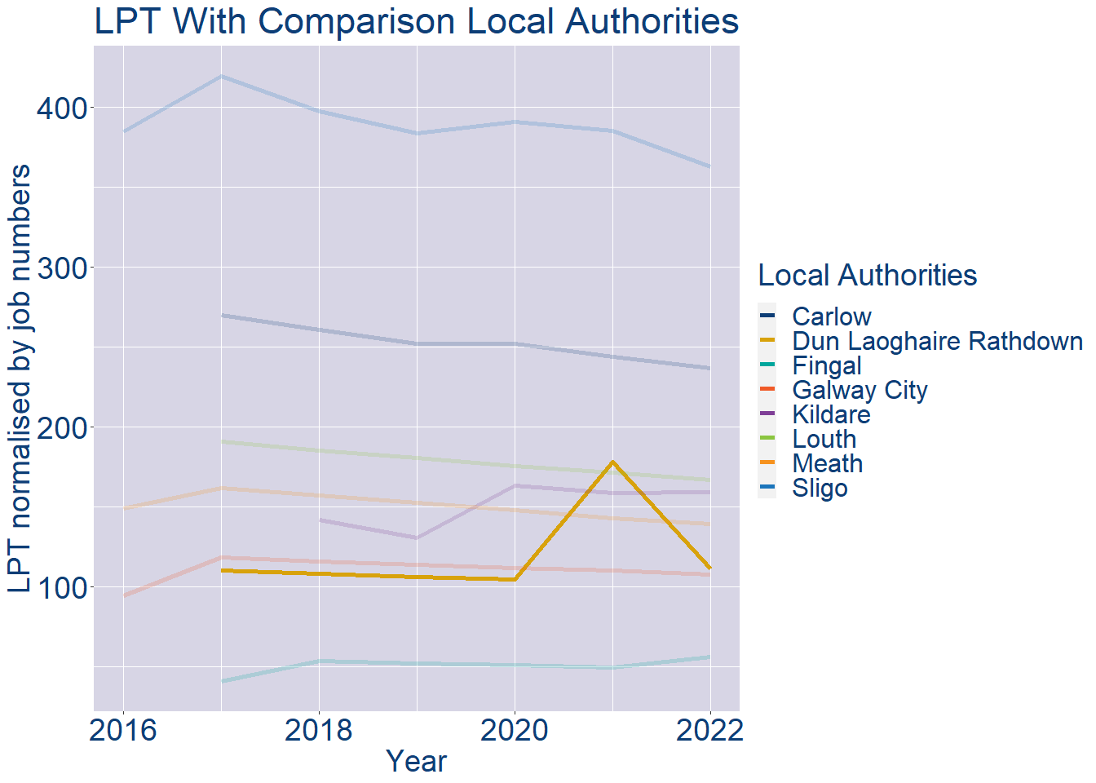
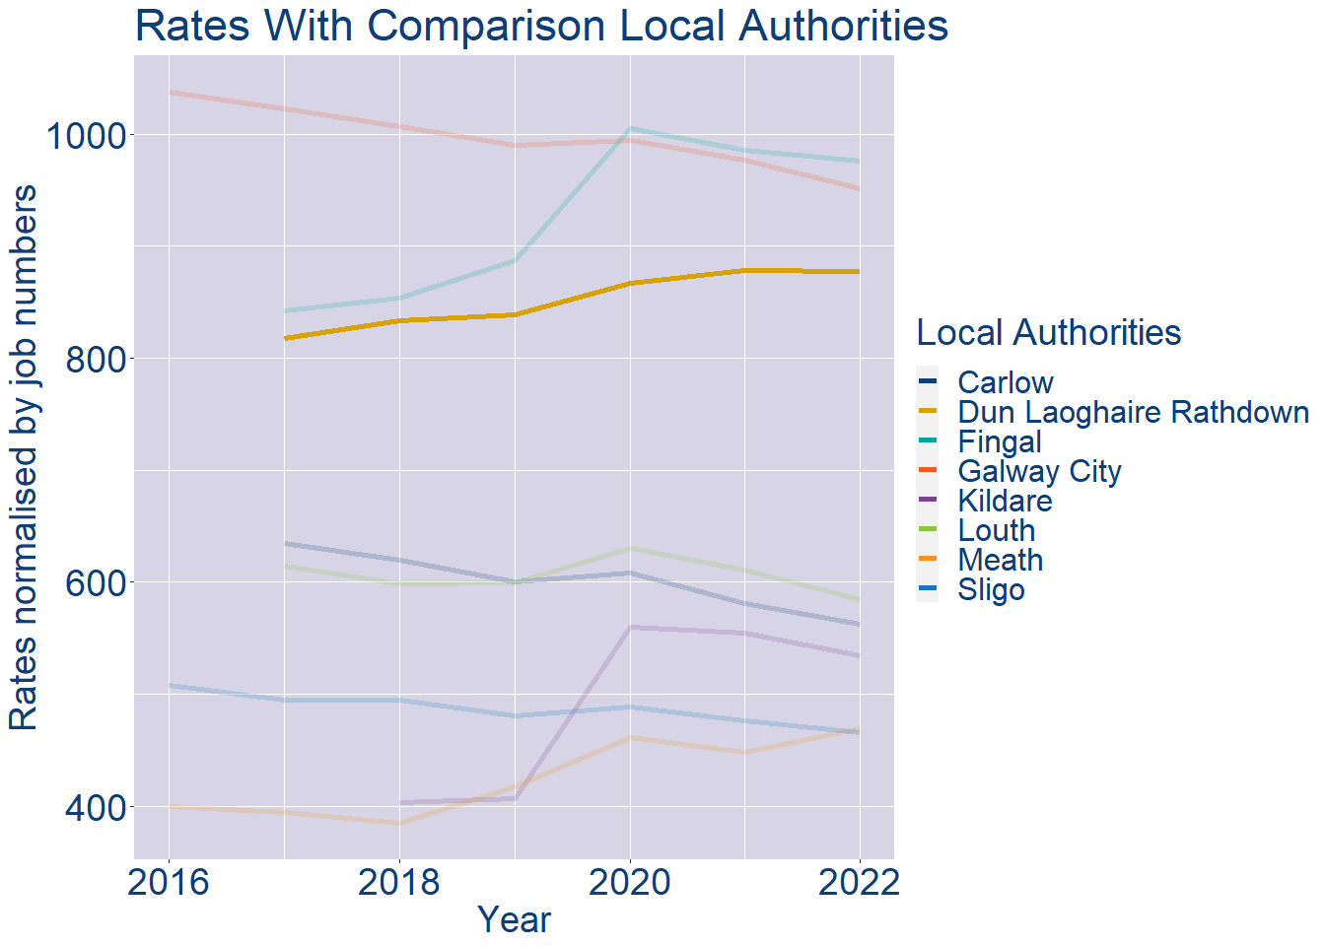
Theme 1: DLR Rates & LPT Income
DLR Local Authority 2022 LPT/employee €111
DLR Local Authority 2022 Rates/employee €878

Slide 5
Theme 2: DLR Workforce Demographics
Audience: Membership/Businesses that are interested in expanding into the local area
Highlights: Workforce details, who is available, education level, population growth
Key messages:
Varies from Local Authority area to area
Important for you to understand the numbers of people who are available to work in your area, their experience levels and the training they have

Slide 6
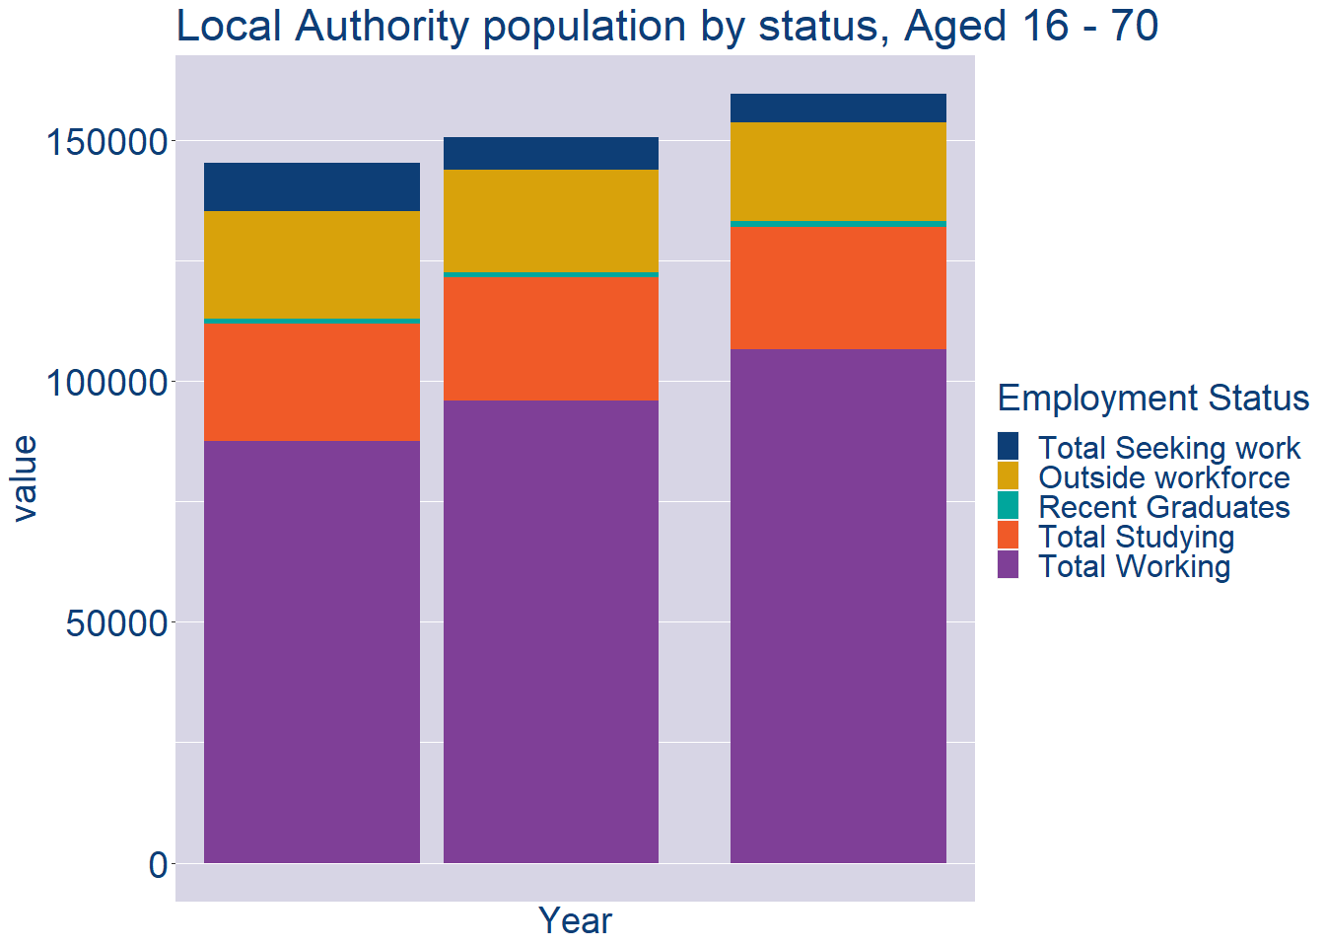
Theme 2: DLR Workforce Demographics
DLR Local Authority Workforce Population
Year | 2022
Total_working | 106548
Total_studying | 25396
Total_recent_grads | 1223
Total_job_seeking | 5827
Total_not_seeking | 20612

Slide 7
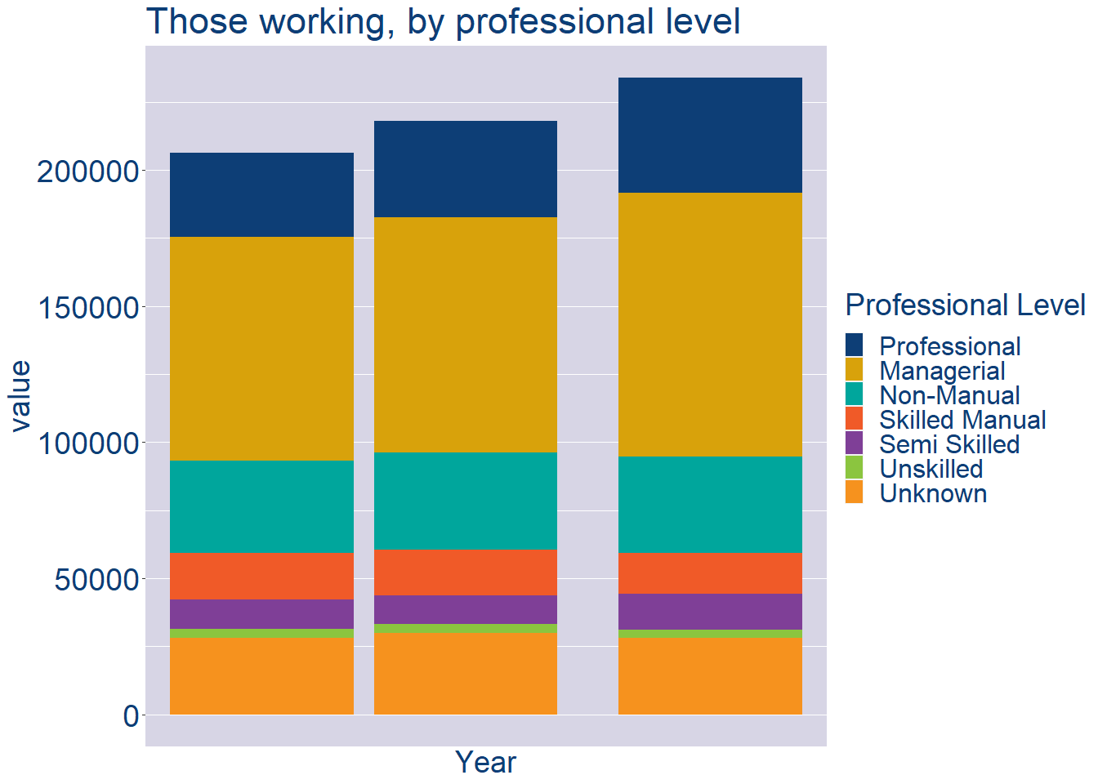
Theme 2: DLR Workforce Demographics
DLR Local Authority Workforce Experience Level
Year | 2022
Professional | 42162
Managerial | 96872
Non_Manual | 35505
Skilled_Manual | 15115
Semi_Skilled | 13129
Unskilled | 3095
All_Others | 27982

Slide 8
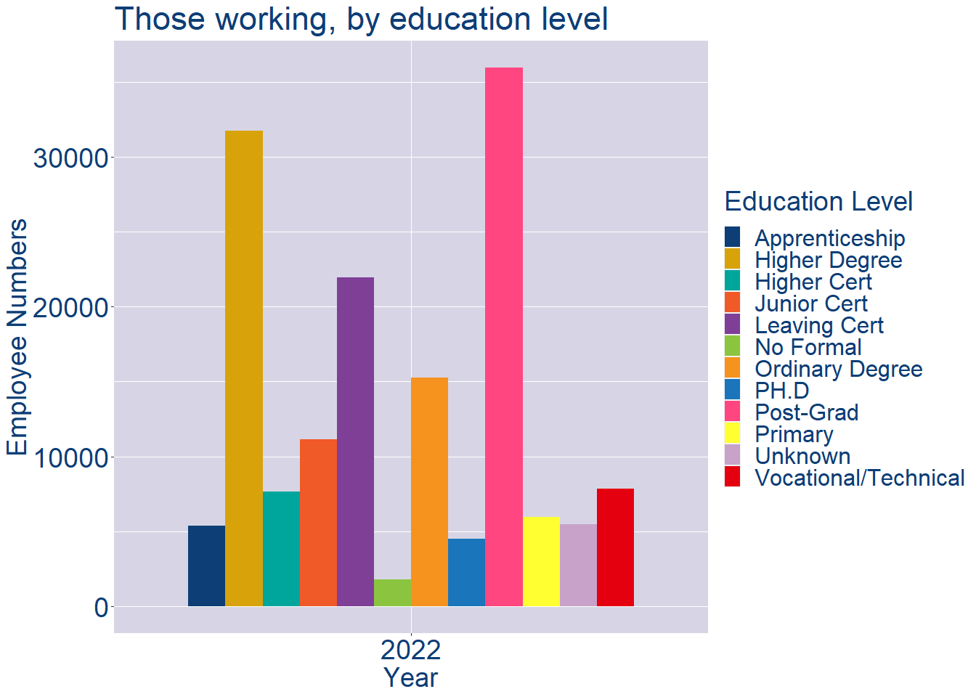
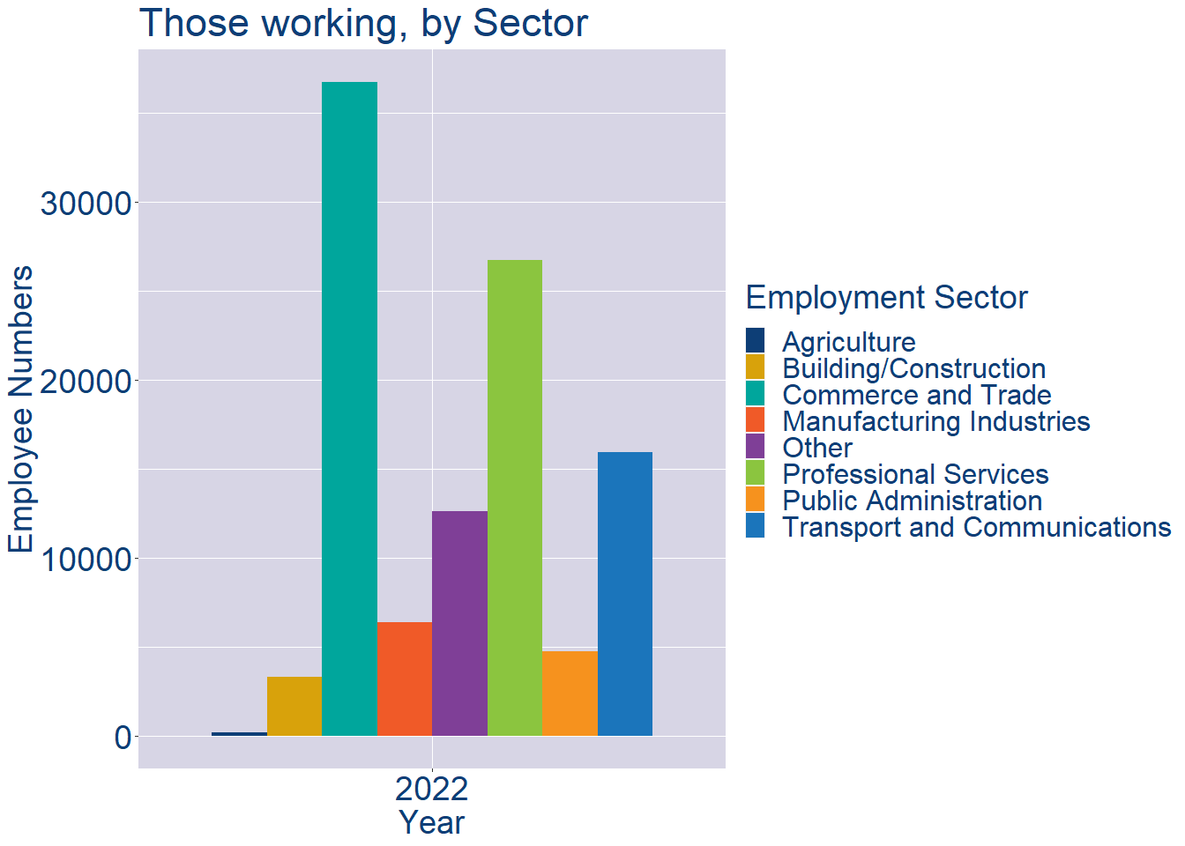
Theme 2: DLR Workforce Demographics
DLR Local Authority Workforce Education Level
DLR Local Authority Workforce Sectors

Slide 9
Theme 3: Co. Dublin Business Demographics
Audience: Internal to Chambers
Highlights: Local Business Community Information
Key messages:
Varies from Local Authority area to area
Local market intelligence to help you identify trends in your local area’s business community i.e.:
Sectoral activity increasing/decreasing
What sectors the self-employed are active in

Slide 10
Theme 3: Co. Dublin Business Demographics

Slide 11
Theme 3: Co. Dublin Business Demographics
Sectors | Businesses | Owners | Employees
(B) Mining | 48 | 6 | 313
(C) Manufacturing | 3725 | 1355 | 56844
(D) Energy/HVAC | 293 | 7 | 8572
(E) Water/Waste | 231 | 49 | 4732
(F) Construction | 19142 | 13042 | 35473
(G) Retail | 12820 | 3883 | 173264
(H) Logistics | 10341 | 8621 | 52661
(I) Hospitality | 4485 | 1247 | 57655
(J) IT | 9529 | 2280 | 99739
(K) Financial | 9641 | 1152 | 91965
(L) Property | 5800 | 2411 | 13275
(M) Professional B2B | 19778 | 9628 | 92635
(N) Support Services | 7194 | 1965 | 79467
(P) Education | 4384 | 2701 | 41294
(Q) Health | 7638 | 5245 | 113727
(R) Arts/Recreation | 4504 | 3249 | 14142
Employment in locally registered businesses, by Sector

Slide 12
Theme 3: Co. Dublin Business Demographics
Employment in locally registered businesses, by employer size - 2021

Slide 13
Theme 3: Co. Dublin Business Demographics
Employment.Size | Businesses | Owners | Employees
All persons engaged size classes | 123874 | 59999 | 947794
Under 10 | 113877 | 58685 | 104583
10 - 19 | 4657 | 718 | 62095
20 - 49 | 3018 | 282 | 90944
50 - 249 | 1811 | 161 | 182776
250 and over | 511 | 153 | 507396
Employment in locally registered businesses, by employer size - 2021

