Slide 1
Cork County Business & Employment Demographics
Chambers Ireland

Slide 2
Theme 1: Cork County Rates & LPT Income
Audience: Existing/Prospective Local Authority members
Highlights: Increasing reliance on Commercial Rates to support Local Authority Activities
Key messages:
Local Authority Budget Reform needed
Rates system putting pressure on labour intensive & vulnerable sectors
Hospitality
Retail
Manufacturing
Obligation on Local Authority to use these taxes effectively

Slide 3
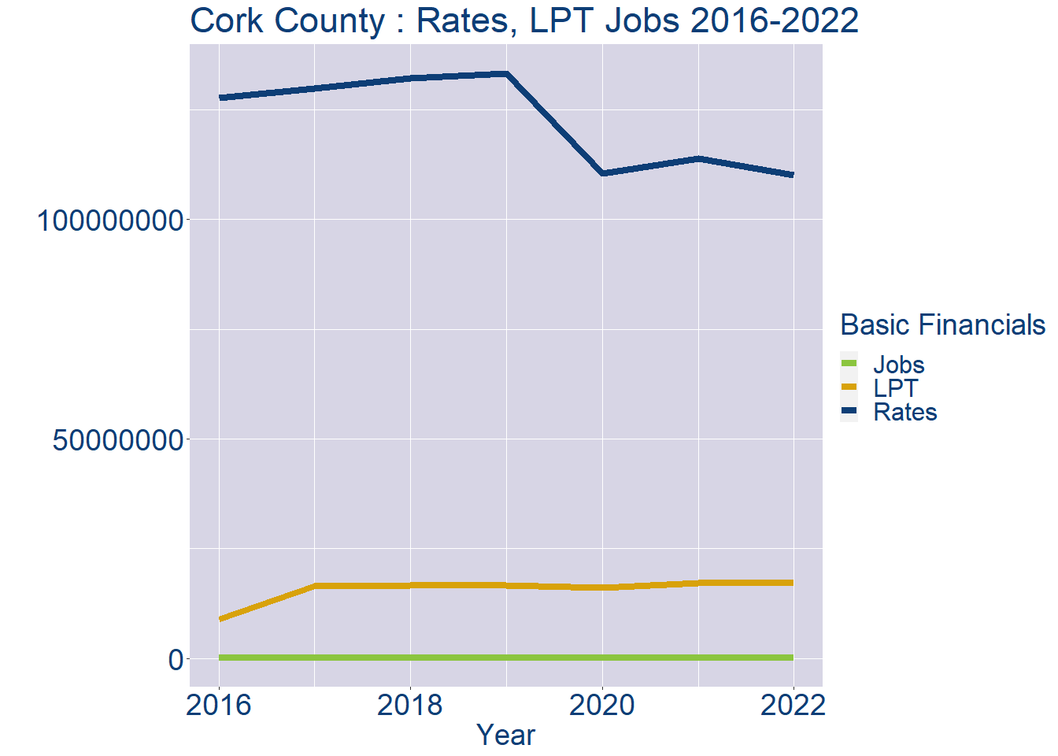
Theme 1: Cork County Rates & LPT Income
Cork County Local Authority Rates and LPT: 2016-2022
Year | Jobs | LPT | Rates
2016 | 179890 | 8927233 | 127622069
2017 | 176771 | 16526083 | 129772049
2018 | 173652 | 16571259 | 132210905
2019 | 170533 | 16590464 | 133225531
2020 | 167414 | 16115798 | 110544462
2021 | 164295 | 17155999 | 113968481
2022 | 161174 | 17178711 | 110200000

Slide 4
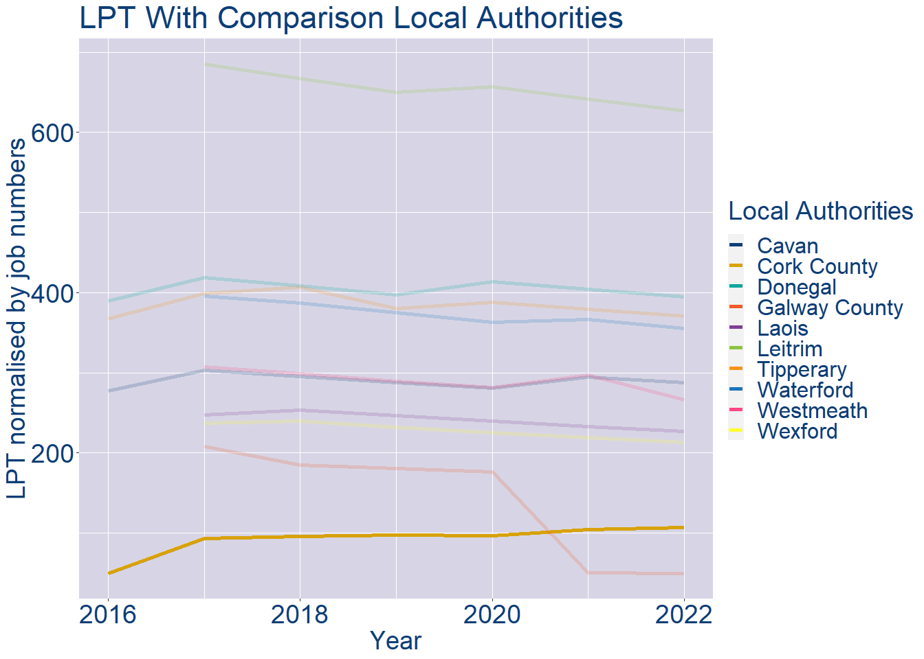
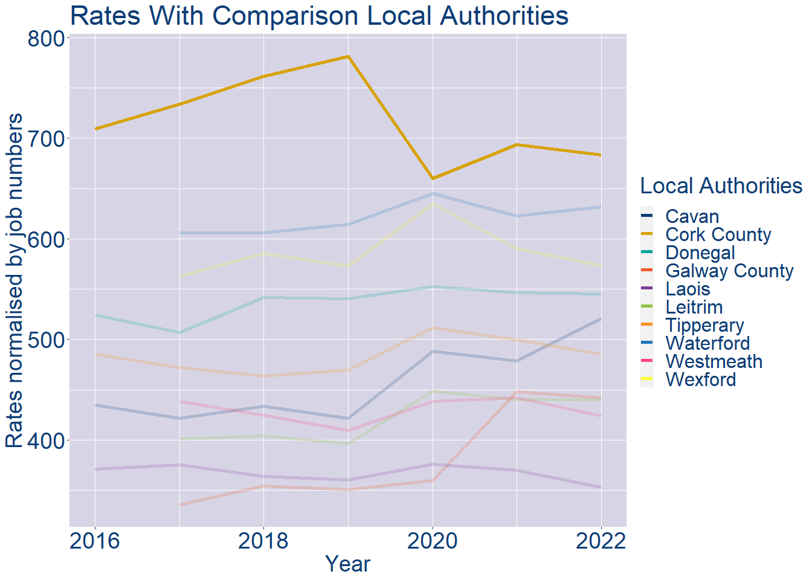
Theme 1: Cork County Rates & LPT Income
Cork County Local Authority 2022 LPT/employee €107
Cork County Local Authority 2022 Rates/employee €684

Slide 5
Theme 2: Cork County Workforce Demographics
Audience: Membership/Businesses that are interested in expanding into the local area
Highlights: Workforce details, who is available, education level, population growth
Key messages:
Varies from Local Authority area to area
Important for you to understand the numbers of people who are available to work in your area, their experience levels and the training they have

Slide 6
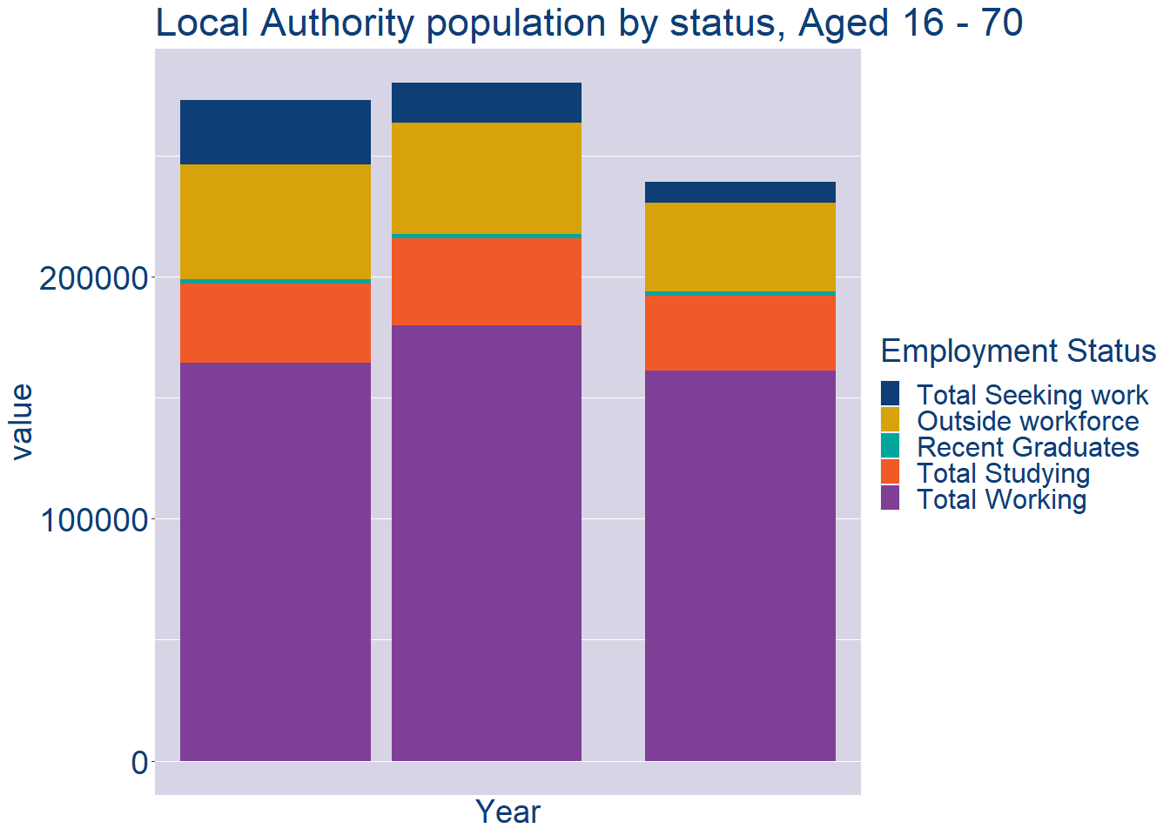
Theme 2: Cork County Workforce Demographics
Cork County Local Authority Workforce Population
Year | 2022
Total_working | 161174
Total_studying | 31048
Total_recent_grads | 1682
Total_job_seeking | 8770
Total_not_seeking | 36699

Slide 7
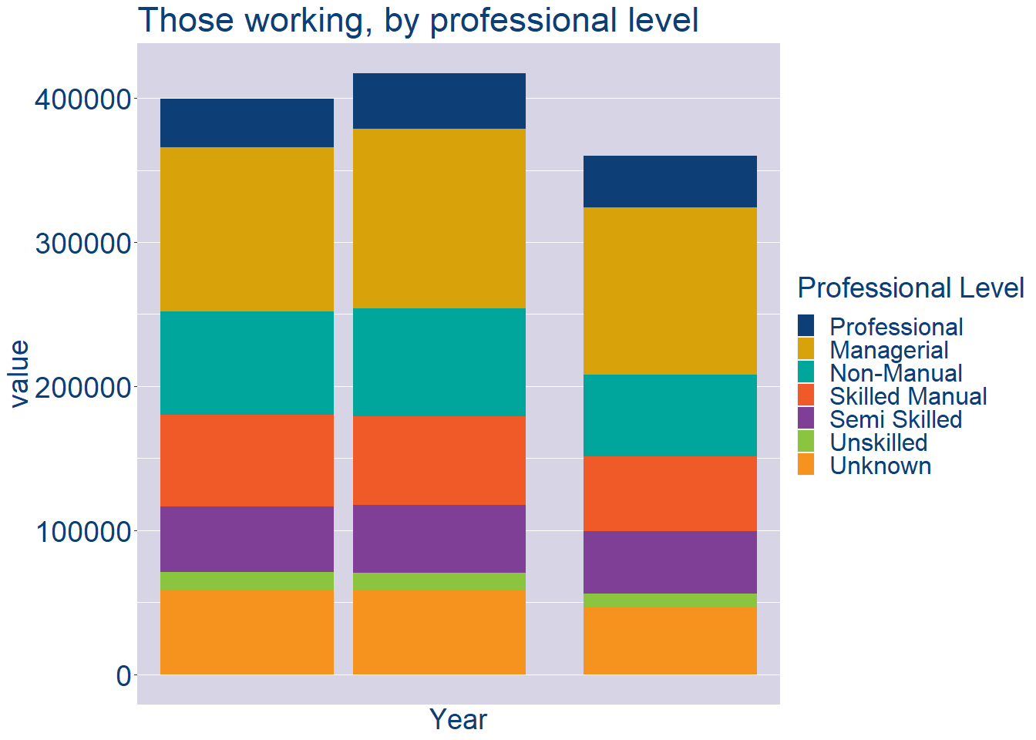
Theme 2: Cork County Workforce Demographics
Cork County Local Authority Workforce Experience Level
Year | 2022
Professional | 36048
Managerial | 115986
Non_Manual | 56859
Skilled_Manual | 51800
Semi_Skilled | 43514
Unskilled | 9783
All_Others | 46162

Slide 8
Theme 2: Cork County Workforce Demographics
Cork County Local Authority Workforce Education Level
Cork County Local Authority Workforce Sectors

Slide 9
Theme 3: Co. Cork Business Demographics
Audience: Internal to Chambers
Highlights: Local Business Community Information
Key messages:
Varies from Local Authority area to area
Local market intelligence to help you identify trends in your local area’s business community i.e.:
Sectoral activity increasing/decreasing
What sectors the self-employed are active in

Slide 10
Theme 3: Co. Cork Business Demographics

Slide 11
Theme 3: Co. Cork Business Demographics
Sectors | Businesses | Owners | Employees
(B) Mining | 32 | 0 | 0
(C) Manufacturing | 2154 | 985 | 37003
(D) Energy/HVAC | 156 | 0 | 0
(E) Water/Waste | 114 | 20 | 896
(F) Construction | 7121 | 4622 | 12523
(G) Retail | 5179 | 2466 | 33964
(H) Logistics | 2135 | 1629 | 4670
(I) Hospitality | 2147 | 1319 | 17405
(J) IT | 1535 | 475 | 9490
(K) Financial | 1338 | 218 | 4240
(L) Property | 1814 | 1058 | 1329
(M) Professional B2B | 6210 | 2644 | 17918
(N) Support Services | 1826 | 1040 | 14069
(P) Education | 1812 | 1110 | 14743
(Q) Health | 2676 | 2037 | 37090
(R) Arts/Recreation | 1364 | 995 | 2739
Employment in locally registered businesses, by Sector

Slide 12
Theme 3: Co. Cork Business Demographics
Employment in locally registered businesses, by employer size - 2021

Slide 13
Theme 3: Co. Cork Business Demographics
Employment.Size | Businesses | Owners | Employees
All persons engaged size classes | 39573 | 22339 | 211842
Under 10 | 36602 | 21729 | 39418
10 - 19 | 1591 | 430 | 20733
20 - 49 | 881 | 140 | 25884
50 - 249 | 429 | 40 | 41669
250 and over | 70 | 0 | 84138
Employment in locally registered businesses, by employer size - 2021

