Slide 1
Clare County Business & Employment Demographics
Chambers Ireland

Slide 2
Theme 1: Clare Rates & LPT Income
Audience: Existing/Prospective Local Authority members
Highlights: Increasing reliance on Commercial Rates to support Local Authority Activities
Key messages:
Local Authority Budget Reform needed
Rates system putting pressure on labour intensive & vulnerable sectors
Hospitality
Retail
Manufacturing
Obligation on Local Authority to use these taxes effectively

Slide 3
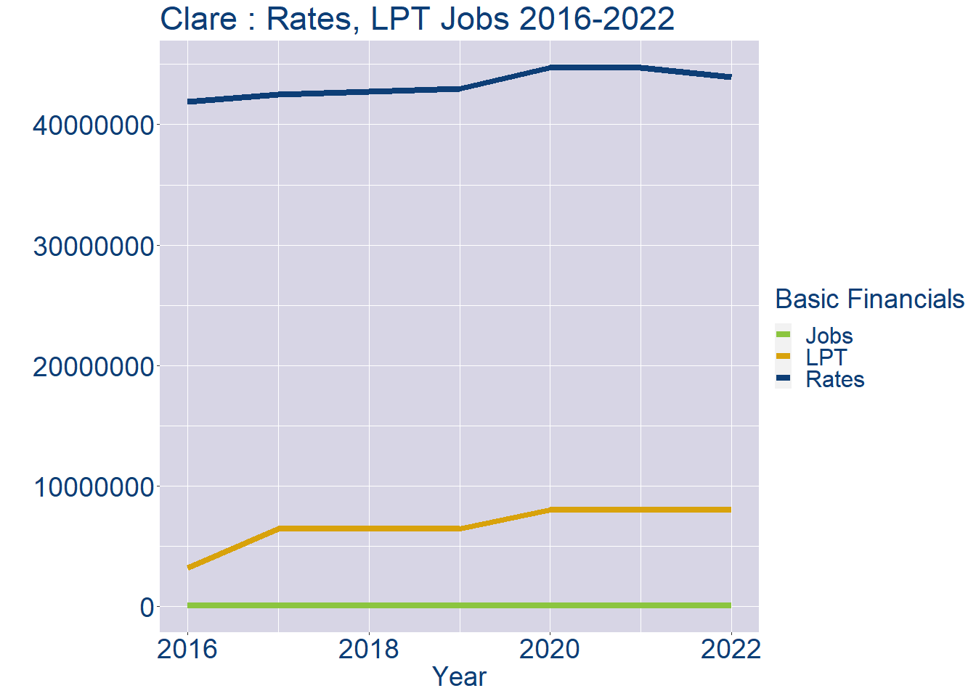
Theme 1: Clare Rates & LPT Income
Clare Local Authority Rates and LPT: 2016-2022
Year | Jobs | LPT | Rates
2016 | 49511 | 3166583 | 41890797
2017 | 50617 | 6440596 | 42510392
2018 | 51723 | 6451268 | 42766699
2019 | 52829 | 6453400 | 43009611
2020 | 53935 | 7973216 | 44715390
2021 | 55041 | 7973216 | 44715390
2022 | 56144 | 7997470 | 43963124

Slide 4
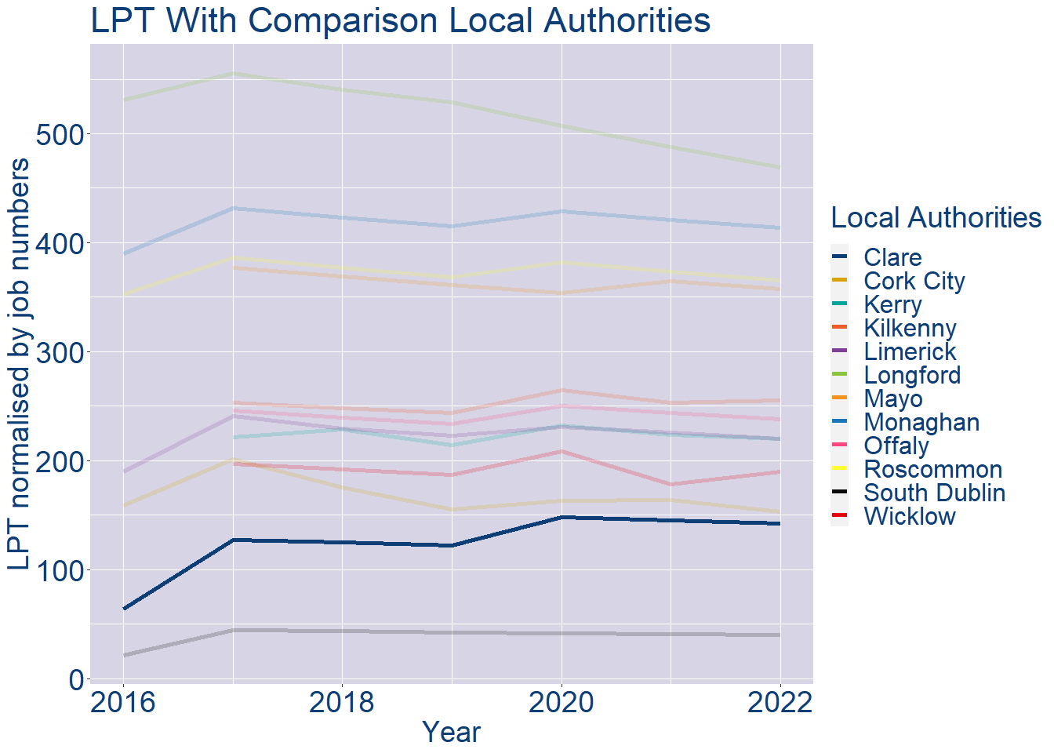
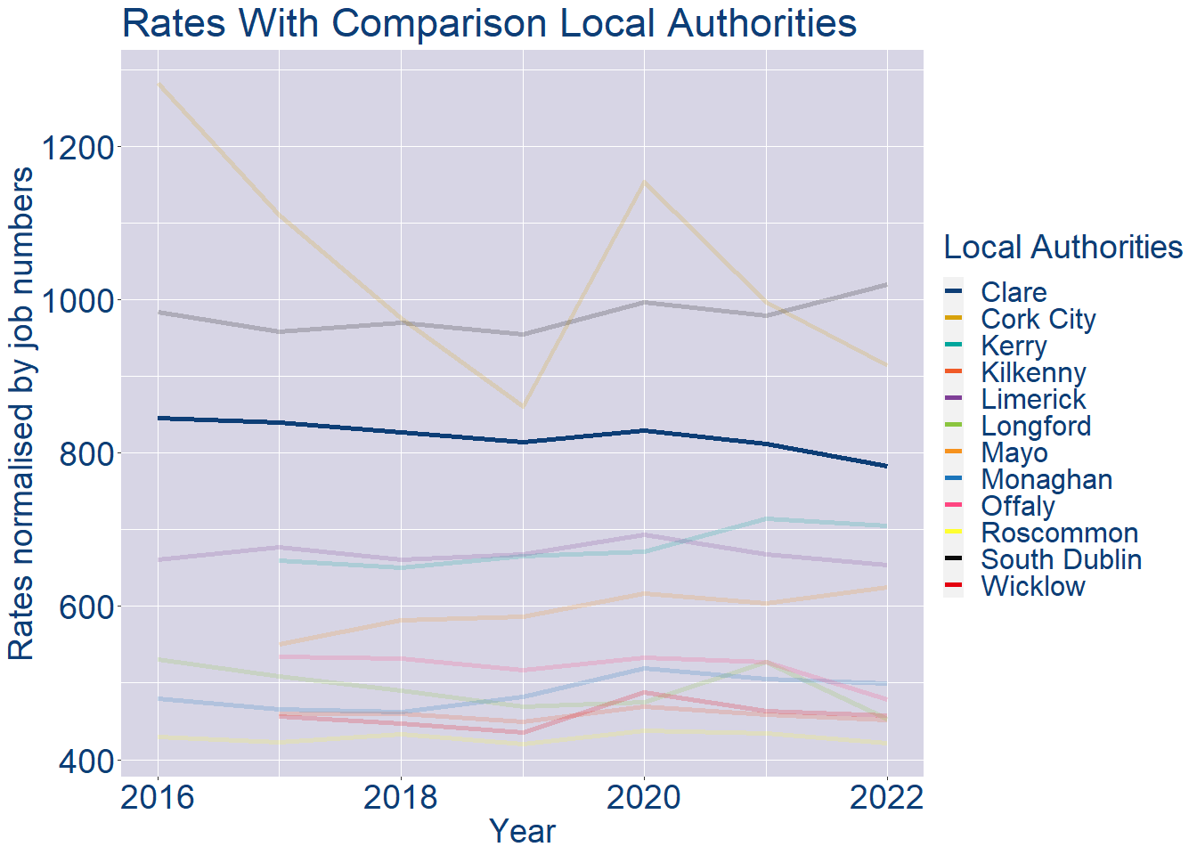
Theme 1: Clare Rates & LPT Income
Clare Local Authority 2022 LPT/employee €142
Clare Local Authority 2022 Rates/employee €783

Slide 5
Theme 2: Clare Workforce Demographics
Audience: Membership/Businesses that are interested in expanding into the local area
Highlights: Workforce details, who is available, education level, population growth
Key messages:
Varies from Local Authority area to area
Important for you to understand the numbers of people who are available to work in your area, their experience levels and the training they have

Slide 6
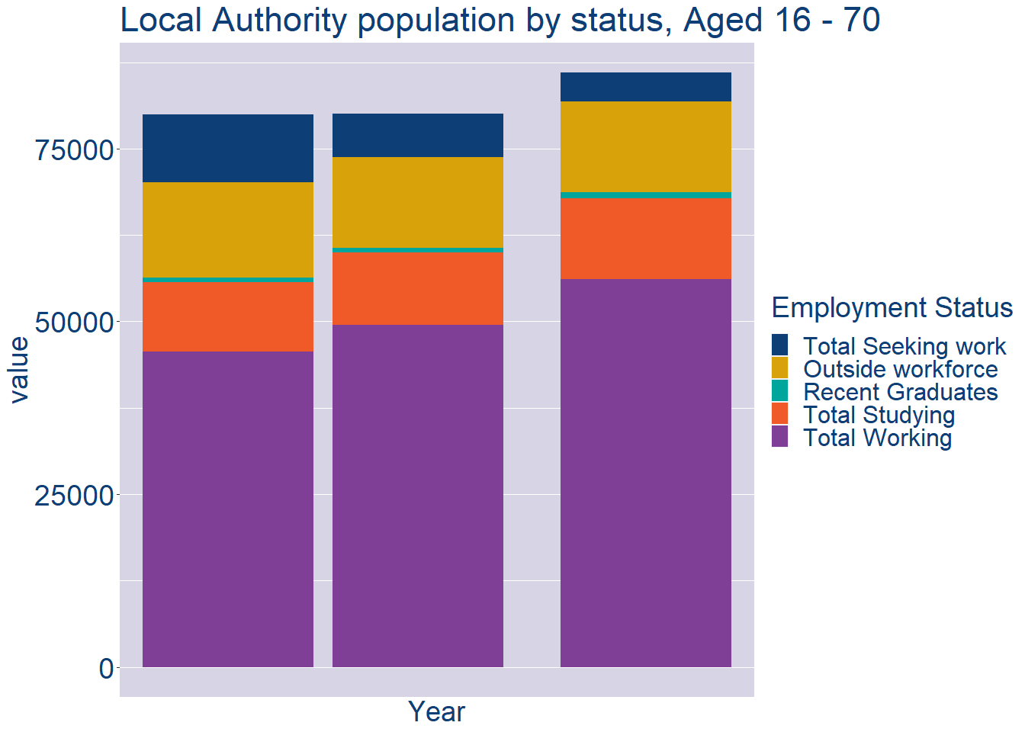
Theme 2: Clare Workforce Demographics
Clare Local Authority Workforce Population
Year | 2022
Total_working | 56144
Total_studying | 11726
Total_recent_grads | 813
Total_job_seeking | 4154
Total_not_seeking | 13185

Slide 7
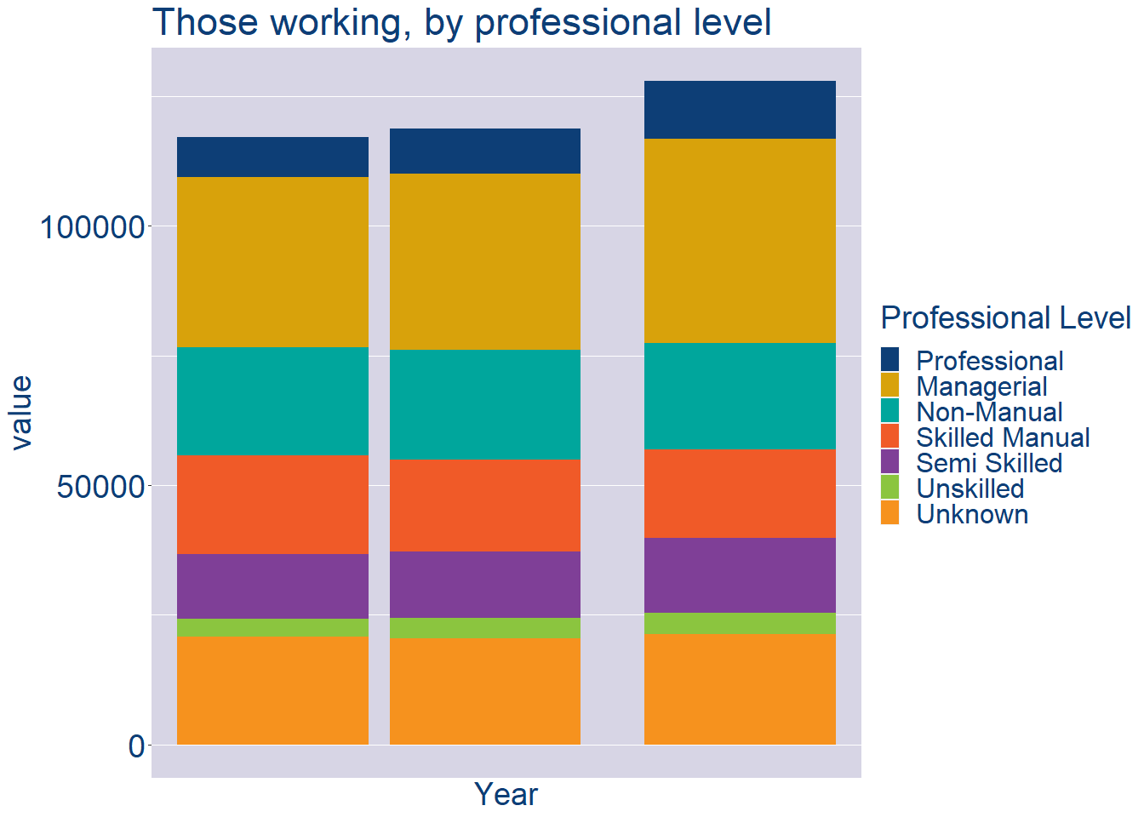
Theme 2: Clare Workforce Demographics
Clare Local Authority Workforce Experience Level
Year | 2022
Professional | 11108
Managerial | 39419
Non_Manual | 20497
Skilled_Manual | 17079
Semi_Skilled | 14518
Unskilled | 4035
All_Others | 21282

Slide 8
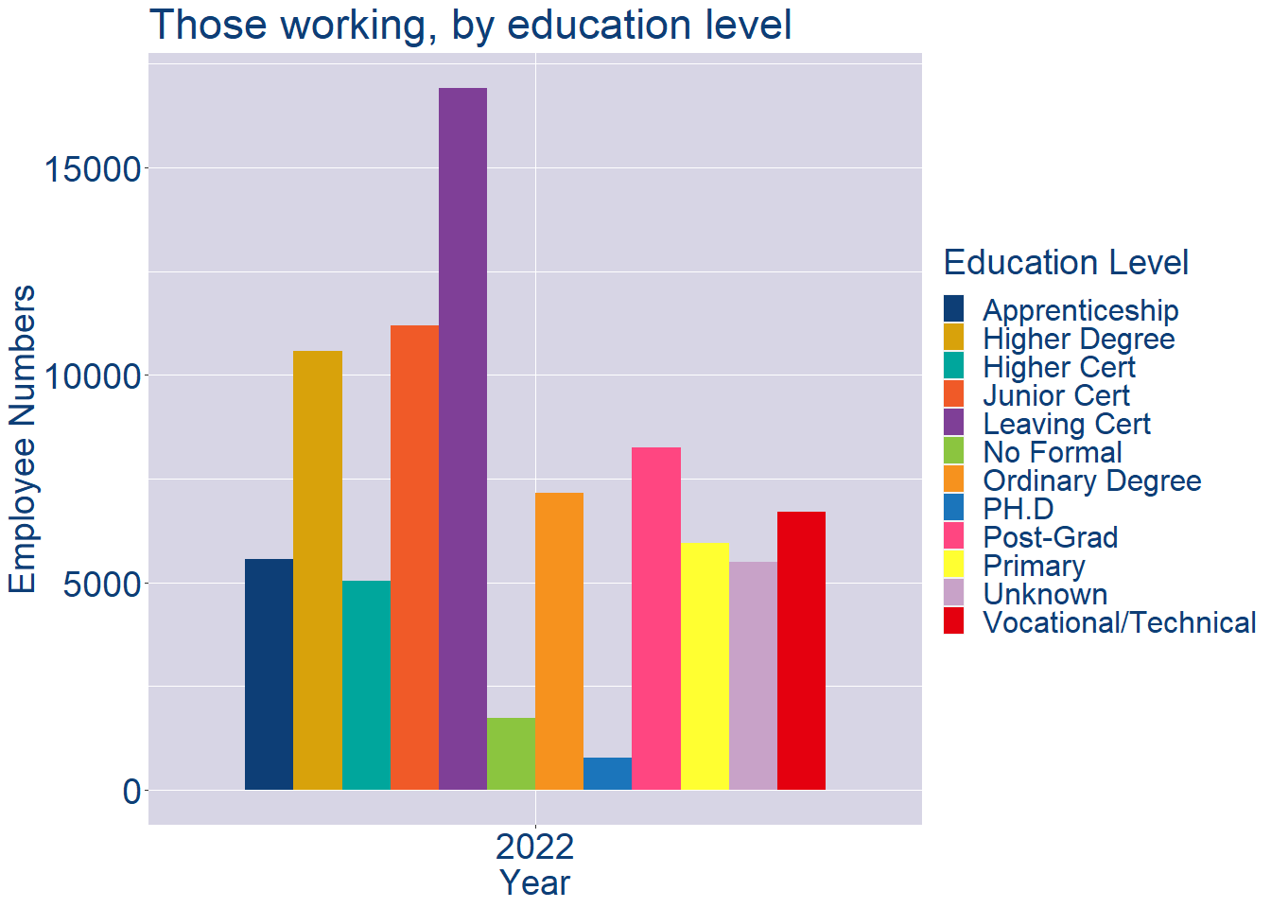
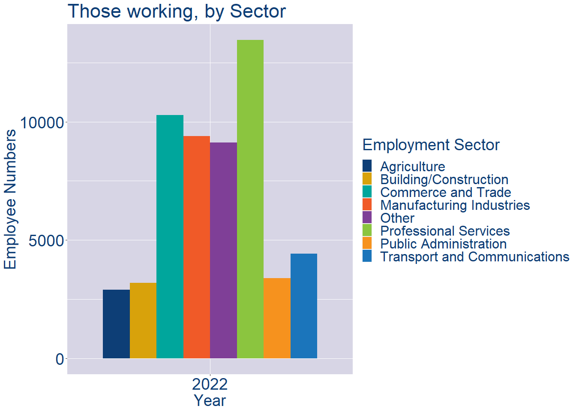
Theme 2: Clare Workforce Demographics
Clare Local Authority Workforce Education Level
Clare Local Authority Workforce Sectors

Slide 9
Theme 3: Co. Clare Business Demographics
Audience: Internal to Chambers
Highlights: Local Business Community Information
Key messages:
Varies from Local Authority area to area
Local market intelligence to help you identify trends in your local area’s business community i.e.:
Sectoral activity increasing/decreasing
What sectors the self-employed are active in

Slide 10
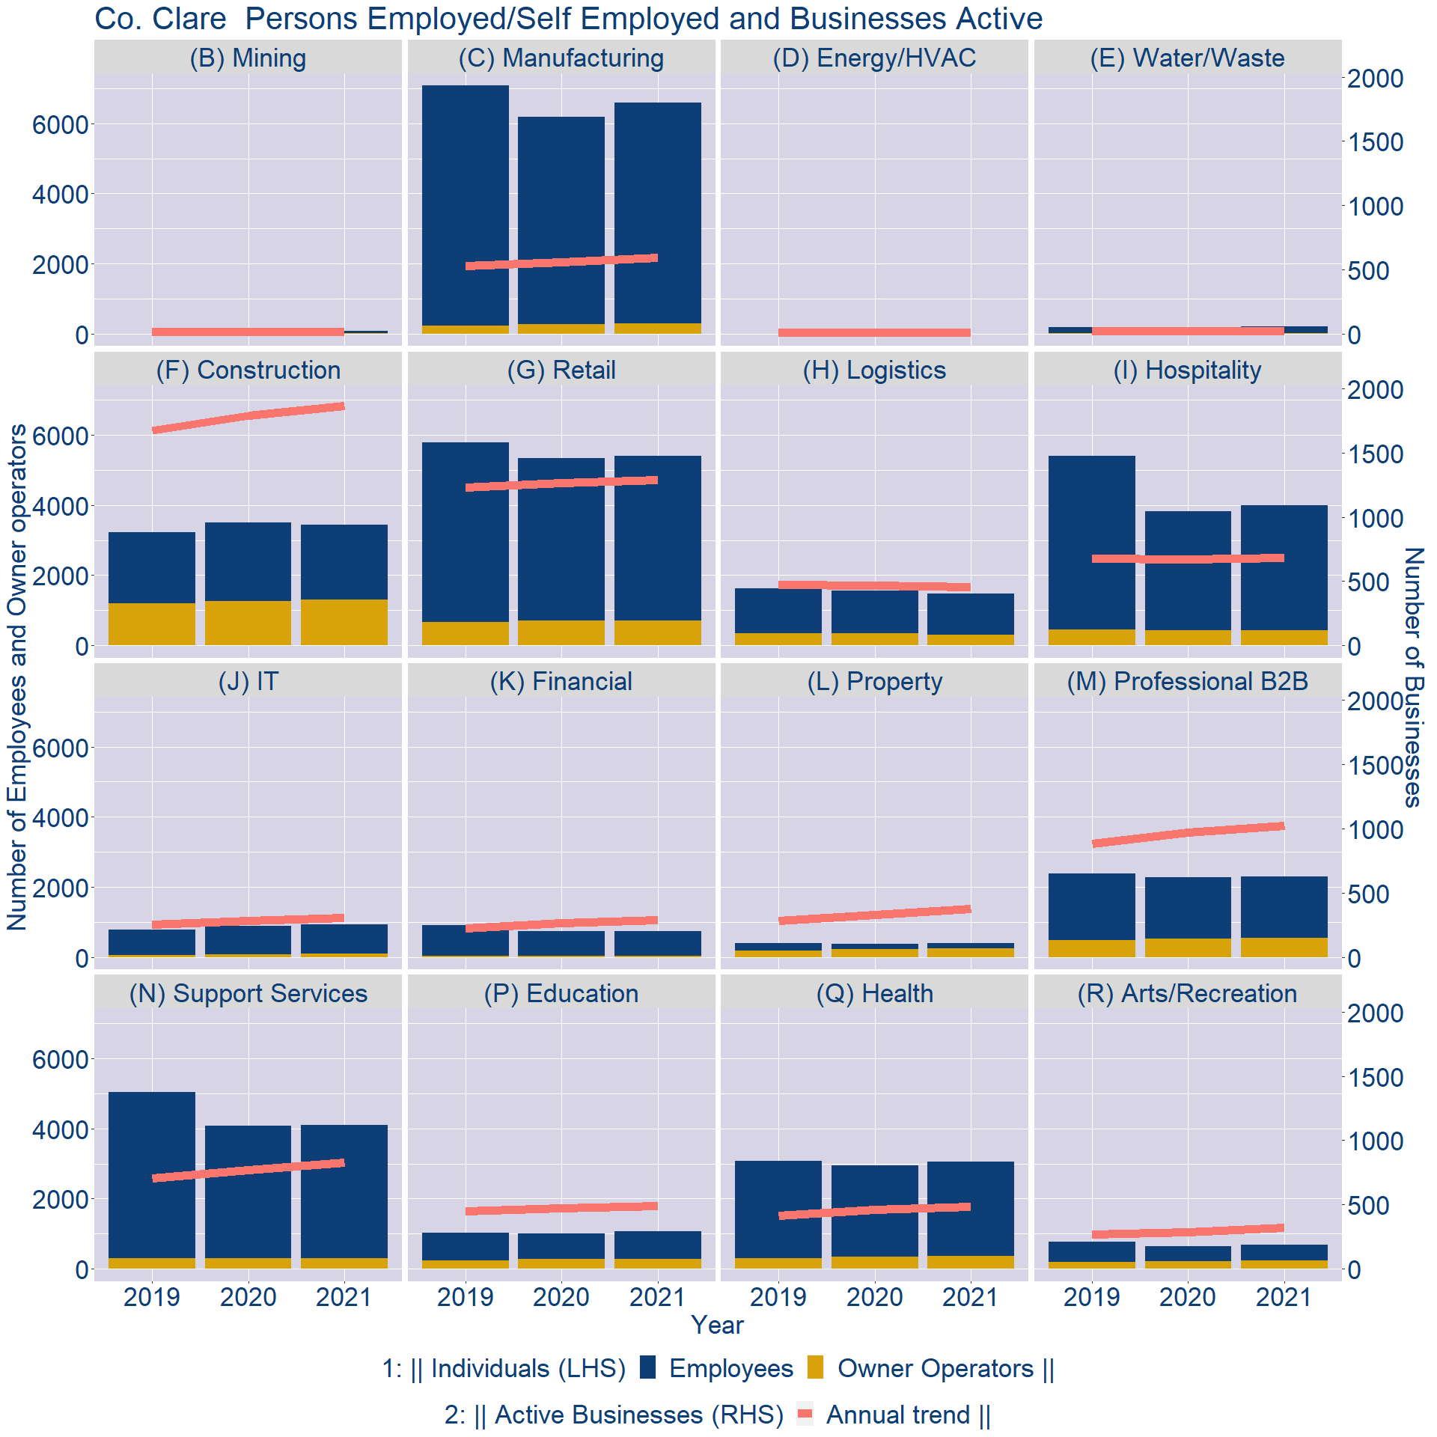
Theme 3: Co. Clare Business Demographics

Slide 11
Theme 3: Co. Clare Business Demographics
Sectors | Businesses | Owners | Employees
(B) Mining | 16 | 5 | 82
(C) Manufacturing | 569 | 297 | 6304
(D) Energy/HVAC | 9 | 0 | 3
(E) Water/Waste | 23 | 9 | 195
(F) Construction | 1801 | 1299 | 2139
(G) Retail | 1244 | 711 | 4704
(H) Logistics | 439 | 305 | 1177
(I) Hospitality | 659 | 431 | 3564
(J) IT | 293 | 92 | 848
(K) Financial | 276 | 34 | 703
(L) Property | 363 | 246 | 141
(M) Professional B2B | 986 | 540 | 1759
(N) Support Services | 799 | 307 | 3797
(P) Education | 473 | 281 | 784
(Q) Health | 464 | 355 | 2708
(R) Arts/Recreation | 311 | 234 | 447
Employment in locally registered businesses, by Sector

Slide 12
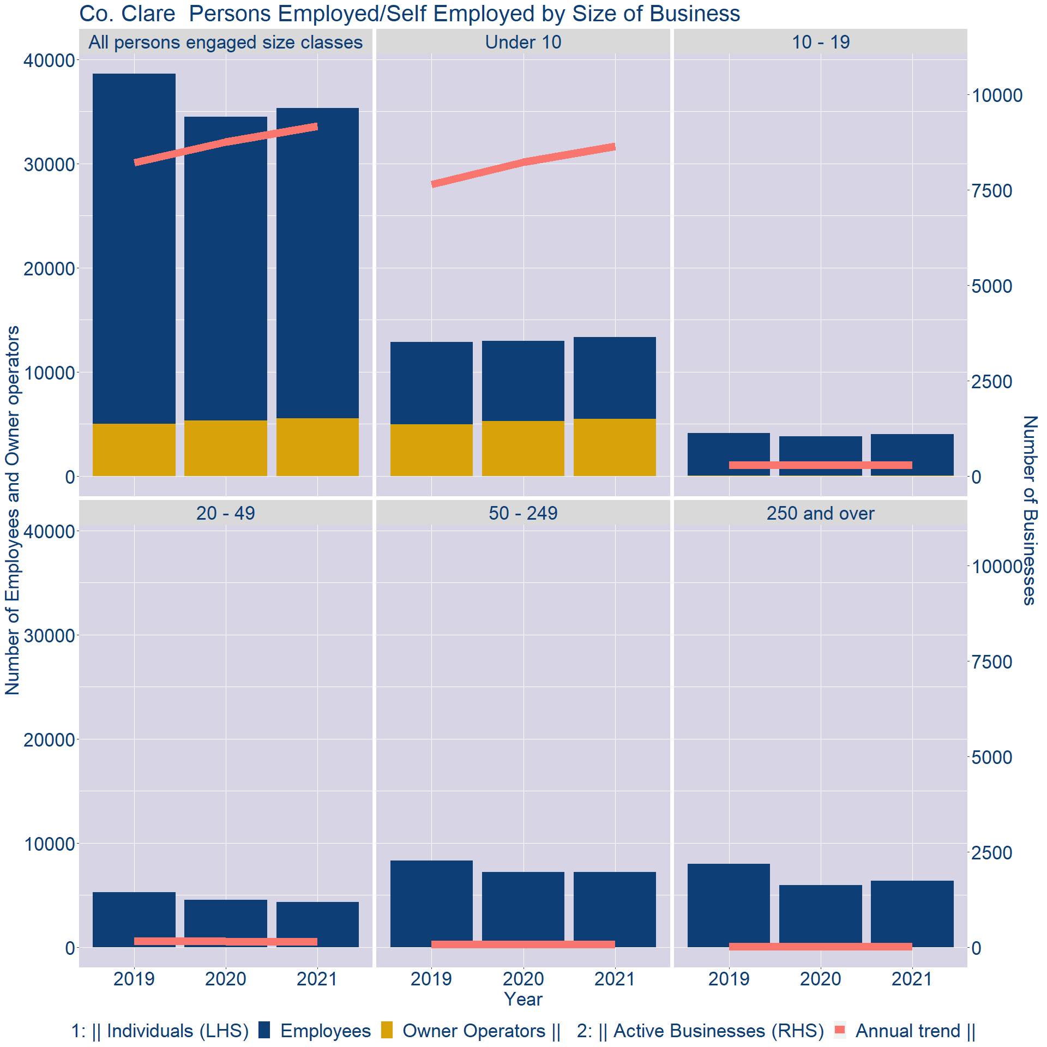
Theme 3: Co. Clare Business Demographics
Employment in locally registered businesses, by employer size - 2021

Slide 13
Theme 3: Co. Clare Business Demographics
Employment.Size | Businesses | Owners | Employees
All persons engaged size classes | 9169 | 5551 | 29755
Under 10 | 8641 | 5477 | 7876
10 - 19 | 300 | 59 | 3980
20 - 49 | 146 | 15 | 4342
50 - 249 | 69 | 0 | 7198
250 and over | 13 | 0 | 6359
Employment in locally registered businesses, by employer size - 2021

