Slide 1
Cavan Business & Employment Demographics
Chambers Ireland

Slide 2
Theme 1: Cavan Rates & LPT Income
Audience: Existing/Prospective Local Authority members
Highlights: Increasing reliance on Commercial Rates to support Local Authority Activities
Key messages:
Local Authority Budget Reform needed
Rates system putting pressure on labour intensive & vulnerable sectors
Hospitality
Retail
Manufacturing
Obligation on Local Authority to use these taxes effectively

Slide 3
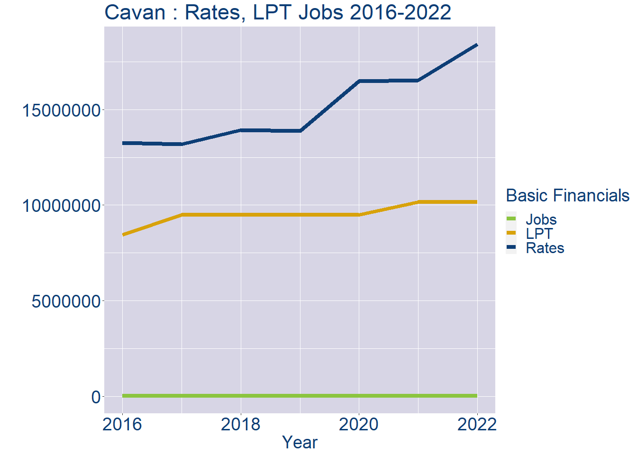
Theme 1: Cavan Rates & LPT Income
Cavan Local Authority Rates and LPT: 2016-2022
Year | Jobs | LPT | Rates
2016 | 30509 | 8458415 | 13269122
2017 | 31316 | 9480501 | 13193336
2018 | 32123 | 9480501 | 13931652
2019 | 32930 | 9480501 | 13884362
2020 | 33737 | 9480498 | 16480680
2021 | 34544 | 10161497 | 16536137
2022 | 35350 | 10162934 | 18406298

Slide 4
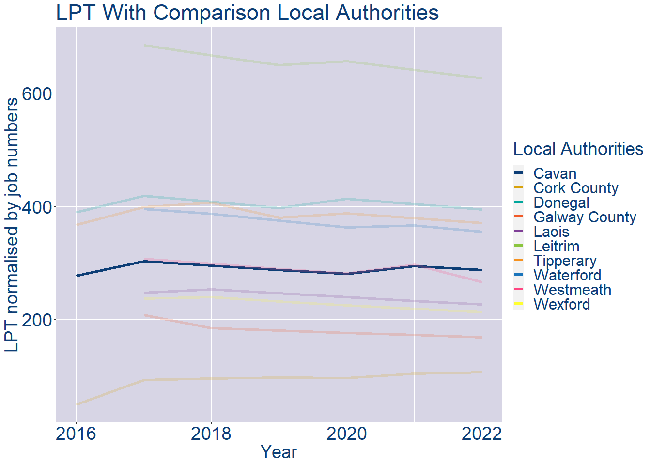
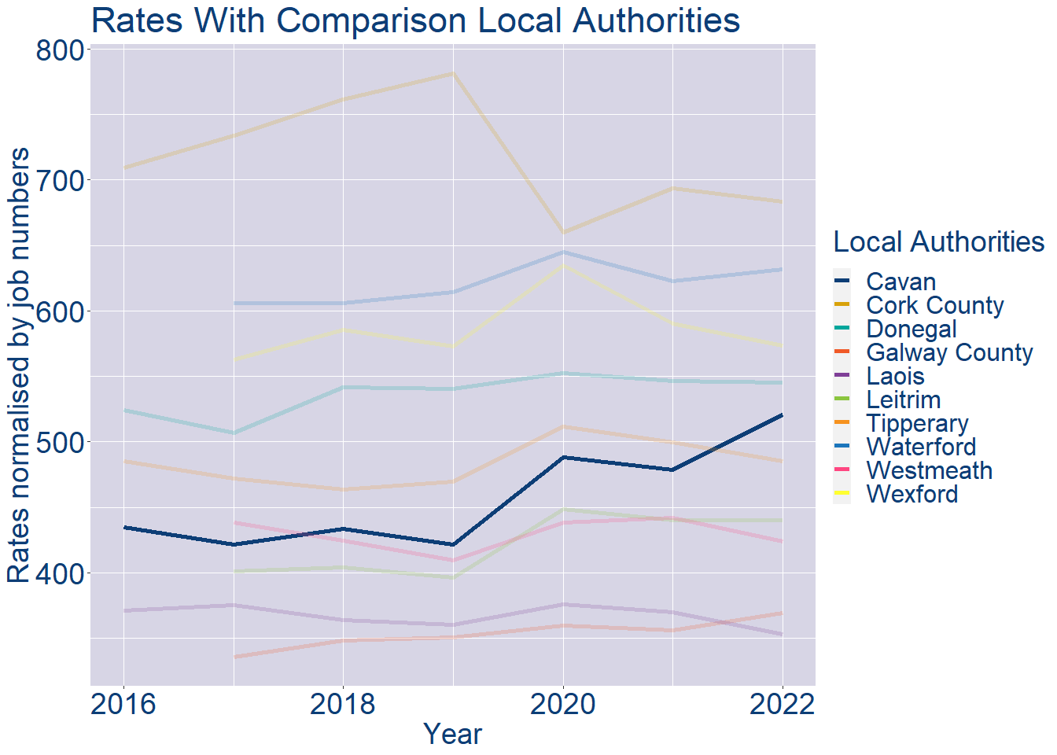
Theme 1: Cavan Rates & LPT Income
Cavan Local Authority 2022 LPT/employee €287
Cavan Local Authority 2022 Rates/employee €521

Slide 5
Theme 2: Cavan Workforce Demographics
Audience: Membership/Businesses that are interested in expanding into the local area
Highlights: Workforce details, who is available, education level, population growth
Key messages:
Varies from Local Authority area to area
Important for you to understand the numbers of people who are available to work in your area, their experience levels and the training they have

Slide 6
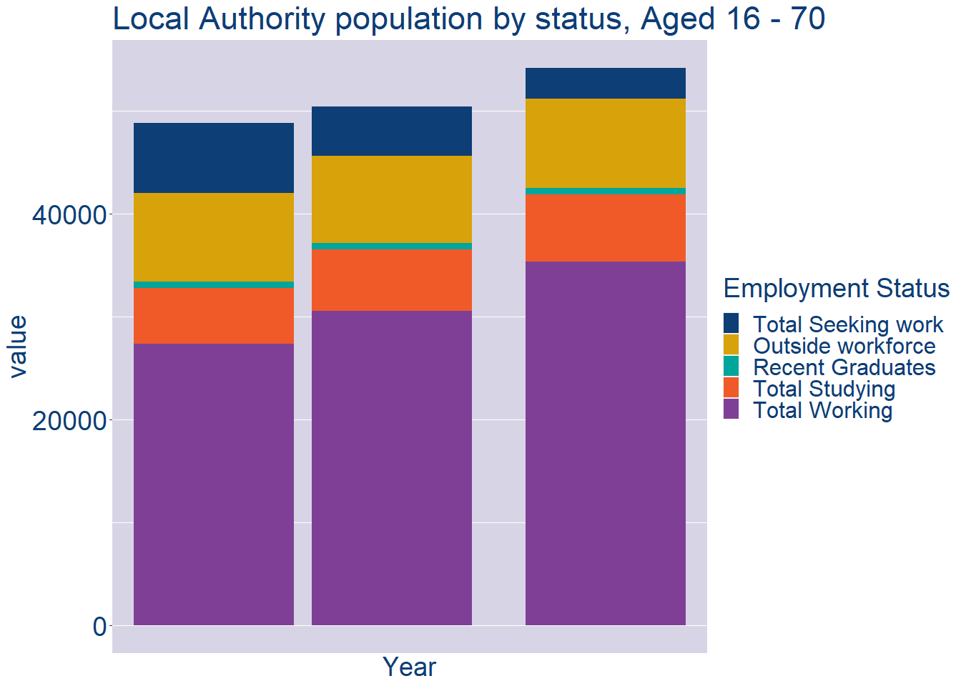
Theme 2: Cavan Workforce Demographics
Cavan Local Authority Workforce Population
Year | 2022
Total_working | 35350
Total_studying | 6525
Total_recent_grads | 625
Total_job_seeking | 2979
Total_not_seeking | 8660

Slide 7
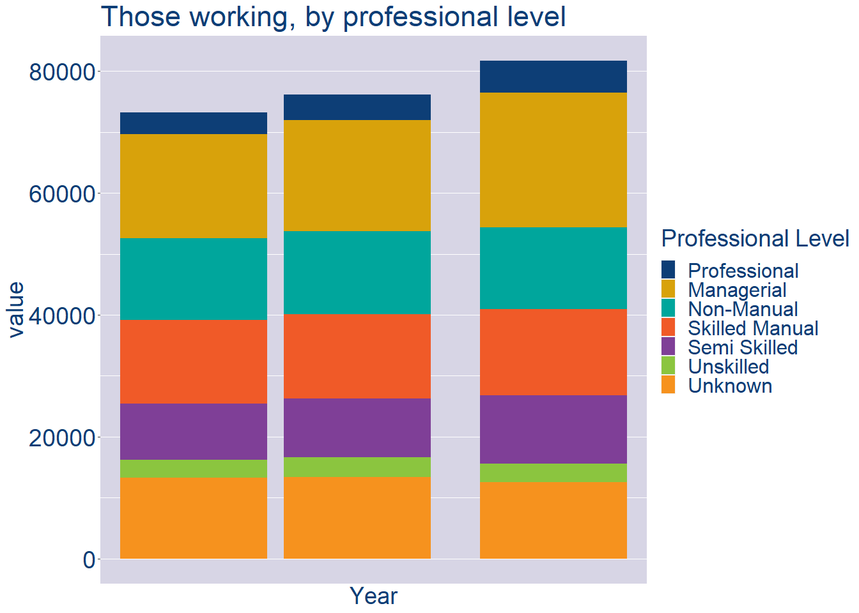
Theme 2: Cavan Workforce Demographics
Cavan Local Authority Workforce Experience Level
Year | 2022
Professional | 5279
Managerial | 22104
Non_Manual | 13372
Skilled_Manual | 14151
Semi_Skilled | 11232
Unskilled | 3005
All_Others | 12561

Slide 8
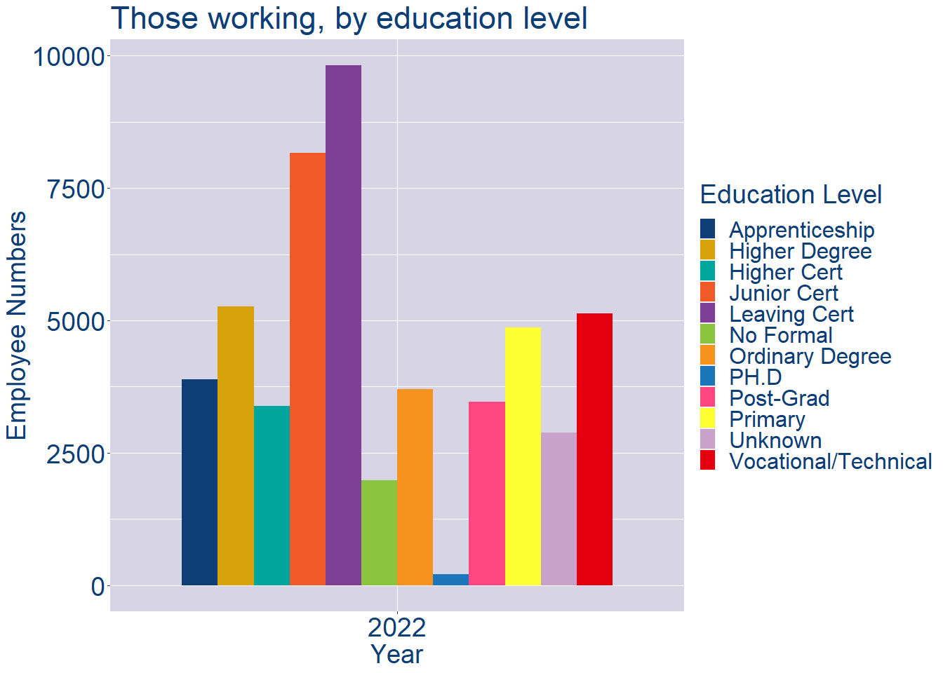
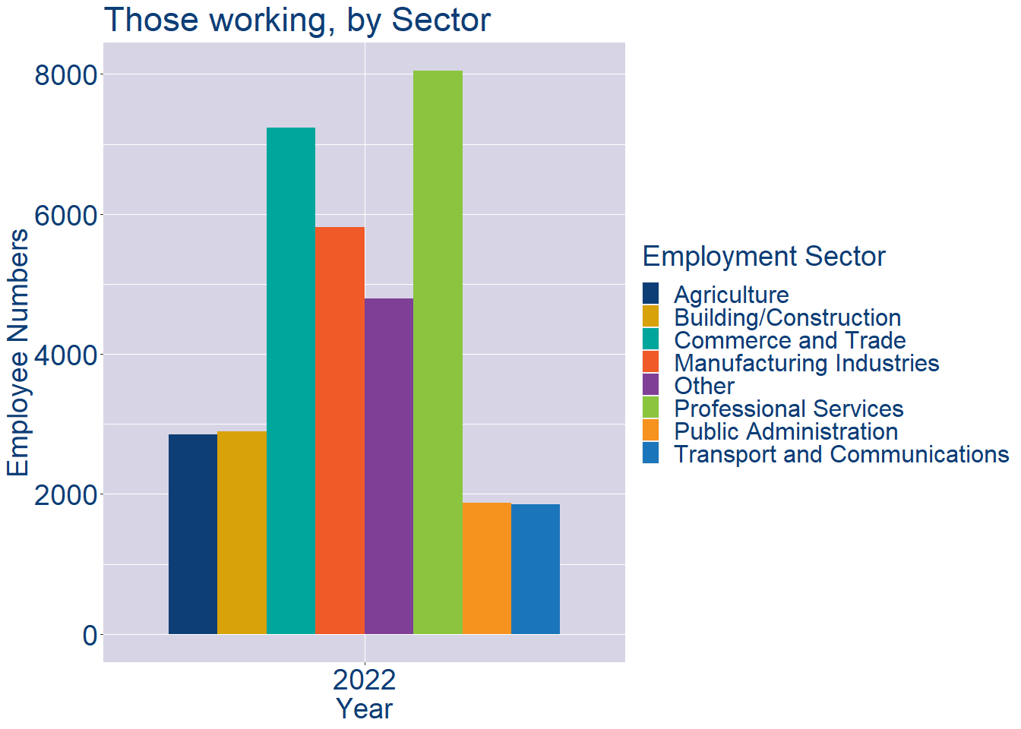
Theme 2: Cavan Workforce Demographics
Cavan Local Authority Workforce Education Level
Cavan Local Authority Workforce Sectors

Slide 9
Theme 3: Co. Cavan Business Demographics
Audience: Internal to Chambers
Highlights: Local Business Community Information
Key messages:
Varies from Local Authority area to area
Local market intelligence to help you identify trends in your local area’s business community i.e.:
Sectoral activity increasing/decreasing
What sectors the self-employed are active in

Slide 10
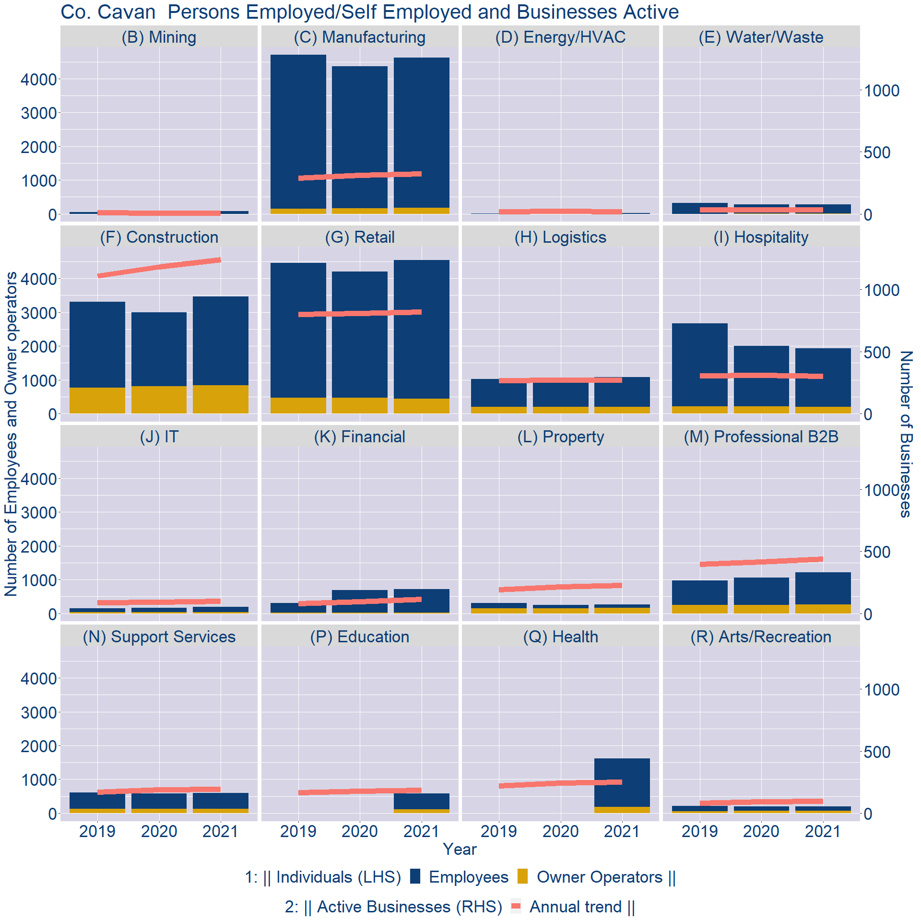
Theme 3: Co. Cavan Business Demographics

Slide 11
Theme 3: Co. Cavan Business Demographics
Sectors | Businesses | Owners | Employees
(B) Mining | 7 | 0 | 80
(C) Manufacturing | 341 | 176 | 4451
(D) Energy/HVAC | 20 | 0 | 20
(E) Water/Waste | 35 | 3 | 273
(F) Construction | 1305 | 838 | 2619
(G) Retail | 861 | 448 | 4092
(H) Logistics | 286 | 203 | 875
(I) Hospitality | 317 | 199 | 1737
(J) IT | 102 | 31 | 155
(K) Financial | 120 | 27 | 695
(L) Property | 236 | 167 | 91
(M) Professional B2B | 460 | 264 | 943
(N) Support Services | 203 | 133 | 465
(P) Education | 193 | 109 | 466
(Q) Health | 262 | 179 | 1435
(R) Arts/Recreation | 100 | 72 | 125
Employment in locally registered businesses, by Sector

Slide 12
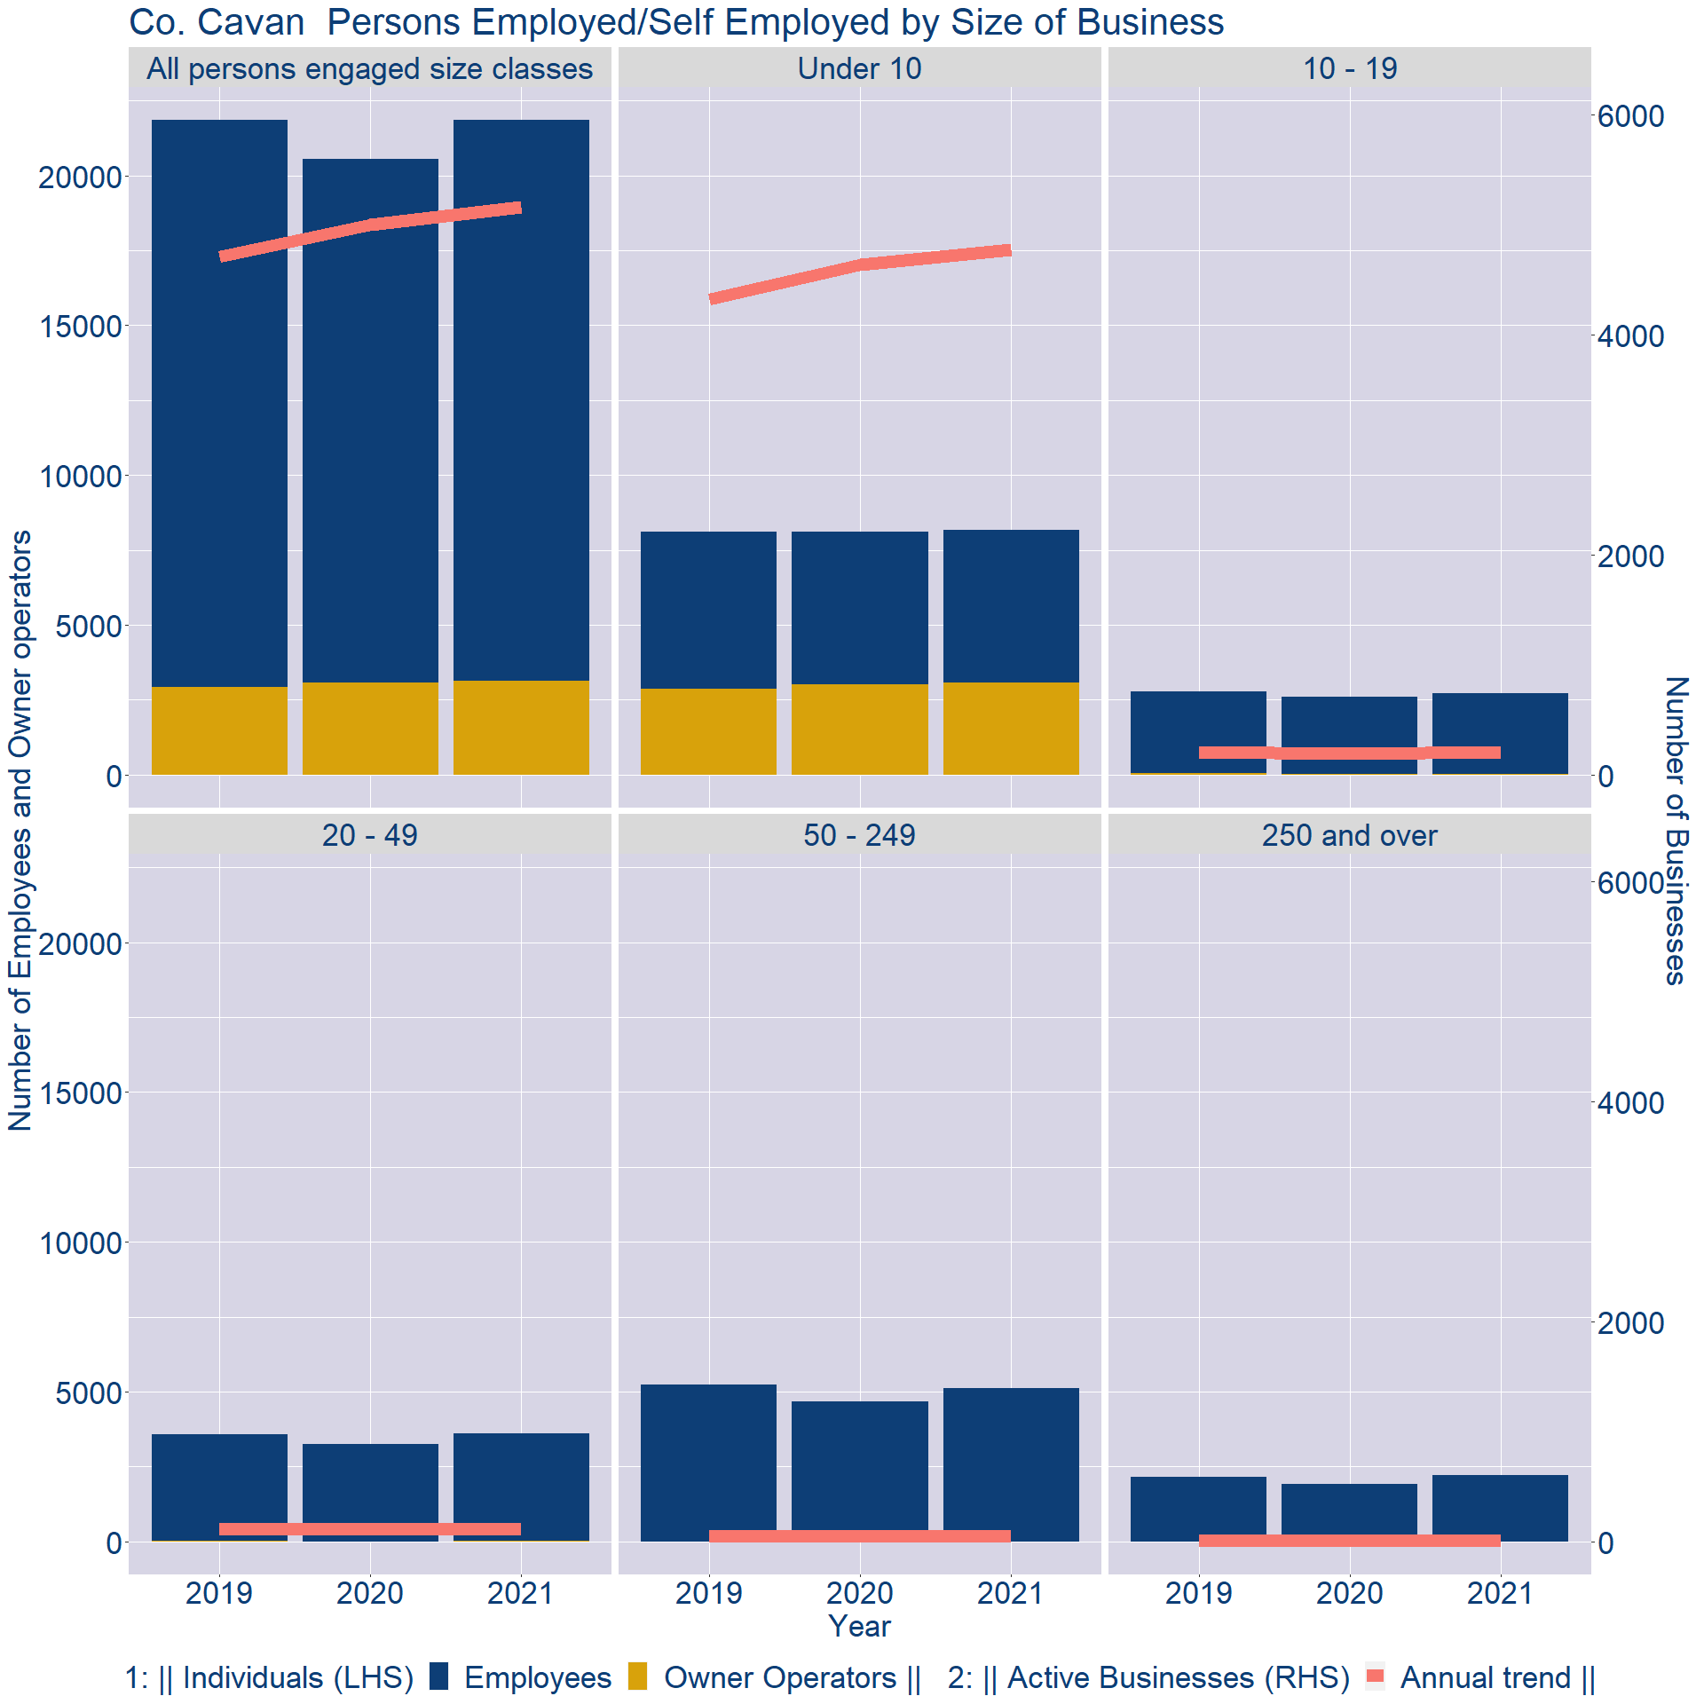
Theme 3: Co. Cavan Business Demographics
Employment in locally registered businesses, by employer size - 2021

Slide 13
Theme 3: Co. Cavan Business Demographics
Employment.Size | Businesses | Owners | Employees
All persons engaged size classes | 5156 | 3126 | 18740
Under 10 | 4770 | 3079 | 5107
10 - 19 | 207 | 37 | 2699
20 - 49 | 121 | 10 | 3603
50 - 249 | 53 | 0 | 5108
250 and over | 5 | 0 | 2223
Employment in locally registered businesses, by employer size - 2021

